Slide 1
Solar Decathlon Controls Team
Colby Jarrett
Travis Lathrop
Zach Cross
Mitchel Routh

Slide 2
System Requirements
Simultaneous control and monitoring of various house systems, e.g. HVAC, ERV, façade , data acquisition, power monitoring.
Intuitive GUI that runs the home autonomously or allows the homeowner to take full control when desired.
Monitors power usage of the main components of the home along with power generated by the photovoltaic panels.
Integrate a data acquisition system for extended research on the Living Light house
A dynamic lighting scheme that integrates fluorescent and LED lighting to operate on a gradual ramping schedule driven by ambient light and time of day.
Control it remotely via the internet

Slide 3
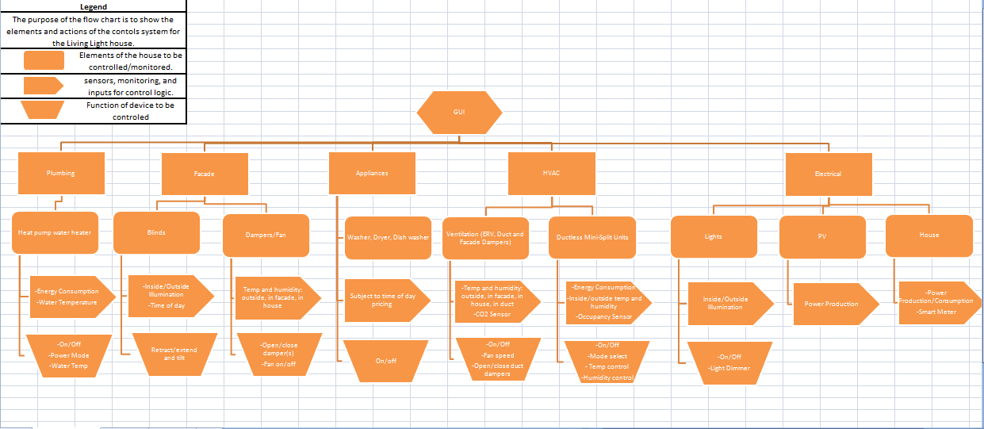
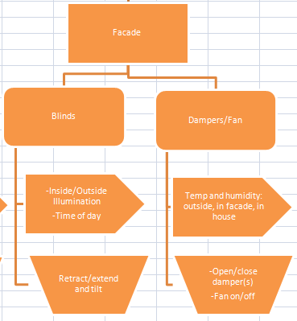
Methodology
Extensive use of flowcharts for brainstorming

Slide 4
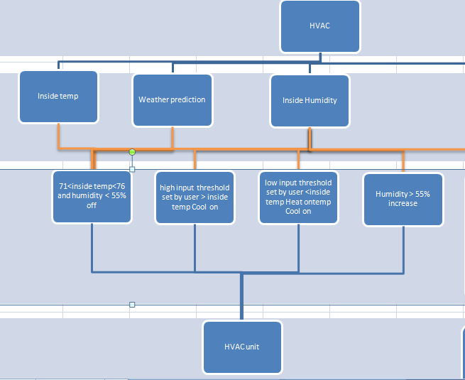
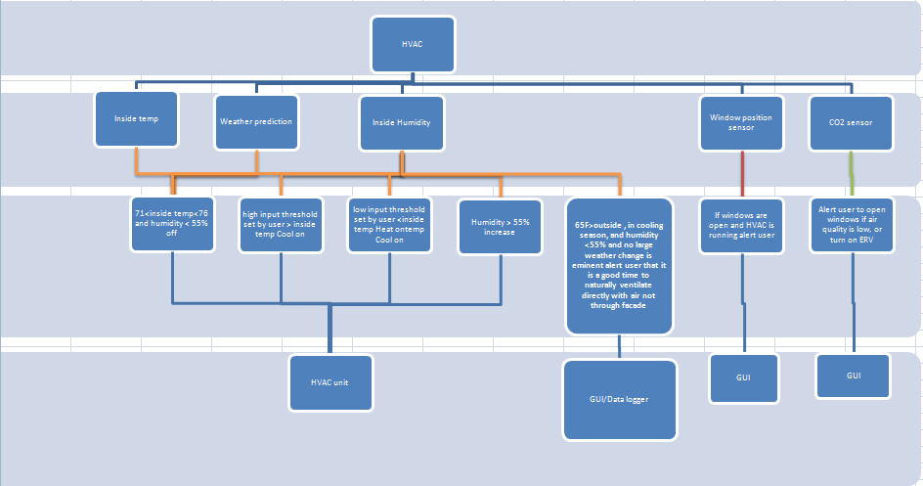
Methodology
Iterative design lead to larger size and increased complexity

Slide 5
Methodology
Made list of all of the inputs/outputs and functionalities required to achieve the required control.
Compared the different products against each other
  Campbell Scientific Data Loggers and Controller
  Clipsal C-bus Home Control
  Cyber Station Building Automation Software.
  Acquisuite Data Acquisition system.

Slide 6
Methodology
  Consulted Experts regarding instrumentation
    ORNL
    Campbell Scientific
  Toured similar systems
    Zebra houses
    Campbell Creek houses
    EPRI National lab

Slide 7

Methodology
Compare and contrast systems
  Cost
  Advantages and disadvantages
  Functionality
Chased down quotes.

Slide 8
Our Solution
Schneider Electric C-bus Clipsal Home Automation System
  Elegant Design/user-friendly GUI
  Sophisticated Control options for lighting
  Open ended logic
  Input unit compatible with raw analog signaling
  Data Acquisition Capability
  Schneider Support & Training
Schneider Electric PowerLogic E4800 Multi-Circuit Meter
  Designed for sub-metering
  Up to 24 Circuits
  Compact Design
  High Density Power Monitoring
  Schneider Product Line

Slide 9
The System
Coordinated with Electrical Engineers on component compatibility
Constructed and finalized material list for Schneider complete with all instruments and controllers
Matthew Berwind and Colby Jarrett completed 3-day C-bus Schneider training in Nashville, TN
Submitted parts list to Schneider along with preliminary list of vital components needed begin preliminary for programming
Constructed an outline to streamline the programming process
Began physically networking, assembling, and programming control system.

Slide 10
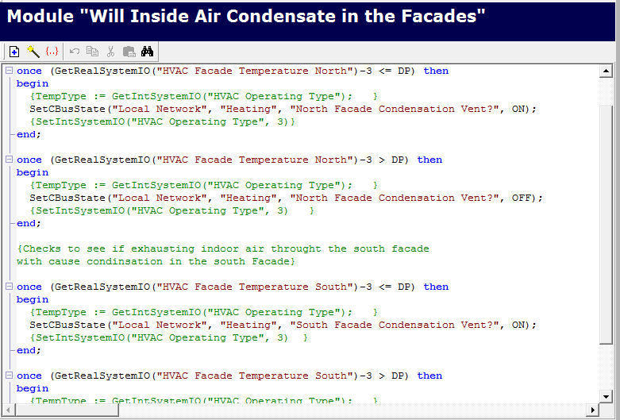
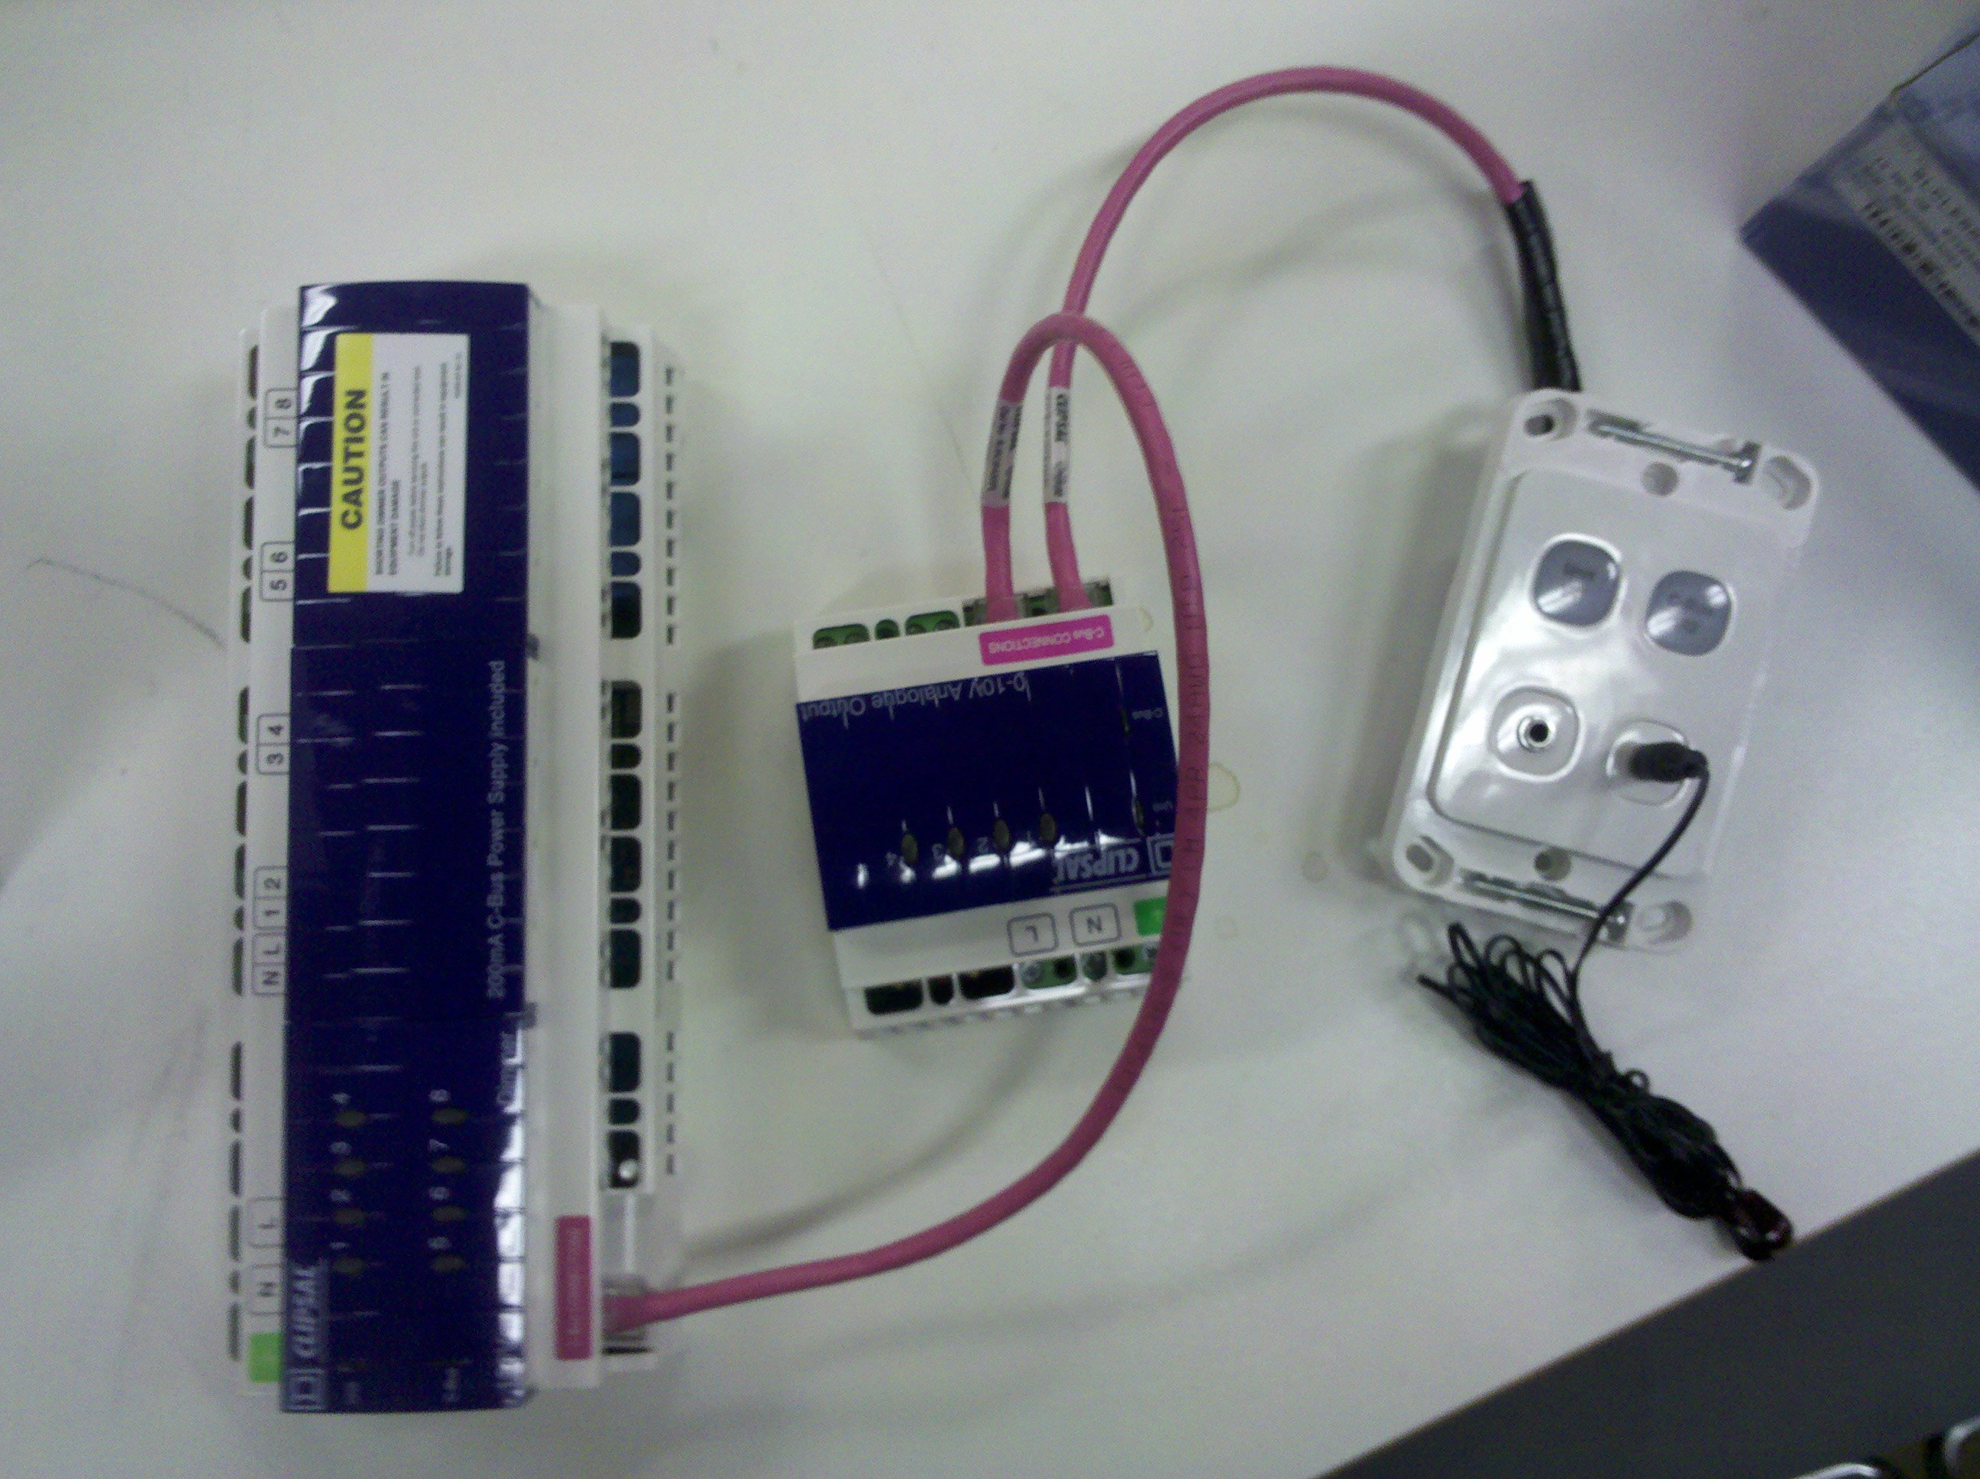
Current Standing
We are currently in process of programming the system with the components from the preliminary material list.

Slide 11
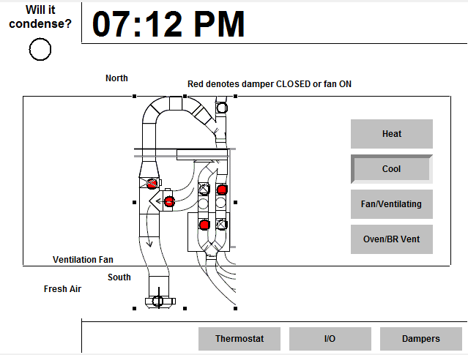
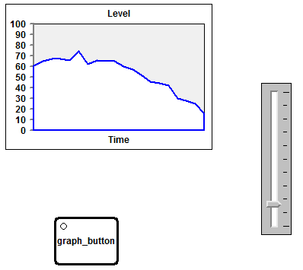
Current Standing
We have already achieved many functionalities we desire in the final product such as damper control and power monitoring.

Slide 12
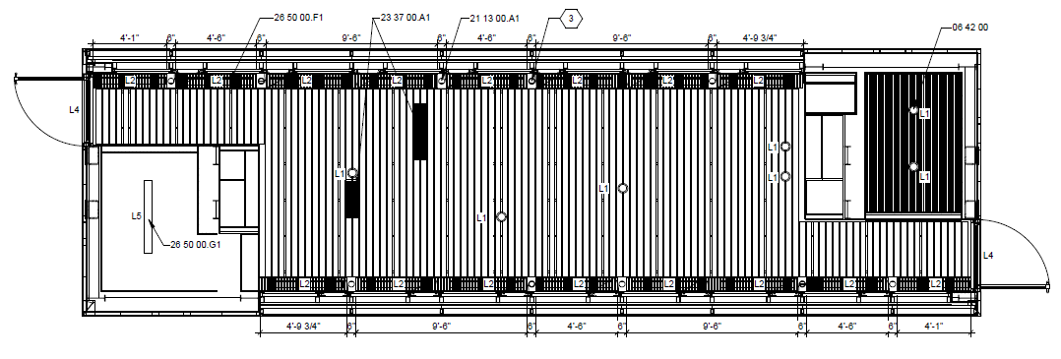
Lighting Control
Target Light Level
Control Logic on Main Living Area
Can Lights
0-100%
Fluorescents
40, 60, or 100%
= Multi-Sensor
Natural
Light
At every step, levels checked against target through the Multi-Sensors

Slide 13
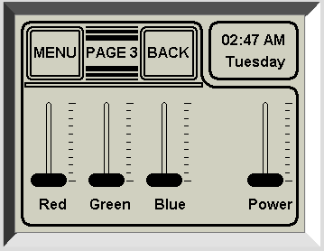
Lighting Control
In addition, several LED lights are placed throughout the structure
Color levels and overall magnitude can be adjusted to create “mood” lighting in the main area

