Slide 1
Research Data Services: A New Focus for Librarians
Carol Tenopir
University of Tennessee
ctenopir@utk.edu
Notes:
1

Slide 2
Today, I will talk about…
3 motivations for thinking about research data services
A bit about the DataONE project
Why libraries fit with research data services
Some definitions
Current status and future plans for data services of academic libraries and librarians in North America
But first…
Notes:
…

Slide 3
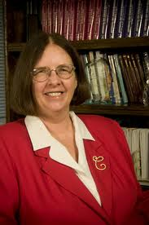

Information Sciences Professor, College of Communication and Information Director of Research, and Director of the Center for Information and Communication Studies
A bit about me…

Slide 4
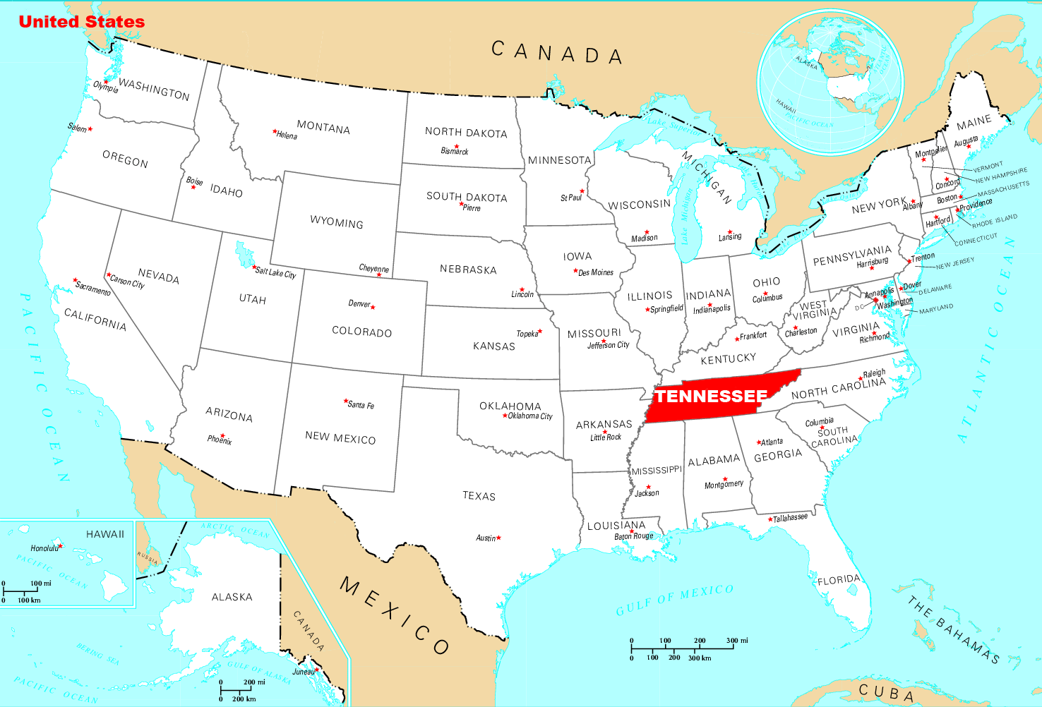
Tennessee

Slide 5
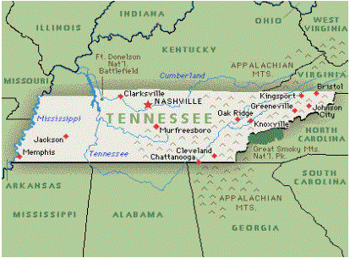

Knoxville

Slide 6
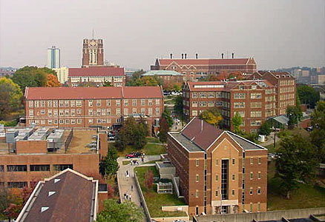

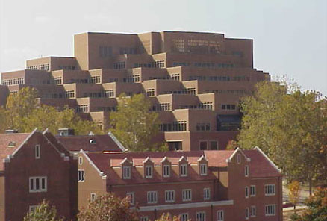
University of Tennessee, Knoxville

Slide 7
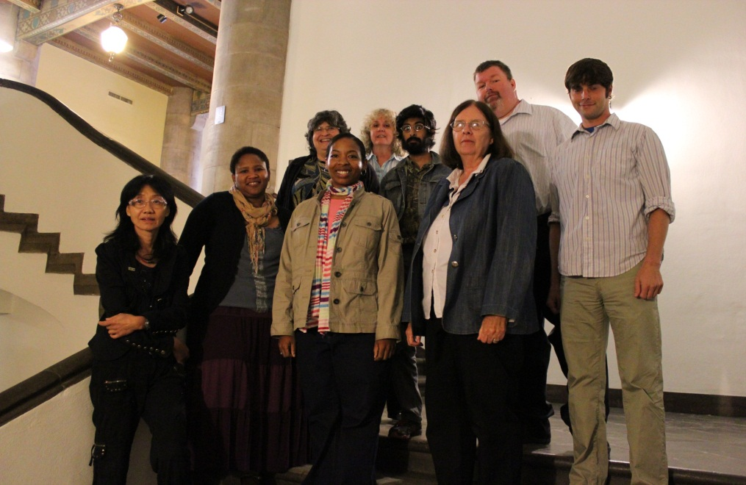
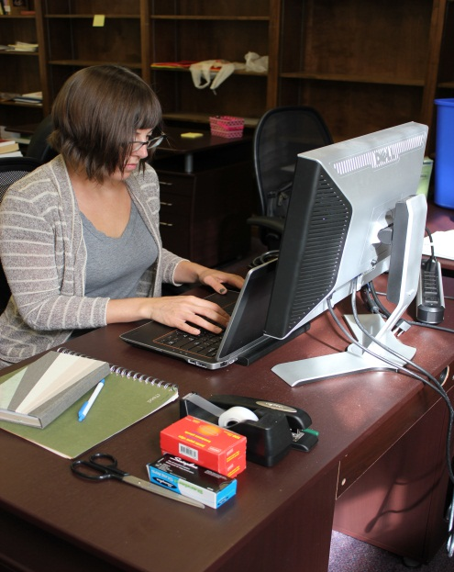
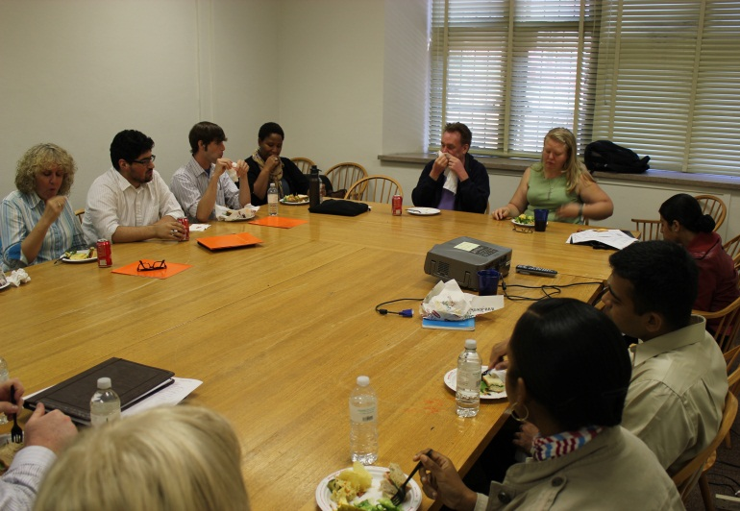
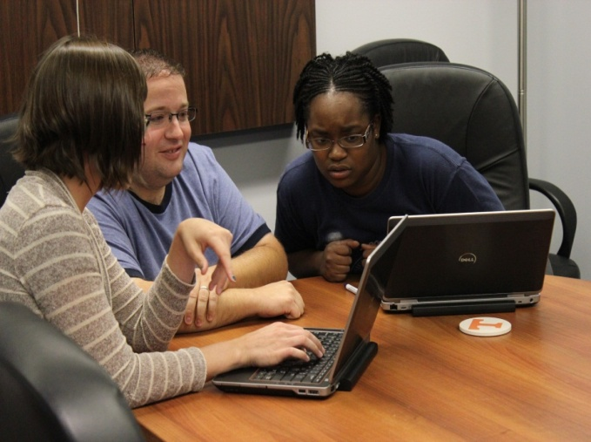
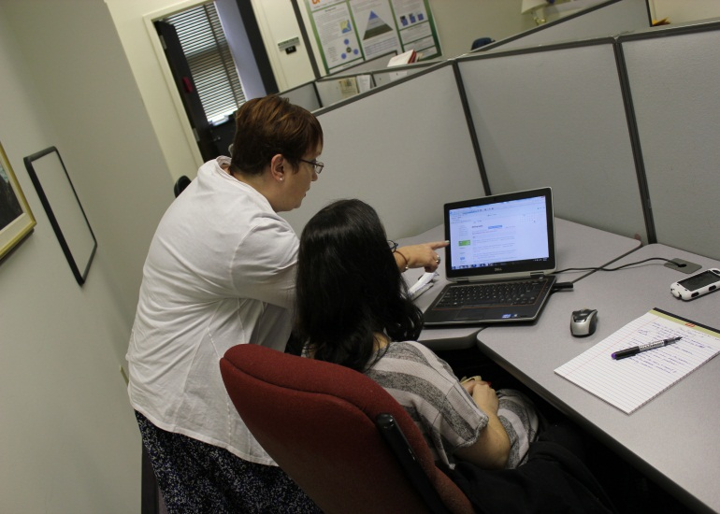
Center for Information and Communication Studies

Slide 8
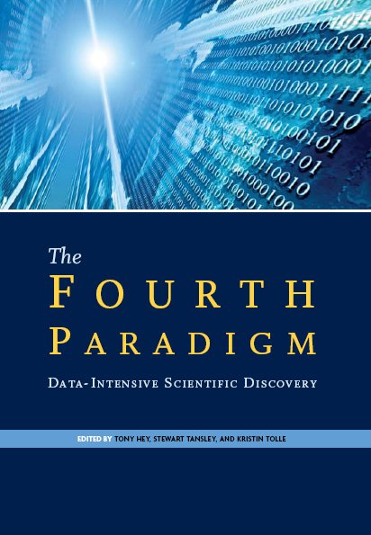

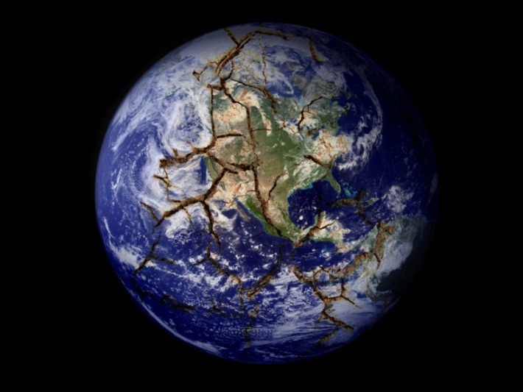
Motivation 1: Science is more collaborative, interdisciplinary, computational,
and data-intensive
Notes:
Science is becoming more data intensive, computational, and collaborative
Science has entered a “fourth paradigm” that is more collaborative, more computational, and more data intensive (Hey, Tansley, & Tolle, 2009a) than the previous experimental, theoretical, and computational paradigms. This emerging scientific paradigm is often referred to as e-science or e-research (Hey, Tansley, & Tolle, 2009b). Increased reliance on technology in all parts of scientific endeavor, or cyberinfrastructure, and the establishment of data management and data sharing mandates by many research funding bodies have motivated academic libraries to respond to the changing needs of their faculty and student researchers and consider how best to engage in e-science through the development of library-based research data services (RDS).

Slide 9
Motivation 2: Open Science Movement…
…governments and funding agencies are requiring data management
United States
“To that end, I have issued a memorandum today to Federal agencies that directs those with more than $100 million in research and development expenditures to develop plans to make the results of federally-funded research publically available free of charge within 12 months after original publication.
…the memorandum requires that agencies start to address the need to improve upon the management and sharing of scientific data produced with Federal funding.” – U.S. Office of the President
Australia
Australian Code for the Responsible Conduct of Research - basic data management mandate for ARC and NHMRC funding
United Kingdom
RCUK Policy on Open Access and Guidance –immediate, unrestricted, on-line access to peer-reviewed and published research papers from RCUK funded projects
Notes:
Motivation for sharing and reusing data and the need for better data services comes from several drivers.
The first of these is the growing open science movement, with government initiatives to make data publicly available. This is from the US, but there are initiatives in other countries as well. In the U.S., Data management and data sharing mandates have been established by the National Science Foundation, the National Endowment for the Humanities, the National Institutes of Health and others (University Libraries, University of Minnesota, 2011).
Australian Research Council

Slide 10
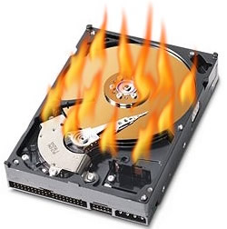
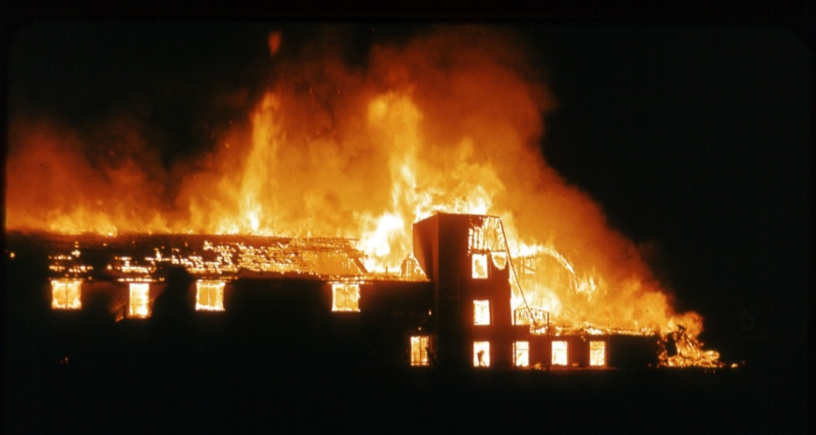
Motivation 3: Data loss potential
Natural disaster
Facilities infrastructure failure
Storage failure
Server hardware/software failure
Application software failure
External dependencies
Format obsolescence
Legal encumbrance
Human error
Malicious attack by human or automated agents
Loss of staffing competencies
Loss of institutional commitment
Loss of financial stability
Changes in user expectations and requirements
Notes:
Both a motivator and a reason for acting now is the vulnerability of data and datasets. A majority of scientists store their data on their own hard drives or in their offices. Back ups may be USB drives or printouts.

Slide 11
NSF Sustainable Digital Data Preservation and Access Network Partners (DataNet)
Will create exemplar partners to address “…one of the major challenges of this scientific generation: how to develop the new methods, management structures and technologies to manage the diversity, size, and complexity of current and future data sets and data streams”.
Notes:
The project I am describing today is part of the National Science Foundation’s DataNet program.

Slide 12

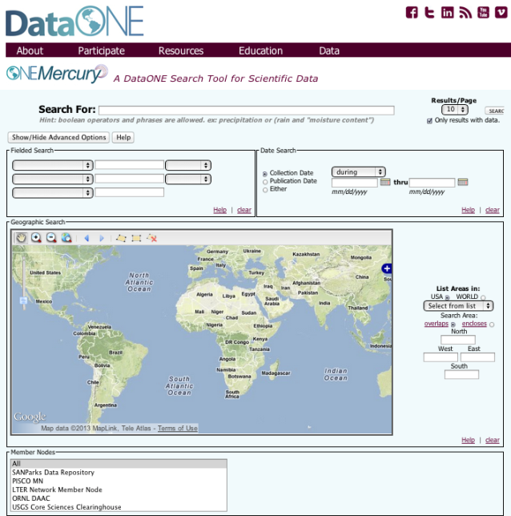





The DataONE Vision and Approach:
Providing universal access to data about life on earth and the environment that sustains it, as well as the tools needed by researchers
1. Building community
2. Developing sustainable data discovery and interoperability solutions
3. Enabling science through tools and services
Assure
Plan
Discover
Integrate
Analyze
Collect
Describe
Preserve
Notes:
DataONE is a combination of people, hardware, and software.

Slide 13
Need new types of organizations that will…
integrate library and archival sciences, cyberinfrastructure, computer & information sciences, and domain science expertise to:
  provide reliable digital preservation, access, integration, and analysis capabilities for science and/or engineering data over a decades-long timeline

Slide 14
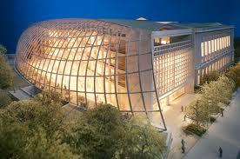



Libraries…
facilitate interdisciplinary work, data access, and data knowledge through collections and services
Can take a leadership role in a variety of research data services

Slide 15
Research Data Services are…
…services that address the full data lifecycle, including the data management plan, digital curation (selection, preservation, maintenance, and archiving), and metadata creation and conversion.
Collect
Discover
Integrate
Analyze
Plan
Assure
Preserve
Describe
Notes:
Today I will talk about surveys of where libraries in North America are now with these.

Slide 16

Data Lifecycle
Collect
Discover
Integrate
Analyze
Plan
Assure
Preserve
Describe

Slide 17

Researcher Challenges
Organizational Support & Training ?
Assure
Plan
Discover
Integrate
Analyze
Collect
Describe
Preserve
Metadata
Standards ?
Where?
Data
Sharing ?
Notes:
Many researchers find the new requirements to be quite confusing. Here are just a few examples of the questions that they are asking.

Slide 18

Librarian & Library Challenges
?
?
Collect
Preserve
Discover
Integrate
Analyze
Plan
Assure
Describe
?
?
?
?
?
?
?
Notes:
Librarians also have questions about their role. We wanted to find out, through Academic university librarian survey
Are RDS priority?
Level of participation with data?
Level of involvement with metadata?
Is there an agency repository that accepts data?
Stewardship role (select & deselect)?
Role of the librarian to help preservation?
Role of librarian discovering data?
Role in partnering with researcher?
Level of my knowledge & skills ?
Do academic librarians have the background, skills and education to provide RDS?
What are librarian attitudes regarding the importance of RDS?
What factors contribute to or inhibit engagement of librarians in RDS?
Services can be hands-on or consultative.

Slide 19
Technical/Hands-On RDS
Providing tech support for RDS systems or data repositories
Identifying data for deposit in repositories
Preparing data for deposit
Creating or transforming metadata
Deselecting datasets for removal from a repository

Slide 20
Informational/Consulting RDS
Consulting on Data Management Plans and standards
Outreach/collaboration with others
Reference for finding and citing data
Creating web guides and finding aids
Directly participating on a project
Training co-workers on data issues
Notes:
Standards for metadata or data

Slide 21

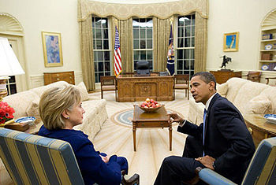
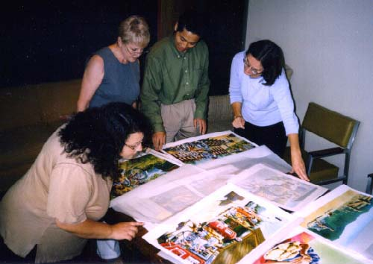
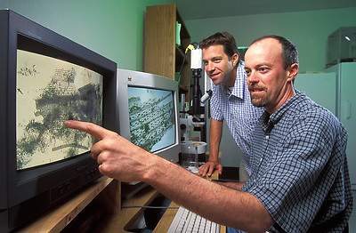

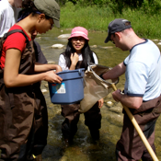

Assessment of Stakeholders
Public Officials
Publishers
Data Managers
Citizen-scientists
Libraries
& Librarians
Scientists
Students
& Teachers

Slide 22
Results of scientists survey shows opportunities for libraries…

Slide 23
What metadata do you currently use to describe your data?
676
266
96
97
95
95
12
21
26
DIF
DwC
DC
EML
FGDC
Open GIS
ISO
My Lab
NONE
Notes:
A variety of metadata schemes are used to describe data, but not surprisingly, the most common answer is “none”.
12) What metadata do you currently use to describe your data, if any (check all that apply)?
DC (Dublin Core) 2.2%
DwC (Darwin Core) 1.7%
DIF (Directory Interchange Format) 1.0%
EML (Ecological Metadata Language) 7.9%
FGDC (Federal Geographic Data Committee) 7.9%
ISO (International Standards Organization) 8.0%
OGIS (Open GIS) 8%
metadata standardized within my lab 22.1%
none 56.1%
Other (please specify) 6.8%

Slide 24
Gap between Willingness to Share and Accessibility
  Although 75% of scientists agree “I share my data”
  Only 36% agree “Others can access my data easily”
Notes:
78% put at least some of their data in a central repository, but only 41% place all of their data.

Slide 25
Reasons for Not Making Data
Electronically Available

Slide 26
Academic Librarians and Academic Libraries
Librarians
  Opinions of individuals
  302 librarians at 111 ARL libraries
Libraries
  What the libraries are actually doing or planning to do re: RDS
  223 ACRL libraries
Notes:
The total response of 302 was composed of librarians at ARL libraries (223) plus the staff of library directors who took the libraries survey, combined with librarians at UC libraries (79)
223 + 79 = 302
223 were librarians working in metadata, digital collections, sciences, scholarly communications, health, e-science, e-resources, IRs, data, other.

Slide 27
librarians (in academic research libraries)…

Slide 28
Current Overall Engagement with RDS
Notes:
Survey Question: Do you interact with faculty, students, or staff in support of their research data services (RDS) as part of your regular job responsibilities?
Answer Choices:
Yes, it is (an) integral part of my job responsibilities
Yes, I have occasional responsibilities
No, it is not part of my responsibilities
Frequency and percent of response to the question.
Over two-thirds of respondents have provision of RDS as an occasional or integral part of their job.

Slide 29
ARL librarians strongly or somewhat agree…
RDS are as important as other services (82% of integral; 68% of occasional; 32% of no)
RDS are a priority at my library (67% integral; 40% of occasional; 19% of no)
Notes:
67%

Slide 30
Librarians’ Skills, Knowledge, and Training Necessary to Provide RDS
I have the skills, knowledge, and training necessary to provide RDS. (n = 159)
I have sufficient subject expertise to provide RDS to my patrons. (n = 159)
Notes:
Survey Question: Tell us how much you agree with each statement regarding your participation in research data services (RDS) using the following scale: strongly agree, somewhat agree, neither agree nor disagree, somewhat disagree, strongly disagree
Top Chart: I have the necessary skills, knowledge, training
Bottom Chart: I have sufficient subject expertise (e.g., physical science; social science, etc.) to help my patrons

Slide 31
Librarians’ Skills, Knowledge, and Training Necessary to Provide RDS
My library provides opportunities to develop skills related to RDS. (n = 159)
My library supports me to attend conferences/workshops on RDS. (n = 157)
Notes:
Survey Question: Tell us how much you agree with each statement regarding your participation in research data services (RDS) using the following scale: strongly agree, somewhat agree, neither agree nor disagree, somewhat disagree, strongly disagree
Top Chart: My library provides opportunities to develop skills related to research data services (RDS)
Bottom Chart: My library supports me to take courses related to research data services (RDS)

Slide 32
For Those Not Currently Involved in RDS, Potential Motivations for Involvement
No (n = 160)
Rank | Motivation
#1 | If my patrons request RDS
#2 | If RDS became a responsibility in my job
#3 | If my institution becomes more involved with RDS
#4 | If my institution develops an IR that accepts data
#5 | If external funding agencies require RDS
#6 | If RDS becomes important to subject disciplines I support
#7 | If I learn more about RDS
Notes:
Survey Question: If you are not currently involved in research data services (RDS), what would most motivate you to do so? (Choose all that apply)
Answer Choices:
If research data services (RDS) became a responsibility in my job
If I learn more about research data services (RDS)
If research data services (RDS) become important to the subject disciplines I support
If my institution becomes more involved in research data services (RDS)
If my institution develops an institutional repository that accepts data
If external funding agencies require research data services (RDS)
If my patrons request research data services (RDS)
Other (please specify)

Slide 33
Next libraries (in all types of academic libraries)…

Slide 34
Informational / Consulting RDS Currently Offered or Planned
Notes:
Currently, a minority of US and Canadian academic libraries are offering research data services, with more planning to begin in the next year to two years. More libraries are offering or planning to offer informational/consultative-type services, rather than technical assistance services. Overall, more libraries are planning to offer research data services in the future than are offering them now, with reference-type services the most popular.
RDS 1 – Consulting with faculty or students on data management plans
RDS 2 – Consulting with faculty or students on metadata standards
RDS 3 – Collaboration with other RDS providers
RDS 4 – Reference support for finding and citing datasets

Slide 35
Informational / Consulting RDS Currently Offered or Planned
Notes:
RDS 5 – Creating Web guides and finding aids for datasets / data repositories
RDS 6 – Directly participating on a project (as a team member)
RDS 7 – Discussing RDS with others on a semi-regular basis
RDS 8 – Training co-workers in your library, or across campus, on RDS
If you are really looking to cut back on the number of slides we can combine slide 27 and 28 and remove a couple of activities.

Slide 36
Technical / Hands-On RDS Currently Offered or Planned
Notes:
RDS 1 – Providing technical support for RDS systems (e.g. a repository)
RDS 2 – Deaccessioning /deselection of datasets for removal from a repository
RDS 3 – Preparing datasets for deposit into a repository
RDS 4 – Creating or transforming metadata for datasets
RDS 5 – Identifying datasets that could be candidates for repositories

Slide 37
Reference support services, by type of institution…
Baccalaureate Colleges
Does your library provide reference support for finding and citing data and data sets? (n = 216)
Notes:
Survey Question: Does your library provide reference support for finding and citing data and data sets?
Answer Choices:
Yes
No

Slide 38
Technical support services, by type of institution…
Baccalaureate Colleges
Does your library provide technical support for research data services systems? (n = 216)
Notes:
Survey Question: Does your library provide technical support for research data services systems?
Answer Choices:
Yes
No

Slide 39
Staff development, by type of institution…
Baccalaureate Colleges
Has your library provided opportunities for staff to develop skills related to RDS? (n = 215)
Notes:
.
Survey Question: Has your library provided opportunities for staff to develop skills related to research data services (RDS)?
Answer Choices:
Yes
No

Slide 40
Conclusions
RDS are important and consistent with library mission and role
There are many levels of RDS involvement
Libraries are at an early point in transition to RDS—requiring resetting of priorities, realignment of responsibilities, and opportunities to develop skills
Librarians need opportunities to develop RDS skills

Slide 41
Data management services are part of transforming research libraries and librarians…
This is next-generation librarianship. The curation of research data is an activity that has gained traction in the wake of library and information science programs offering concentrations in data curation and institutes in digital curation, promising a cohort of librarians qualified to meet the challenges of managing data.
http://www.arl.org/rtl/eresearch/escien/nsf/leadershiproles.shtml
Authors: Patricia Hswe and Ann Holt. Part of ARL’s transforming research libraries series.

Slide 42

Academic Libraries And Research Data Services: Current Practices and Plans for the Future, ACRLWhite Paper, 2012. http://www.ala.org/acrl/sites/ala.org.acrl/files/content/publications/whitepapers/Tenopir_Birch_Allard.pdf
Academic Librarians and Research Data Services: Preparation and Attitudes, IFLA Journal 2013. http://ifl.sagepub.com/content/39/1/70.abstract
Data Sharing by Scientists: Practices and Perceptions, PlosONE, 2011. http://www.plosone.org/article/info:doi/10.1371/journal.pone.0021101

Slide 43

Thank you!
Carol Tenopir
University of Tennessee
ctenopir@utk.edu
Notes:
43

