Slide 1
DataONE AHM
Sept. 2016
Usability and Assessment (Mike Frame, Carol Tenopir, Suzie Allard)
Notes:
List Leadership Team members and BOLD those that will be present at RSV

Slide 2
Phase 2
18-month Milestones
✓
New Content: Demonstrations of increased capacity through addition of new Member Nodes and new,
substantive data holdings
Data Services: Completion of Member Node Data Services Registration support by the Coordinating Nodes
Provenance: Pre-release implementations available
for Provenance Tracking and Management capabilities
Semantics: Functional proof-of-concept of Semantic Measurement Search capabilities targeted at a subset of science domain data represented by DataONE
Surveys: Completion and publication of scientist and
educator surveys
Education Resources: Development of new education resources for online and in person training activities
✓
✓
✓

Slide 3

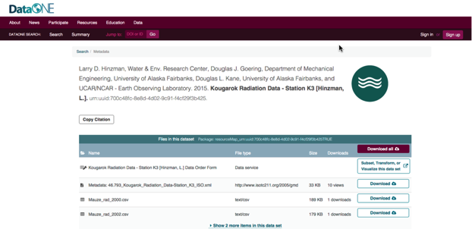
Usability & Assessment
Working Group Summary
Continues to drive input to DataONE tools, services & priorities
Demonstrates a continuing need for more education, development of best practices, changing culture of data sharing

Slide 4
Milestones and Funding
18-36 Months
Actual funding model
Proposed funding model
2015
2016
2017
2018
2019
2014
Start of Phase II
Reverse Site Visit
Reverse Site Visit
End of Phase II
18-36m
0-18m
Milestones
18-36 months
Funding
25-60 (reduced budget)
0-24m (accelerated budget)
Notes:
SLIDE 22
Budget reminder:
accelerated development in first 24 mos.;
25-60 mo. schedule less ambitious due to cut-backs
Planned activities and alternatives
CI
Usability and Assessment
Community Engagement and Outreach
Sustainability and Governance

Slide 5
Phase 2
36-month Milestones
Production releases of Provenance Tracking and Management services and tools
Increased capacity through addition of new Member Nodes including new software stacks
Pre-release implementation available for Semantic Measurement Search capabilities
Revised user interfaces incorporating user feedback and design iterations
Established program of educational webinars focused on different stages of the data life cycle meeting a large targeted audience

Slide 6
Phase 2
36-month Milestones
Production releases of Provenance Tracking and Management services and tools
Increased capacity through addition of new Member Nodes including new software stacks
Pre-release implementation available for Semantic Measurement Search capabilities
Revised user interfaces incorporating user feedback and design iterations
Established program of educational webinars focused on different stages of the data life cycle meeting a large targeted audience

Slide 7

Phase 2
18-36 month activities
Surveys:
  Second Scientist Follow up survey
  Second Libraries & Librarians Follow up survey
Usability:
  Product feedback from stakeholders
  Conduct interview, focus groups, case studies

Slide 8

Phase 2 Usability and Assessment
25-60 months
Continue assessing community and user needs through surveys, interview, focus groups, case studies
Continue working closely with the community and DataONE CI to delivery timely, effective, and user-driven tools/applications.

Slide 9
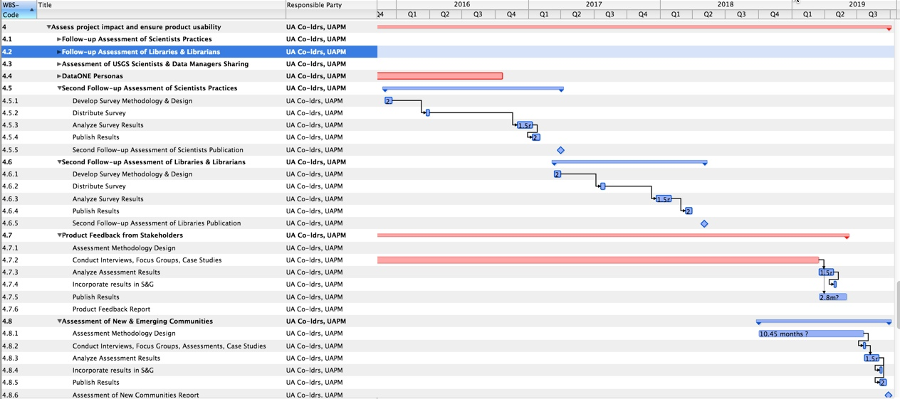
DataONE Project Plan

Slide 10
This Meeting Topics & Agenda
Update on Current Activities
  Assessment(s)
  Usability
Review key topics for meeting discussion
Discuss Meeting Approach

Slide 11
Meeting Topics
1) Emerging Communities: (1) work on draft of article (2) create plan for next steps [multiple sessions]
2) LIBER: Finish article [multiple sessions]
3) Usability: Plan assessments on effectiveness of D1 tools - prior surveys provide basis [multiple sessions]
4) 2nd Scientist Follow-Up survey: review distribution plan, schedule implementation [1 session]
5) Librarians/Libraries: review assessments and plan librarians follow-up [1 session or more]
6) S&G Support: (1) discuss new MN survey -- needs, approaches, outcomes [cross over session]
7) Synthesis Centers: Explore “How are these groups tackling sustainability? How can this interface with DataONE?” [1 session or more]
8) Simple Provenance Annotation Web UI to (Manual annotation to derived data in DataONE
Link to pubs (42A); Link to people (42B) [1 session or more]
9) Other Topics?

Slide 12

Approach
Deposit documents in our Google Area:
https://drive.google.com/drive/folders/0B-3MDH3CtJCFX0NzZTFfeHBBd0E
Slack.dataone.org

Slide 13
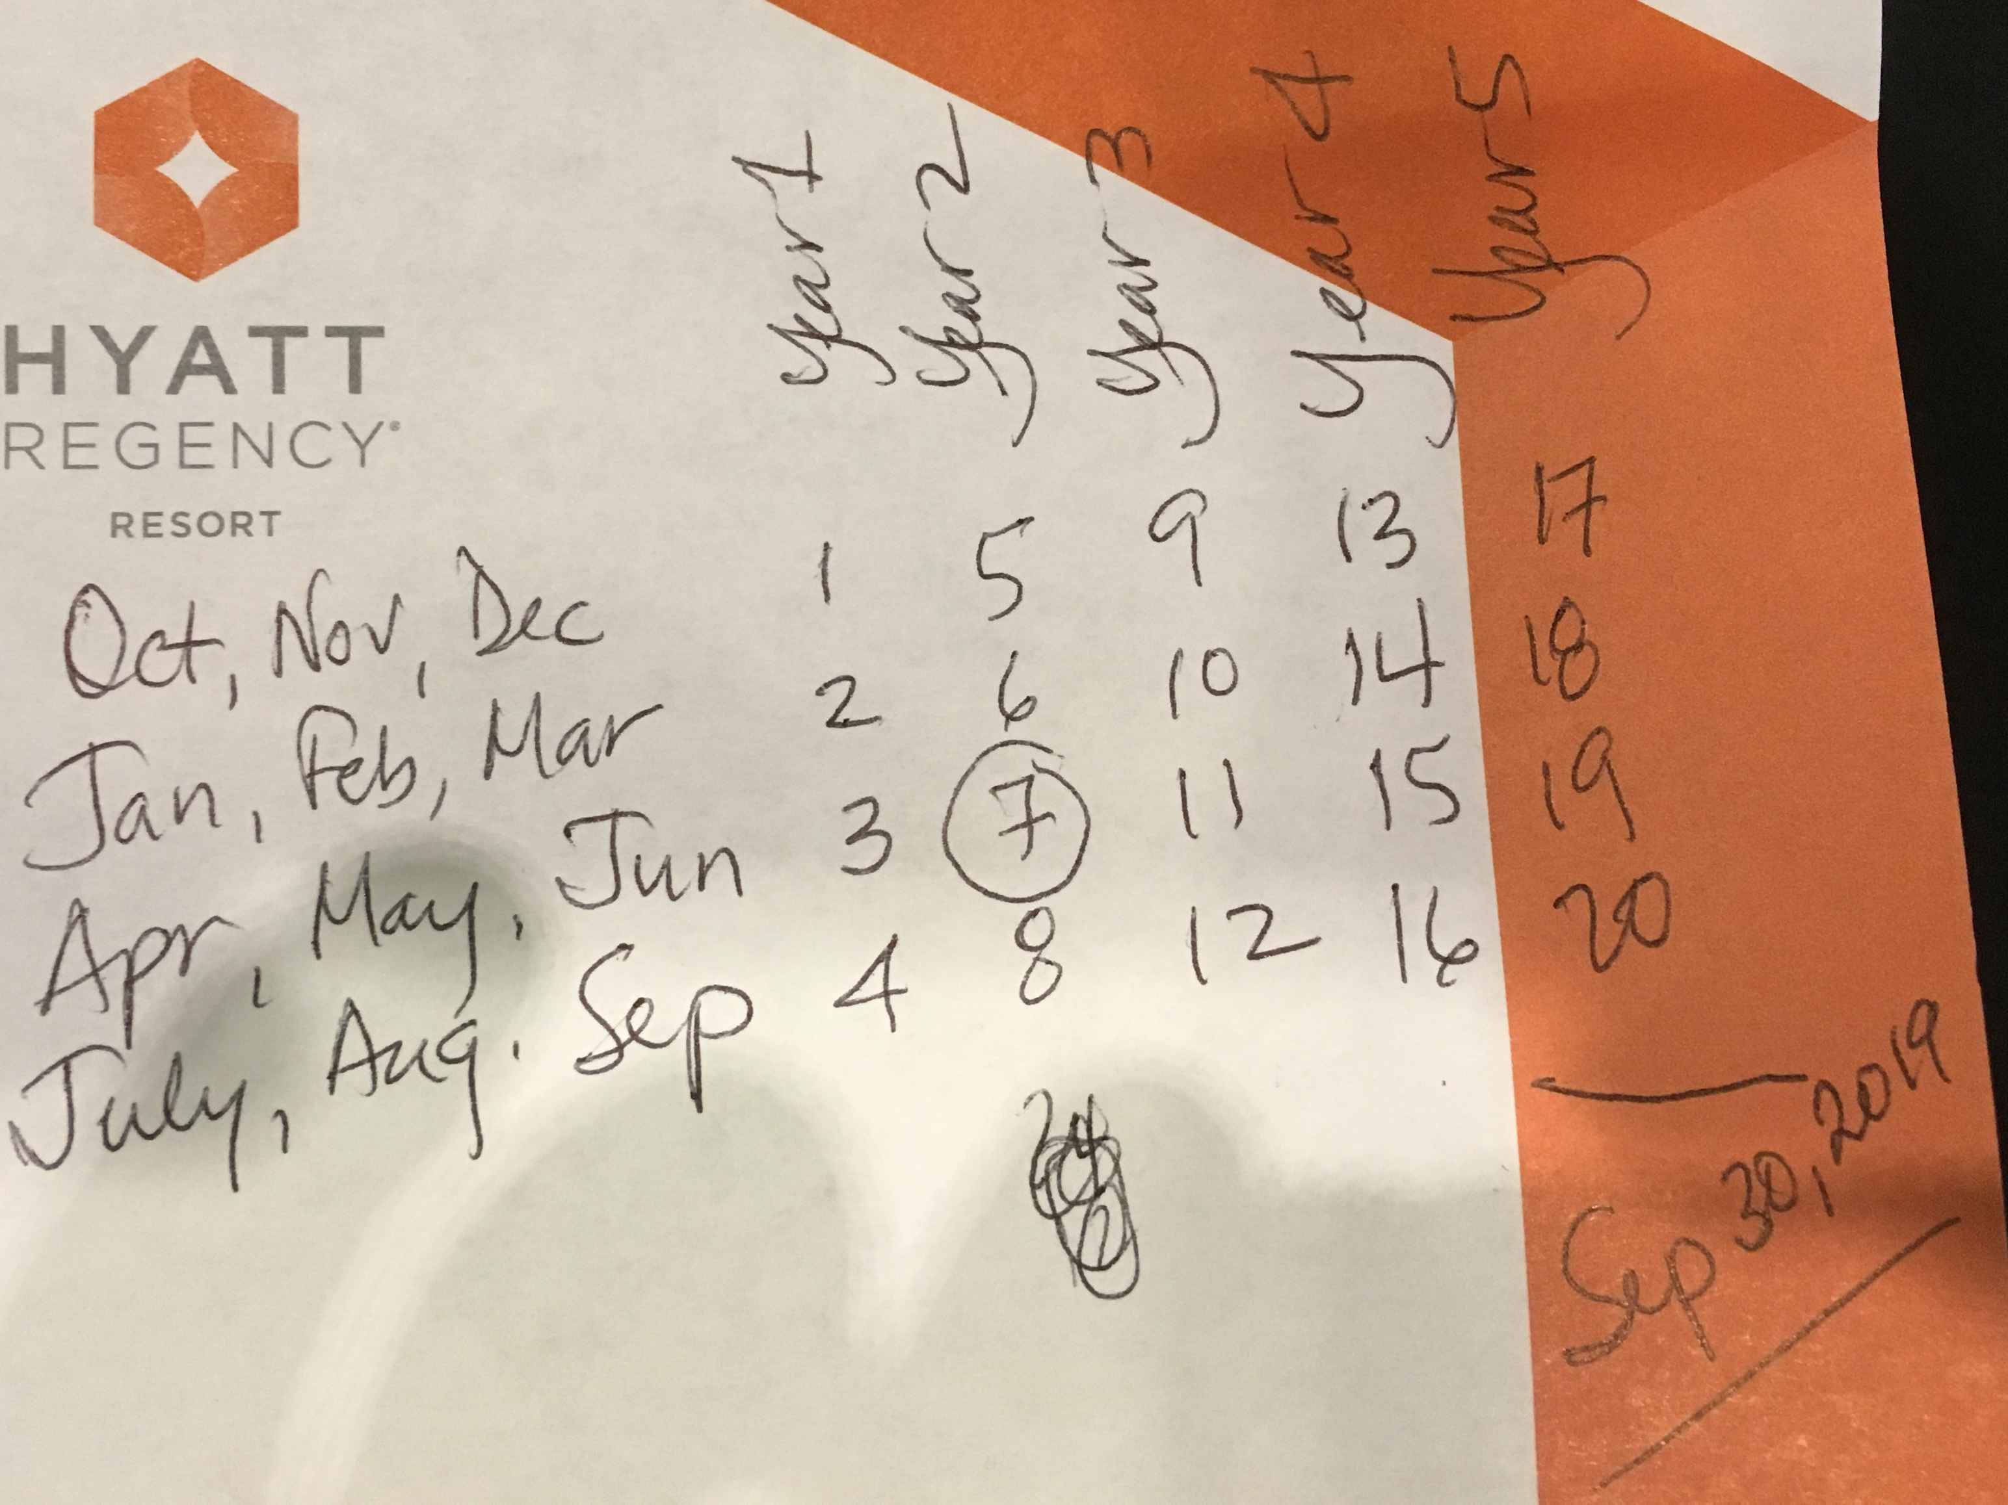
DataONE timeline – 5 years

