Slide 1

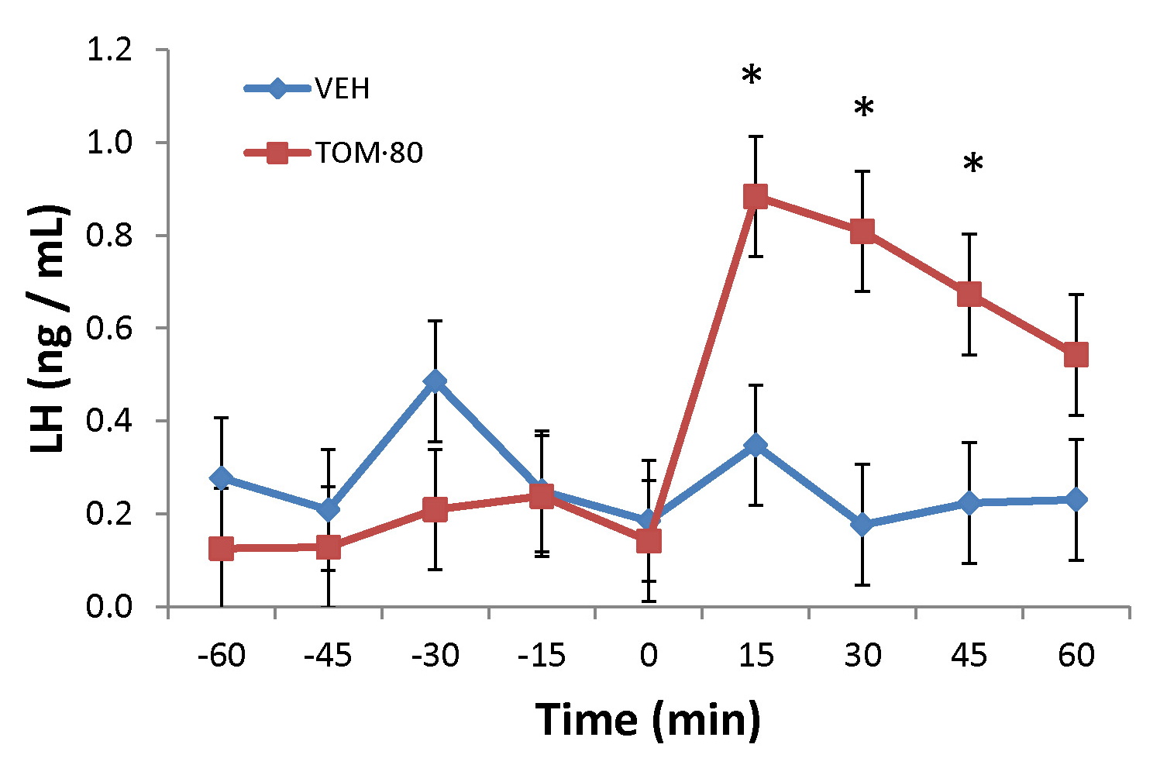
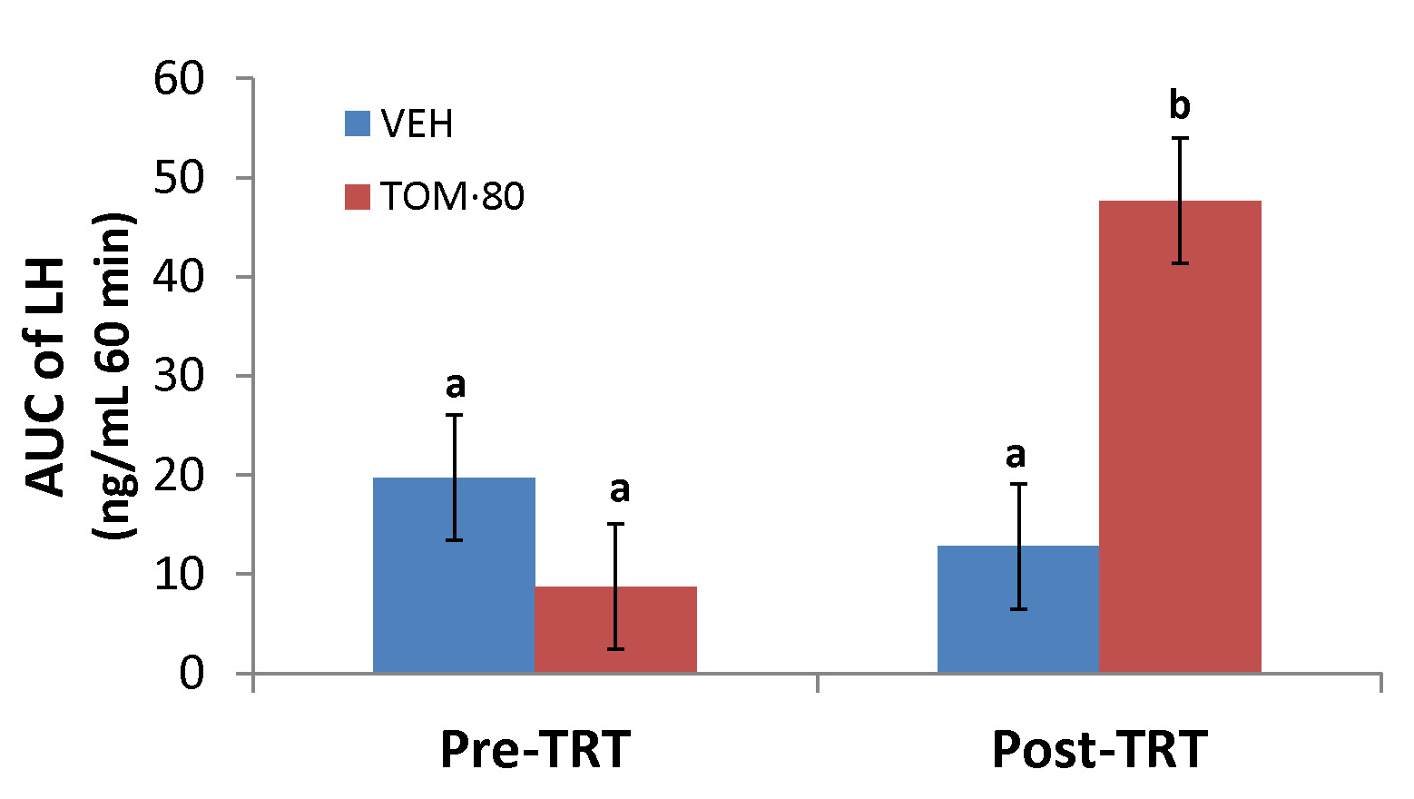
The Effect of Kisspeptin Receptor Agonist (FTM080) on Luteinizing Hormone in Sheep
B. Whitlock^{*1}, J. Daniel², M. Hes¹, B. Steele³, J. Sartin^{3,4}, S. Oishi⁵, and N. Fujii⁵
1: Department of Large Animal Clinical Sciences ~ The University of Tennessee College of Veterinary Medicine, Knoxville, TN USA
2: Department of Animal Science ~ Berry College, Mt. Berry, GA 30149
3: Department of Anatomy, Physiology and Pharmacology ~ College of Veterinary Medicine, Auburn University, Auburn, AL 36849
4: Agricultural Experiment Station ~ Auburn University, Auburn, AL 36849
5: Graduate School of Pharmaceutical Sciences ~ Kyoto University, Sakyo-ku, Kyoto 606-8501, Japan
Abstract
  Kisspeptin receptor (Kiss1r) agonists with increased half-life and similar efficacy to kisspeptin (KP) in vitro potentially may provide beneficial applications in breeding management of many species. However, many of these agonists have not been tested in vivo. This study was designed to test the effect of a Kiss1r agonist (FTM080) on luteinizing hormone (LH) in vivo. Sheep were treated with FTM080 (500 pmol/kg BW) or sterile water in a 2-ml bolus via the jugular cannula. Serial blood samples were collected every
  15-min before (1 hr) and after (1 hr) treatment. Intravenous (IV) injection of FTM080 increased (P < 0.05) LH plasma concentrations through the 45-min sample following treatment. Moreover, the area under the curve of LH in the period from 0 to 60-min following FTM080 treatment was also increased (P < 0.05). These data provide evidence to suggest that FTM080 stimulates the gonadotropic axis of ruminants in vivo.
FIGURE 1
FIGURE 2
FTM080
FTM080
Figure 1: Response of circulating concentration of LH (mean ± pooled SEM = 0.13) to IV administration of VEH and FTM080 (500 pmol/kg). * p < 0.05 vs. VEH. There was an effect of time
(P = 0.0019) and an interaction for FTM080 by time for LH
(P = 0.0009) such that FTM080-treated ewes had elevated
LH concentrations through the 45-min sample.
Figure 2: Effect of IV administration of VEH and FTM080 (500 pmol/kg) on AUC of LH concentrations from -60 to 0 min before (Pre-TRT) and from 0 to 60 min following treatment (Post-TRT) (mean ± pooled SEM = 6.29). AUCs with different superscripts differ (p < 0.05).
Introduction
Kisspeptin and Kiss1r are integral to central regulation of the gonadotropic-axis [1]. The demonstration that IV infusion of KP can stimulate gonadotropin secretion and ovulation in seasonally anestrous female sheep offers a means of manipulating the reproductive axis [2]. However, KP may be of limited clinical use because of the short circulating half-life [3]. Rational modification of Kiss1r agonists were synthesized to be resistant to matrix metalloproteinase activity and found to have increased half-life
in murine serum, and to have comparable binding affinity and efficacy in vitro to KP [4,5]. However, in vivo activities of these peptides have not yet been studied. Thus, the present experiment was designed to determine the effect of a novel Kiss1r agonist on plasma LH concentrations in seasonally anestrus female sheep.
Results
Three ewes per treatment are reported; two ewes (one per treatment) were excluded from the analysis and results due to plasma progesterone concentrations were >1 ng/mL (2.60 and
1.70 ng/mL).
Plasma progesterone concentration for the remainder of the animals was <1 ng / mL [0.12 ± 0.08 (SEM) ng/mL]. Mean ± SEM plasma LH concentration was 0.31 ± 0.16 ng/mL and 0.14 ± 0.06 ng/mL before treatment with sterile water and FTM080, respectively. Mean plasma LH concentra-tion was 0.21 ± 0.08 ng/mL and 0.97 ± 0.72 ng/mL after treatment with sterile water and FTM080, respectively. Treatment had no effect (P = 0.1641) on mean plasma LH concentration.
There was an effect of time (P = 0.0019) and an interaction of treatment and time (P = 0.0009)
on plasma LH concentrations. Plasma LH concentrations following treatment with FTM080 were significantly greater than the controls (P < 0.05) through the 45-min sample (Figure 1) and there was no effect of treatment (P = 0.1590) on area under the LH curve. However, there was an effect of period (pre- and post-treatment) (P = 0.0464) and an interaction of period and treatment
(P = 0.0150) on area under the LH curve. The area under the curve of LH in the period from 0 to 60 min following FTM080 treatment was greater than all other treatments and periods (Figure 2).
Materials and Methods
All procedures were approved by the Berry College (Rome, GA) Institutional Animal Care and Use Committee.
Eight adult parous Katahdin female sheep [41.6 ± (SEM) 1.3 kg] were used in this experiment. Sheep were exposed to ambient temperature (25°C average daily temperature) and photoperiod (14:10 [L:D] hr) throughout the experiment (June), and fed a maintenance diet calculated to meet daily requirements.
The effect of a novel Kiss1r agonist (FTM080: 4-fluorobenzoyl-Phe-Gly-Leu-Arg-Trp-NH₂; Graduate School of Pharmaceutical Sciences, Kyoto University) [4,5] on plasma LH concentrations in anestrous sheep was tested. The study was conducted during a long photoperiod to increase the likelihood of ewes being in the anestrous period, which was done to reduce variation in response(s) as the KP-Kiss1r system is clearly influenced by sex steroids [6].
Blood samples were collected before and after the experiment
(7 days between samples) and assayed to determine progesterone concentrations. Data from animals with circulating progesterone concentrations greater than 1 ng/ml was excluded from the analysis. Each animal was fitted with an indwelling intravenous jugular catheter the day before experimentation. Sheep were treated with FTM080 (500 pmol/kg BW) or sterile water (Vehicle; VEH) in a 2-ml bolus via the jugular cannula (4 sheep/treatment). Serial blood samples (3 ml) were collected before (1 hr) and after (1 hr) treatment. Samples were collected at 15-min intervals. Plasma was stored at -20°C for radioimmunoassay (RIA) of LH and progesterone.
Plasma LH concentrations were assayed by double-antibody RIA as previously described [7]. Plasma progesterone concentrations were determined using the Coat-a-Count® Progesterone RIA kit (Siemens, Los Angeles, CA, USA) [8].
Circulating concentrations of LH were tested for effect of treatment (FTM080 or sterile water), time, and treatment by time interaction using ANOVA procedures for repeated measures with JMP Software (version 7 SAS Inst. Inc., Cary, NC). Area under the LH concentration curve pre (-60 to 0 min) and post (0 to 60 min) treatment was calculated using the trapezoid method with MSExcel Software. Area under the LH curve was tested for effect of treatment (FTM080 or sterile water), period (pre- or post-treatment), and treatment by period interaction using ANOVA procedures for repeated measures with JMP Software (version 7 SAS Inst. Inc., Cary, NC). Means separation was performed using Student’s t-test when appropriate.
  Summary
  The half-life of FTM080 in murine serum (6.6 h) is greater than KP-10 (< 1 hr) while maintaining bioactivity for Kiss1r in vitro [4]. However, the in vivo activity of FTM080 had not been studied.
  In vitro and in vivo activity/potency of Kiss1r agonists are not always the same [9,10]. Some
  KP-10 analogs may act as Kiss1r superagonists in specific in vitro systems, but may not have greater activity than KP-10 in vivo.
  This study of the effect of a Kiss1r agonist in anestrous sheep revealed that intravenous FTM080 stimulated plasma LH concentrations through the 45-min sample.
  There was approximately a 6-fold increase in plasma LH concentrations following intravenous treatment with FTM080 (from 0.142 to 0.884 ng/mL).
  The magnitude and duration of the LH-response following treatment with FTM080 was similar
  to previous observations in ovariectomized sheep given comparable doses of KP-10 [2,11].
  The reported stimulation of the gonadotropin axis by KP-10 in seasonally acyclic ewes [2] is greater than the effect of FTM080 reported in this study. Caraty et al., [2] reported that an intravenous bolus of KP-10 of approximately half the molar dose used here increased concen-trations of LH in plasma of seasonally acyclic ewes from 0.2 ng/mL to 8.0 ng/mL. A similar response was observed by the authors following intravenous KP-10 treatment of seasonally acyclic ewes (unpublished observations).
  These data provide evidence to suggest that FTM080, a Kiss1r agonist, stimulates the gonado-tropic axis of ruminants in vivo. However, the increased half-life and comparable efficacy of FTM080 to KP-10 in vitro [4,5] does not appear to translate to longer duration of efficacy in vivo.
References
Seminara SB, Messager S, Chatzidaki EE, Thresher RR, Acierno JS, Jr., Shagoury JK, Bo-Abbas Y, Kuohung W, Schwinof KM, Hendrick AG, Zahn D, Dixon J, Kaiser UB, Slaugenhaupt SA, Gusella JF, O'Rahilly S, Carlton MB, Crowley WF, Jr., Aparicio SA, Colledge WH: The gpr54 gene as a regulator of puberty. N Engl J Med 2003;349:1614-1627.
Caraty A, Smith JT, Lomet D, Ben Said S, Morrissey A, Cognie J, Doughton B, Baril G, Briant C, Clarke IJ: Kisspeptin synchronizes preovulatory surges in cyclical ewes and causes ovulation in seasonally acyclic ewes. Endocrinology 2007;148:5258-5267.
Kotani M, Detheux M, Vandenbogaerde A, Communi D, Vanderwinden JM, Le Poul E, Brezillon S, Tyldesley R, Suarez-Huerta N, Vandeput F, Blanpain C, Schiffmann SN, Vassart G, Parmentier M: The metastasis suppressor gene kiss-1 encodes kisspeptins, the natural ligands of the orphan g protein-coupled receptor gpr54. J Biol Chem 2001;276:34631-34636.
Tomita K, Oishi S, Ohno H, Peiper SC, Fujii N: Development of novel g-protein-coupled receptor 54 agonists with resistance to degradation by matrix metalloproteinase. J Med Chem 2008;51:7645-7649.
Tomita K, Oishi S, Cluzeau J, Ohno H, Navenot JM, Wang ZX, Peiper SC, Akamatsu M, Fujii N: Sar and qsar studies on the n-terminally acylated pentapeptide agonists for gpr54. J Med Chem 2007;50:3222-3228.
Smith JT, Clay CM, Caraty A, Clarke IJ: Kiss-1 messenger ribonucleic acid expression in the hypothalamus of the ewe is regulated by sex steroids and season. Endocrinology 2007;148:1150-1157.
Coleman ES, Elsasser TH, Kemppainen RJ, Coleman DA, Sartin JL: Effect of endotoxin on pituitary hormone secretion in sheep. Neuroendocrinology 1993;58:111-122.
Minton JE, Coppinger TR, Spaeth CW, Martin LC: Poor reproductive response of anestrous suffolk ewes to ram exposure is not due to failure to secrete luteinizing hormone acutely. J Anim Sci 1991;69:3314-3320.
Gutierrez-Pascual E, Leprince J, Martinez-Fuentes AJ, Segalas-Milazzo I, Pineda R, Roa J, Duran-Prado M, Guilhaudis L, Desperrois E, Lebreton A, Pinilla L, Tonon MC, Malagon MM, Vaudry H, Tena-Sempere M, Castano J: In vivo and in vitro structure-activity relationships and structural conformation of kisspeptin-10-related peptides. Mol Pharmacol 2009.
Curtis AE, Cooke JH, Baxter JE, Parkinson JRC, Bataveljic A, Ghatei MA, Bloom SR, Murphy KG: A kisspeptin-10 analog with greater in vivo bioactivity than kisspeptin-10. Am J Physiol-Endoc M 2010;298:E296-E303.
Whitlock BK, Daniel JA, Wilborn RR, Maxwell HS, Steele BP, Sartin JL: Interaction of kisspeptin and the somatotropic axis. Neuroendocrinology 2010;92:178-188.

