Slide 1


Modeling and Analysis of Turbojet Compressor Inlet Temperature Measurement System Performance
Brian Binkley
Aerospace Testing Alliance (ATA)
Arnold Air Force Base, TN
UTSI
January 2011
Air Force Materiel Command
Arnold Engineering Development Center
Arnold Air Force Base, TN 37389
Approved for public release; distribution is unlimited.
AEDC PA# 2010-342

Slide 2
OUTLINE
Introduction/Background
Modeling Work
  Eductor Flow
  T2 Tube Heat Transfer
Analysis
Conclusions
Approved for public release; distribution is unlimited.

Slide 3
INTRODUCTION
Hydromechanical Engine Control (Eductor)
T2 bellows and RTD sensors control engine speed, inlet guide vanes, nozzle position and exhaust gas temperature
Ejector pumps T2 air through eductor tubes
EDUCTOR
90⁰ Bend
exit
1” OD Tube
Secondary Stream
Ejector
T2 Sensors
Bellows and RTD)
150⁰ Bend
Primary Stream
(not to scale)
Compressor
Engine Inlet
Radius
Airflow
Screen
Bleed Holes
Engine Bay
T2 sensors
(Bellows and RTD)
Aluminum Duct
Flexible Hose
(1” ID)
Eductor
Approved for public release; distribution is unlimited.

Slide 4
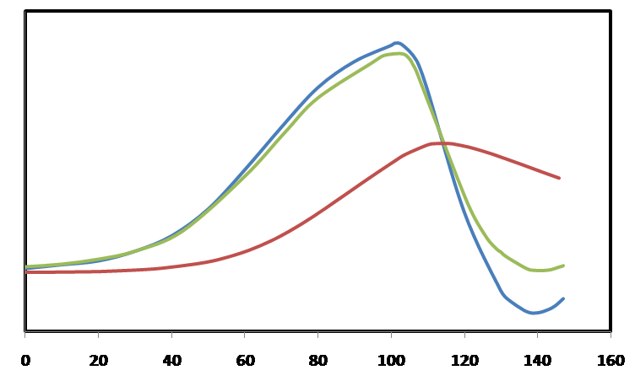
INTRODUCTION
T2 Bias
T2 sensors may not indicate true compressor inlet temperature
Components
  Inlet duct heat transfer (thermal boundary layer)
  Engine bay air re-ingestion
  T2 tube heat transfer
Bias can cause engine mis-scheduling
Temperatures
Free Stream Total
T2 Sensor
Thermal Lag
Inlet Wall
Dive
Climb
Time (sec)
(not to scale)
Compressor
Engine Inlet
Radius
Airflow
Screen
Bleed Holes
Engine Bay
T2 sensors
(Bellows and RTD)
Aluminum Duct
Flexible Hose
(1” ID)
Eductor
Approved for public release; distribution is unlimited.
Notes:
The inlet wall temperature curve is a prediction from previous work to determine the engine inlet thermal boundary layer.
The green line is the biased T2 sensor temperature measurement.
Inlet duct heat transfer is accounted for indirectly.

Slide 5
T2 BIAS MITIGATION APPROACHES
Engine Bay
Engine Bay
Bleed Holes
Variable Exhaust Nozzle
Bleed Holes
Variable Exhaust Nozzle
Inlet
Compressor
Inlet
Compressor
Sensors
Engine Bay
Bleed Holes
Blocked
Sensors
Engine Bay
BASELINE CONFIGURATION
Eductor pulls air from engine inlet
Eductor exhausts to engine face
BLEED HOLES BLOCKED
Bleed holes in front of eductor tube inlet blocked
Engine Bay
Engine Bay
Variable Exhaust Nozzle
Inlet
Compressor
Variable Exhaust Nozzle
Inlet
Compressor
Sensors
Engine Bay
Sensors
Engine Bay
SNORKEL CONFIGURATION
Eductor pulls air from free stream total temperature
Eductor exhausts to engine face
SCOOP CONFIGURATION
Eductor pulls from scoop static pressure
Eductor exhausts to engine bay
Approved for public release; distribution is unlimited.

Slide 6
OUTLINE
Introduction/Background
Modeling Work
  Eductor Flow
  T2 Tube Heat Transfer
Analysis
Conclusions
Approved for public release; distribution is unlimited.

Slide 7
PURPOSE OF MODELING WORK
Eductor Flow
  Develop understanding of baseline eductor flow
  Eliminate fly-fix-fly iterations and ensure safety of test during alternate configuration testing
    Maintain positive eductor flow
    Optimize mass flow to reduce heat transfer
Heat Transfer
  Determine the impact of tube heat transfer on T2 bias
Approved for public release; distribution is unlimited.

Slide 8
ADDITIONAL CONSIDERATIONS OUTSIDE THE SCOPE OF THIS THESIS
Icing is a concern (particularly for the snorkel configuration)
Aircraft boundary layer ingestion (fluid and thermal)
Upstream flow obstructions / aircraft attitude
Cost/Complexity/Maintenance
Approved for public release; distribution is unlimited.

Slide 9
EDUCTOR COMPRESSIBLE FLOW MODEL
EDUCTOR INLET MODELS
Baseline
Modeled using experimental results
EDUCTOR MODEL
d
90⁰ Bend
e (exit)
Secondary Stream
Scoop
Modeled using CFD results
T2 Sensors
150⁰ Bend
Primary Stream
b (compressor bleed)
All Configurations
Tube loss model from CFD results
One dimensional ejector model
Snorkel
Modeled using CFD results
Approved for public release; distribution is unlimited.

Slide 10
ONE-DIMENSIONAL EJECTOR MODEL
Without an ejector, the total pressure entering the eductor must be sufficiently higher than the exit static pressure to overcome losses
PTd > PSe
Ejector adds energy to the system and pumps the air through the T2 tube and can overcome an adverse pressure gradient
PTd < PSe
90⁰ Bend
e (exit)
d
(T2 tube)
Secondary Stream
T2 Sensors
150⁰ Bend
Primary Stream
b (compressor bleed)
Supersonic Ejector
A
  Constant area expansion process
    High velocity primary stream lowers the static pressure in the diffuser (pumping for secondary stream)
  Isentropic mixing
    Mass, linear momentum and energy conserved
    Static pressure of both streams must be equal-couples equations
    Resulting increase in secondary stream total pressure and velocity
  Total pressure of mixed stream now higher than exit static pressure
Secondary Flow
Primary Flow
A
B
C
Exit
Mixed Flow
Secondary Flow
B
Static Pressures Must Be Equal
Subsonic Ejector
Secondary Flow
Primary Flow
Exit
Mixed Flow
Secondary Flow
C
Static Pressures Must Be Equal
Approved for public release; distribution is unlimited.
Notes:
The following simplifying assumptions are made in the development of the eductor model:
The flow is steady, i.e. no mass accumulates inside the control volume.
The working fluid (air) behaves as an ideal gas at the operating conditions of interest.
The working fluid (air) is calorically perfect with constant specific heats.
Conservation laws hold, i.e., mass, linear momentum and energy are conserved.
Secondary stream remains subsonic throughout the eductor.
Primary stream can be subsonic or supersonic.
The mixing process is isentropic.
Any expansion or contraction processes (such as shocks) occur prior to mixing.
Area changes are small enough to permit quasi-one-dimensional flow assumptions.
Eductor Physics
Constant area expansion process
High velocity primary stream lowers the static pressure in the diffuser (pumping for secondary stream)
Isentropic mixing in diffuser (static pressure of both streams must be equal)
Resulting increase in secondary stream total pressure and velocity
Total pressure of mixed stream now higher than exit static pressure
Static pressure constraint couples the equations for primary and secondary streams

Slide 11



ONE-DIMENSIONAL EJECTOR MODEL
Without an ejector, the total pressure entering the eductor must be sufficiently higher than the exit static pressure to overcome losses
PTd > PSe
Ejector adds energy to the system and pumps the air through the T2 tube and can overcome an adverse pressure gradient
PTd < PSe
90⁰ Bend
e (exit)
d
(T2 tube)
Secondary Stream
T2 Sensors
150⁰ Bend
Primary Stream
b (compressor bleed)
Supersonic Ejector
Secondary Flow
Primary Flow
Exit
Mixed Flow
PT, TT and Geometry Known
Secondary Flow
Static Pressures Must Be Equal
PS Known
Subsonic Ejector
PS guessed (iteration req’d)
Secondary Flow
Primary Flow
Exit
Mixed Flow
Secondary Flow
Static Pressures Must Be Equal
Approved for public release; distribution is unlimited.
Notes:
The following simplifying assumptions are made in the development of the eductor model:
The flow is steady, i.e. no mass accumulates inside the control volume.
The working fluid (air) behaves as an ideal gas at the operating conditions of interest.
The working fluid (air) is calorically perfect with constant specific heats.
Conservation laws hold, i.e., mass, linear momentum and energy are conserved.
Secondary stream remains subsonic throughout the eductor.
Primary stream can be subsonic or supersonic.
The mixing process is isentropic.
Any expansion or contraction processes (such as shocks) occur prior to mixing.
Area changes are small enough to permit quasi-one-dimensional flow assumptions.
Eductor Physics
Constant area expansion process
High velocity primary stream lowers the static pressure in the diffuser (pumping for secondary stream)
Isentropic mixing in diffuser (static pressure of both streams must be equal)
Resulting increase in secondary stream total pressure and velocity
Total pressure of mixed stream now higher than exit static pressure
Static pressure constraint couples the equations for primary and secondary streams

Slide 12
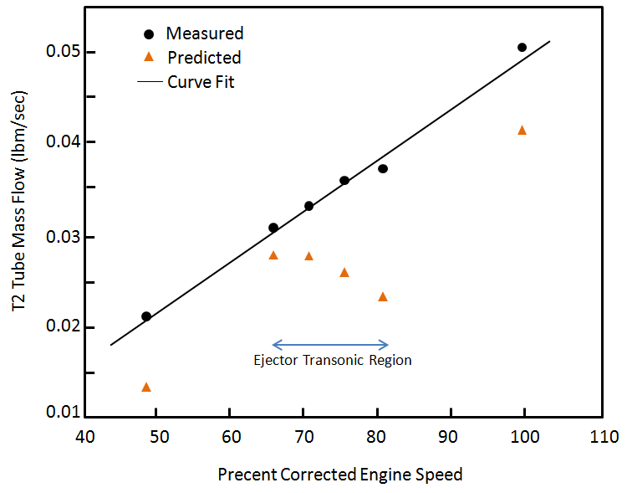
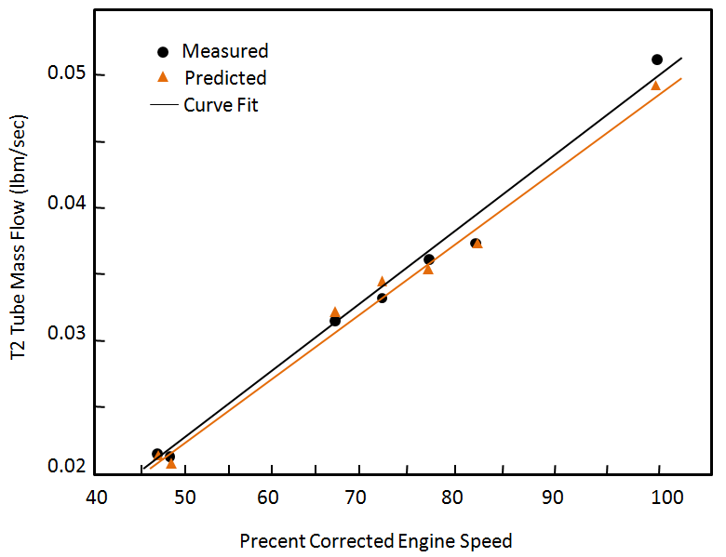
MODEL DEVELOPMENT PROGRESSION
Literature review for existing ejector models
3D CFD for Snorkel
3D CFD for Scoop
Calibrate eductor model to ground test data
3D CFD on eductor tubes
Update ejector model
Preliminary snorkel/eductor predictions
Combine scoop CFD model results with eductor model
Combine scoop CFD model results with eductor model
Calibrate existing model to match CFD results
Preliminary scoop/ eductor predictions
Validate ejector model updates
Updated predictions
Derived from ground test data
Eductor model
Curve Fit
Derived from ground test data
Calibrated eductor model
Curve Fit
Baseline
T2 Tube Mass Flow (lbm/sec)
Baseline
T2 Tube Mass Flow (lbm/sec)
Percent Corrected Engine Speed
Percent Corrected Engine Speed
Approved for public release; distribution is unlimited.

Slide 13
MODEL PREDICTIONS OF MINIMUM REQUIRED EDUCTOR PRESSURE RATIO
PTd
90⁰ Bend
PSe
Secondary Stream
T2 Sensors
Bellows and RTD)
150⁰ Bend
Primary Stream
Eductor pressure ratio captures the performance of the eductor inlet configurations (PTd) as well as the effects of alternate eductor exit locations (PSe)
Ejector allows pumping of secondary stream in adverse pressure gradient
Approved for public release; distribution is unlimited.

Slide 14
OUTLINE
Introduction/Background
Modeling Work
  Eductor Flow
  T2 Tube Heat Transfer
Analysis
Conclusions
Approved for public release; distribution is unlimited.

Slide 15
EDUCTOR HEAT TRANSFER MODEL
(not to scale)
Model of time dependent convection/conduction through tube into air stream
No heat sources
Discretized geometry
  Each element has constant thermal properties but can vary from element to element
  Tube wall temperature is uniform in each element but may vary from element to element
  No conduction along length of element
  Air properties iterated inside each element
March along tube length to solve elements sequentially, repeat in time
Compressor
Engine Inlet
Radius
Airflow
Screen
Engine Bay
n+1
T2 sensors
n
Aluminum Duct
Flexible Hose
Eductor
TT_{b}
TT_{b}
Tw_{n}
Tw_{n+1}
n
n+1
Tout_{n-1}
Tout_{n}
Tout_{n+1}
Tin_{n}
Tw_{n}
Tin_{n+1}
Tw_{n+1}
Tin_{n+2}
TT_{b}
TT_{b}
Tout | Air temperature leaving element
Tin | Air temperature entering element
TTb | Tube external air temperature boundary condition
Tw | Tube wall temperature
Approved for public release; distribution is unlimited.
Notes:
The air entering the T2 tube pickup screen (Figure B‑1) has a temperature equal to free stream total temperature. This essentially removes the effects of engine bay air re-ingestion and engine inlet duct heat transfer from the incoming air and provides an isolated prediction of T2 tube heat transfer effects.
The T2 tube geometry may be discretized such that each element of the tube is solved sequentially and the resulting outlet temperature of the element is the inlet temperature to the next element.
Initial temperature of the tube wall is the average of the engine bay air and incoming T2 tube air temperature at each element.
The lumped capacity method (LCM) can be used when the element Biot number is less than 0.1.
For development purposes, the engine bay temperature is greater than the tube wall temperature and the tube wall temperature is greater than the air temperature inside the tube.
Material properties (density, specific heat and thermal conductivity) are assumed to be constant over the length of each element but are allowed to vary from element to element.
The tube wall temperature is assumed to be constant over the length of each element, but not the entire length of the T2 tube.
Heat conduction along the length of the tube is negligible in comparison to the heat transferred radially through the wall.
The engine bay air flow over the T2 tube can be modeled as a tube in crossflow.
An average forward engine bay temperature can be used to describe the T2 tube external temperature boundary condition.
There are no source terms due to heat generation within the tube wall.

Slide 16
HEAT TRANSFER SOLUTION
Lumped Capacitance Model (Bi ≤ 0.1)
Biot Number
TT_{b}
n
Tw_{n}
Tw_{n}
If Bi<<1 then resistance to conduction is negligible and wall temperature assumed to be uniform
Biot number checked for each tube element
Heat transfer solution selected based on Biot number
Tw_{n}
TT_{b}
Heat Equation (Bi > 0.1)
TT_{b}
Tw_{n}
r_{o}
n
r_{i}
TT_{b} ,h
Tw_{n}
Tw_{n}=T(r,t)
TT_{b}
Approved for public release; distribution is unlimited.

Slide 17
HEAT TRANSFER COEFFICIENTS
INTERNAL CONVECTION
Gnielinski Relationship
  Uniform surface heat flux and temperature
  Smooth or rough wall
  0.5 ≤ Pr ≤ 2000
  3000 ≤ Re ≤ 5x10⁶
EXTERNAL CONVECTION
Hilpert’s Empirical Correlation
  Circular and non-circular tubes
  Pr ≥ 0.7
  0.4 ≤ Re ≤ 4x10⁵
D | Tube Diameter | Nu | Nusselt Number
k | Tube Thermal Conductivity | Re | Reynolds Number
h | Heat Transfer Coefficient | Pr | Prandtl Number
Approved for public release; distribution is unlimited.

Slide 18
HEAT TRANSFER MODEL CONVERGENCE
2-Norm of error in tube air temperature ||T||₂
Initial air temperature at each element equal to converged temperature of previous element
Maximum error at x/L=0.4. Initial guess improves as grid density increases.
Control volume independence with 8x or higher grid density
10⁰
T
10⁻²
2
10⁻⁴
10⁻⁶
10⁻⁸
10⁻¹⁰
10⁻¹²
T at x/L=0.4
(deg. F)
Control Volume Independent
x=0
i=1
x/L=0.4
x=L
i=n
Approved for public release; distribution is unlimited.

Slide 19
GROUND RUN
~130 second dwell time
Corrected Engine Speed (% RPM)
Bleed valve open
Bleed valve closed
Augmentation
Approved for public release; distribution is unlimited.

Slide 20
MEASURED TUBE AIR TEMPERATURE RISE
Bleed valve closed
Augmentation
50% Speed
60% Speed
80% Speed
90% Speed
100% Speed
TT_{d,1}
ΔT=TT_{d,2} – TT_{d,1}
Tube air temperature measurements
TT_{d,2}
Approved for public release; distribution is unlimited.
TT_{b}

Slide 21
TUBE AIR TEMPERATURE RISE PREDICITONS
Prediction
(TTb= Average Forward Bay Air Temperature)
Measurement
Prediction with Estimated Boundary Condition
TTb = 60%TT0 + 40% Average Forward Bay Air Temperature
Bleed valve closes and nozzle pumping above 80% engine speed
Heat transfer sensitive to forward engine bay air temperature
Uncertainty in forward engine bay air temperature
Tube heat transfer is a significant contribution to T2 bias
Approved for public release; distribution is unlimited.

Slide 22
OUTLINE
Introduction/Background
Modeling Work
  Eductor Flow
  T2 Tube Heat Transfer
Analysis
Conclusions
Approved for public release; distribution is unlimited.

Slide 23
EDUCTOR PERFORMANCE PREDICTIONS
(GROUND RUN)
d
90⁰ Bend
e (exit)
Secondary Stream
Snorkel
T2 Sensors
150⁰ Bend
Scoop
Baseline
Minimum for positive flow
Approved for public release; distribution is unlimited.

Slide 24
T2 TUBE MASS FLOW PREDICTIONS
(GROUND RUN)
Snorkel
Scoop
Baseline
Approved for public release; distribution is unlimited.

Slide 25
BASELINE T2 TUBE HEAT TRANSFER PREDICITON
(GROUND RUN)
INCREASING ENGINE POWER SETTING
Average Forward
Engine Bay
(Air Temperature)
Predicted Tube Temperature at T2 Sensor
(Wall Temperature)
Ambient Air Temperature
Heat transfer model solves for tube wall temperature (orange line)
Average forward engine bay air temperature is the tube external temperature boundary condition
Time dependent predicted tube wall temperature behaves as expected
Approved for public release; distribution is unlimited.

Slide 26
BASELINE T2 TUBE HEAT TRANSFER PREDICITON
(GROUND RUN)
INCREASING ENGINE POWER SETTING
Measured T2 Sensor
(Air Temperature)
Predicted T2 with Tube Heat Transfer
(Air Temperature)
Contribution of Bay Air Re-ingestion
Contribution of T2 Tube Heat Transfer
14°
Tube heat transfer is a function of tube wall temperature and convecting air inside and outside of tube
Tube heat transfer is a significant contribution to T2 bias (predicted up to 14°F)
Approved for public release; distribution is unlimited.

Slide 27
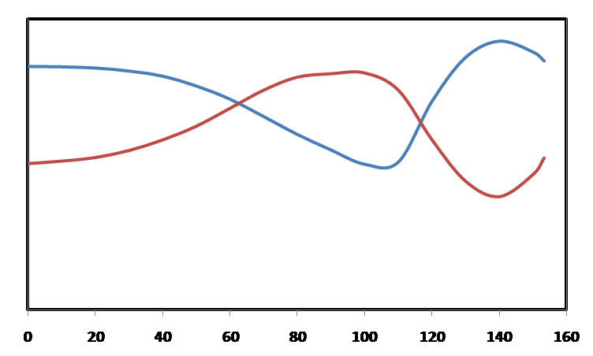
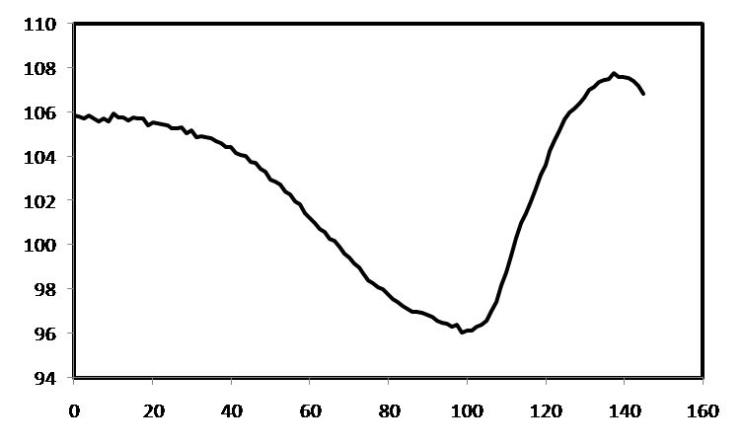
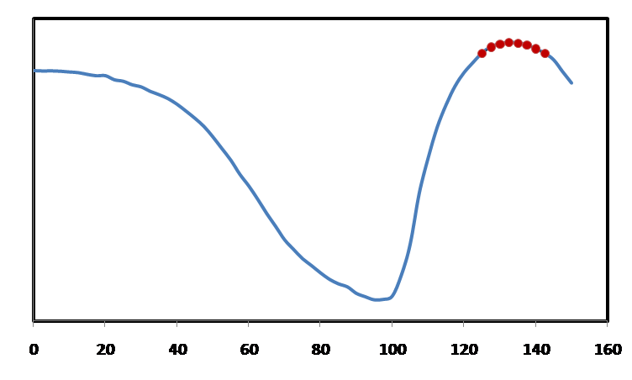
FLIGHT MANEUVER
Altitude and Mach Number
Percent Corrected Engine Speed
Mach 1.0
Altitude
Mach
Dive
Climb
Dive
Climb
Time (sec)
Time (sec)
Temperatures
Bay Air Re-ingestion
(Pressure Ratio Across Bleed Holes)
Free Stream Total
1.0
T2 Sensor
Bay Ps
Inlet Ps
Thermal Lag
Engine Bay
Air Re-ingestion
Inlet Wall
Dive
Climb
Dive
Climb
Time (sec)
Approved for public release; distribution is unlimited.
Time (sec)

Slide 28
EDUCTOR PERFORMANCE PREDICTIONS
(FLIGHT MANEUVER)
Snorkel
Scoop
Baseline
Minimum for positive flow
Dive
Climb
d
e (exit)
Scoop/eductor performance drops below baseline at high aircraft Mach numbers due to bay pressurization and total pressure loss in T2 tube
Approved for public release; distribution is unlimited.

Slide 29
T2 TUBE MASS FLOW PREDICTIONS
(FLIGHT MANEUVER)
Snorkel
Baseline
Scoop
Lower scoop/eductor T2 tube mass flow due to increased adverse pressure gradient across eductor
Approved for public release; distribution is unlimited.

Slide 30
BASELINE T2 TUBE HEAT TRANSFER PREDICITON
(FLIGHT MANEUVER)
Average Forward
Engine Bay
(Air Temperature)
Predicted Tube Temperature at T2 Sensor
(Wall Temperature)
Free Stream Total
As with the ground test predictions, the time dependent tube wall temperature prediction behaves as expected
Approved for public release; distribution is unlimited.

Slide 31
BASELINE T2 TUBE HEAT TRANSFER PREDICITON
(FLIGHT MANEUVER)
Predicted T2 with Tube Heat Transfer
(Air Temperature)
Engine Bay Air Re-ingestion
Measured T2 Sensor
(Air Temperature)
Free Stream Total
50% of T2 bias attributed to T2 tube heat transfer outside of engine bay air re-ingestion region during transient maneuvering
T2 Bias due to inlet duct heat transfer and/or engine bay air re-ingestion
T2 bias due to T2 tube heat transfer
Approved for public release; distribution is unlimited.

Slide 32
OUTLINE
Introduction/Background
Modeling Work
  Eductor Flow
  T2 Tube Heat Transfer
Analysis
Conclusions
Approved for public release; distribution is unlimited.

Slide 33
CONCLUSIONS
Validated engineering model matches baseline ground test data well and provides good snorkel and scoop predictions
Snorkel is the best configuration
  Highest eductor pressure ratio in flight and on the ground
  Lowest probability of reversed eductor flow
  Highest T2 tube mass flow rate in flight and on the ground
  Highest potential for most T2 bias mitigation
Scoop configuration unnacceptable
  Potential for T2 tube mass flow and eductor pressure ratio to be lower than baseline levels at some flight conditions
  Potential for increased T2 bias and engine mis-scheduling
Benefits provided by eductor flow and heat transfer modeling and analysis
  Identified deficiencies in alternate configuration designs
  T2 tube heat transfer can be as much as half of the T2 bias
  Assisted determination of instrumentation requirements for flight test
Approved for public release; distribution is unlimited.

