Slide 1

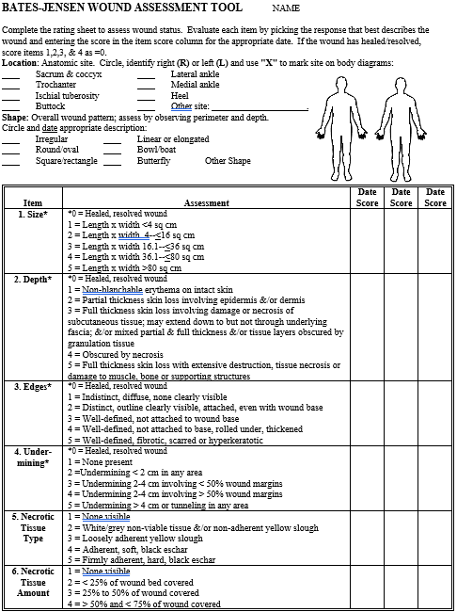
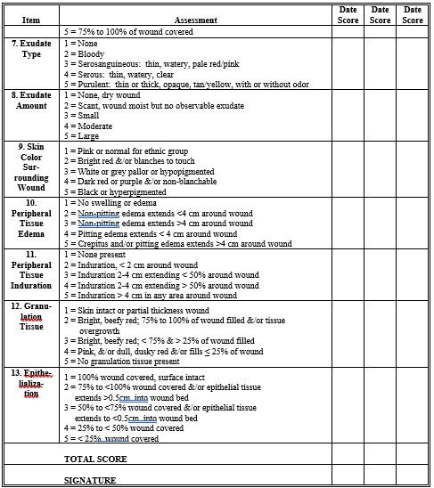
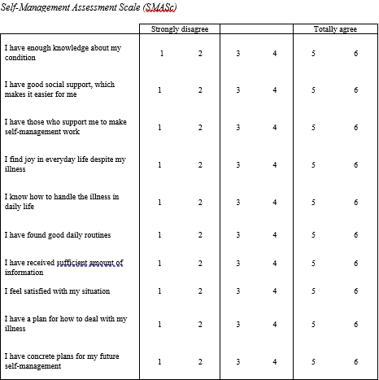
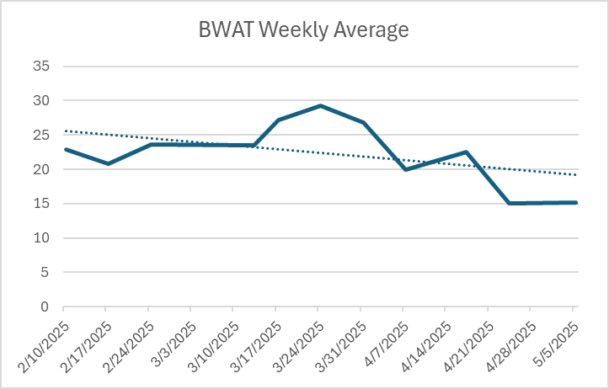
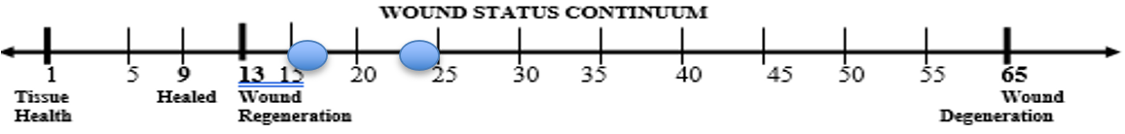
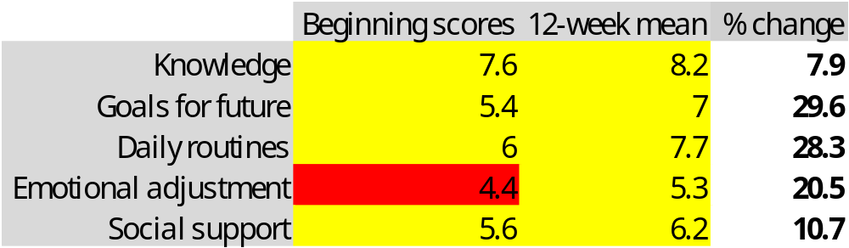
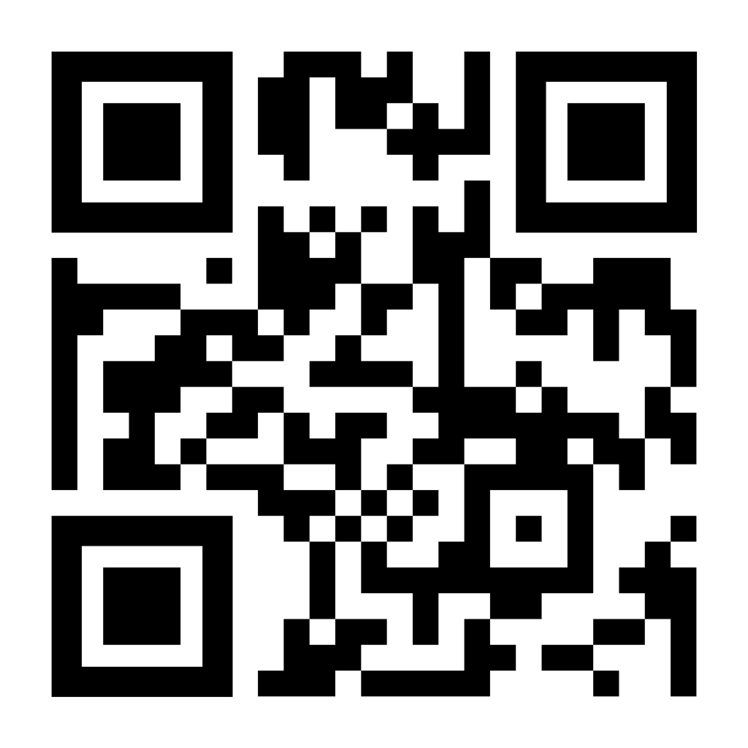

Wound care for patients with xylazine-related wounds improved after implementing a standardized wound care protocol.
Xylazine-Related Wounds: Using Wound Care and Harm Reduction Best Practices to Improve Wound Healing and Patient Education for People Who Inject Drugs
Dustin Gibbons, BSN, RN; Greg Stafford, BSN, RN; Noël Arring, DNP, PhD, RN
BACKGROUND
INTERVENTIONS
Xylazine is a non-opioid sedative used in veterinary practice (Rodriguez et al., 2008).
In humans, it can cause decreased breathing, bradycardia, lower blood pressure, and infected wounds (CDC, 2024; McFadden et al., 2024).
People who inject drugs (PWID) containing xylazine have higher prevalence of skin ulcers (38.5%) the those using unadulterated drugs (6.8%) (Rodriguez et al., 2008).
Often mixed with drugs like fentanyl; Increasingly found in illicit drug supply (CDC, 2024).
PWID often defer care due to stigma, lack of resources, lack of transportation, other socioeconomic factors (McFadden et al., 2024).
All patients with wounds choosing to participate in the project received standardized wound care using the BWAT and DIME principles, received home care education with a supply kit, and completed the SMASc at each visit (Tools used with permission from authors).
LOCAL PROBLEM
The project site was a harm reduction exchange (HRE) in Tennessee.
HRE lacked a standardized wound care protocol.
The purpose of this project was to implement a standardized wound care protocol which included using the Bates-Jensen Wound Assessment Tool (BWAT) for use during wound-care related visits.
The project aims were:
    25% improvement of BWAT score for patients with wounds
    50% of patients with wounds will receive wound care using standardized wound care protocol every two weeks
RESULTS
55% participation rate, with 53% return rate for follow-up care, falling short of the project aim.
Mean starting BWAT score 24; after 12 weeks mean score was 16; 33% improvement, exceeding project aim.
Mean beginning and ending SMASc scores showed improvement in self-management across all five domains: knowledge, goals for the future, daily routines, emotional adjustment, and social support.
METHODS
The Johns Hopkins Evidence-Based Practice Model was used as the project framework (Dang et al., 2022).
Literature appraisal provided good evidence for improved wound healing based on DIME principles (Debridement, Infection control, Moisture balance, and Edge preparation) and using the BWAT (Bates-Jensen, 2006; McFadden et al., 2024).
Pre-implementation workflow was developed and adjusted during the project through PDSA (Plan-Do-Study-Act) cycles.
BWAT score was measured at initial visit and subsequent follow-up visits for 12 weeks.
Standardized self-care supply given after each visit with education on self-care for wounds.
Self-Management Assessment Scale (SMASc) completed by patients at each visit (Öberg et al., 2019).
CONCLUSIONS
Standardized wound care protocol was a successful evidence-based practice change.
Using an assessment tool, providing standardized supply kits, and educating patients on wound care can lead to wound healing, reduce burden of wounds on patients, and allow HRE to save time and resources.
The HRE has affirmed the sustainability of this protocol and continues to use it post-implementation.
Scan the QR code to review the executive summary and references.
ACKNOWLEDGEMENTS/FUNDING DISCLOSURE:
The authors wish to thank the staff of the project site for their dedication and commitment to this practice change.

