Slide 1
Implementation of Pediatric Palliative Care Training to Advance Nursing Knowledge and Increase referrals
Whitney Stone
University of Tennessee, Knoxville

Slide 2
Overview of Problem
Palliative care services are substandard (WHO, 2018).
Children disproportionately underserved compared to adults (ICPCN, n.d.).
Patient complexity escalates the demand for pediatric palliative care (Friebert & Williams, 2015).
Tennessee’s palliative care services are lower than the national average (National Palliative Care Registry, 2015).
One Comprehensive Regional Pediatric Center in East Tennessee (ETCH, n.d.).
Notes:
Children don’t get nearly the amount of funding or research as adults
Kids having increasing numbers of chronic illnesses and are living longer
Need more care coordination and layers of support

Slide 3
Clinical Significance of Palliative Care
Improve patients’ quality of life (Groh et al., 2013)
Better symptom management (WHO, 2018), fewer procedures (Keele et al., 2013), and more complementary therapies (Osenga et al., 2016)
Improved quality of life for parents (Groh et al., 2013)
Significantly less expensive compared to other care (Smith, Brick & Normand, 2014)
Lack of education identified as a major barrier (WHO, 2018)
Notes:
The WHO defines palliative care as the active total care of the child’s body, mind, and spirit. Which also involves giving support to the family
Less invasive procedures, fewer ER admissions, shorter hospital stays
Some don’t even know the true definitions and nature of palliative care. Still only associate it with hospice and end-of-life scenarios

Slide 4
Project Purpose and Goals
Purpose: Implement an evidence-based educational initiative to improve pediatric palliative care at the project site
Goals:
  1) Improve patient outcomes by advancing registered nurses’ knowledge regarding palliative care
  2) Increase the amount of patient referrals made to the palliative care service
Notes:
Goal number 1 is the nursing outcome
Goal number 2 is the patient focused outcome

Slide 5
PICOT Question
“In acute care pediatric nurses, how does participation in an evidence-based pediatric palliative care training program compared to no palliative care training, affect nurses’ knowledge of pediatric palliative care and number of palliative care team referrals over three months?”

Slide 6
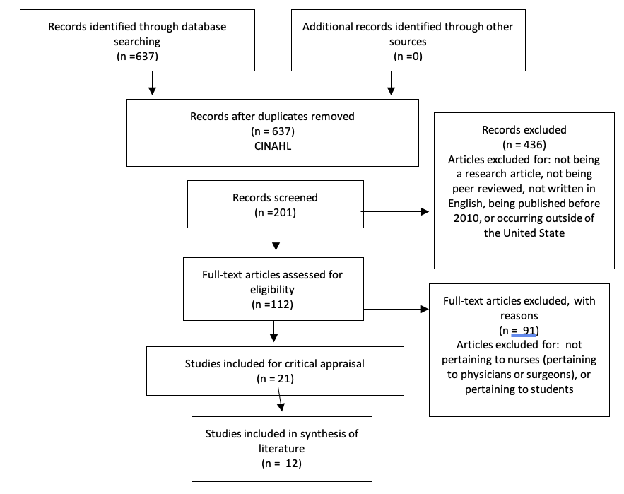
Literature Search
Notes:
Palliative care, education, referrals
Inclusion criteria: original research, peer reviewed, English, published within the last ten years, and occurring inside the United States
Full text articles excluded for not pertaining to target audience (RNs)
12 final studies

Slide 7
Synthesis of the Literature
Training significantly increases RNs’ knowledge (ELNEC, EPEC, Comfort, and CARE)
Most assessed knowledge via a pre and post-test methodology
Many tools to measure outcomes (PCQN and ELNEC’s KAT)
Clinically significant increase in palliative care referrals after training
More rigorous research needed regarding patient outcomes (Hasson et al., 2020)
Notes:
No universal tool or tool that has been proven valid
Other key points included: increased comfortability, better attitudes, decreased anxieties, and Increase perceived importance of palliative care and training

Slide 8
Source | Reville et al., 2013 | McAndrew (2020) | Anderson et al., 2017 | Widger et al., 2018 | Newton & Sebbens, 2020 | O’Shea & Mager, 2019 | Bishop et al., 2019 | Harden et al., 2017 | White-head et al., 2010 | Haugh (2015) | Balicas (2018) | Haut et al., 2017
Know-ledge |  |  |  | ⬆s |  | ⬆s | ⬆s   | ⬆s | ⬆s | ⬆s | ⬆s | ⬆s
Referral | ⬆s | ⬆c | ⬆c | ⬆s | ⬆c |  |  |  |  |  |  | 
Level and Quality | II, B | II, B | II, A | II, B | II, B | II, A | I, B | II, B | II, A | II, A | II, A | II, A
Notes:
5 of these studies look ELNEC specifically which guided the curriculum for this learning intervention
All but one being considered level II meaning they are quasi-experimental in nature. Only one randomized control trial

Slide 9
Recommendations for Practice
Implement a palliative care training program for registered nurses to advance knowledge regarding palliative care
Implement a palliative care training program for registered nurses to increase palliative care referrals
Notes:
We could strongly recommend

Slide 10
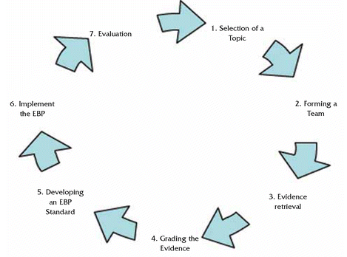
Conceptual Framework
IOWA Model
Notes:
A step-by-step guide for the evidence-based practice process
Both a process model and an action model. Prescribe a number of steps that should be followed in the process of translating research into practice
Seven clear steps with decision points all throughout
Used in a number of clinical settings (including acute care) and even with pediatric focus

Slide 11

Implementation
Population: Pediatric Registered Nurses
Setting: Local children’s hospital in East Tennessee
Intervention:
  Exempt from IRB
  ELNEC curriculum
  Pre and Post knowledge assessment
    Four-week follow-up (retention)
Notes:
I completed the entire course and received a certificate in July of 2020
Pre-test, online module, post-test, in-person content, and then four week follow-up
Online content was definitions and purpose of palliative care (key points)
In-person learning was patient scenarios with different respects to palliative care and then actual demonstrations with a computer on how to make the referral
Also filled out a demographic survey during the in-person portion

Slide 12
Outcome Measures
The outcomes of interest for this project are:
Participant knowledge of pediatric palliative care
Number of palliative care referrals

Slide 13
Professional Team and Stakeholders
DNP Student
DNP Chair
Community Member
Nurse Managers
Nursing Staff
Notes:
Tammy for allowing the project and helping with curriculum. Provided support
Nurse managers for allowing me to use their education time for this project
Nurse educator for helping facilitate PowerPoint, case studies, and ETCH day logistics

Slide 14
Restraining Forces
Planned Change
Driving Forces
Knowledge Deficit
Implementation of specialized palliative care training to advance RN knowledge and increase palliative care referrals
Desire to deliver best care
Barriers
Resistance to Change
Facilitators
Supporting Evidence
Competing Priorities
Low Cost/ Potential Savings
Time
Partnership between UTK and ETCH
COVID-19
Notes:
Covid changed location and design of education.
Classroom to small patient room (3 at a time) and not additional cost to hospital. Mandatory training anyway so no one was paid extra to be there

Slide 15
Methods of Evaluation
Exams graded via the NetLearning (Learning Management Software)
Scores and surveys matched by names, but de-identified before analysis
Pre-intervention referrals compared to post-intervention referrals using EMR
Data stored on a UTK OneDrive Business Account
SPSS used for data analysis
Notes:
Cary the UTK statistician
December to march and then march to june

Slide 16
Results: Demographics
Variable | Options | Count | Percentage
Gender | Female | 43 | 93.5
 | Male | 3 | 6.5
Shift | Dayshift | 25 | 54.3
 | Nightshift | 21 | 45.7
Status | Full time | 35 | 76.1
 | Part time | 4 | 8.7
 | PRN | 7 | 15.2
Highest Education | Diploma | 2 | 4.3
 | ASN | 11 | 23.0
 | BSN | 29 | 63
 | Masters | 3 | 6.5
 | Doctorate | 1 | 2.2
Years of Experience | Under 5 | 14 | 30.4
 | 5-9 | 12 | 28.1
 | 10+ | 20 | 43.5
Previous Training | Yes | 6 | 13
 | No | 40 | 86
ELNEC Training | Yes | 1 | 2.2
 | No | 2 | 6.5
 | Unsure | 3 | 4.3
Notes:
13% had previous palliative care training they remember
1 person (2.2%) had ever been trained under ELNEC before

Slide 17
Results: Knowledge Assessments
Increase from pre-test to immediate post-test (p<.05)
Decrease from immediate post-test to four-week follow-up (p<.001)
Increase from pre-test to four-week follow-up (p<.05)
Changes across time did not differ by shift or years of experience
Pre-test | Post-test | Four-week follow-up
73.2% | 91.7% | 86.4%
Notes:
Repeated Measures ANOVA showed there was a difference between timepoints. Then did pairwise comparisons for each time point to see the significance of the difference
Changes across time did not differ by shift or years of experience
Did not compare gender, status, highest level of education, or previous palliative care education (frequencies were not evenly distributed)

Slide 18
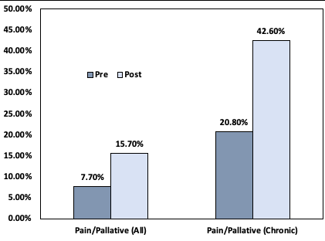
Results: Palliative care Referrals
p= .028
p= .011
Notes:
Chi square test
Pain and Palliative Care:
Increased from 7.7% (11 patients) to 15.7% (29 patients) for all PICU admissions (p=.028)
Increased from 1 out of 53 (20.8%) increased to 29 out of 68 (42.6%) for chronic conditions (p=.011)

Slide 19
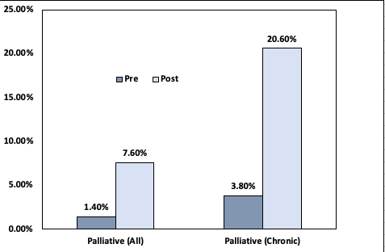
Results: Palliative care Referrals
p= .010
p= .007
Notes:
Chi square test performed in SPSS
Palliative care Only:
Increased from 2 out of 143 (1.4%) to 14 out of 185 (7.6%) for all PICU admissions (p=.010)
Increased from 2 out of 53 (3.8%) increased to 14 out of 54 (20.6%) for chronic conditions (p=.007)

Slide 20
Financial Implications
No separate reimbursement for palliative care services
Big Picture: More cost effective in the long run (Smith, Brick & Normand, 2014)
  Inpatient: shorter lengths of hospital stay, reduced aggressive interventions, and fewer deaths in acute care settings
  Outpatient: decreased ER visits, decreased hospitalizations
Notes:
Flat rate of the patient’s Diagnosis Related Group
Must have certified provider in order to bill separately

Slide 21
Significance and Implications
Coinciding with the literature, this project:
  1) Increased participant knowledge (O’Shea & Mager, 2019; Harden et al., 2017; Haugh, 2015, Widger et al., 2018)
  2) Increased number of palliative care referrals (Widger et al., 2018; Anderson et. al. 2017; McAndrew 2020; Newton and Sebbens, 2020)
  3) Increased usage of complementary therapies (Osenga et al., 2016)
Notes:
This project did not address:
Improved well-being, quality of life, and symptom management for patients
Increased trust and quality of life for families
Decreased emotional burden for healthcare professionals
Advance care planning, end-of-life scenarios, and bereavement
Reduce the high cost of healthcare

Slide 22
Limitations
Charts for review were based on admitting diagnosis
Assessments were not proctored
Time constraints of the academic calendar
Southeast United States
  Limited transferability
Non-random, convenient sample
  Majority female and all Caucasian
Notes:
Could have missed chronic diagnosis
Strengthen with in-person or proctored exam

Slide 23
Sustainability
Recurring ELNEC training courses
New option to consult coordinator and not physician
Standardized referral tool to be utilized by nurses (Bergstraesser et al., 2013)
Notes:
an instrument that can identify children with palliative care needs (especially helpful in PICU setting and for those not so familiar with palliative care)

Slide 24
Dissemination Plan
UTK’s Research Day 2021
Submit manuscript in spring 2022
  Journal of Pediatric Nursing
Poster/Presentation at national conference
Present study findings to administrators at ETCH
  Discuss palliative care team growth and expansion of services

Slide 25
Questions?

Slide 26
References
Anderson, W. G., Puntillo, K., Cimino, J., Noort, J., Pearson, D., Boyle, D., Grywalski, M., Meyer, J., O'Neil-Page, E., Cain, J., Herman, H., Barbour, S., Turner, K., Moore, E., Liao, S., Ferrell, B., Mitchell, W., Edmonds, K., Fairman, N., Joseph, D., … Pantilat, S. Z. (2017). Palliative Care Professional Development for Critical Care Nurses: A Multicenter Program. American journal of critical care : an official publication, American Association of Critical-Care Nurses, 26(5), 361–371. https://doi.org/10.4037/ajcc2017336
Bergstraesser, E., Hain, R. D., & Pereira, J. L. (2013). The development of an instrument that can identify children with palliative care needs: the Paediatric Palliative Screening Scale (PaPaS Scale): a qualitative study approach. BMC palliative care, 12(1), 20. https://doi.org/10.1186/1472-684X-12-20
East Tennessee Children’s Hosptial. (n.d.) Annual Report and Facts. https://www.etch.com/About-Us/Annual-Report-Facts.aspx
Friebert, S. & Williams, C. (2015). NHPCO’s Facts and Figures: Pediatric Palliative & Hospice Care in America. National Hospice and Palliative Care Organization. https://www.nhpco.org/wp-content/uploads/2019/04/Pediatric_Facts-Figures-1.pdf
Groh, G., Vyhnalek, B., Feddersen, B., Führer, M., & Borasio, G. D. (2013). Effectiveness of a Specialized Outpatient Palliative Care Service as Experienced by Patients and Caregivers. Journal of Palliative Medicine, 16(8), 848–856. https://doi-org.proxy.lib.utk.edu/10.1089/jpm.2012.0491
Harden, K., Price, D., Duffy, E., Galunas, L., & Rodgers, C. (2017). Palliative Care: Improving nursing knowledge, attitudes, and behaviors. Clinical Journal of Oncology Nursing, 21(5), E232–E238. https://doi-org.proxy.lib.utk.edu/10.1188/17.CJON.E232-E238
Haugh, K. E. (2015, January). Nursing Practice Improvement through Education: End-of-Life Care in the Intensive Care Unit (D.N.P.). Nursing Practice Improvement through Education: End-of-Life Care in the Intensive Care Unit. Brandman University. Retrieved from https://search-ebscohost-com.proxy.lib.utk.edu/login.aspx?direct=true&db=ccm&AN=109786643&scope=site
Keele, L., Keenan, H. T., Sheetz, J., & Bratton, S. L. (2013). Differences in Characteristics of Dying Children Who Receive and Do Not Receive Palliative Care. Pediatrics, 132(1), 72–78. https://doi-org.proxy.lib.utk.edu/10.1542/peds.2013-0470

Slide 27
References
McAndrew, N. S. (2020). Evaluating the Outcomes of an Organizational Initiative to Expand End-of-Life Resources in Intensive Care Units With Palliative Support Tools and Floating Hospice. Dimensions of Critical Care Nursing, 39(4), 219–235. https://doi-org.proxy.lib.utk.edu/10.1097/DCC.0000000000000423
National Palliative Care Registry. (2015). Tennessee. https://registry.capc.org/wp-content/uploads/2017/08/TN_EastSouthCentral_StateReport.pdf
Newton, K., & Sebbens, D. (2020). The Impact of Provider Education on Pediatric Palliative Care Referral. Journal of Pediatric Healthcare, 34(2), 99–108. https://doi-org.proxy.lib.utk.edu/10.1016/j.pedhc.2019.07.007
Osenga, K., Postier, A., Dreyfus, J., Foster, L., Teeple, W., & Friedrichsdorf, S. J. (2016). A Comparison of Circumstances at the End of Life in a Hospital Setting for Children With Palliative Care Involvement Versus Those Without. Journal of Pain & Symptom Management, 52(5), 673–680. https://doi-org.proxy.lib.utk.edu/10.1016/j.jpainsymman.2016.05.024
O’Shea, E. R., & Mager, D. (2019). End-of-life nursing education: Enhancing nurse knowledge and attitudes. Applied Nursing Research, 50, N.PAG. https://doi-org.proxy.lib.utk.edu/10.1016/j.apnr.2019.151197
Smith, S., Brick, A., O, H. S., & Normand, C. (2014). Evidence on the cost and cost-effectiveness of palliative care: A literature review. Palliative Medicine, 28(2), 130–150. https://doi-org.proxy.lib.utk.edu/10.1177/0269216313493466
The International Children’s Palliative Care Network (ICPCN) (n.d.). Scale of the need. http://www.icpcn.org/information/the-need-for-childrens-palliative-care/
Widger, K., Wolfe, J., Friedrichsdorf, S., Pole, J. D., Brennenstuhl, S., Liben, S., Greenberg, M., Bouffet, E., Siden, H., Husain, A., Whitlock, J. A., Leyden, M., & Rapoport, A. (2018). National Impact of the EPEC-Pediatrics Enhanced Train-the-Trainer Model for Delivering Education on Pediatric Palliative Care. Journal of Palliative Medicine, 21(9), 1249–1256. https://doi-org.proxy.lib.utk.edu/10.1089/jpm.2017.053
World Health Organization. (2018). Palliative Care. https://www.who.int/news-room/fact-sheets/detail/palliative-care

