Slide 1

Improving Human Papillomavirus Vaccination Rates in Adolescents:
A Quality Improvement Project
Keylea Harrison, BSN-RN
University of Tennessee, Knoxville

Slide 2
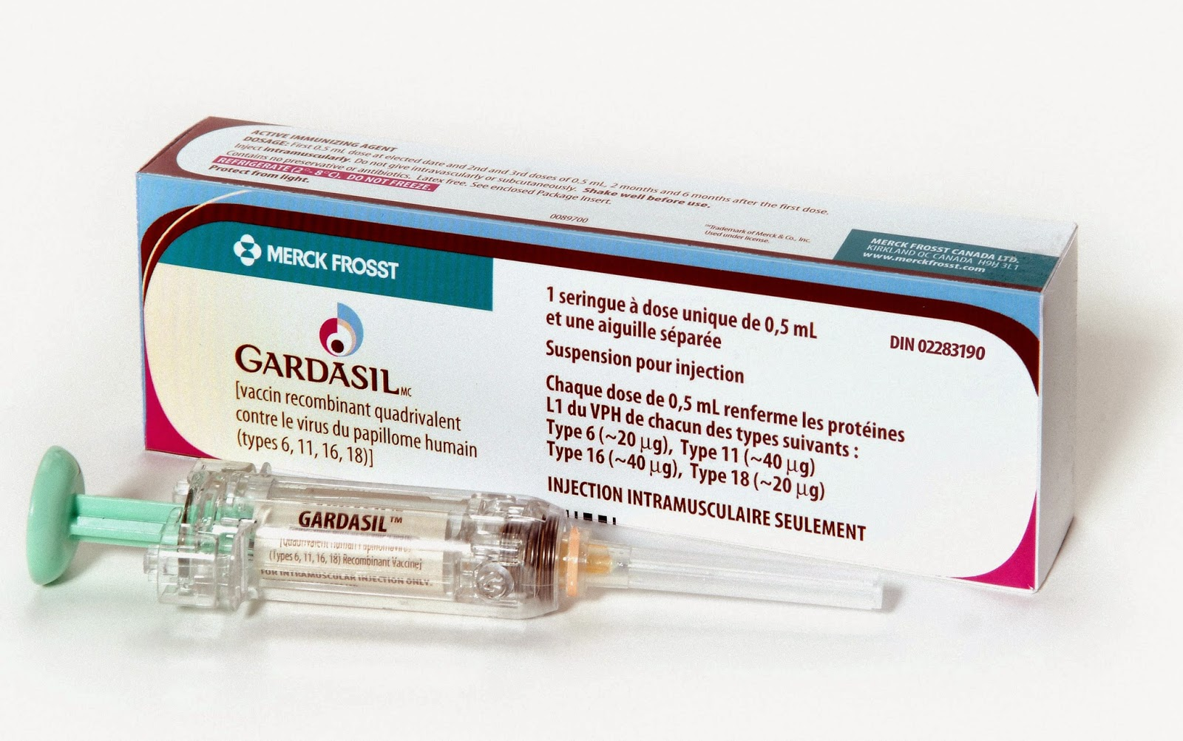
Overview of Problem
Human Papillomavirus (HPV) is the most common sexually transmitted infection in the United States.
Gardasil® 9 is the only vaccine available for use in the United States
  Given in a series of two or three shots
  Recommended for males and females aged 9 to 45 years
Number of adolescents receiving the initial vaccine are increasing, but problems persist
with completion of the vaccine series
(Centers for Disease Control and Prevention [CDC], 2018b; CDC, 2019; National Cancer Institution, 2019)
Notes:
HPV is the most common sexually transmitted infection in the United States that affects the genital area of both males and females including the skin of the penis, vulva, anus, and linings of the vagina, cervix and rectum.
HPV can be prevented by Gardasil 9, which is the only vaccine available for use in the United States. Gardasil works best if administered prior to any exposure to HPV. It is recommended for males and females aged 9 to 45 years of age. The CDC recommends administering the vaccine at the age of 11 and 12 years of age with other required vaccinations and prior to sexual activity. If given prior to age 15, the vaccine is only a two-dose series. If given after 15 years of age the vaccine is a three-dose series. Adolescents who receive their first HPV vaccine between 11 and 12 years of age must return for the second dose with a 6-12 months interval.
Since Gardasil 9 has been in use, HPV causing cancers and genital warts have dropped 86%.
Although the number of adolescents receiving the initial vaccine is increasing, problems still persist of the completion of the vaccine series. Data from the CDC in 2017, roughly 51% of adolescents still had not completed the HPV vaccines series. In 2018, data was similar in only 49% of adolescents had completed the vaccine. Healthy People 2030 target goal is 80%.

Slide 3
Clinical Significance
80 million Americans are infected with HPV
Approximately 14 million become newly infected every year
340,000 to 360,000 people were affected by HPV prior to the HPV vaccine
Fourth most common cause of cancer in women
Leads to various types of cancer
  90% anal and cervical cancer
  70% vaginal and vulvar cancer
  60% penile cancer
(CDC, 2019a; CDC, 2019c; World Health Organization [WHO], 2019)
Notes:
Approximately 80 million Americans are infected with HPV. About 14 million become newly infected every year. Before the HPV vaccine approximately 340-360,000 individuals were affected by genital warts related to HPV.
HPV is the fourth most common cancer in women with approximately 311,000 deaths and 570,000 newly diagnosed cases in 2018. HPV is so common that nearly all sexually active men and women become infected with at least one type of HPV at some point in their lives.
According to the CDC, HPV is responsible for more than 90% of anal and cervical cancers, 70% of vaginal and vulva caners, and more than 60% of penile cancer.
Reasons for HPV vaccine series completion is not completely understood. A study by Perkins et al. showed problems with communication between parents and providers. Providers expected parents and guardians to make follow up appointments while parents were expecting to be reminded when the next vaccine was due.

Slide 4
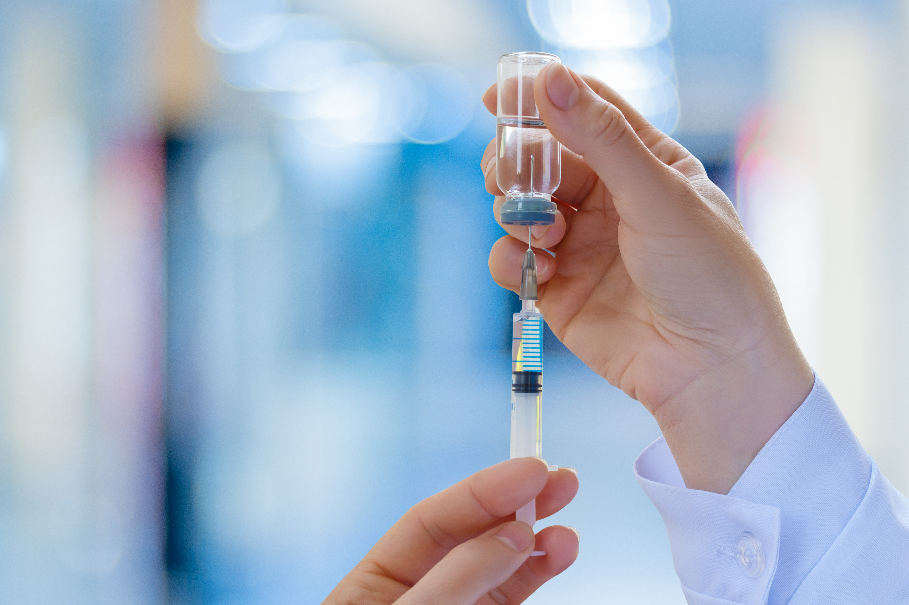
Project Purpose and Goal
  Implement an evidence-based intervention to improve HPV vaccine series completion rates among adolescents between 11 and 12 years of age.
  Increase HPV
  vaccine completion
  rates by 10% over a
  3-month period
Notes:
The purpose and goal of this quality improvement project is to improve HPV vaccine series completion rates by 10% among adolescents between 11 and 12 years of age over a 3-month period.

Slide 5
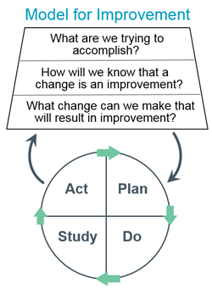
Guiding Framework
1. Set the aim
THINKING
part
2. Select measures
3. Develop ideas for change
Four steps for TESTING the ideas for change that's developed
DOING
part
Plan it, try it, observe the results, and act on what is learned
(Langley, et al, 2009)
Notes:
The Healthcare Improvement Model for Improvement was used as the guiding framework for this project. This framework is an integrated approach to process improvement that delivers quick and substantial results in quality and productivity in diverse settings.
The model is a two step process starting with three fundamental questions
1. What are we trying to accomplish?
2. How will we know that a change is an improvement
3. What change can we make that will result in improvement
From there, the second step consists of a PDSA cycle. Plan Do Study and Act. The PDSA can help determine whether there is an improvement change made. To accomplish the PDSA cycle one must form a team, set an aim/goal, establish measures, select what change needs to be made, test the changes, implement changes and spread the change.

Slide 6
PICOT Question
P: Population
C: Comparison
O: Outcome
T: Time
I: Intervention
“In adolescents in a school-based health clinic, how does the implementation of an evidenced-based appointment reminder intervention compared to current practice affect completion of the recommended doses of the HPV vaccine within three months?”
(Melnyk & Fineout-Overholt, 2019)
Notes:
Following the PICOT question approach, it allows an individual to search for the most relevant and current evidence –based practice recommendations through a structured approach. PICOT stands for Population, intervention or issue of interest, comparison, outcome and time. (Melnyk & Fineout-Overholt, 2019).
The prediction template for PICOT question formation I used to guide the search for literature was:
In _______ (P), how does ___________ (I) compared to ___________(C) influence __________ (O) during/over _______(T).
The PICOT question for this quality improvement project is : “In adolescents in a school-based health clinic, how does the implementation of an evidenced-based appointment reminder intervention compared to current practice affect completion of the recommended doses of the HPV vaccine within three months?”

Slide 7
Evidence
Search for evidence
Melnyk & Fineout-Overholt’s Rapid Critical Appraisal
JHNEBP Evidence Level & Quality Guide
JHNEBP Synthesis Process and Recommendations
Consistency & Strength of Recommendations
(Dang & Dearholt, 2018; Melnyk & Fineout-Overholt, 2019).
Notes:
A literature search was completed using the National Library of Medicine (PubMed), Cumulative Index to Nursing (CINAHL) and ScienceDirect. Keywords used were HPV (Human papillomavirus), vaccine and vaccinations, immunizations, adolescents, compliance text message reminders, and phone call reminders. There were 105 articles on PubMed, 26 articles on CINAHL and 1856 on ScienceDirect. After article titles and duplicates were reviewed and removed, 21 articles remained and were kept for further review. 15 articles were excluded for inconsistency of relationship to the PICOT question and unable to retrieve the full-text articles. The remaining 6 articles were kept and further reviewed.
All articles that were kept for further review met criteria to be critically appraised. Those articles were appraised using the rapid appraisal tools.
After evidence appraisal, the JHNEBP evidence level and quality grade was used to assign a level of evidence and quality grade for each article. The evidence level and quality grade uses a structured approach to acknowledge the different levels of strength and quality of evidence. The level of evidence is based off the study design and ranges from level I to level V, indicating the highest to lowest level of evidence. The quality grade is based upon the sample size, consistency of results, definitive conclusions and consistent recommendations. The quality grade ranges from A to C with A being high quality grade, B is good quality grade and C is low quality grade. Higher level of evidence with higher quality grades implies best practice and better recommendation for change.
Evidence was then synthesized to determine consistency and common findings to form recommendations for practice change supported by evidence using the JHNEBP Synthesis process and recommendation tool

Slide 8

STATEMENT 1:
  Strong and consistent evidence to recommend implementing text message reminders for parents/guardians and patients for upcoming appointments for HPV vaccine.
References in Support:
  Bar-Shain et al. (2015), Kharbanda et al. (2011), and Rand el al. (2016).
Notes:
The first statement of recommendation is that there is strong and consistent evidence to recommend implementing text message reminders for parents/guardians and patients for upcoming appointments for HPV vaccines.
This recommendation is supported by the evidence throughout the literature reviews listed in this slide.

Slide 9
STATEMENT 2:
  Strong and consistent evidence to recommend implementing phone call reminders for parents/guardians and patients to schedule appointment to complete HPV vaccine.
References in Support:
  Cassidy et al. (2014), Fu et al. (2014), and Rand et al. (2016).
Notes:
The second statement of recommendation is that there is strong and consistent evidence to recommend implementing phone call reminders for parents/guardians and patients to schedule appointments to complete vaccine series.
This recommendation is supported by the evidence throughout the literature reviews listed in this slide.

Slide 10

Project Setting
Vine School Health Clinic
  Serves a large population within Knox County from birth to 21 years of age
  Staff: 1 MD, 4 NPs, 1 RN, 2 LCSW, office manger and office assistant
  UT College of Nursing students
  Social work students
Notes:
The project will take place at Vine School Health Clinic which serves a large population within Knox County from birth to 21 years of age. The clinic is staffed with 1 medical doctor, 4 nurse practitioners, 1 registered nurse, 2 licensed social workers, an office manager and an office assistant. UT College of Nursing students and the social workers students from UT help staff in the clinic as well.

Slide 11
Project Stakeholders
Project Lead - DNP Student
Providers
Nursing Staff
Project Chair
Community Member
Statistician
Patients & Parents/Guardians
Notes:
Project stakeholders include the project lead, project chair, community member at Vine, the providers, nursing staff, statistician, patients, parents & guardians.

Slide 12
Ethical Consideration
Approval from Institutional Review Board (IRB) before project implementation
No patient identifiers, patient identification numbers given
Data collection stored on Excel – saved on OneDrive business account, password protected
Notes:
Data will be limited to patients between 11 and 12 years of age who have already received and completed the HPV vaccine series one year prior to implementation and the patients between 11 and 12 years of age who have received the first dose of the HPV vaccine series 6 months prior to implementation.
It is important to weigh the benefits against the risk when proposing an evidenced-based quality improvement project that utilizes human participants as the main subject. To ensure the safety and protection of the participants, I will seek approval from the Institutional Reivew Board before implementation. This will ensure that appropriate measures are taken to protect the rights and welfare of the human participants. The proposed project will involve accessing patient medical records and patient detectible information; therefore, seeking IRB approval is necessary. However, the overall data collected will include patient demographic information rather than patient identifiable information. It is projected that the proposed project will not require a full IRB review since it is a quality improvement project and not research.
No patient identifiers will be used on the data collection, each patient will be assigned a code number for collection purposes. Data collected will be stored on an excel document and saved to a password protect OneDrive business account through UTK. The project lead will be the only person with access to the spreadsheet linking codes to patient information.

Slide 13

Population
Educational Intervention Population:
Adolescent male and females between 11- and 12-years-old in the Knox Co. School district who have received their first dose of the HPV vaccine series

Slide 14

Intervention Implementation
Chart reviews
Text message reminders
Phone calls
Make appointments
Chart Reviews
Phone calls to set up vaccination appointments
Text message reminders
Notes:
The intervention aimed at a chart review of patients between 11 and 12 years of age who have received their first dose of the HPV vaccine and are within their six to 12 months window for their second dose will be contacted via telephone to schedule an appointment for their vaccine. At that time, a verbal consent will be obtained to send a follow-up text message appointment reminder two to three days prior to the scheduled appointment date.

Slide 15
Outcomes
RECHPV2 |  | Pre-intervention June 2019 – June 2020 | Post-intervention June 2020 – June 2021 | Total
Yes | Count | 4 | 23 | 27
 | % | 19.0% | 31.5% | 28.7%
No | Count | 17 | 50 | 67
 | % | 81.0% | 68.5% | 71.3%
Total | Count | 21 | 73 | 94
(p=.266) no statistical significantly difference, one sample Chi-square (p=0.006)
Notes:
The pre-intervention return rate for a second dose of the HPV vaccine was 19%, postintervention the return rate was 31.5%.
A Chi-square test was used to compare the number of patients who received the second dose of the HPV vaccine series compared to the patients who received the second dose after the quality improvement intervention was implemented. Although there was an increase in the number of patients who returned for their second dose, there was not a statistically significant difference in the return for the second dose pre- and postintervention (p=.266). A comparison of the overall number of adolescents who initiated the HPV vaccine series pre-intervention had increased from 21 adolescents to 72 adolescents. One reason, a statistical difference was not detected may be due to the smaller sample size in pre-intervention data (June 2019 – June 2020). Therefore, a One Sample Chi-Square test was run to test if the follow-up rate during the intervention was greater than the 19% rate. The follow-up rate was significantly higher than 19% for June 2020 – June 2021 (p=0.006). This quality improvement project indicated that more adolescents had chosen to receive their HPV vaccine in the post-intervention group.

Slide 16


Limitations
Small sample size
Ceased data collection
Global pandemic
Notes:
Several limitations occurred within the quality improvement intervention. The project took place at a single institution excluding any outlying facilities. The pre-intervention sample size was drastically smaller than the post-intervention sample size. The project was also implemented in the middle of a global pandemic (COVID), which impacted the number of patients who were willing to return to the clinic for their vaccination appointment. There were 30 out of the 73 post-intervention patients who did not answer the phone or call back to the clinic to schedule the appointment within the intervention time frame.
After the conclusion of the 3-month QI project, data was no longer collected. Therefore, it is unknown if any of the thirty post-data patients called back to schedule their vaccines. However, the clinic continued to use the text message reminder system to remind patient’s about coming appointments.

Slide 17
Conclusions
Evident that practice changes need to be made
Continuation of implemented project could benefit this clinical practice.
The total number of adolescents receiving the HPV vaccines are increasing.
Notes:
With the low national HPV vaccine series completion rates, it is evident that practice modifications need to be made. This evidence-based intervention showed a small increase in HPV vaccine completion rates can be made from minor practice changes. This intervention would benefit to be continued throughout this institution without the limitations listed above to investigate if the outcomes would increase with the number of patients who return for their vaccines. The overall number of patients who had received their first dose of the vaccine prior to the intervention was doubled with the patients used for the project. Therefore, the total number of adolescents receiving the HPV vaccine has increased.

Slide 18
Dissemination
Project presentation to stakeholders & project site
Submit to the Journal of Nurse Practitioners
Notes:
The project lead will disseminate results to the project stakeholders. The results will be disseminated to the project site through a presentation by the project lead.
The presentation will include project successes, limitations outcomes, opportunities for improvement and any further recommendations. This will allow for any feedback or discussion of the project related to the sustainability of the intervention.
If an in-person presentation is not feasible, a virtual presentation will be completed with the project stakeholders.
Depending upon the final results of the project, the project lead and project chair may discuss the possibility of submitting the project to a scholarly journal or professional organization for the possibility of publication.
Incorporating HPV phone call and text message appointment reminders into a clinical setting is not a new topic, the research on improving HPV vaccines in adolescents is an ongoing process. Providing any positive findings that could lead to incorporating more HPV appointment reminders into pediatric practices would be an important process for dissemination.

Slide 19

Questions?

Slide 20
References
Abraham, C., & Sheeran, P. (2007). The Health Belief Model. Cambridge Handbook of Psychology, Health and Medicine. (pp. 97-102). Cambridge: Cambridge University Press. https://doi.org/10.1017/CBO9780511543579.022
Bar-Shain, D. S., Stager, M. M., Runkle, A. P., Leon, J. B., & Kaelber , D. C. (2015). Direct messaging to parents/guardians to improve adolescent immunizations. Journal of Adolescent Health, 56(5), S21-S26. https://doi.org/10.1016/j.jadohealth.2014.11.023
Cassidy, B., Braxter, B., Charron-Prochownik, D., & Schlenk, E. A. (2014). A quality improvement initiative to increase HPV vaccine rates using an educational and reminder strategy with parents of preteen girls. Journal of Pediatric Health Care, 28(2), 155-164. https://doi.org/10.1016/j.pedhc.2013.01.002
Centers for Disease and Control Prevention. (2018, August 22). HPV and Cancer. https://www.cdc.gov/cancer/hpv/basic_info/
Centers for Disease and Control Prevention. (2019, March 26). Human Papillomavirus: Reasons to get vaccinated. https://www.cdc.gov/hpv/parents/vaccine/six-reasons.html
Centers for Disease and Control Prevention. (2019a, April 29). Human Papillomavirus: About HPV. https://www.cdc.gov/hpv/parents/about-hpv.html?CDC_AA_refVal=https%3A%2F%2Fwww.cdc.gov%2Fhpv%2Fparents%2Fwhatishpv.html
Centers for Disease and Control Prevention. (2019c, August 2). HPV and Cancer Statistics. https://www.cdc.gov/cancer/hpv/statistics/
Dang, D., & Dearholt, S. L. (2018). Evidence appraisal: Research. John Hopkins nursing evidenced-based practice: Model and guidelines (3rd ed. (p.97-144). Indianpolis, IN: Sigma Theta Tau International.

Slide 21
References (continued)
Fu, L. Y., Bonhomme, L. A., Cooper, S. C., Joseph, J. G., & Zimet, G. D. (2014). Educational interventions to increase HPV vaccination acceptance: A systematic review. Vaccine, 32(17): 901-1920. https://doi.org/10.1016/j.vaccine.2014.01.091
Kharbanda, E. O., Stockwell, M. S., Fox, H. W., Andres, R., Lara, M., & Rickert, V. I. (2011). Text message reminders to promote human papillomavirus vaccination. Vaccine, 29(14), 2537-2541. https://doi.org/10.1016/j.vaccine.2011.01.065
Langley, G. J., Moen, R. D., Nolan, K. M., Nolan, T. W., Norman, C. L., & Provost, L. P. (2009b). The Improvement Guide: A Practical Approach to Enhancing Organizational Performance (2nd ed). San Francisco, California. Jossey-Bass Publishers. http://www.ihi.org/resources/Pages/HowtoImprove/ScienceofImprovementHowtoImprove.aspx
Melnyk, B. M., & Fineout-Overholt, E. (2019). Evidence-Based Practice in Nursing and Healthcare (4th ed). Philadelphia: Wolters Kluwer.
National Cancer Institute. (2019, September 9). Human Papillomavirus Vaccines. https://www.cancer.gov/about-cancer/causes-prevention/risk/infectious-agents/hpv-vaccine-fact-sheet
Rand, C. M., Vincelli, P., Goldstein, N., Blumkin, A., & Szilagyi, P. G. (January 2017). Effects of Phone and Text Message Reminders on Completion of Human Papillomavirus Vaccine Series. Journal of Adolescent Health, 60(1): 113-119. https://doi.org/10.1016/j.jadohealth.2016.09.011
World Health Organization. (2019, January 19). Human Papillomavirus (HPV) and cervical cancer. https://www.who.int/en/news-room/fact-sheets/detail/human-papillomavirus-(hpv)-and-cervical-cancer

