Slide 1
University of Tennessee’s User-eXperience Lab (UXL)
Rachel Volentine, UXL Manager
College of Communications and Information
University of Tennessee
ESIP Usability Cluster
February 7, 2018

Slide 2
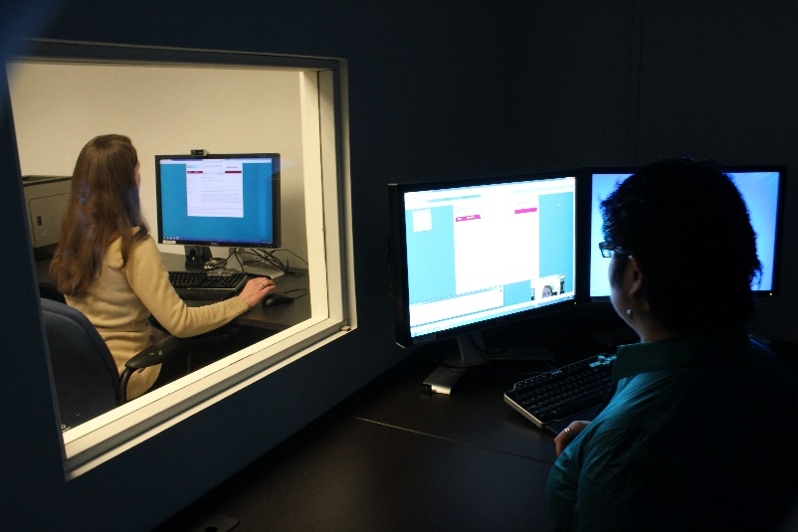
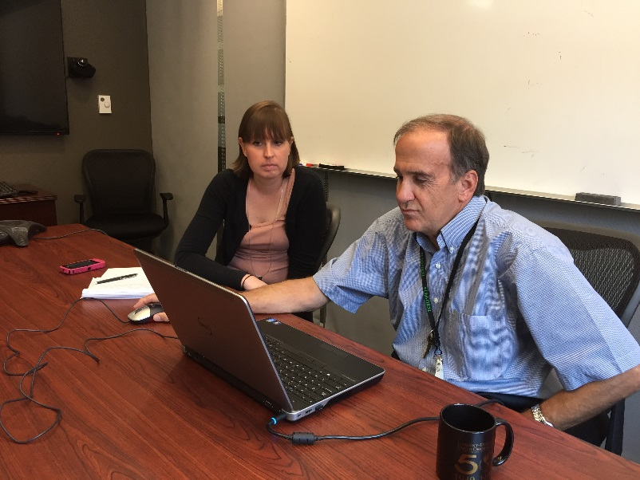
About the Lab
Founded in 2008
Collaboration between UT and ORNL
612 square feet
University of Tennessee, College of Communications and Information.
Capabilities for remote, portable, and in-lab UX testing
Open to UT faculty, students, organizations, and outside entities
Usability study in the lab
Usability study at ORNL

Slide 3
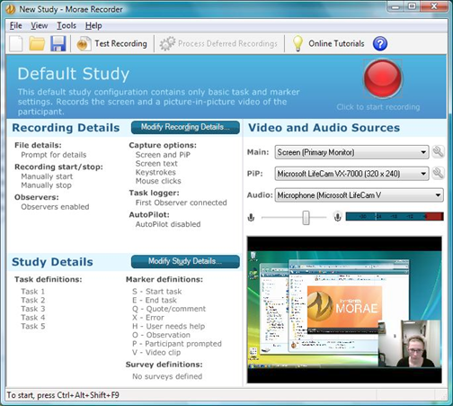
Morae Software
Morae Recorder
  Audio
  Video
  On-screen activity
  Keyboard/mouse input
  Preset study templates
Morae Observer
  Watch the experience
  Make notes

Slide 4
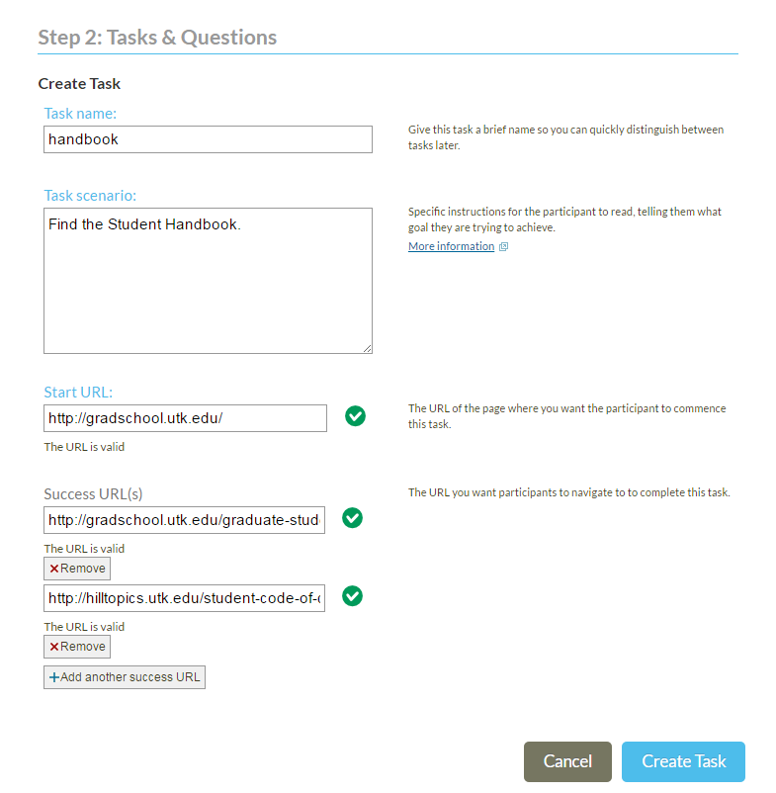
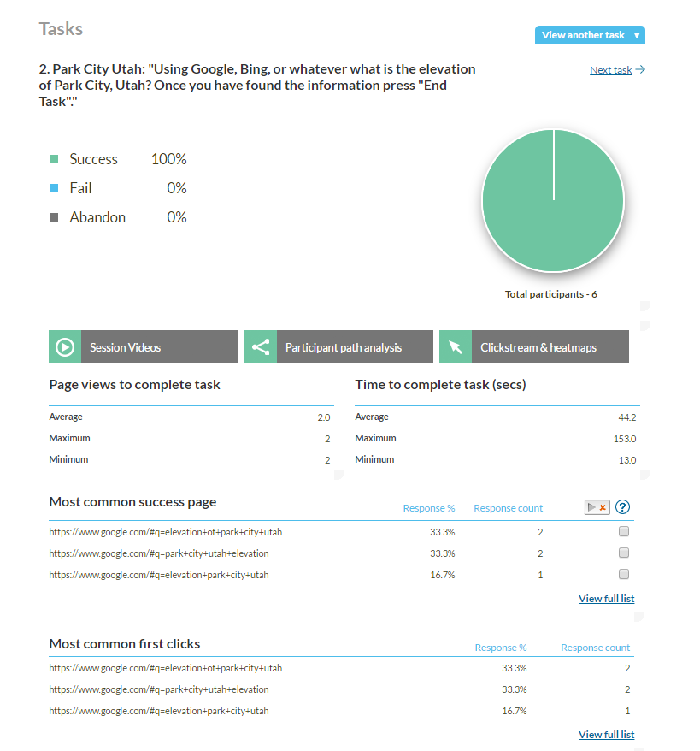
Loop11—Remote UX Software
Create usability test with tasks and questions.
User opens URL to take test.
Results analyzed in Loop11.
Monthly or yearly subscription.
Notes:
Collects:
Time completion rate (success vs fail)
Time to complete task
Most common success page
Most common fail page
Most common first click
Most common navigation path
Number of page views to complete task
Add JavaScript Code to website or user must download plug-in for browser
Benefits
Reach users regardless of where they live
Users can complete on their own time
Limitations
No think aloud so need to account for that missing piece

Slide 5
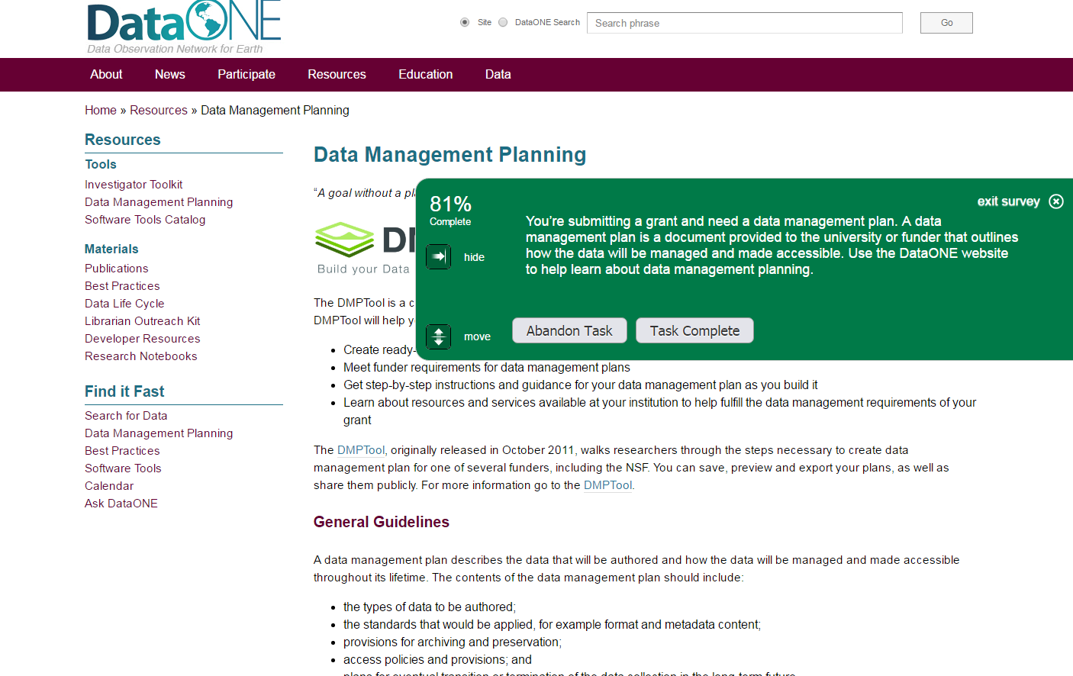
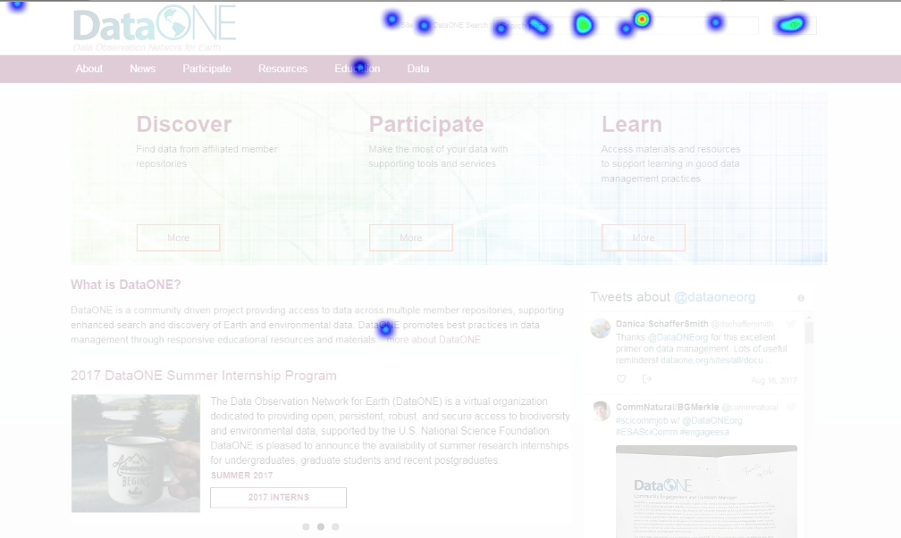
Example Project—How do non-native English speakers use the DataONE website?
Notes:
42 participants, Brazilian

Slide 6
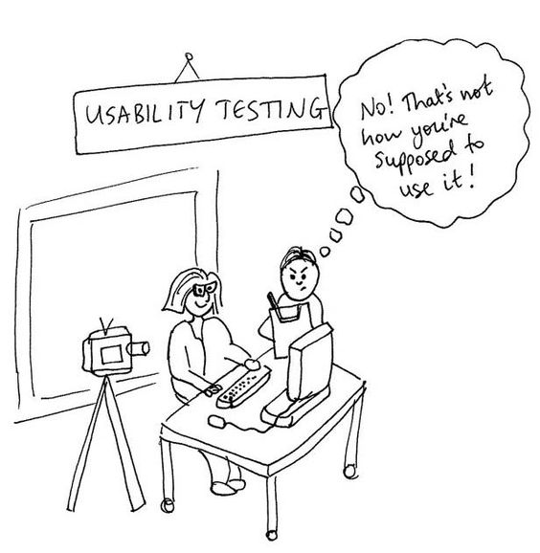
Tips for remote UX
Keep test short
Make sure to have follow-up questions (open-ended, rating, scale, etc.)
Time on Task doesn’t mean as much
Plan on iterative testing
Can be incorporated with in-person testing
Notes:
Can also use online meeting software to conduct simple UX tests (e.g., GoToMeeting, Zoom)

Slide 7
Practice Test:
https://www.dataone.org/?l11_uid=38598

