Slide 1
Sharing Data:
Practices, Barriers, & Incentives
Carol Tenopir
Jeffrey van der Hoeven
Jim Malone and Priyanki Sinha
Carole Palmer
ASIST 2011 Annual Meeting

Slide 2

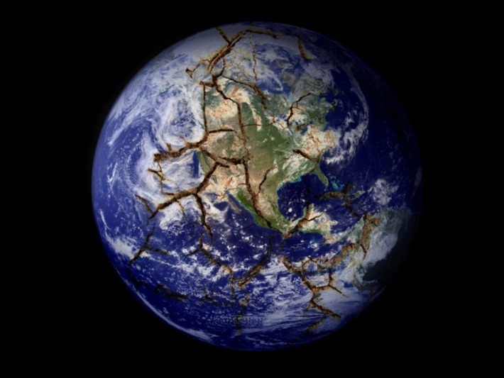


Slide 3

Data Life Cycle
Assure
Preserve
Discover
Integrate
Analyze
Collect
Describe
Deposit
Assessment

Slide 4
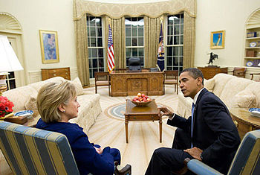
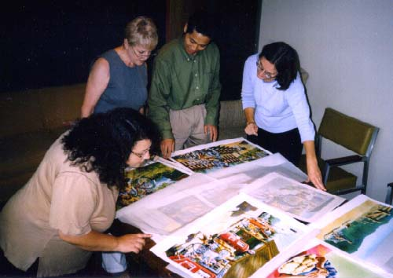
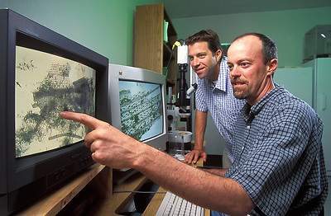




Data Stakeholders
Data Managers
Public Officials
Publishers
Scientists
Libraries
& Librarians
Citizen-scientists
Students
& Teachers

Slide 5

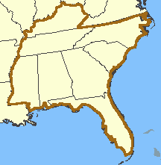

Data Observation Network for Earth (DataONE)
International
NSF
+1300 respondents
Increasing Biological Information Sources (IBIS)
Southeast US
USGS
+420 respondents
IBIS
Both use assessments to gain insights into scientists’ data and information practices and needs.

Slide 6

Lessons Learned
+
IBIS

Slide 7
Many scientists are interested in sharing and using a variety of types of data

Slide 8
Biodiversity Data Type Needed
IBIS

Slide 9
Data Types Used

Slide 10
Interest in Data Sharing

Slide 11
Gap Between Willingness to Share and Accessibility

Slide 12
2. There are barriers to data sharing and conditions that must be met.

Slide 13
Conditions for Data Sharing

Slide 14
Reasons for Not Making Data
Electronically Available

Slide 15
Satisfaction with Ability to Engage in Data Management Activities
 | % Government | % Academic
Satisfied with the process for cataloging/describing my data | 47.5 | 61.5
Satisfied with the tools for preparing my documentation | 33.7 | 45.6
Managing data during the life of the project | 52.4 | 39.6
Storing data beyond the life of the project | 53.3 | 34.6
Notes:
Academic respondents are more likely to have sole responsibility for approving access to some or all of their datasets.
Academic 83%, Government 63%

Slide 16
3. There are many ways that scientists can be assisted.

Slide 17
Importance of Information Tools
IBIS

Slide 18
Metadata Standards Currently Used

Slide 19
Importance of Information Source Criteria
IBIS

Slide 20
My organization provides…
 | % Government | % Academic
Training on best practices | 23 | 21
Funds for data management long-term | 27 | 20
Funds for data management short-term | 34 | 29
Tools and technical support for data management long-term | 39 | 34
Tools and technical support for data management short-term | 48 | 43

Slide 21
Data Stakeholders
Data Managers
Public Officials
Publishers
Libraries
& Librarians
Citizen-scientists
Students
& Teachers
Scientists

