Slide 1

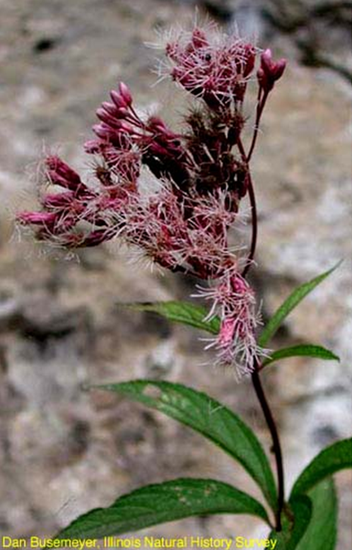
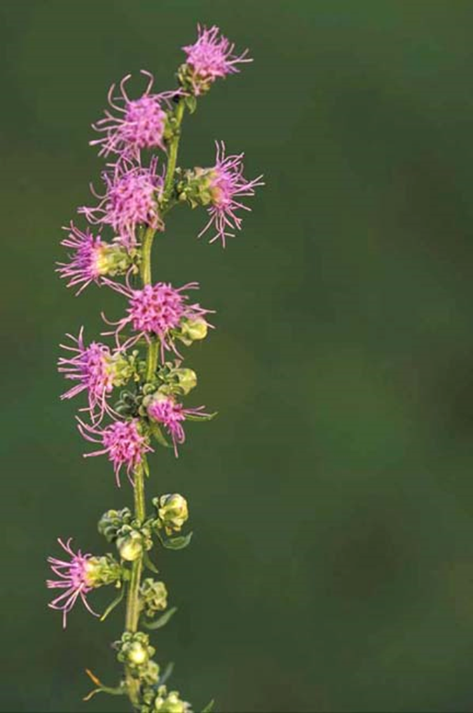
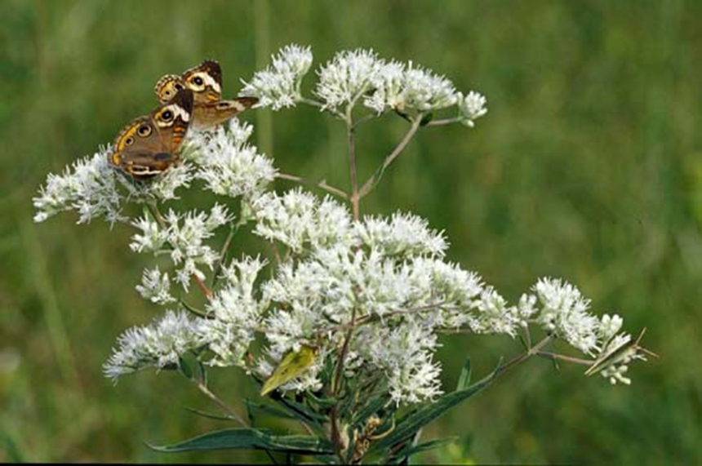
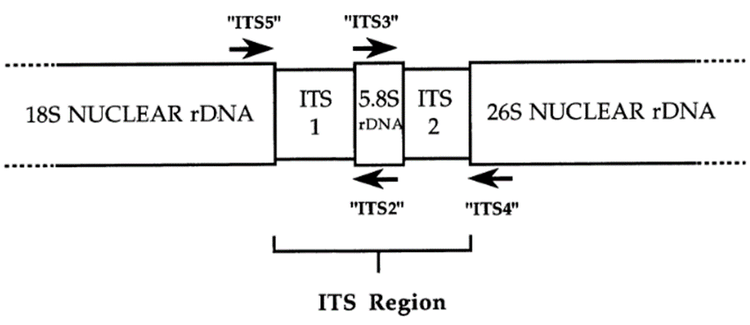
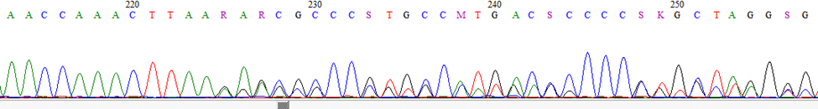
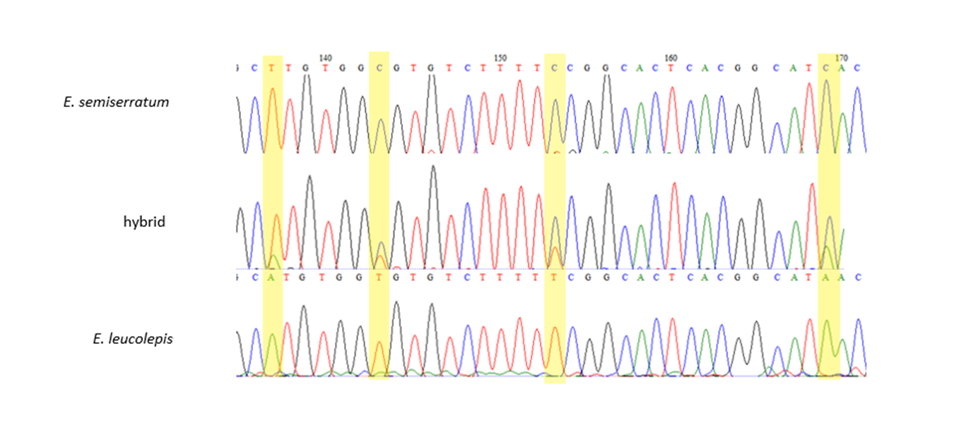
Molecular Barcoding of Eupatorieae of Tennessee
Magen Poindexter
Department of Ecology and Evolutionary Biology, University of Tennessee, Knoxville, TN 37996
Joe pye weed (Eutrochium maculatum) photo by Dan Busemeyer, from TENN herbarium website
Introduction
Eupatorieae: tribe of plants within Asteraceae family
150+ genera, 2400+ species worldwide
Many common wildflowers (joe pye weed, blazing star)
Popular sugar substitute, Stevia rebaudiana
8 genera native to Tennessee
Both sexual reproduction and apomixis
Hybridization is common
Goal: obtain molecular barcode data for each of the Tennessee native species
Barcode marker: nuclear DNA marker ITS
Purpose: facilitate identification, detect hybrids
Summary
Molecular analysis has become a popular method used to help characterize the complex biodiversity of our world. Our goal for this project was to add to the understanding of the biodiversity of Tennessee by obtaining molecular barcodes for all species of the Eupatorieae tribe native to this state. We did this by sequencing the ITS region of each species. These sequences will be submitted to GenBank, and will facilitate quick and easy identification of unknown specimens. We found that the ITS region can be used to identify this tribe to the genus level, and not all, but some of these genera can be identified to the species level with this barcode.
Eupatorium album (left) and Liatris aspera (right) photos by Thomas G. Barnes, from TENN herbarium website
Eupatorium in Tennessee
Eupatorium is the most abundant and diverse genus of the Eupatorieae tribe found in Tennessee. This genus reproduces sexually and through apomixis and contains nine species, plus several hybrid variants. One species, E. leucolepis, is currently recognized as a state endangered plant, occurring in only one county, hundreds of miles away from any other of its species. However, our molecular analysis suggests the Tennessee plants identified as E. leucolepis are actually of hybrid origin.
What is ITS?
Internal Transcribed Spacer of the nuclear ribosomal DNA
Commonly used barcode in plants
Always present in high copy number
Flanked by highly conserved 18S and 28S regions in plants (Figure 1)
How the new hybrid was found
DNA was extracted from two TENN herbarium specimens collected in Tennessee and identified as E. leucolepis. The sequences were analyzed using Bioedit and Sequencher software to identify single nucleotide polymorphisms (SNPs) and length polymorphisms. Due to the length polymorphism present in these sequences (Figure 3), BLAST results showed no close matches. The sequences were compared to a list of known Eupatorium sequences and were found to most closely resemble E. leucolepis in the region preceding the length polymorphism. However, the sequences also contained SNPs where the sequences matched both E. leucolepis and E. semiserratum (Figure 4). This, in combination with the length polymorphism allowed us to identify these samples as a hybrid.
Figure 1. Illustration of Internal Transcribed Spacer (ITS) region. Adapted from “The ITS Region of Nuclear Ribosomal DNA: A Valuable Source of Evidence on Angiosperm Phylogeny” by Baldwin et al., 1995, Annals of Missouri Botanical Garden 82(2) pp. 247-277.
Methods
Hypothesis: Each species of this tribe in TN will have a distinctive ITS sequence that will allow identification.
Obtained ITS sequence for each native species
Extracted DNA using Qiagen extraction kit
PCR amplified ITS region with ITS4 and ITS5 primers
Cleaned amplifications with Exosap
Sequenced in UT genomics core by Joe May
Analysis done on Sequencher and BioEdit
Maximum Likelihood Tree obtained using RAxML in Geneious (Figure 2)
Figure 2. Maximum Likelihood Tree generated with RAxML implemented in Geneious from ITS sequence alignments. Numbers following organism name indicate sample number used for analysis. Sequences for species without a sample number were obtained from GenBank. Polymnia represents an outgroup. This tree indicates that each genus has a distinct ITS sequence, making this region a suitable barcode for genus level identification. Species of some, but not all genera have distinct ITS regions.
Results and Discussion
We found that the ITS sequence can be used to identify this tribe to the genus level. It can also be used for identification at the species level for some, but not all. Ageratina shows no differences in the ITS region in any of the three native species. This could be due to recent divergence. Liatris and Eutrochium show ITS variation in some, but not all species. Eupatorium shows distinct ITS regions in all Tennessee species, and nearly every other species of this genus worldwide. This makes this molecular barcode an important tool in Eupatorium identification since hybridization is common in this genus. Eupatorium leucolepis samples from Tennessee appear to be of hybrid origin with E. semiserratum as the other parent. While E. semiserratum is known to hybridize frequently, this is the first time it has been seen to hybridize with E. leucolepis.
Figure 3. Short stretch of ITS sequence of Eupatorium leucolepis from Tennessee showing length polymorphism. The parent species have sequences of different length causing an echo in the sequence.
References
Baldwin, Bruce G., et al. "The ITS region of nuclear ribosomal DNA: a valuable source of evidence on angiosperm phylogeny." Annals of the Missouri Botanical Garden (1995) 82: 247-277.
Eupatorium, in Flora of North America. Vol. 21. pp. 456, 459
Schilling, Edward E., and Daniel E. Schilling. "A Novel Hybrid Apomictic Eupatorium (Asteraceae) from the Southern Appalachians." Castanea 80.4 (2015): 273-277.
Figure 4. Chromatograms showing the bases present in a short stretch of the ITS region of Eupatorium semiserratum (top), Eupatorium leucolepis (bottom), and a Tennessee sample identified as E. leucolepis (middle), but suggested by ITS data to be of hybrid origin of the two species. Highlighted areas show points in the hybrid sample where two bases are present, one from each of the parent species.

