Slide 1

Mashups: Supporting Music Communities @ Your Library
UT Libraries Diversity Committee
UT Libraries Diversity Committee Black Issues Conference Feb 18, 2012

Slide 2
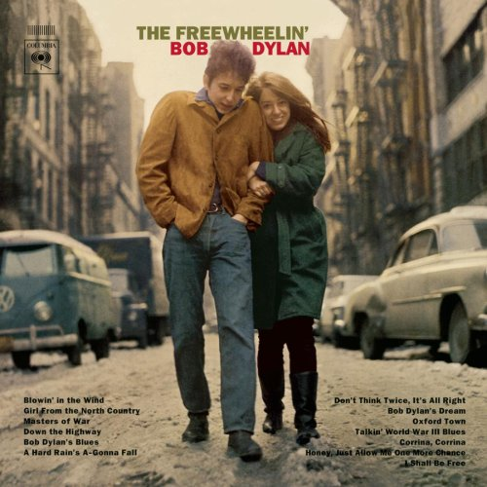
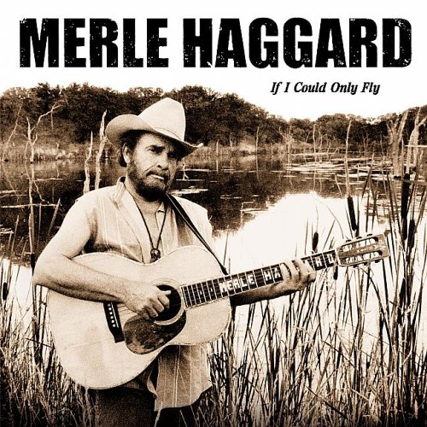
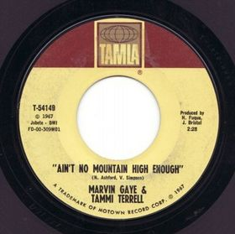
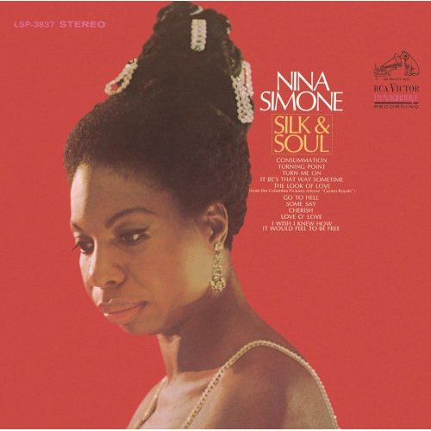
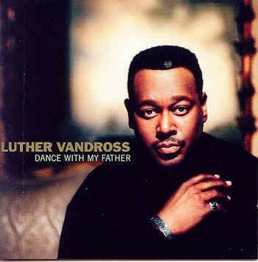

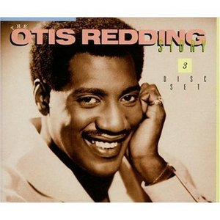
Library Diversity Committee
Marva Rudolph
Director of Office of
Equity & Diversity
Favorite Song: “Aint No
Mountain High Enough”
Thura Mack
Coordinator of Community Learning
Services @ Hodges Library
Favorite Artist: Bob Dylan
Jerry Roberson
Associate Professor
Large Animal Clinical Sciences
Favorite Artist: Merle Haggard
Rabia Gibbs
Digital Services and
Access Librarian
Special Collections
Favorite Artist:
Nina Simone
Anne Hulse
Programs Abroad
Coordinator
Favorite Artist:
India Arie
Elizabeth Young
Senior Library Associate II
Favorite Song: “These
Arms of Mine”
– Otis Redding
Annazette Houston
Director of Disability Services
Favorite Artist:
Luther Vandross

Slide 3
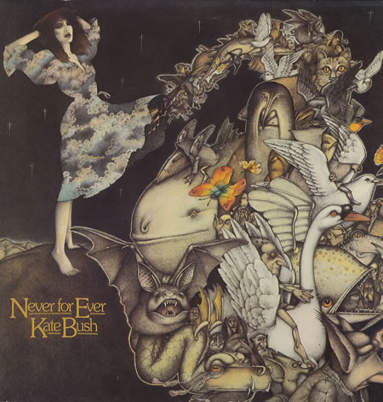

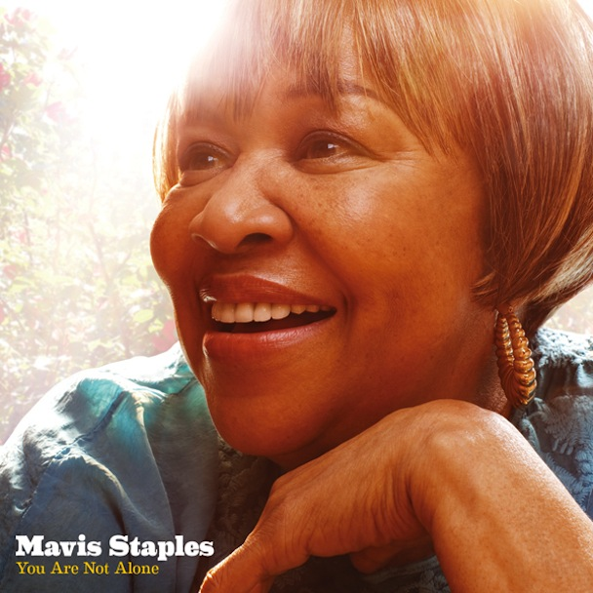


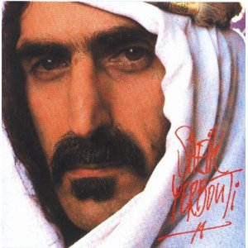
Library Diversity Committee - Presenters
Allison Sharp
Instructional Librarian
for Student Engagement &
Learning Technologies
Favorite Band: U2
Allison Roberts
Library Departmental Supervisor
Hodges Library
Favorite Artist: Kate Bush
Matt Jordan
Library Departmental Supervisor
George F. DeVine Music Library
Favorite Album: “You Are Not Alone”
- Mavis Staples
Laurie Roberson
Director of Student Services,
College of Architecture & Design
Favorite Song: “A New Day
Has Come” Celine Dion
Trey Hobson
Student in Psychology
& Sociology
Favorite Artist: R. Kelly
Michelle Brannen
Senior IT Technolgist II
The Studio @ Hodges Library
Favorite Artist: Frank Zappa

Slide 4

Resources at the Music Library
www.lib.utk.edu/music
UT Libraries Diversity Committee Black Issues Conference Feb 18, 2012

Slide 5
Poll
Have you ever been to the Music Library?
  Yes
  No
  I didn’t know we had a music library
?

Slide 6
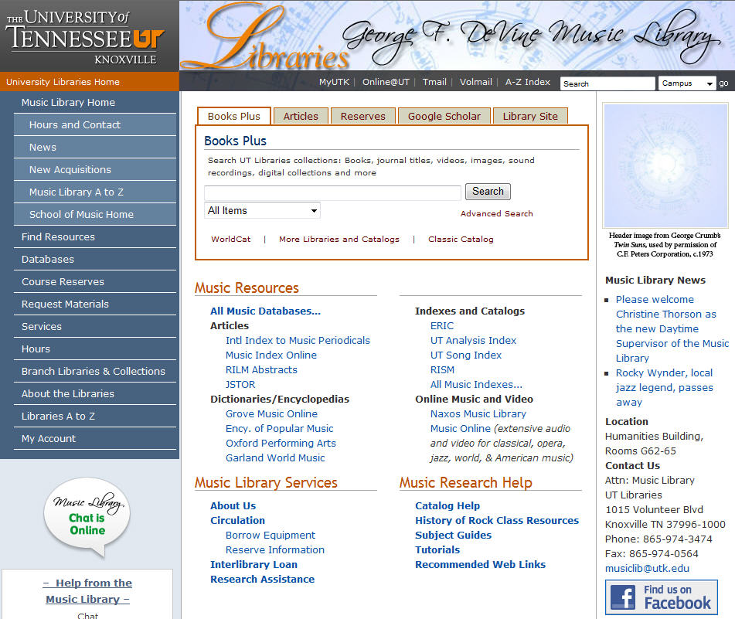
The UT Music Library
Find us online at http://www.lib.utk.edu/music/ or navigate to us through the main library website. Friend us on Facebook or follow us on Twitter
Call us at 974-3474, email us at musiclib@utk.edu, or chat with us from the link on our homepage
Or better yet, come visit us at the Humanities Building!
Notes:
-you can find extensive resources online or the physical collection at the library.
-Explain the move to the Humanities Building and where exactly to find us.

Slide 7

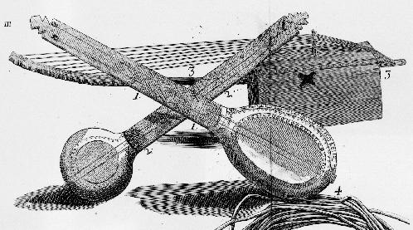
Musical traditions from Africa and Europe meet in America…
Check out Grove Music Online on our homepage: http://www.lib.utk.edu/music/
Notes:
--First, let’s just say that it’s nearly impossible to touch any genre of music in America without coming across African American influence. For example the modern day banjo finds its roots in a traditional African instrument. When musical traditions from Africa were carried over to the new world, some remained true, some were suppressed, and some evolved over time as they were influenced by European American musical traditions. In turn, European traditions evolved as well as they came in contact with African traditions. Many new genres were spawned that we count as part of the uniquely American musical tradition.
--Grove Music Online is the standard Music encyclopedia. So if we go to our homepage and click on the link and type in African American, we can find an historical overview.
--But some of the genres often originally associated with African Americans include: Jazz, Blues, R&B, Soul, Rap, Hip-hop, Black Gospel. And we have a wide representation of genres across all of our resource formats. Not everyone is even aware of the Music Library on campus, and even the ones that our collection covers a wide spectrum, not just classical and band music.

Slide 8

Reference Books
Examples include:
The Biographical Encyclopedia of Jazz
Encyclopedia of Rap and Hip Hop Culture
International Dictionary of Black Composers
A Blues Bibliography
Notes:
--These books are for basic reference and stay in the library

Slide 9

Circulating Books
Keep on Pushing: Black Power Music from Blues to Hip Hop
Blues Empress in Black Chattanooga : Bessie Smith and the Emerging Urban South
When the Church Becomes Your Party : Contemporary Gospel Music
Way up north in Dixie : a Black Family's Claim to the Confederate Anthem
Notes:
--These books can be checked out.

Slide 10
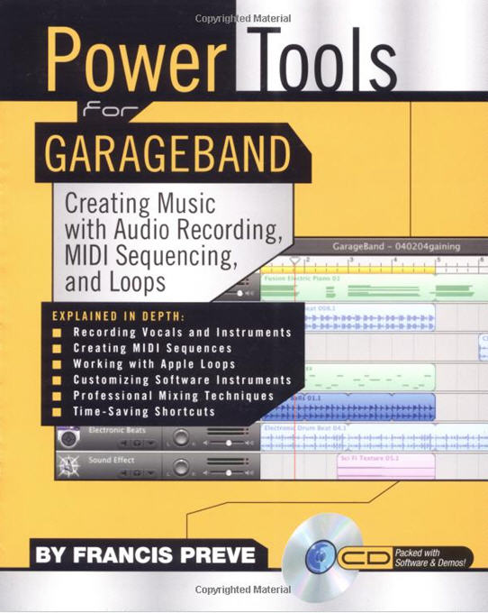
Instructional Books & Creating Music
Power tools for GarageBand: creating music with audio recording, MIDI sequencing, and loops
Bastien Piano for Adults: A Beginning Course- Lessons, Theory, Technique, Sight Reading
The Electric Guitar : How to Find the Sounds You Like
Teaching Music Through Performance in Choir
Notes:
Studio has a better collection of software how-to books, and Michelle will talk more about them during her part of the presentation…

Slide 11
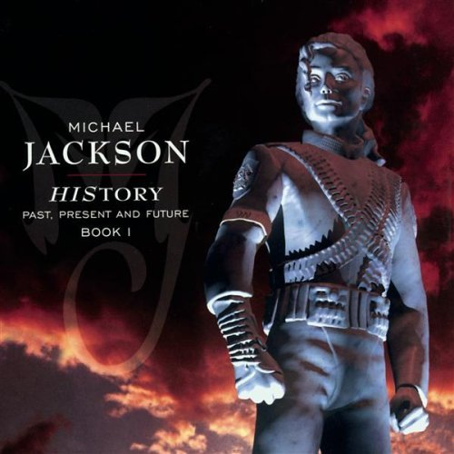
Scores & Sheet Music
Billie Holiday Anthology : Lady Sings the Blues
Hip-hop & rap : complete lyrics for 175 songs
W. C. Handy's Second Collection of 37 Spirituals
Count Basie Collection
History, Past, Present and Future: Songs of Michael Jackson
Kind of Blue: Miles Davis

Slide 12

Compact Discs
A Festive Sunday with William Grant Still
Carolina Chocolate Drops: Dona Got a Ramblin' Mind
Mahalia Jackson's Greatest Hits
Head Hunters: Herbie Hancock
Teenage dream: Snoop Dogg, Katy Perry
http://www.lib.utk.edu/music/
Notes:
--Circulation policy: 3 CDs at a time for 3 days, unlimited for faculty
--Show how to look up in catalog/Primo – use Booker T. Jones, Trombone Shorty, and the most recent Roots album “Undun” as recent purchases
--Or you can come in and browse the CD stacks…

Slide 13

DVDs
Sweet old song: Louie Bluie (Howard Armstrong)
The Gershwins' Porgy and Bess
Through many dangers: the Story of Gospel Music
Ken Burns Jazz: The Story of America’s Music
Notes:
--includes feature films, live performances, histories, etc
--Circulation policy: 3 DVDs at a time for 3 days, unlimited for faculty

Slide 14
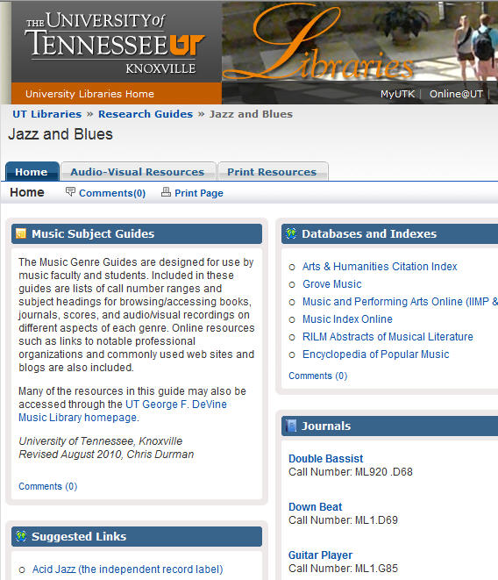
Subject Guides
Jazz and Blues
Rock Music
Sacred Music
Women in Music
World Music, Folk Music, and Ethnomusicology
Resources for Careers in Music
--Music Business: The Key Concepts
--Garage to gigs: a musician's guide
--Hip-hop, inc.- success strategies of the rap moguls
--The big payback: the history of the business of hip-hop
http://www.lib.utk.edu/music/
Notes:
--As for other music business resources, we have an assortment of other things not on this subject guide if you do some searching in the catalog, like “Music Business: The Key Concepts” and “Garage to Gigs: A Musician’s Guide”.
--Or type in hip-hop into the catalog and you’ll get things like “Hip-hop, Inc.- Success strategies of the rap moguls” and “The Big Payback: the history of the business of hip-hop”

Slide 15
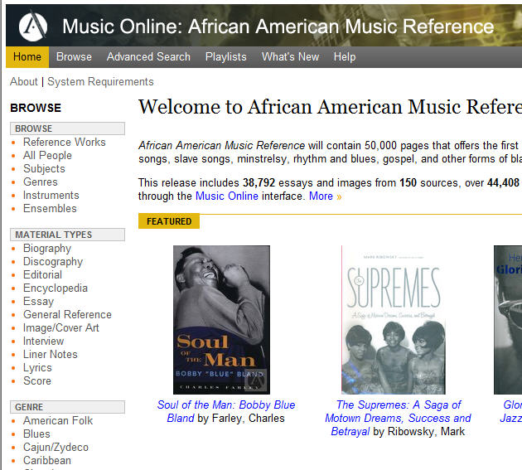
Online Research Databases
African American Music Reference
Grove Music Online
Encyclopedia of Popular Music
International Index to Music Periodicals
Notes:
African American Music Reference will contain 50,000 pages that offers the first comprehensive coverage of blues, jazz, spirituals, civil rights songs, slave songs, minstrelsy, rhythm and blues, gospel, and other forms of black American musical expression.
This release includes 38,792 essays and images from 150 sources, over 44,408 pages.

Slide 16
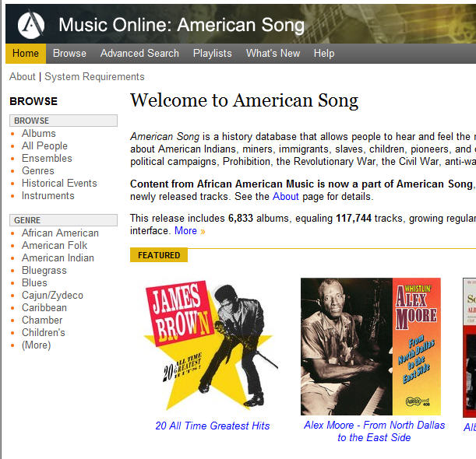
Streaming Audio & Video Databases
Music Online (covers all musical genres, including historical recordings)
Naxos Music Library (all genres, including Naxos Jazz)
Smithsonian Global Sound
American Song (which absorbed African American Music database)
http://www.lib.utk.edu/music/
Notes:
--You can find the content of the original African American Music database by clicking on our Music Online link on our homepage. You can search for specific pieces of music or musicians, or browse by genre.
--You can also access videos through the online catalog (show Jimi Hendrix Monterey example – and open in new window)

Slide 17
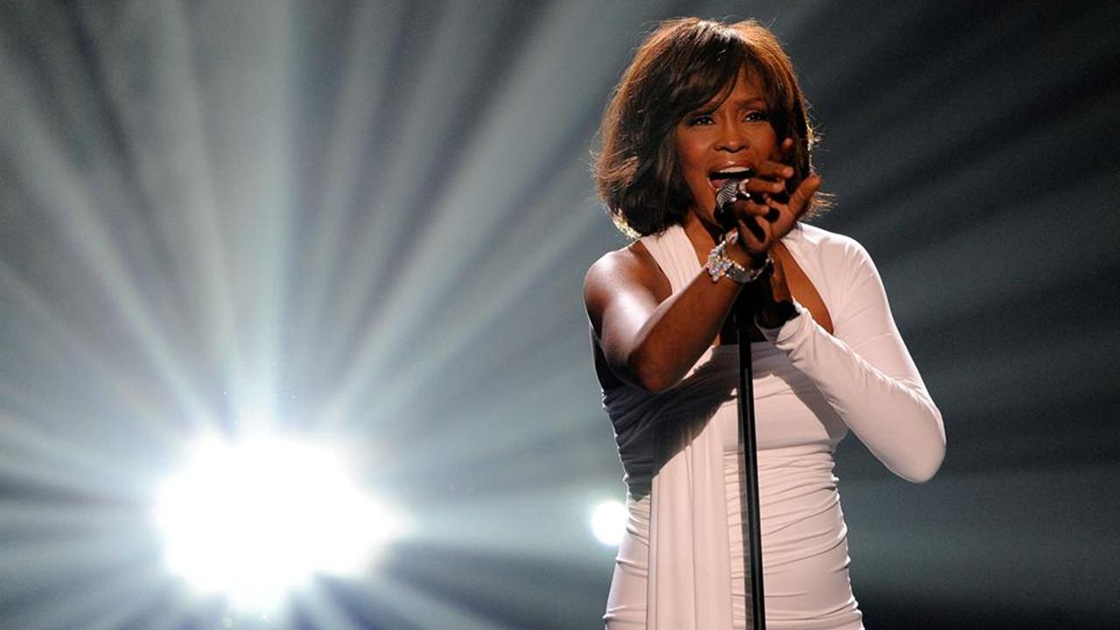
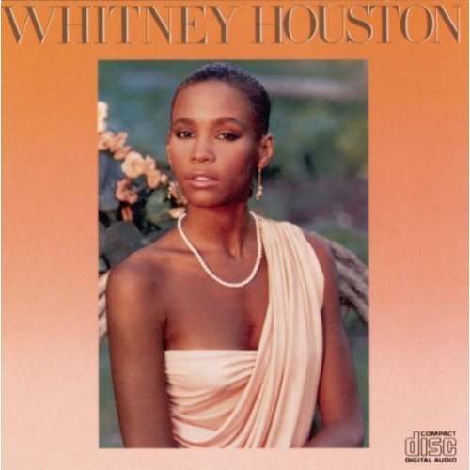
A Little Love for Whitney
http://www.lib.utk.edu/music/
Notes:
--(Look up Whitney Houston in Primo.) We do have her self-titled album, The Soulful Divas book, the Waiting to Exhale video. After she passed, we decided to purchase some of her other albums.
--But if you go to the Encyclopedia of Popular Music, you’ll find subject entries for her that include her history, discography, videography, filmography, etc. And in International Index to Music Periodicals, you can find journal articles, reviews, and all sorts of other things…

Slide 18
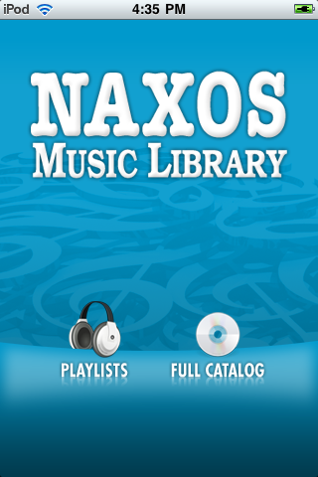
Music Databases on Mobile Devices
UT Libraries Diversity Committee Black Issues Conference Feb 18, 2012

Slide 19
Poll
What device did you last listen to music on?
  iPod or mp3 player
  Car stereo
  Streaming on computer (i.e. Pandora)
  Live performance
  8-track tape deck
  Other
?

Slide 20
Resources in The Studio
www.lib.utk.edu/studio
UT Libraries Diversity Committee Black Issues Conference Feb 18, 2012
Notes:
Media production lab – examples of types of projects
Location – 245 Hodges Library inside Media Center
Hours – until 3am all nights but Fri and Sat

Slide 21
Poll
Have you ever been to the studio?
  Yes
  No
  What is the studio?
?

Slide 22
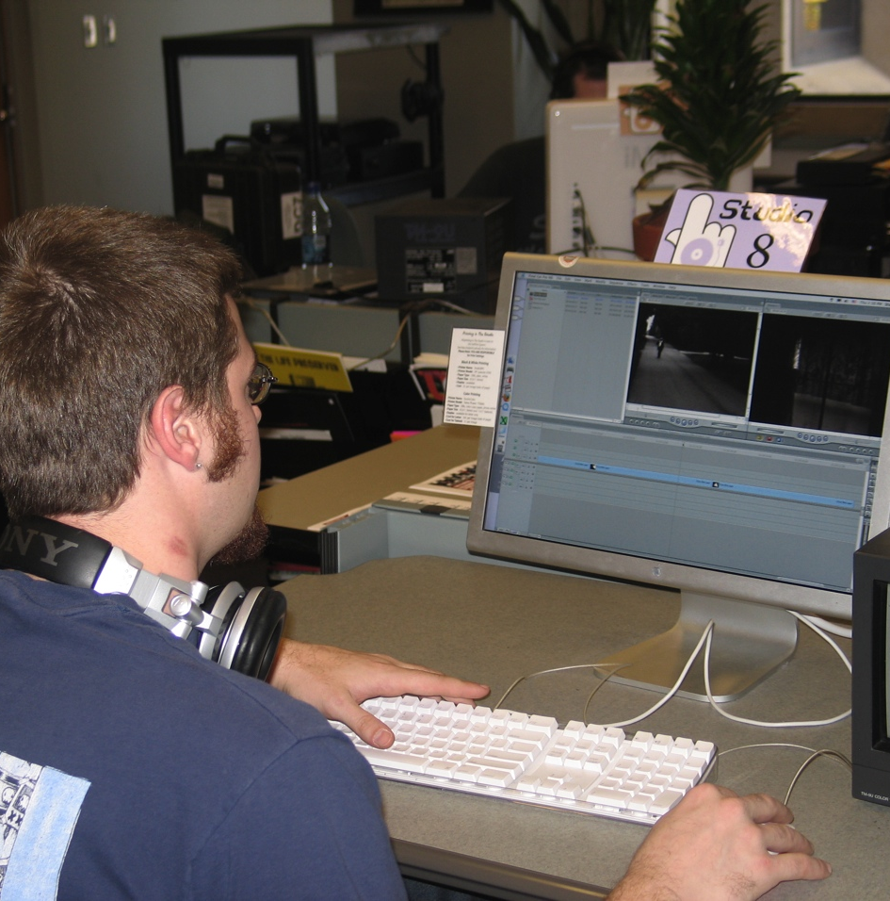
Media Production
Audio, video, and graphics workstations
Input equipment
Industry standard software
Learning resources
Notes:
Audio, video, and graphics workstations
Input equipment including scanners, media converters, microphones, decks, etc.
Industry standard software
Short courses, consultation, help desk, reference collection

Slide 23
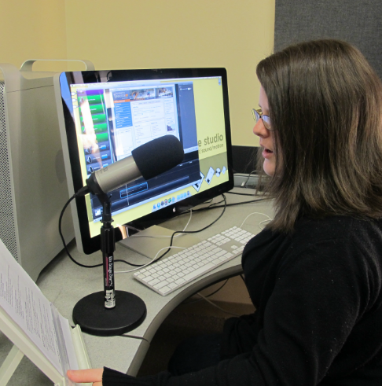
Sound Rooms
2 rooms for sound recording
Software for recording and editing sound includes:
  GarageBand
  Pro Tools
  Logic
USB and XLR microphones
USB keyboards
Notes:
Sound rooms used for a range of purposes from recording voice over for video projects to completing language class assignments to recording music
USB mics used for much recording
Keyboards, XLR mics and racks to plug in your equipment available
Full mic stands and table top mic stand available

Slide 24
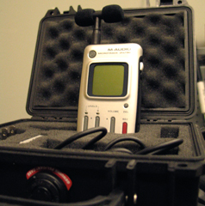
Checkout Equipment
Checkout for 1-3 days
Reserve in advance
Certification required for checkout
Equipment Available:
  Digital Audio Recorders
  Video Cameras
  Digital & SLR Cameras
  Lighting Kits
  Green Screens
  etc.

Slide 25
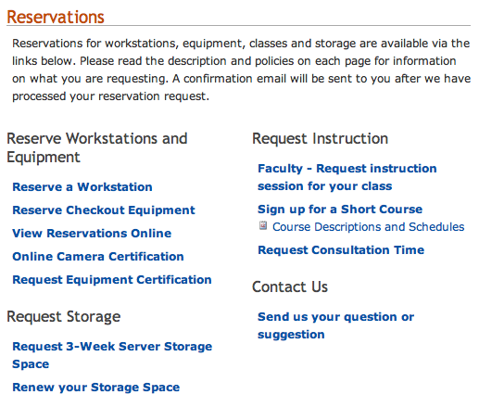
Reservations
Reservations can be made in advance by phone, email, or at The Studio desk
Checkout equipment can be reserved for up to 3 days
Reserve workstations for times you are available
Sound rooms are popular – reserve in advance

Slide 26
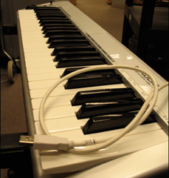
The Studio: Student Perspective
UT Libraries Diversity Committee Black Issues Conference Feb 18, 2012
Notes:
Media production lab – examples of types of projects
Location – 245 Hodges Library inside Media Center
Hours – until 3am all nights but Fri and Sat

Slide 27
Poll
Have you ever recorded music?
  Yes
  No
  Want to but don’t know how
?

Slide 28
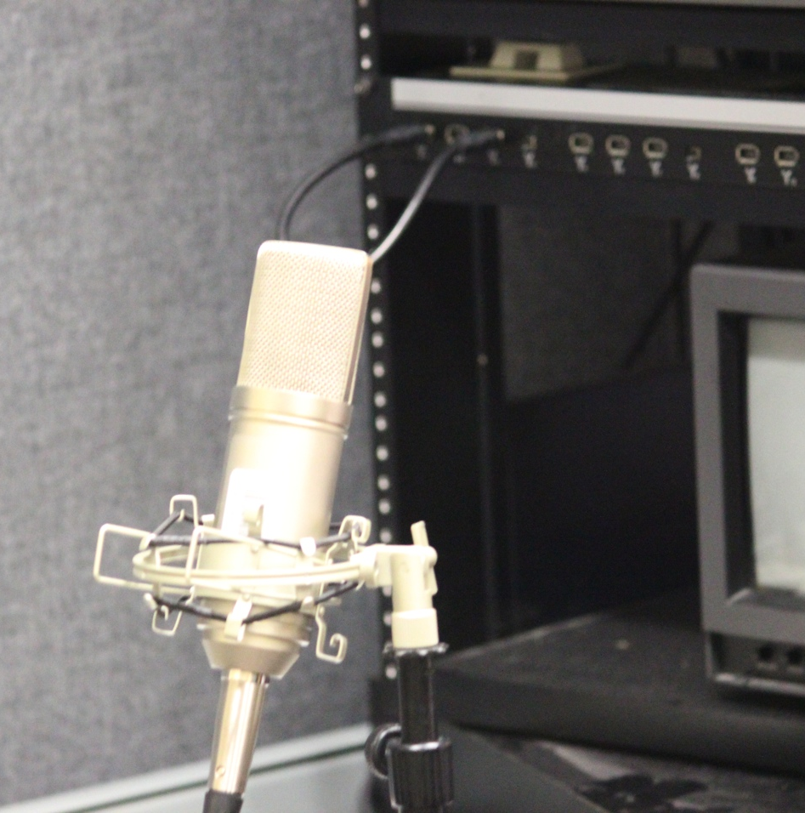
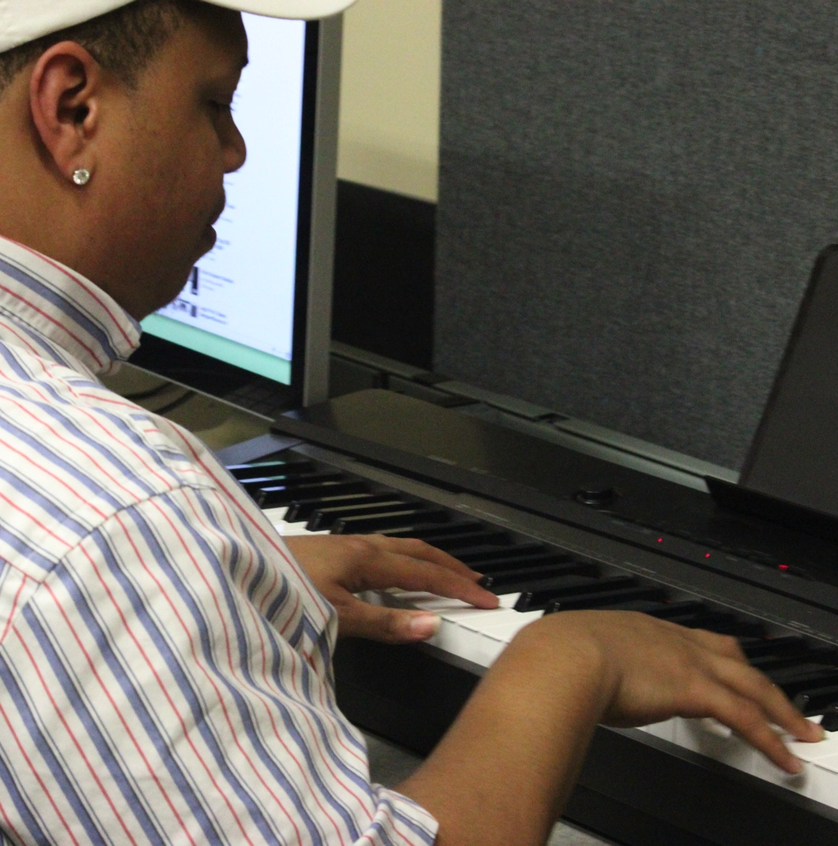
Using the Sound Rooms

Slide 29
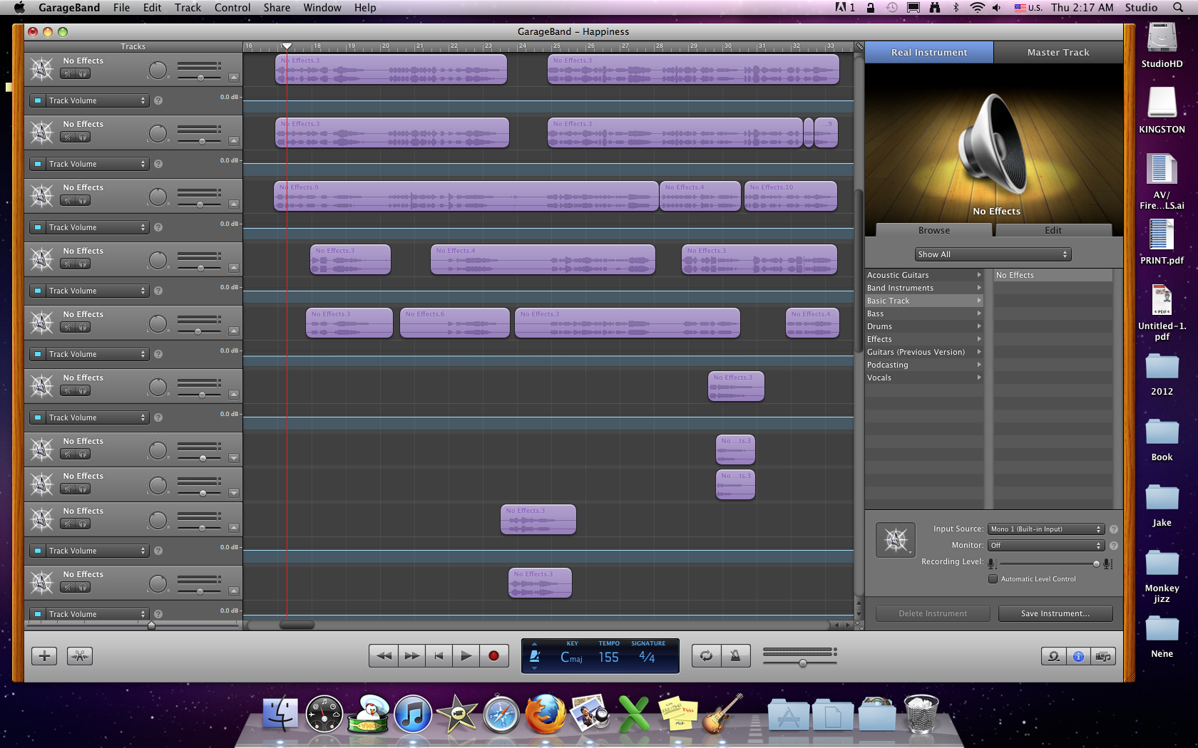

Trey’s Music
“Happiness” by Trey Hobson

Slide 30
Thank you for attending our program
UT Libraries Diversity Committee
Questions?
Door prize
UT Libraries Diversity Committee Black Issues Conference Feb 18, 2012

