Slide 1
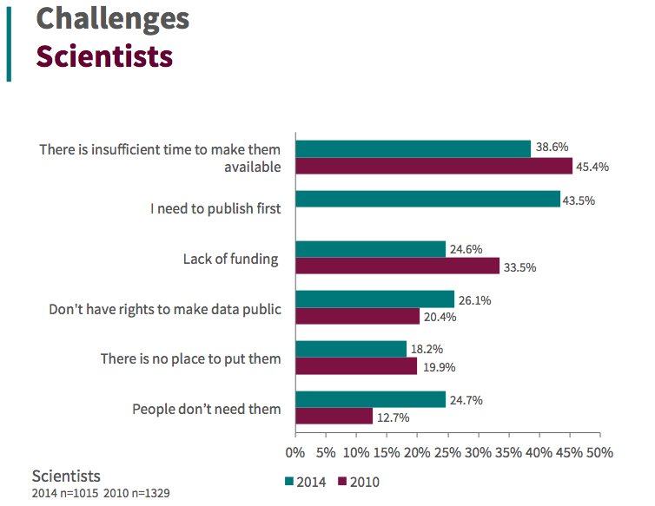
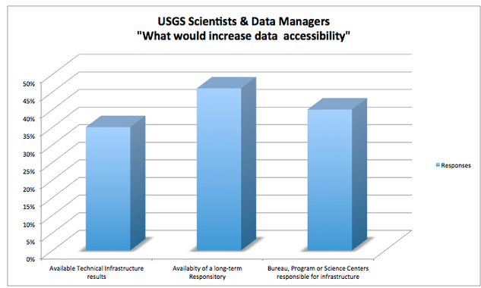
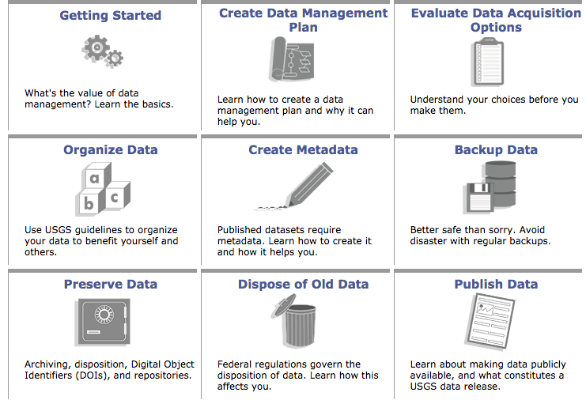
Assessing Stakeholders to Inform Open Science Policies:
The Case of the U.S. Geological Survey
Mike Frame, mike_frame@usgs.gov; Lisa Zolly, Lisa_Zolly@usgs.gov; Carol Tenopir, ctenopir@utk.edu; Suzie Allard, sallard@utk.edu
Librarians & Data Managers are Critical
Need for Authoritative, Centrally Available Guidance, Training, Infrastructure and Best Practices for Management & Delivery of Data
What Scientist Say Are Challenges
The nature of nature of scientific discovey is that scientists are more focused on their research rather than on determining how to comply with recent open access regulations
US Federal Regulations
USGS Polices Best Practices
Mandate digital open access to publications and research data that represent the outcomes of federally funded science.
Increasing Access to the Results of Federally Funded Scientific Research, February 22, 2013-- U.S. Office of Science and Technology Policy
Open Data Policy—Managing Information as an Asset, May 9, 2013--Office of Management and Budget
Supported by a variety of training, informational materials, and cyberinfrastructure
Facilitating compliance with federal open science regulations, while remaining
Remains sensitive to the realities of science practice
QQML, Limerick
May 2017

