Slide 1
Digital Showcase in the Library
How Trace enhances UT’s Virtual Library

Slide 2
The Virtual Library – a few definitions
  A set of electronic resources for creating, searching, and using information constructed by and for a community of users (Borgman 2007, 17-18)
  An information network overlay that facilitates the creation of collaborative and contextual knowledge environments (Lagoze et al. 2005)

Slide 3
The UT Virtual Library
Enhance the library’s virtual presence through efficient searching capabilities, interactive features, archiving services, tools for discovery and delivery of scholarly resources, and new technologies that advance and scale services.
(Virtual Library Steering Committee Charge, February 18, 2009)
…an evolving concept defined by and for UT’s user communities: collaborative, discoverable, contextual, interactive
Notes:
So where does Trace fit in the virtual library? After the VLSC charge, it enhances the library’s virtual presence – with searching, interactive, and archiving features. Clearly, an evolving concept.

Slide 4
Trace: UT’s Digital Showcase
Vision
“Trace acquires, organizes, preserves, and provides access to the intellectual capital that makes Tennessee a leader in research and teaching. These services highlight UT's prominence in advancing knowledge globally.” (“About Us” http://trace.tennessee.edu/about.html)
Born-digital preservation and archiving tool
Advance UT’s institutional profile
Increase exposure to and dissemination of faculty research
Notes:
Trace’s vision is to promote UT’s intellectual capital. How does Trace achieve these services? [click]

Slide 5
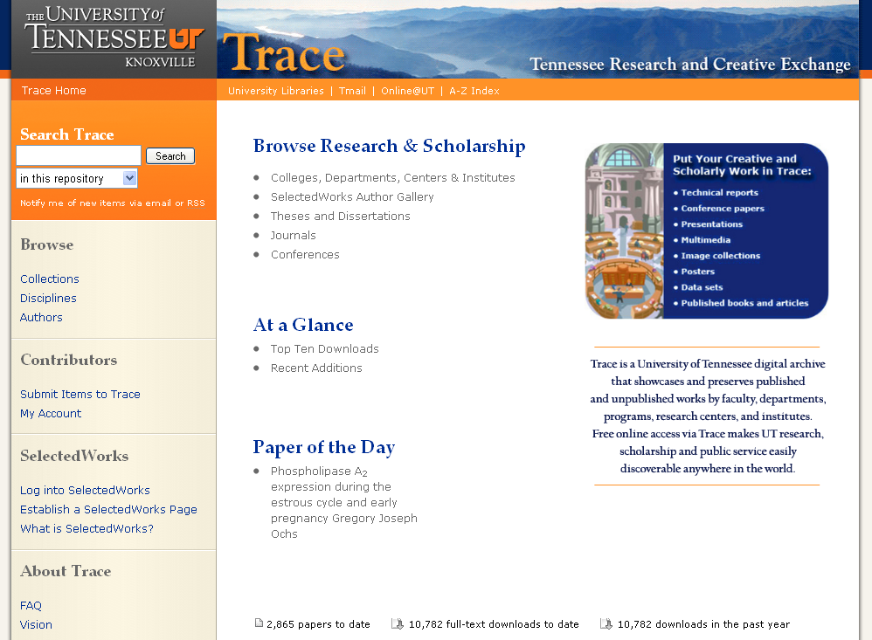
Trace: UT’s Digital Showcase
Notes:
Here’s an introduction Today we’re actually over 2800 papers and 10,000 downloads. [click] Trace allows full-text searchability, and [click] links to SW faculty profiles.

Slide 6

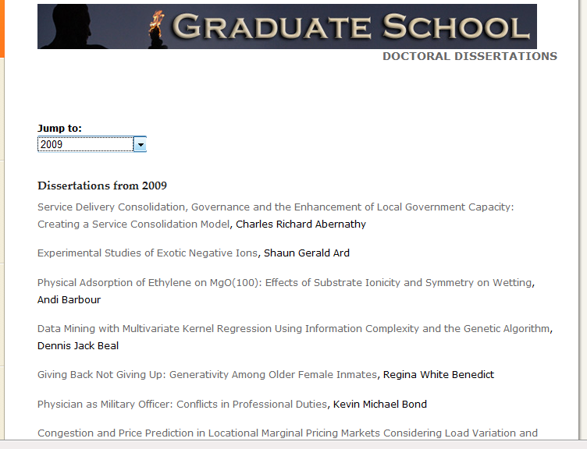
Trace: UT’s Digital Showcase
Highlights
ETDs
Notes:
Here are examples of content Trace provides. Electronic Theses & dissertations [click]

Slide 7

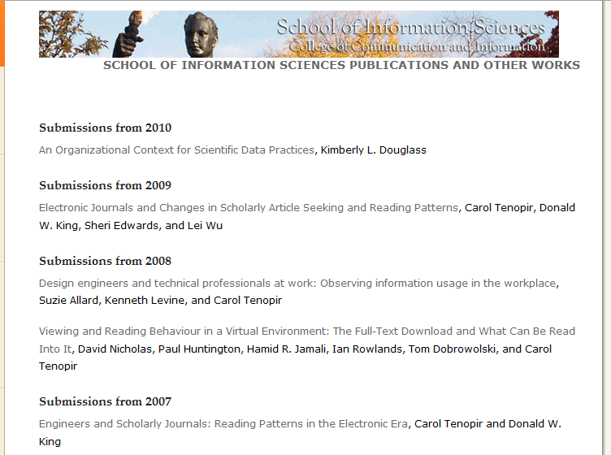
Trace: UT’s Digital Showcase
Highlights
Campus Collections
Notes:
Here are examples of content Trace provides. Campus collections [click]

Slide 8
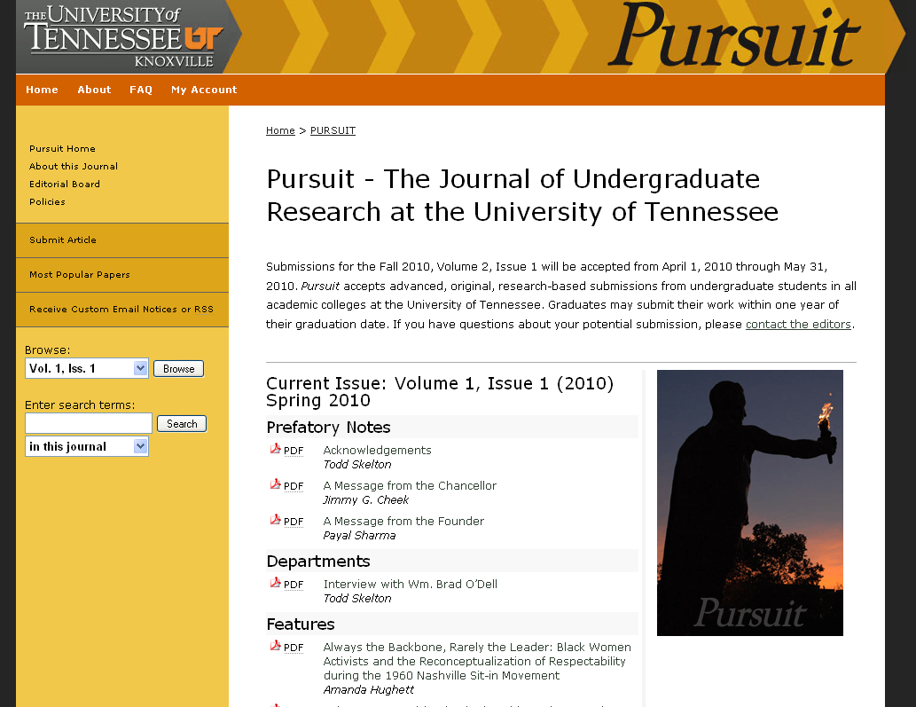
Trace: UT’s Digital Showcase
Highlights
Journals
Notes:
Here are examples of content Trace provides. Journals – we have 3 now: Pursuit (Undergrad research), Transactions (law review), Intl Ed (cultural studies)

Slide 9

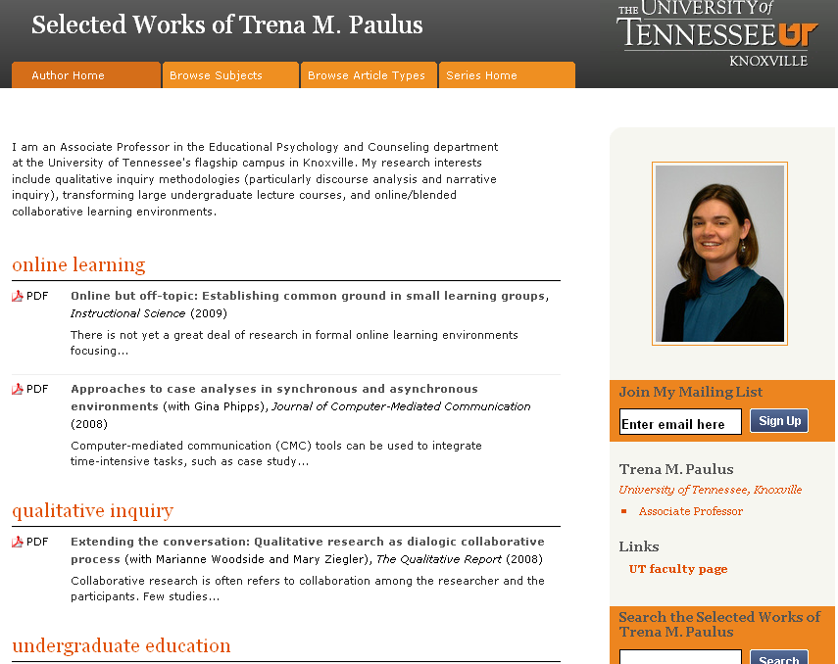
Trace: UT’s Digital Showcase
Highlights
SelectedWorks Profiles
Notes:
Here are examples of content Trace provides. SW are faculty personal profile pages that showcase faculty publications and creative output. These pages stay with faculty if they change institutions (which helps win them over!).

Slide 10
Trace in the Virtual Library
The content is:
Discoverable
Collaborative
Contextual
Networked
Notes:
How can Trace enhance UT’s Virtual Library? By providing digital content that is [click] discoverable on multiple engines [click] collaborative involving users and stakeholders [click] contextual within larger institutional frameworks and [click] networked within institutions

Slide 11
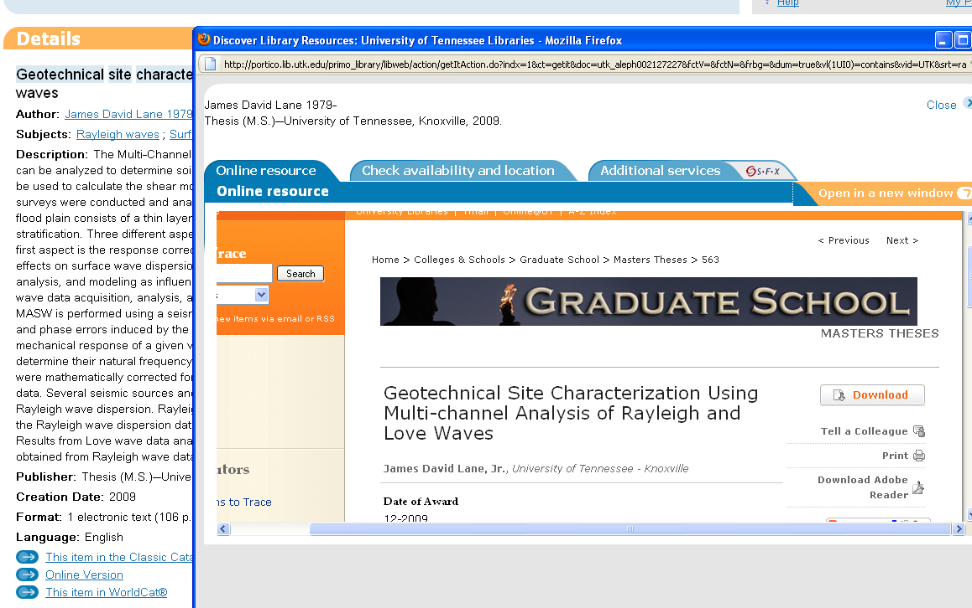
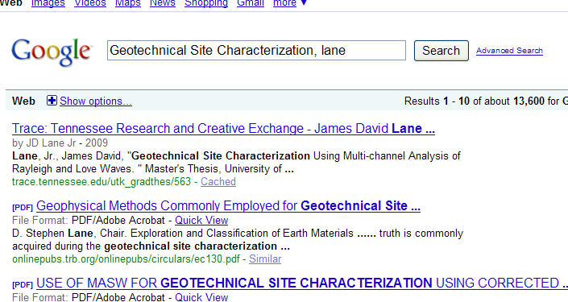
Trace in the Virtual Library
Discoverable
Primo, Google, and OAI harvesters
Notes:
Trace is discoverable: After M. Breeding’s suggestion, the virtual library must include deep indexing and full-text searching options. To the extent that records are OCR’d, Trace is full-text searchable, allowing records in Primo to be searched, and “optimized for Google indexing.” This example traces discovery of a thesis in Primo and Google. I just received an email from a professor in Germany who found a Trace ETD on Google, so we are getting results! These searching services do produce in-text search results.

Slide 12
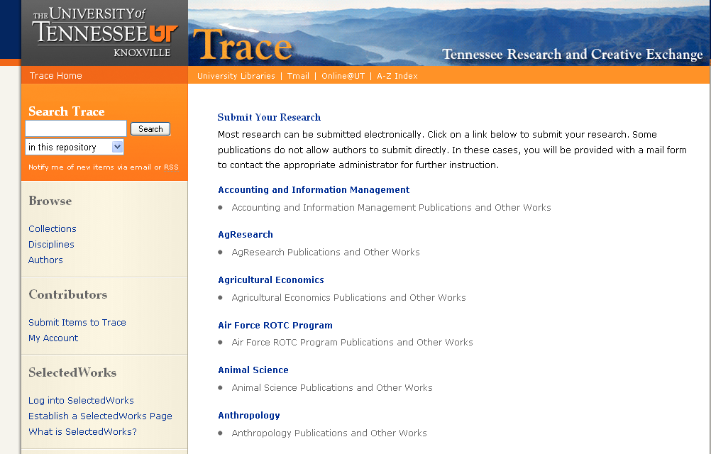
Trace in the Virtual Library
Collaborative
Notes:
Trace is collaborative: Trace allows individual campus contributors to self-archive their publications and other works through a streamlined submit form. Once submitted, a manager must approve the work for Trace. These collaborative services make contributors aware of how the library/IR can help disseminate their work.

Slide 13
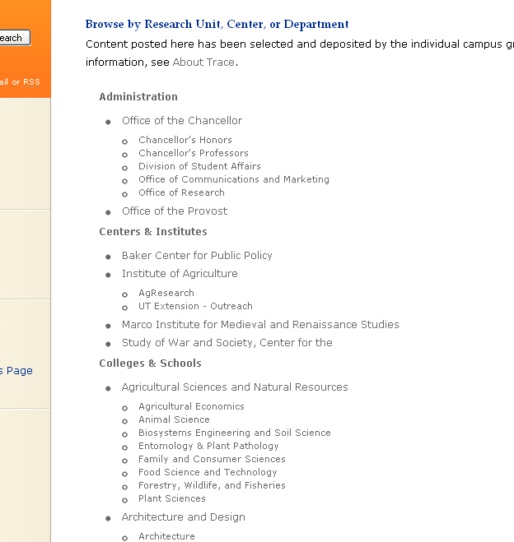
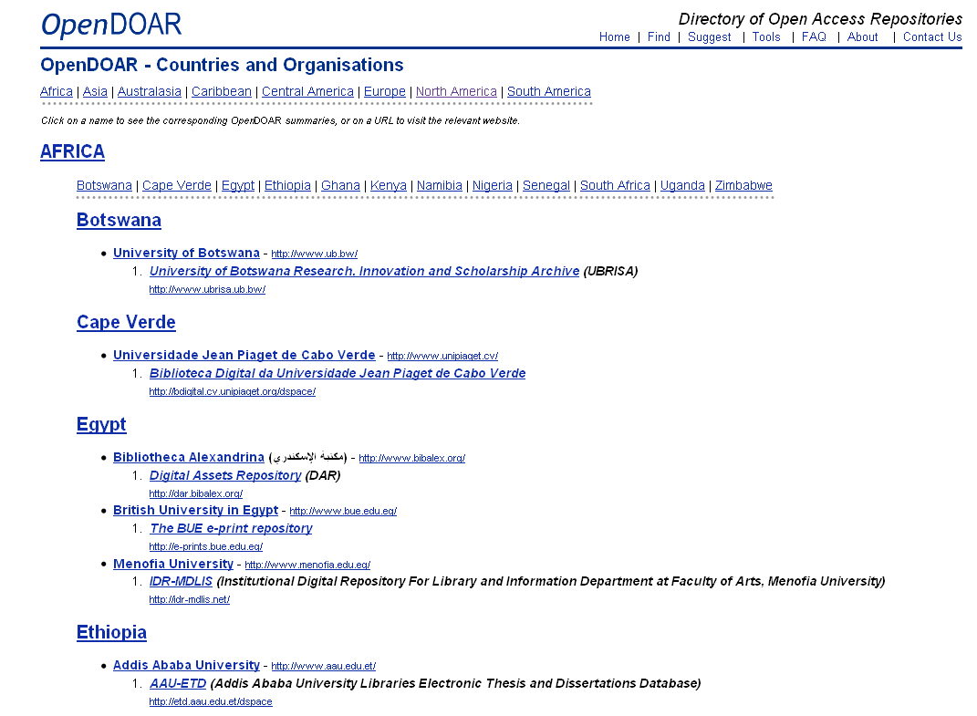
Trace in the Virtual Library
Contextual
Notes:
Trace is contextual: Trace places contributors and collections in the larger context of the UT environment, side-by-side with the scholarly and artistic contributions of their colleagues and students. Similar services at other universities and among scholarly societies link this work to the global community. For ex, Digital Commons provides a list of their institutions and OpenDOAR lists all academic open access repositories

Slide 14
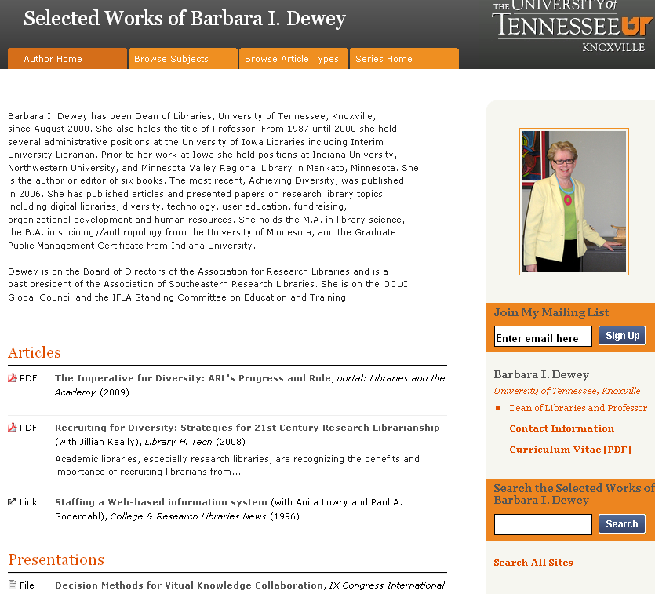
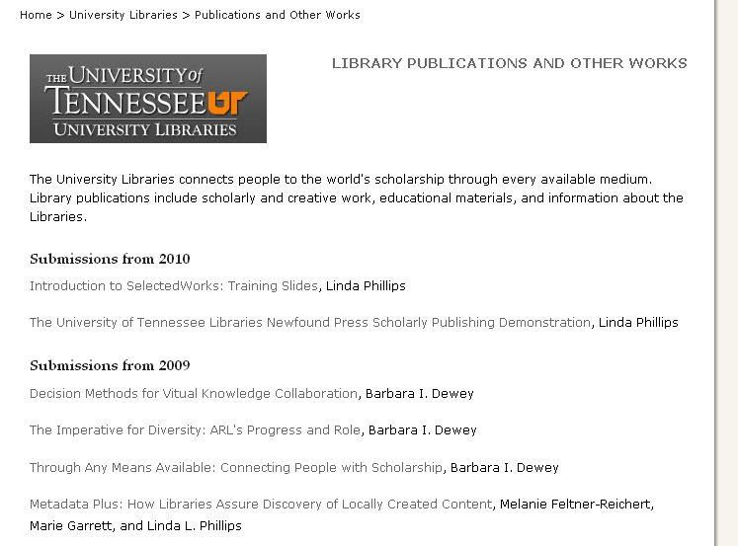
Trace in the Virtual Library
Networked
Notes:
Trace is social networked and provides services like links to SelectedWorks profile pages and other bepress-hosted sites. Trace also lets researchers invite subscribers to RSS feeds for research alerts. This service is useful to expose faculty work and departmental productivity. The College of Veterinary Medicine is considering requesting faculty to create the SW profiles that will be harvested in Trace to create a list of faculty publications for their annual report!

Slide 15
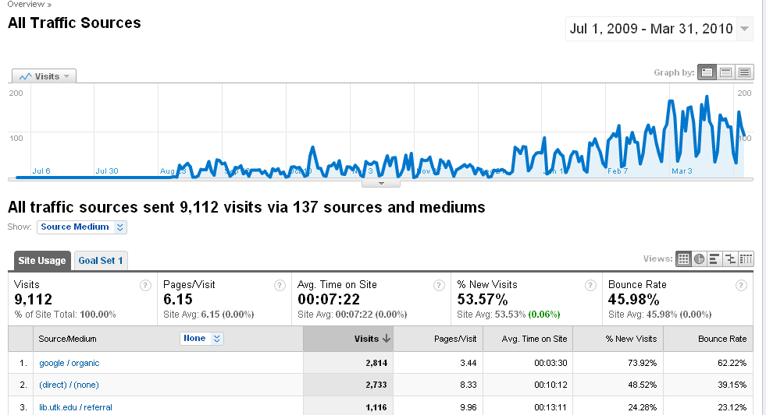
Trace in the Virtual Library
Statistics
Notes:
So who uses Trace? With Google Analytics (focuses on visitor provenance and traffic sources), we know that currently, Google is the top referring site, followed by the UT library’s website.

Slide 16
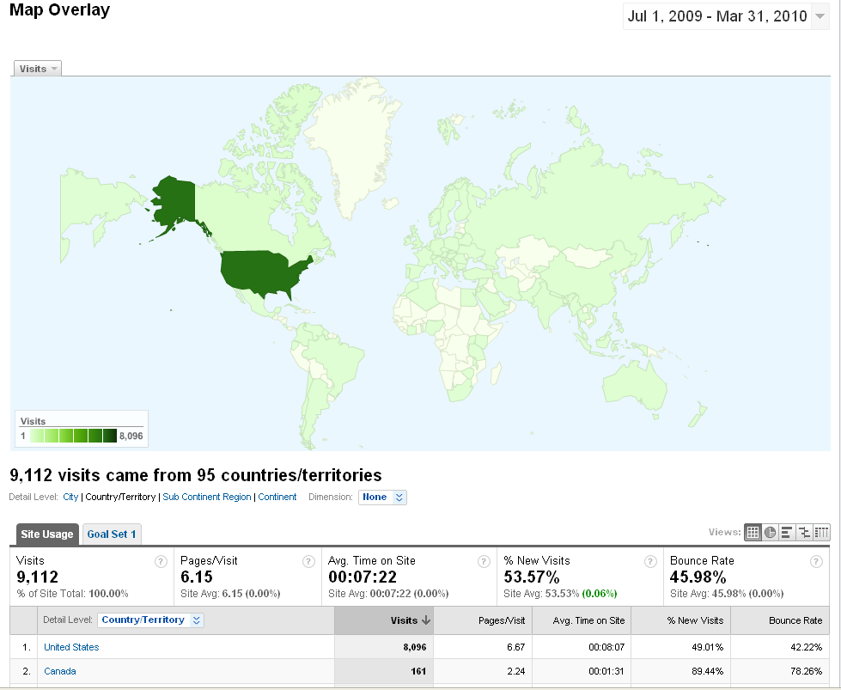
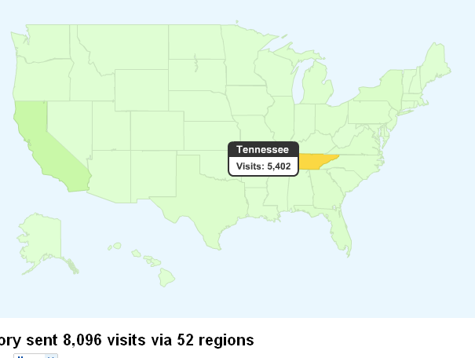
Trace in the Virtual Library
Statistics
Notes:
To give another example of Google Analytics : This map illustrates heavy use by US users, and of course demonstrates that Trace is aiding local audiences.

Slide 17
Trace in the Virtual Library
Statistics
Notes:
In-house Trace usage reports (for entire site, any series, or indiv article) also provide data, focusing on frequency of use
(here we’re comparing downloads (lilac) and hits (purple) by month to the contents ingested (teal). notice exponential growth of downloads as more content is ingested).

Slide 18
Trace in the Virtual Library
Statistics
Notes:
Again, as we add more content and links, Trace is becoming more discoverable). These statistics help track our users’ behaviors and needs, and can be valuable to help track the virtual library outreach to users.

Slide 19
Trace in the Virtual Library
The future of Trace…oh, the possibilities!
For contributors:
Born-digital journal and conference publishing and preservation
Content management capabilities
Social networking enhancements
For users:
Long-term open access to digital information
Multiple points of entry
Notes:
So Trace defines its place in the virtual library in 2 ways. For Contributors and content managers Trace provides an easy interface to manage content, from submission to revision. We’ve begun to promote Journal and conference hosting asvaluable features that can facilitate the UT community’s outreach. For Users , Trace delivers lasting content via Trace, Primo, or search engines such as Google.

Slide 20
Future Virtual Library Development
Standards!
Suggestions?
Comments?
Notes:
As Trace nears the end of its first year, we’re excited to watch its virtual library services grow. With DLI, we’re currently working to develop digitization standards for the virtual library and best practices to provide digitization consultations to the larger UT community. As part of the VLSC’s charge, how can we include Trace in our conversation to “Identify priorities for future virtual library development”?

Slide 21
Works Cited
The Berkeley Electronic Press. 2010. SelectedWorks vs. faculty publication pages. http://works.bepress.com/comparison.html (accessed March 29, 2010).
Borgman, Christine. 2007. Scholarship in the digital age: information, infrastructure, and the internet. Cambridge, MA: The MIT Press.
Breeding, Michael. 2010. Is the library web site the new library catalog? Exploring a vision of next-generation library discovery. Presented at the University of Tennessee Virtual Library Steering Committee meeting, January 13, 2010.
Lagoze, Carl, Dean B. Krafft, Sandy Payette, and Susan Jesuroga. 2005. What is a digital library anymore, anyway? beyond search and access in the NSDL. D-LibMagazine. 11, no. 11 (Nov. 2005) http://dlib.org/dlib/november05/lagoze/11lagoze.html (accessed February 26, 2010).
University of Tennessee Libraries. 2009. Virtual library steering committee charge. February 18, 2009.

