Slide 1
Design of Additive Manufacturing Feedstocks with Enhanced Performance: Final Report
Robert Minneci, Evans Gritton, Austin Plymill, Duncan Greeley
MSE 489 - 4/27/2016
Advisor: Dr. Gajanan Bhat
Industry Sponsor: NatureWorks LLC
Funding Provided by the University of Tennessee, Knoxville
Notes:
duncan

Slide 2
Outline
Introduction
Additive manufacturing concepts
  Filament - PLA
  Common additives
Objective and project description
1
Fabrication Process
Raw material to printed part
Extruder complications and filament reduction
1
Testing
Methods
Results
1
Conclusions
Testing conclusions
  Difficulties/Retrospective
  Recommendations

Slide 3
Outline
Introduction
Additive manufacturing concepts
  Filament - PLA
  Common additives
Objective and project description
1
Fabrication Process
Raw material to printed part
Extruder complications and filament reduction
1
Testing
Methods
Results
1
Conclusions
Testing conclusions
  Difficulties/Retrospective
  Recommendations

Slide 4
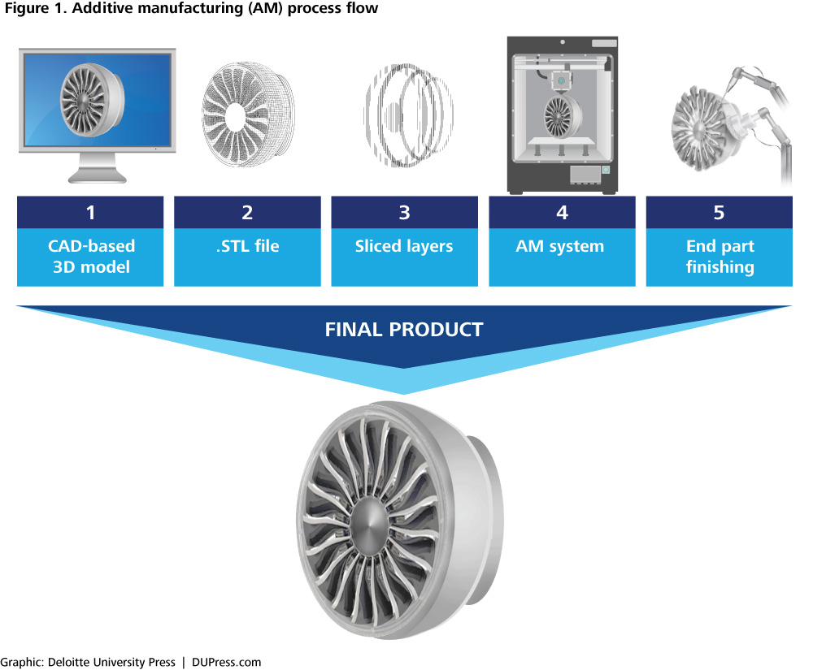
Introduction
What is additive manufacturing?
Traditional manufacturing (i.e. CNC) is subtractive
Additive manufacturing (AM) uses an alternative “build up” approach
Why does it matter?
Geometric complexity
Less raw material required
Decreased production time/cost for small quantities
Notes:
duncan

Slide 5
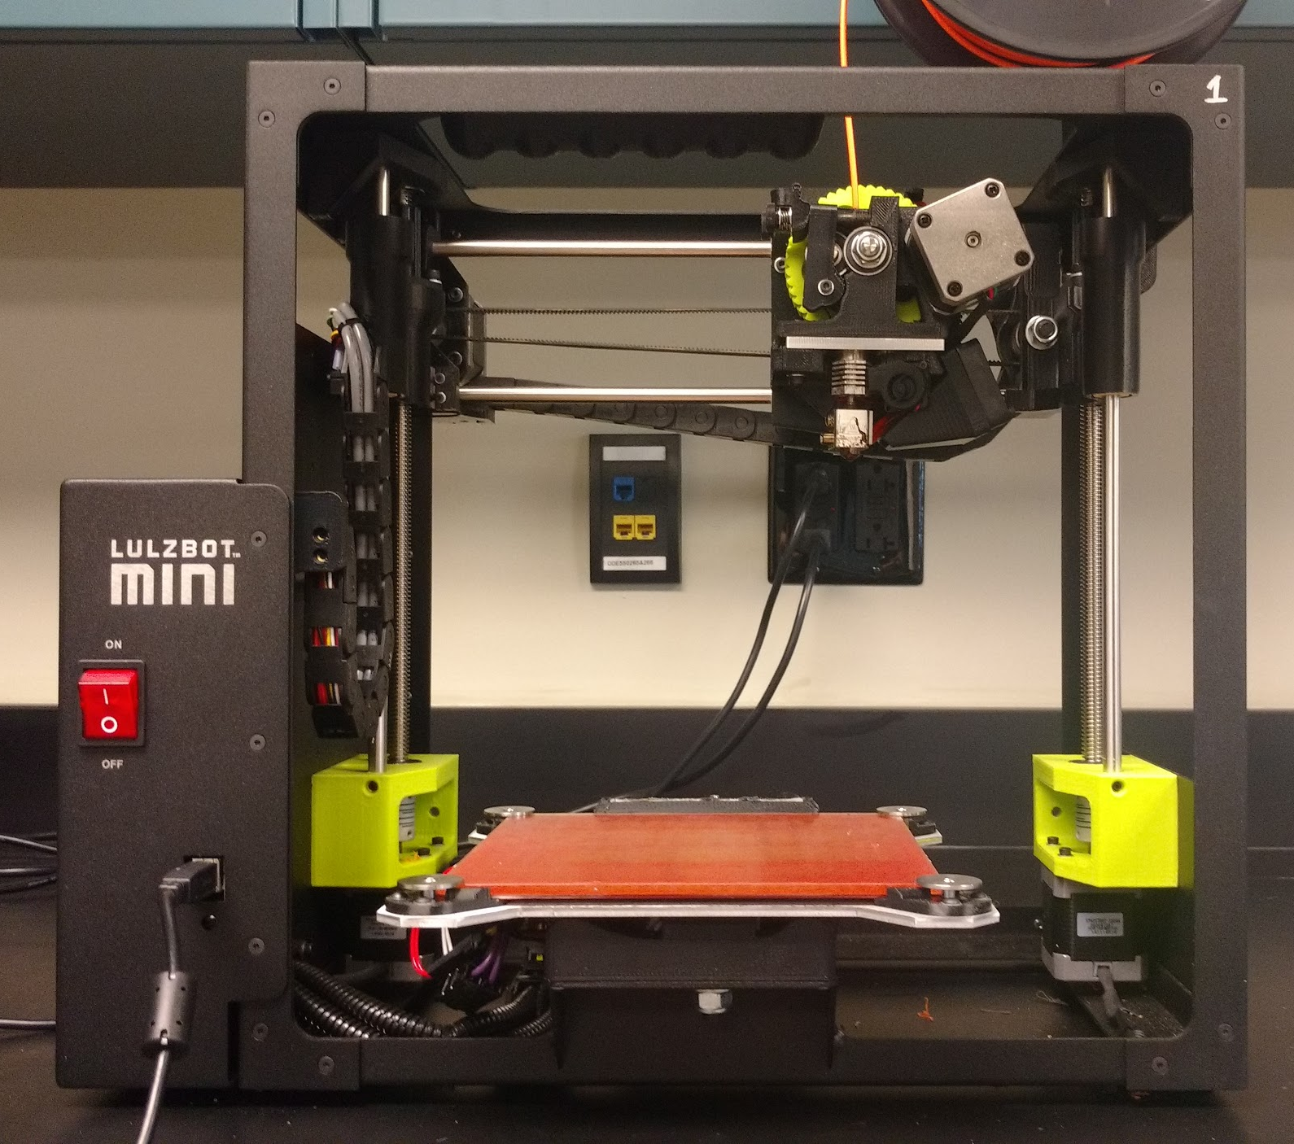
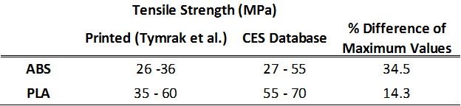
Issues with Additive
Reduction in mechanical properties
Property anisotropy
Variation in build quality
Process modeling
In-situ feedback

Slide 6
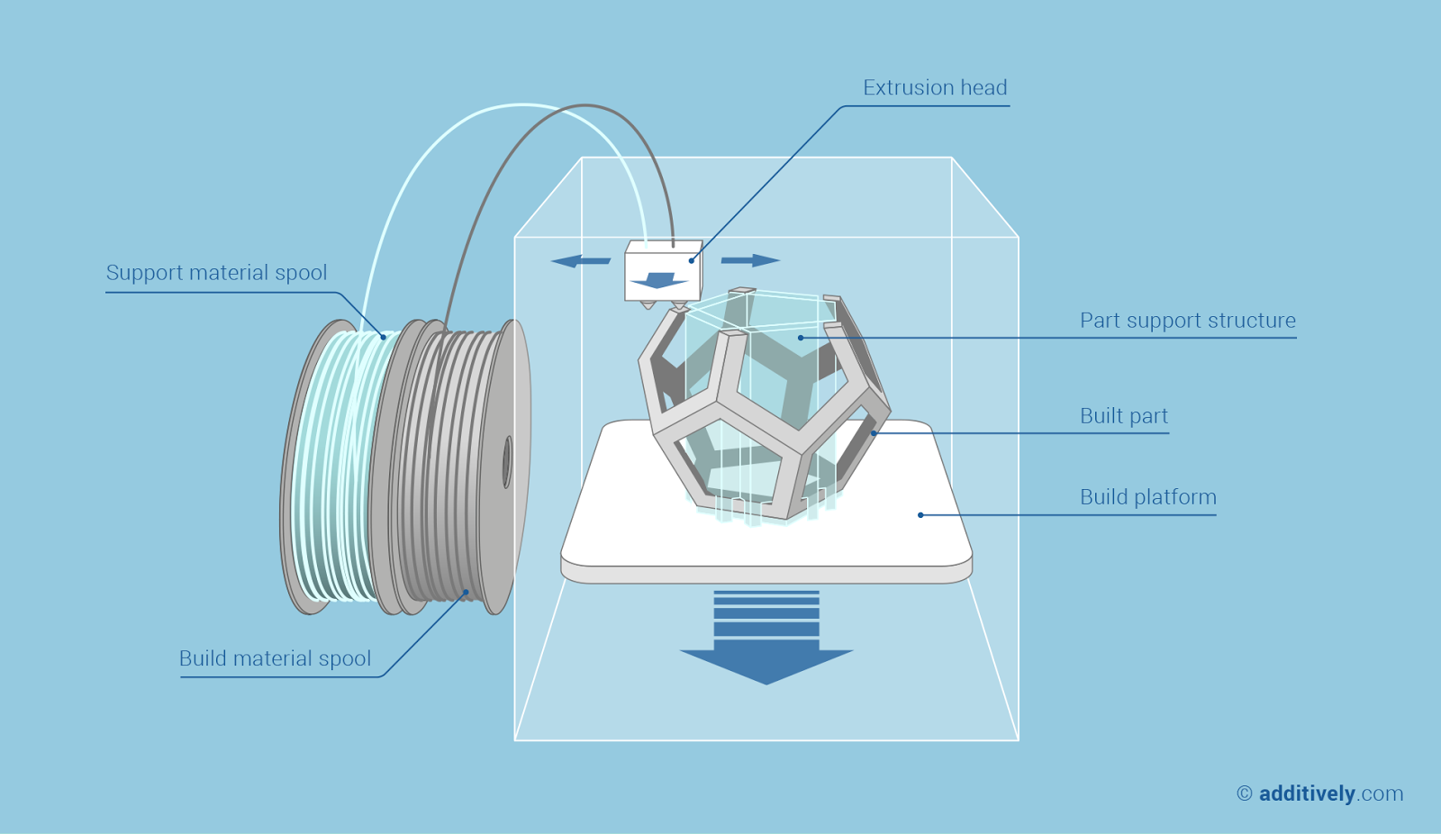

Fused Deposition Modeling

Slide 7
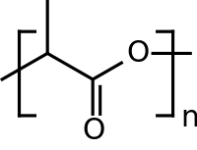
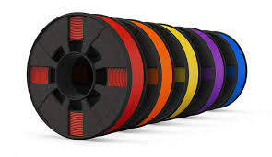
Printing Filament: PLA
Advantages
Biodegradability
Biocompatibility
Higher strength than ABS
Inexpensive
Less dimensional warping than ABS
Drawbacks
Lower glass transition temperature
Hydrophilic - must be vacuum sealed for long term storage

Slide 8
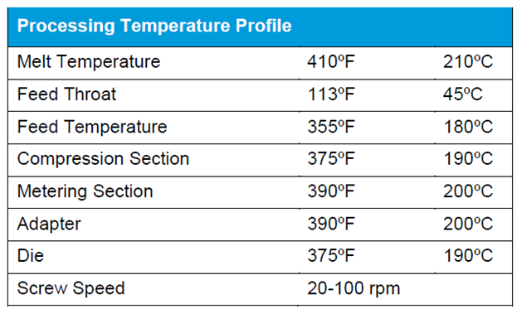
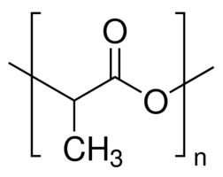
Feedstock Resin
PLA - Natureworks 4060D Resin
Intended for use in films
  Heat seal layer
Received in pellet form
Fully amorphous polymer

Slide 9
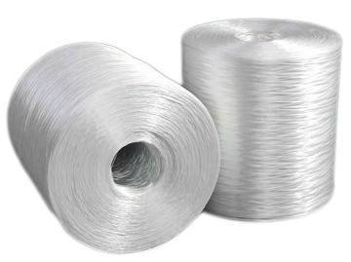
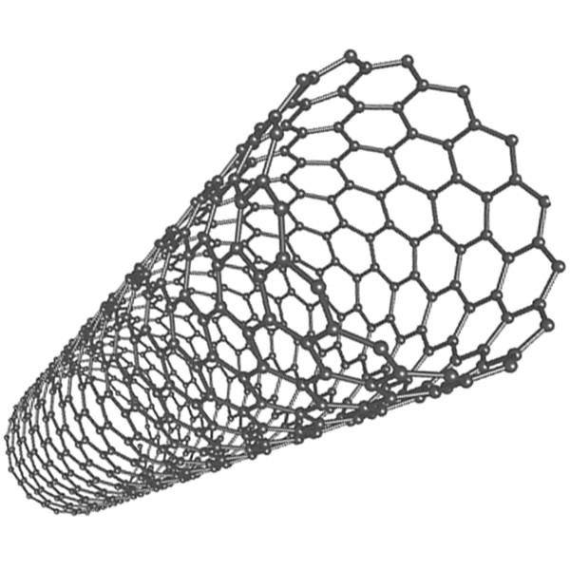
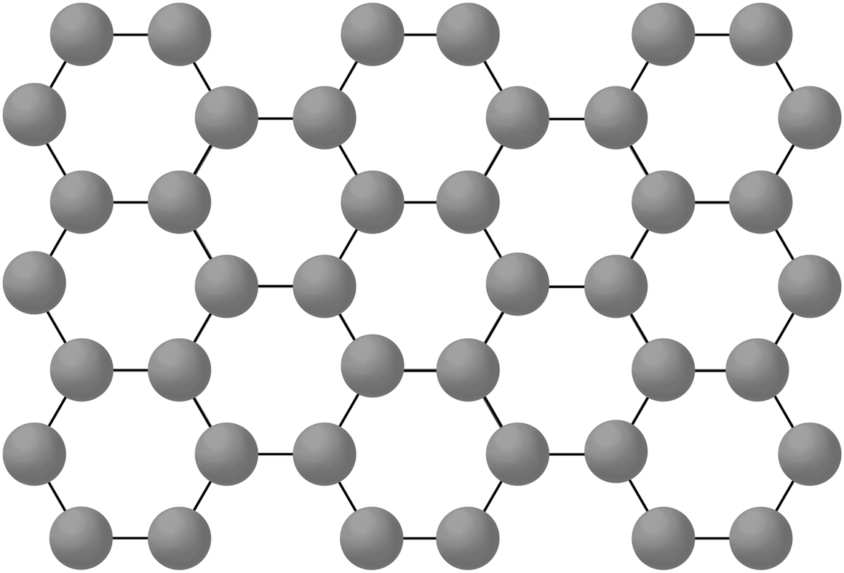
Background: Reinforcing Material
Traditional reinforcement: glass fiber
Requires high doping percentage
Glass fiber substantially heavier
Potential replacement candidates
Graphene
Multiwall Carbon Nanotubes (MWCNT)
Advantages
Higher strength to weight ratio
S-2 Glass UTS: 4.8 GPa
E: 87 GPa
PLA UTS: 50 MPa
E: 3.5 GPa
MWCNT UTS: 150 GPa
E: 900 GPa
Graphene UTS: 130 GPa
E: 1000 GPa

Slide 10

What is our Objective?
“To enhance mechanical properties of an inexpensive, renewable feedstock while minimizing detrimental effect on cost”
Carbon nanotubes and graphene are expensive
CNT ranges from $45 - 385 per gram
Graphene $100 - 200 per gram
  Depends on the quality and type
PLA is relatively brittle, but inexpensive
  $30 per kg
Goal: reinforce PLA with small weight percentages
0.5, 0.2, and 0.1 wt.%
Sources
Graphene
Multiwall Carbon Nanotubes (MWCNT)

Slide 11
Outline
Introduction
Additive manufacturing concepts
  Filament - PLA
  Common additives
Objective and project description
1
Fabrication Process
Raw material to printed part
Extruder complications and filament reduction
1
Testing
Methods
Results
1
Conclusions
Testing conclusions
  Difficulties/Retrospective
  Recommendations

Slide 12
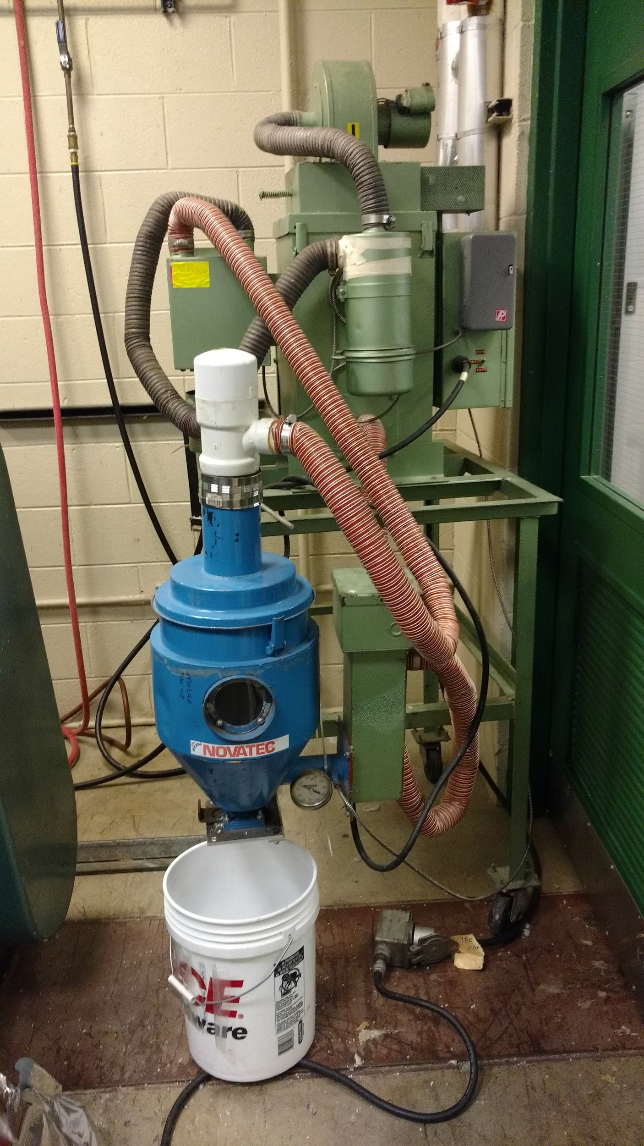
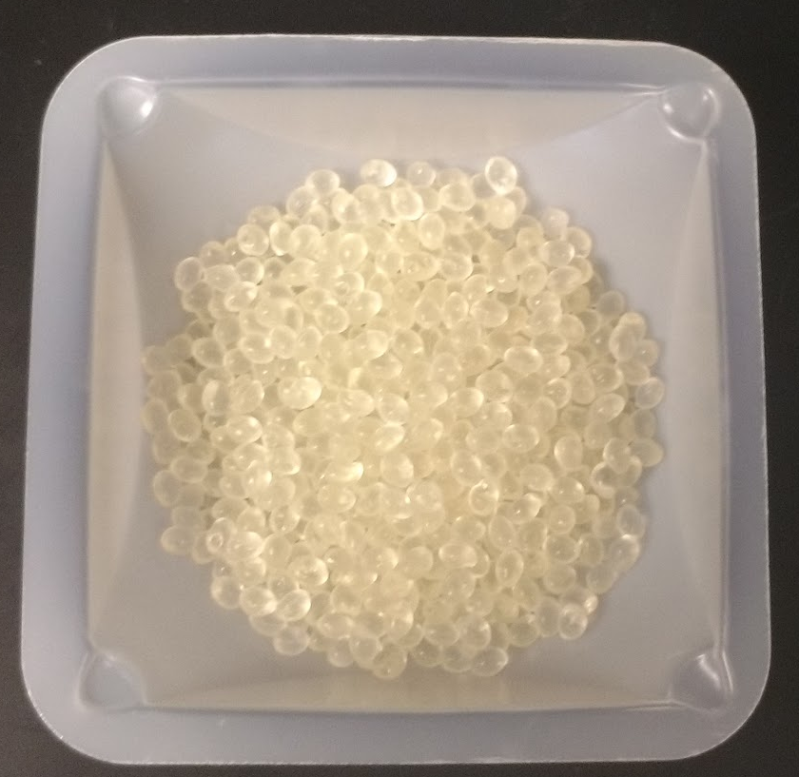
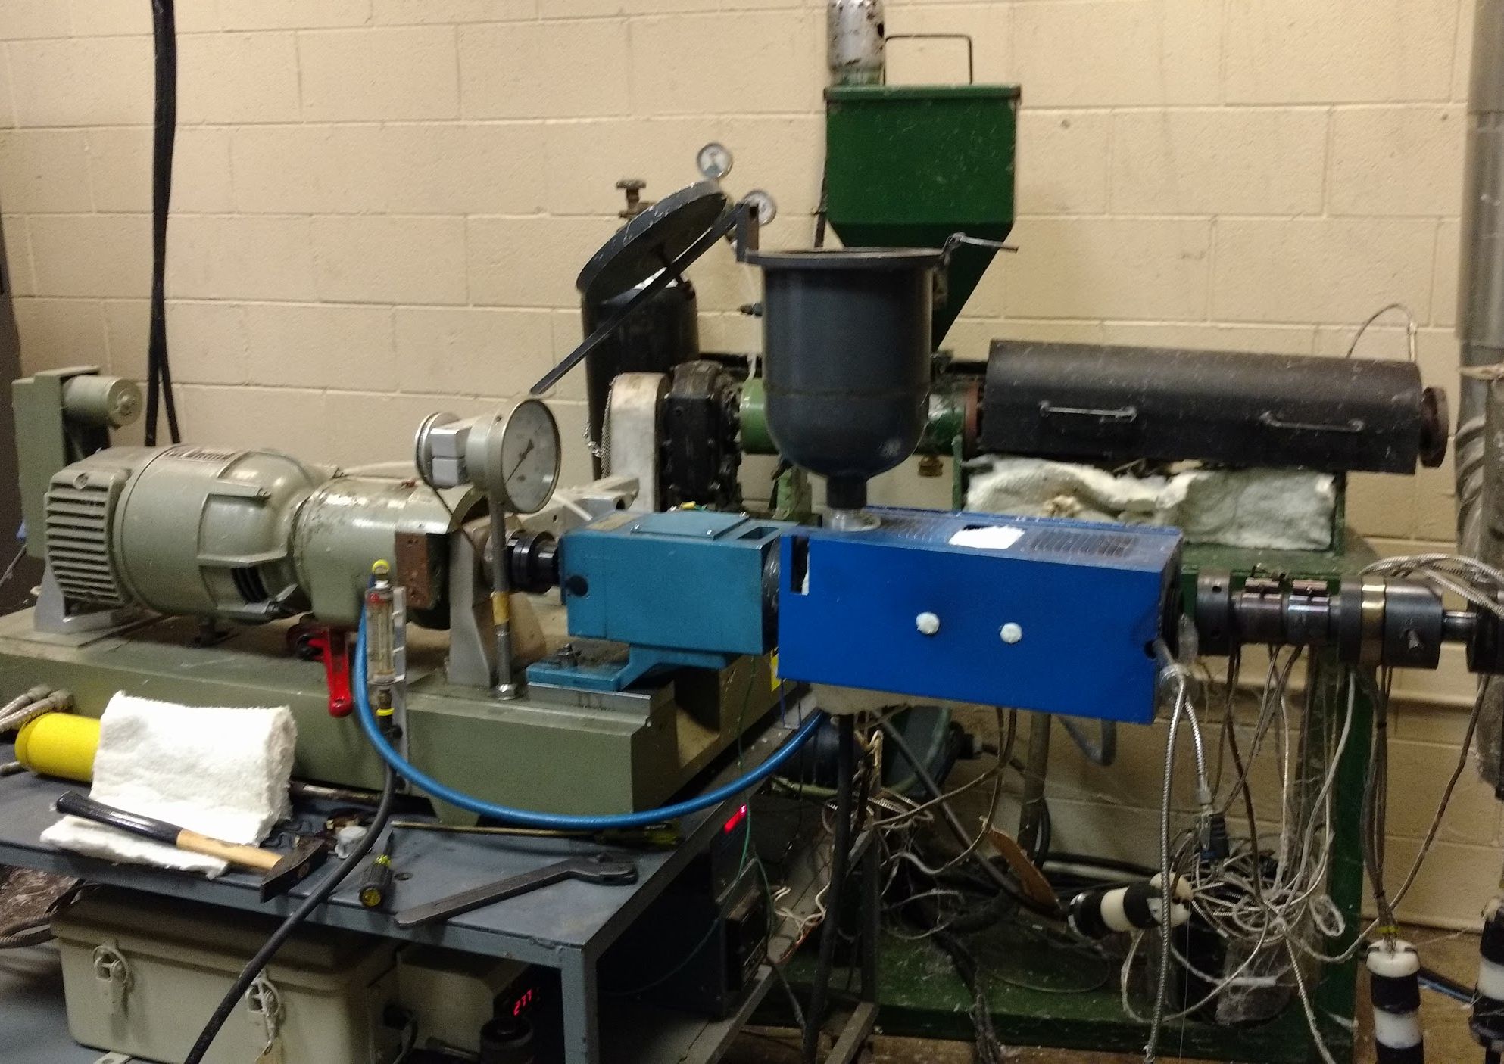
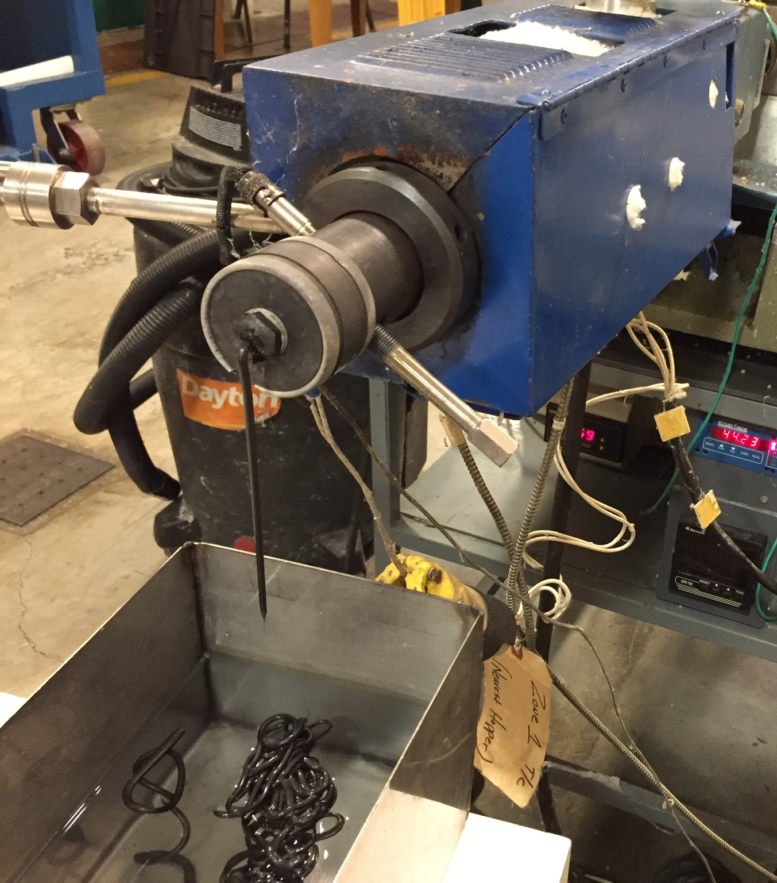
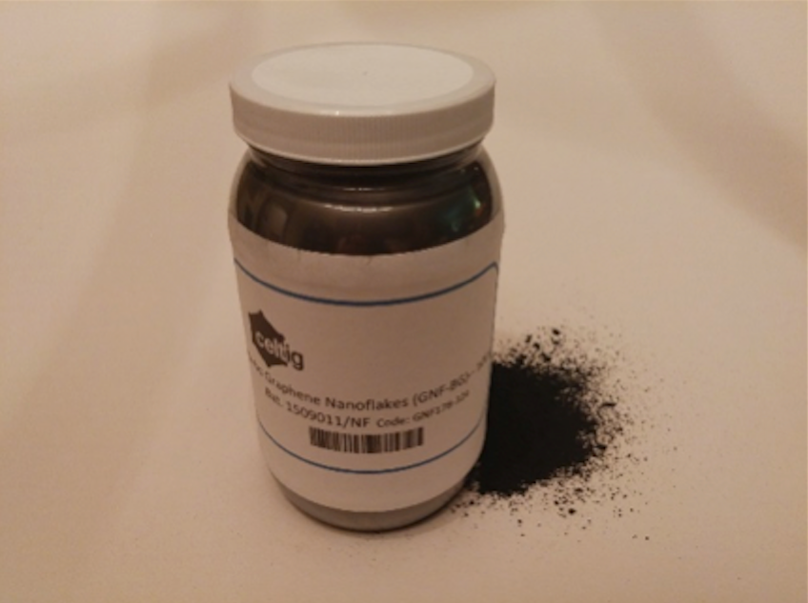
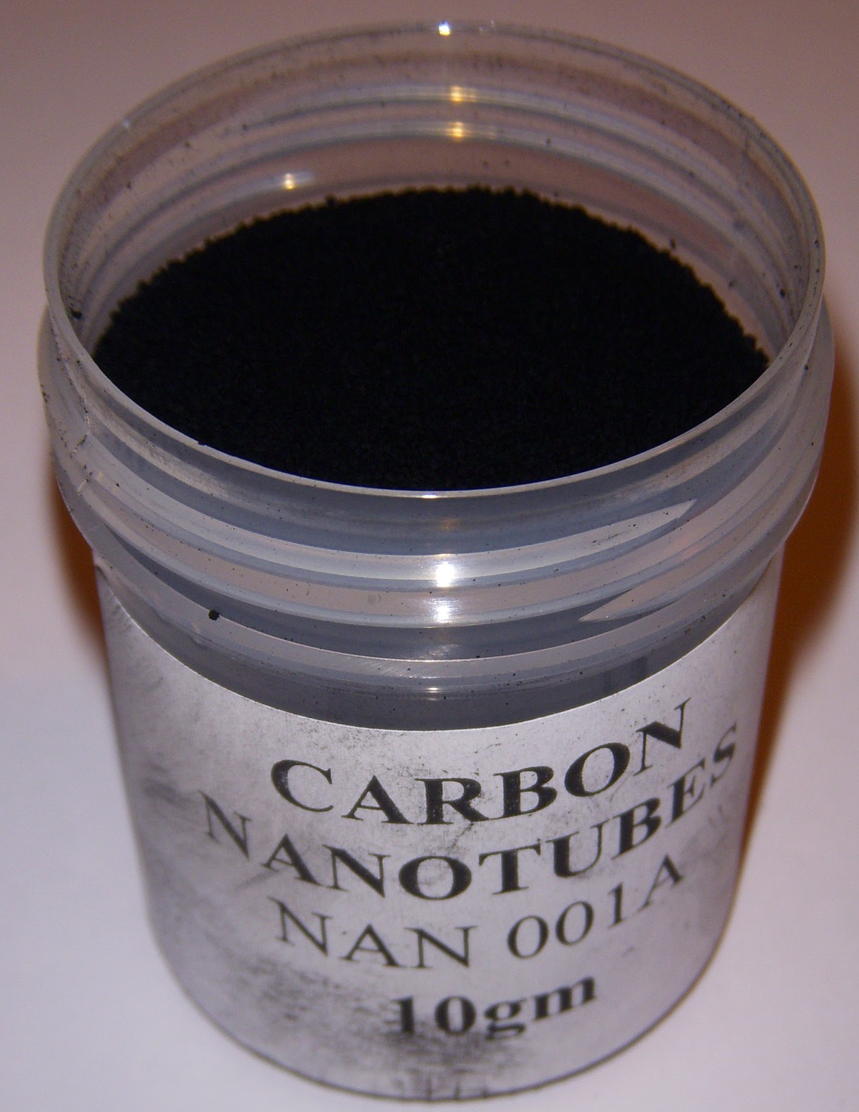
Fabrication Process Part One
Neat PLA
Graphene MWCNT
Novatech Dessicator Haake Twin Screw Extruder Water Bath

Slide 13
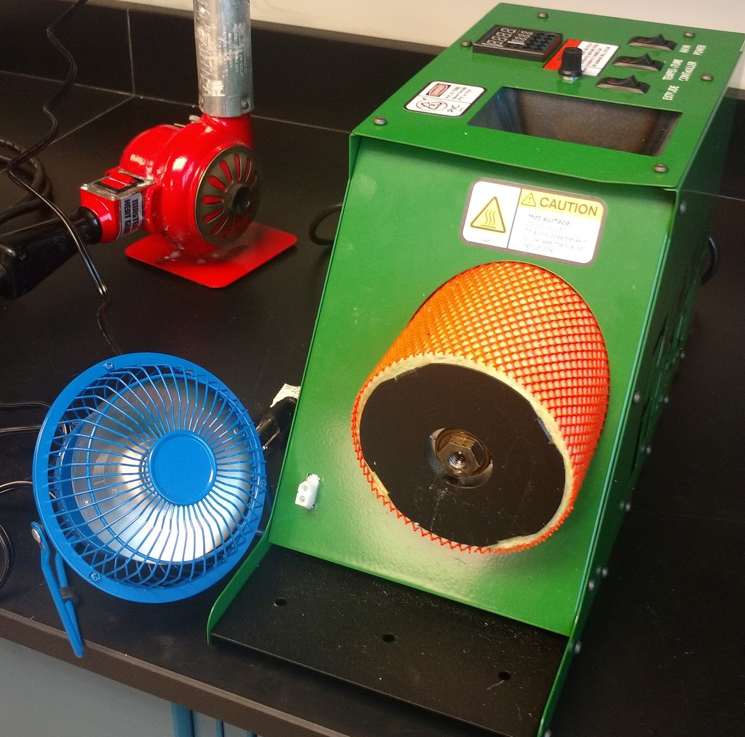
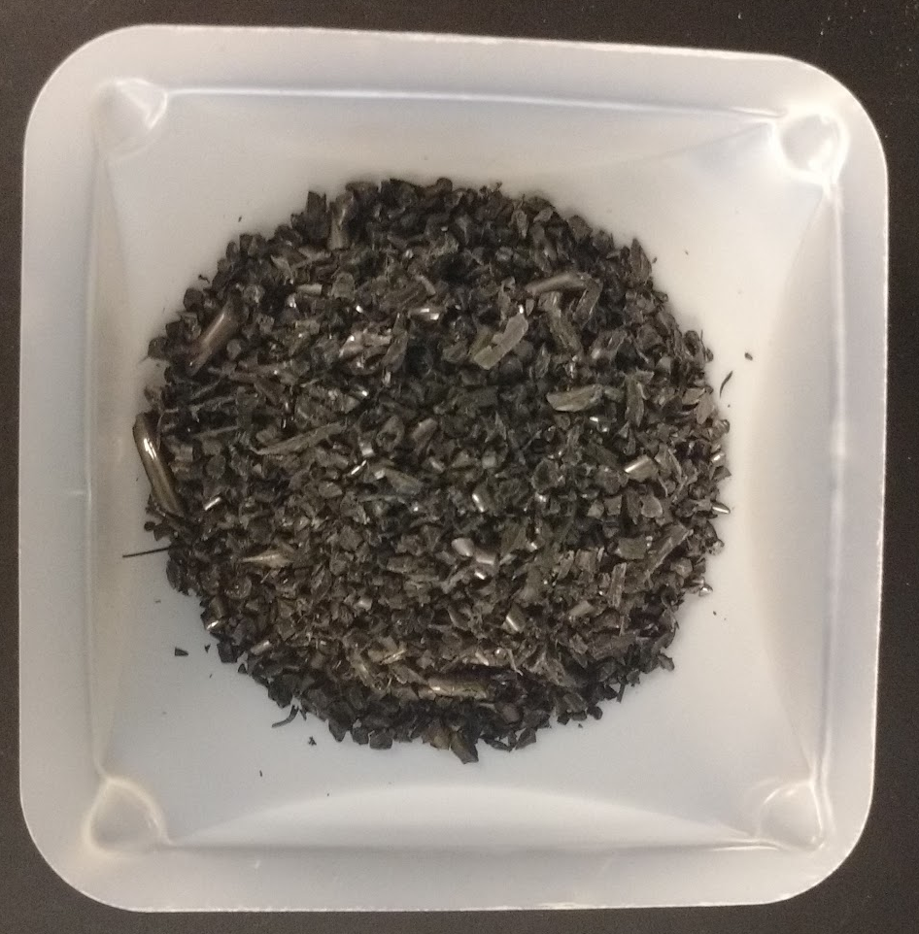
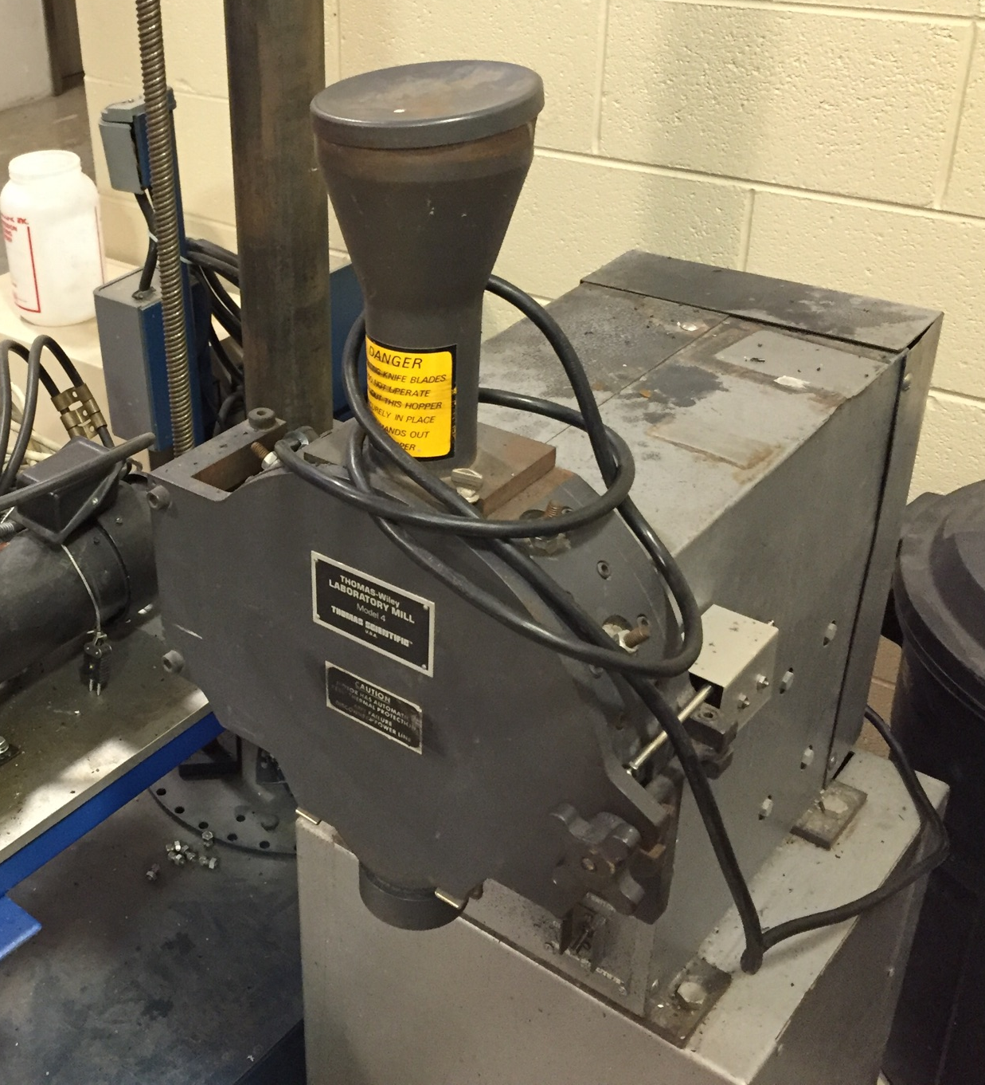
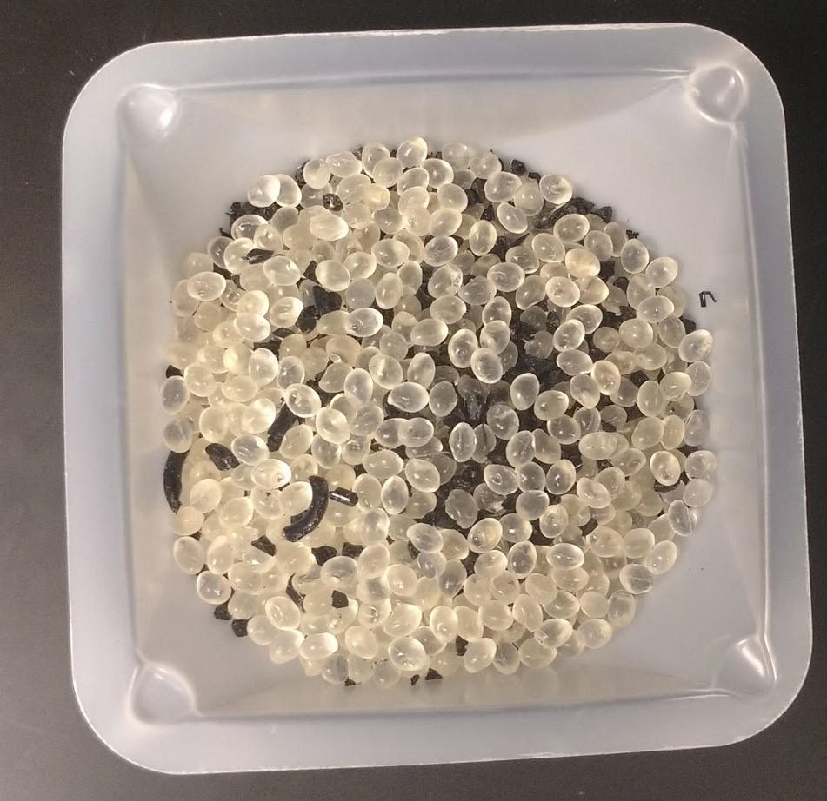
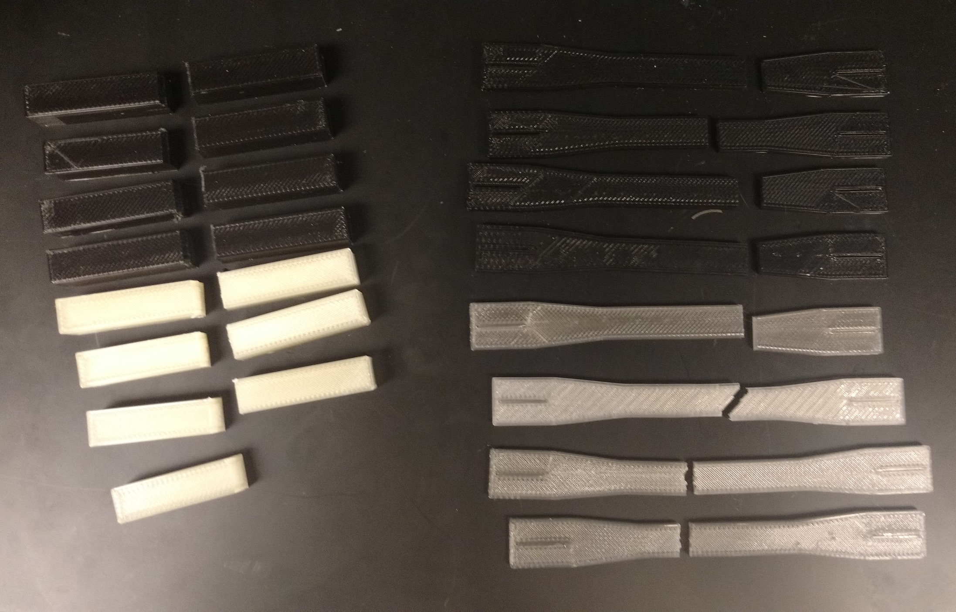
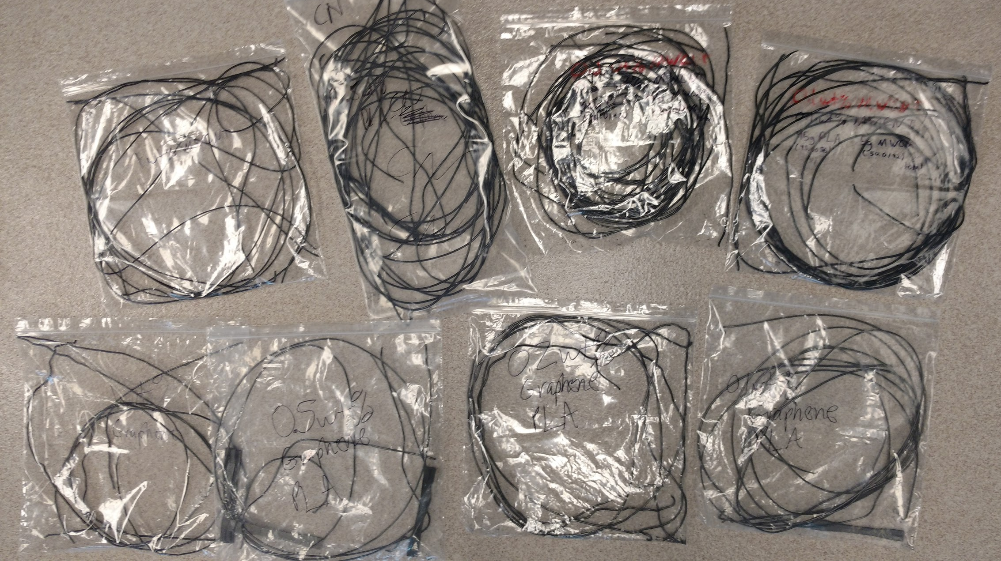
Fabrication Process Part Two
Masterbatch
Filabot Filament Extruder
LulzBot Mini 3D Printer
Laboratory Mill
Typical Mix

Slide 14
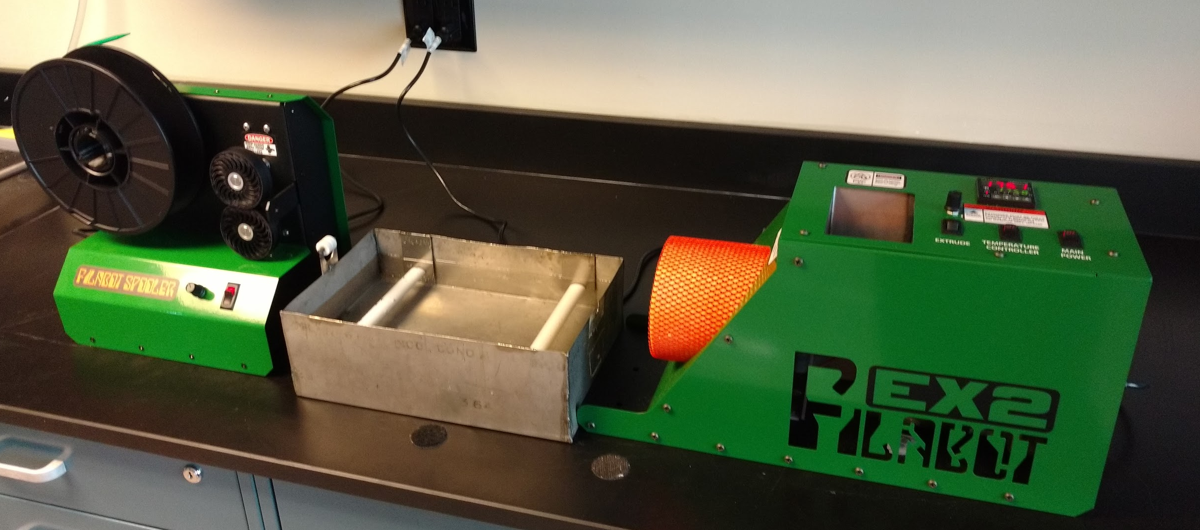
Initial Setup

Slide 15
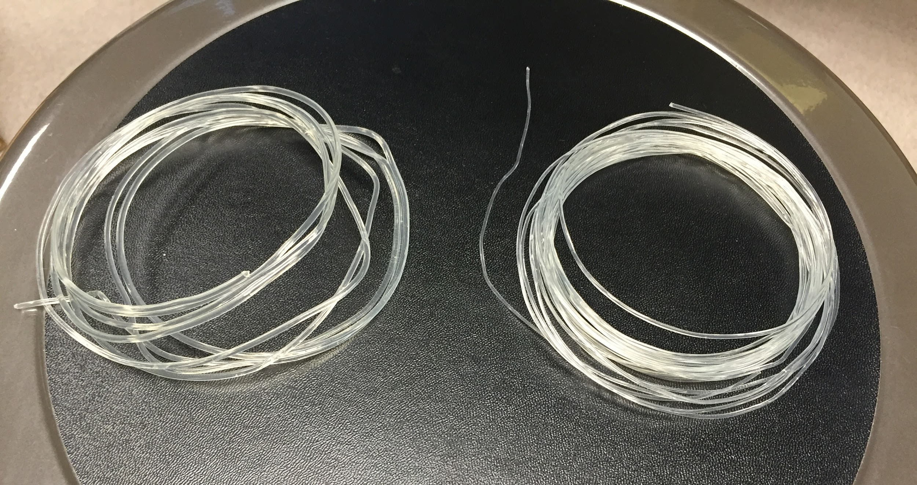
Diameter Reduction
Approximately
3 mm
Reduced Thickness
PLA - Natureworks 4060D Resin
Exhibits low melt strength
  Fully amorphous polymer
  Brittle and fractures easily
Extruded filament applies stress
  Resulting strain reduces the thickness
  Need to maintain ~3 mm thickness (die diameter)
Notes:
evans

Slide 16
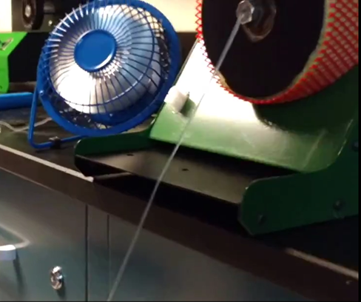
Filament Production Methods Tested
Extrude at 170⁰C
Extrude at 180⁰C
Extrude at 190⁰C
Water Bath
No Bath
Filament Winder
Drop Down
Filament Winder
Drop Down
Unassisted Cool
Fan
Notes:
austin

Slide 17
Final Filament Production Method

Slide 18
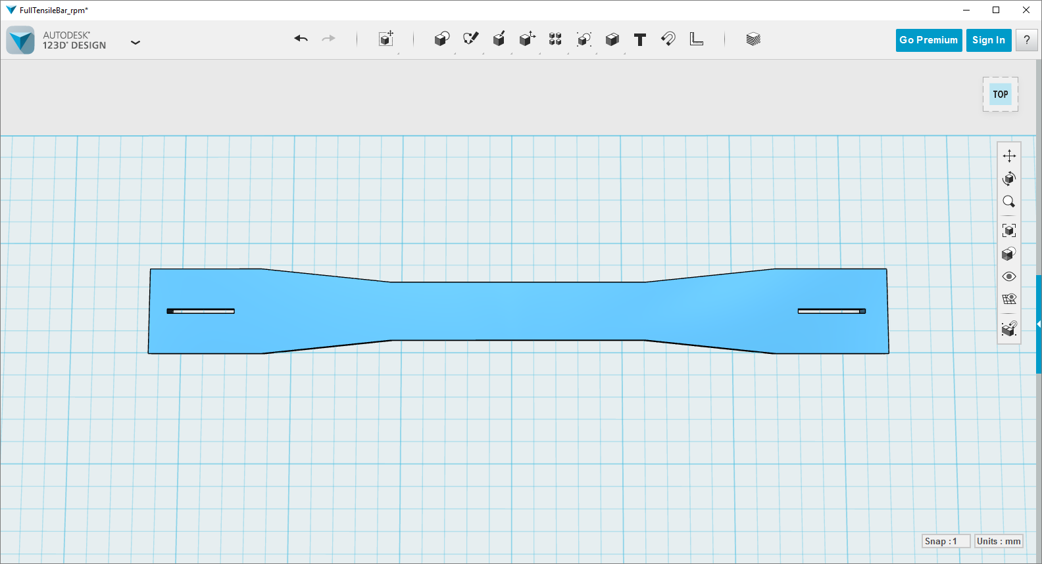
Printing Set-up
Attempted rafting
Gaps are for expansion

Slide 19
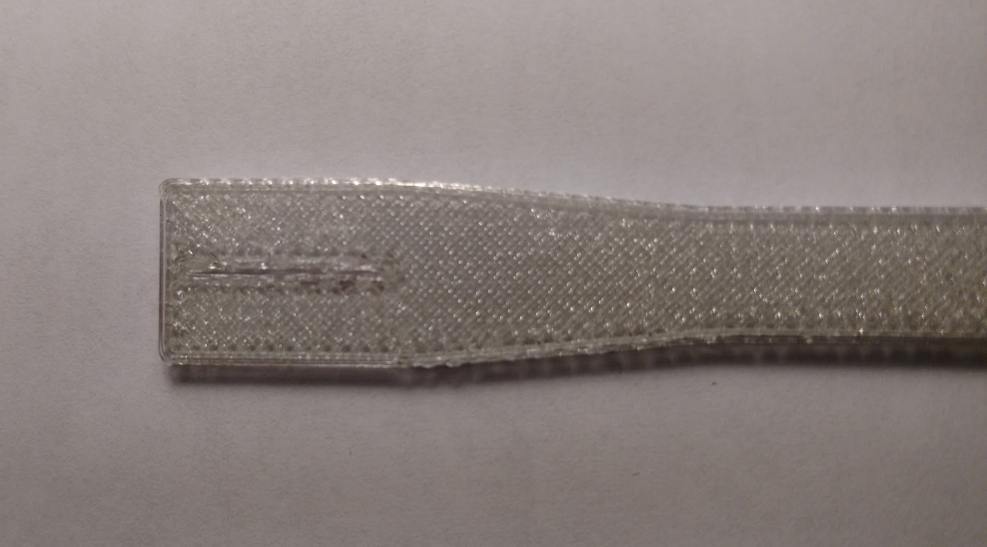
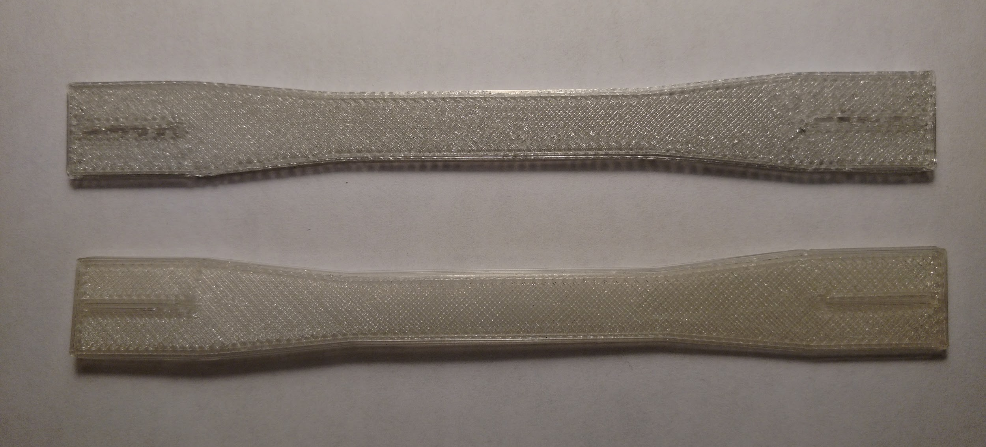
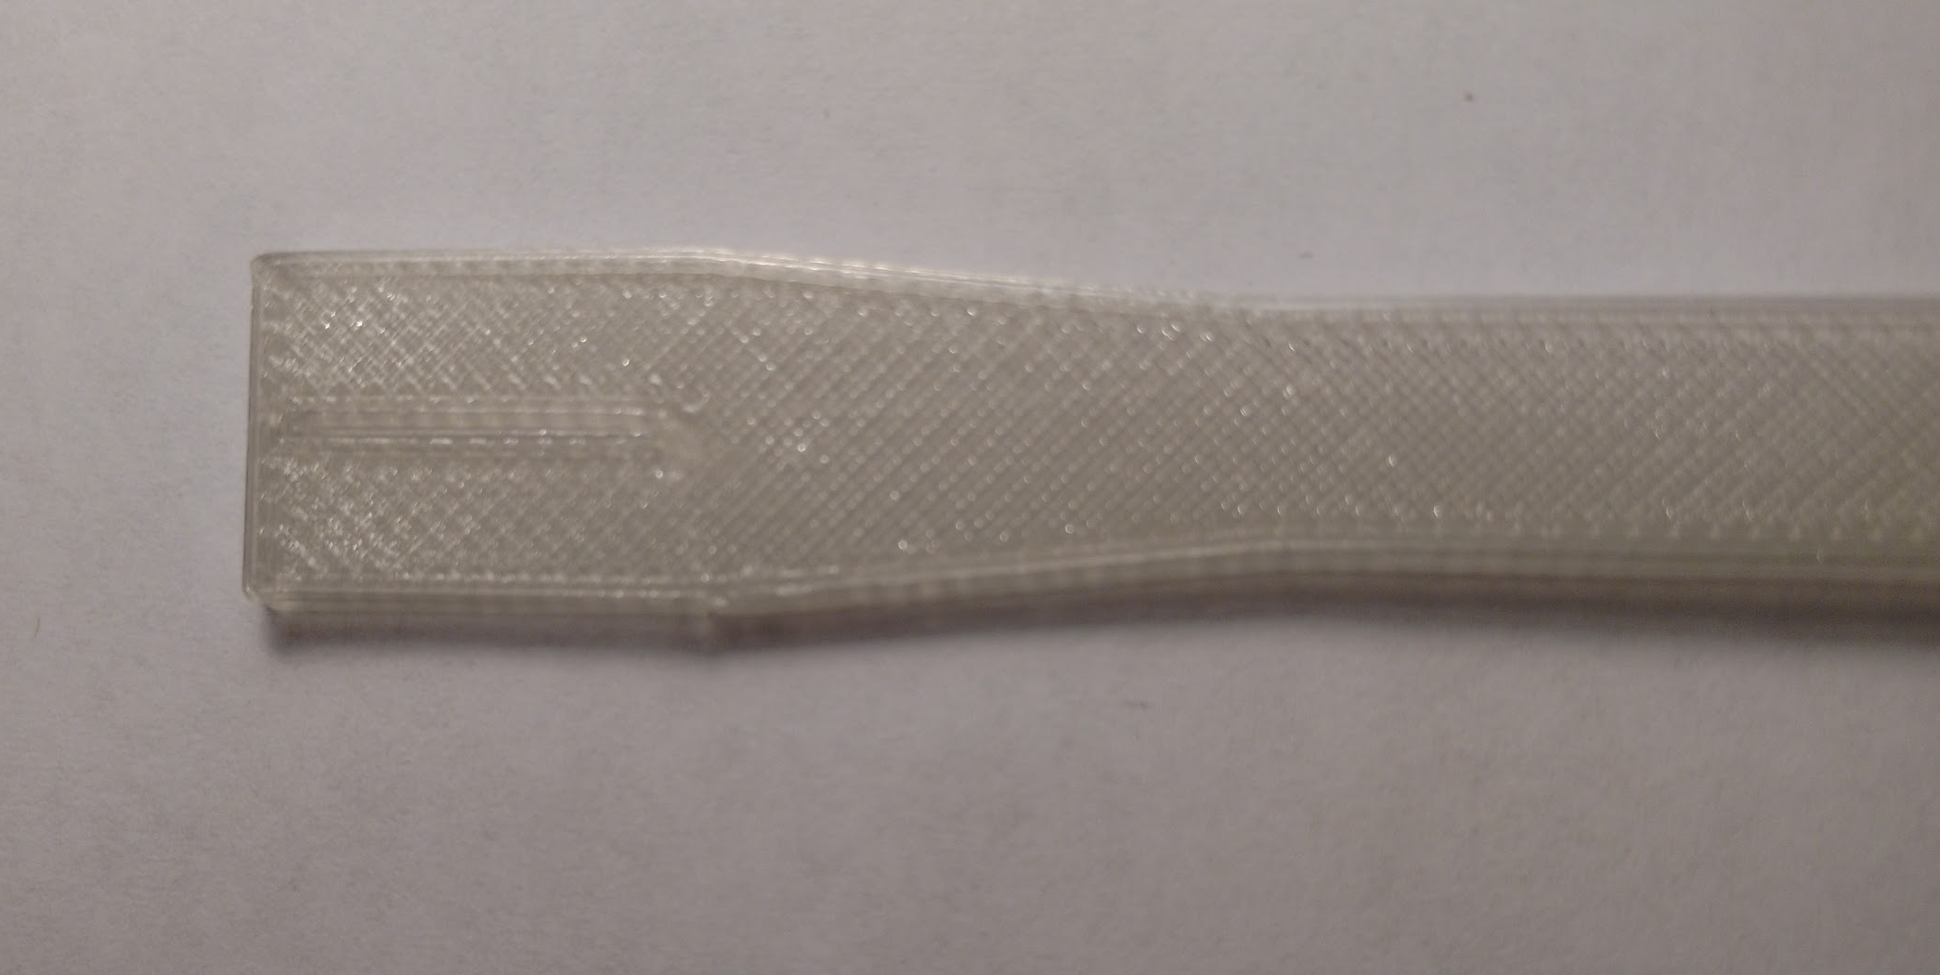
Printing with Different Diameters
A - Reduced diameter filament
B - 3 mm diameter filament
A
A
B
B
Notes:
robert

Slide 20
Outline
Introduction
Additive manufacturing concepts
  Filament - PLA
  Common additives
Objective and project description
1
Fabrication Process
Raw material to printed part
Extruder complications and filament reduction
1
Testing
Methods
Results
1
Conclusions
Testing conclusions
  Difficulties/Retrospective
  Recommendations

Slide 21
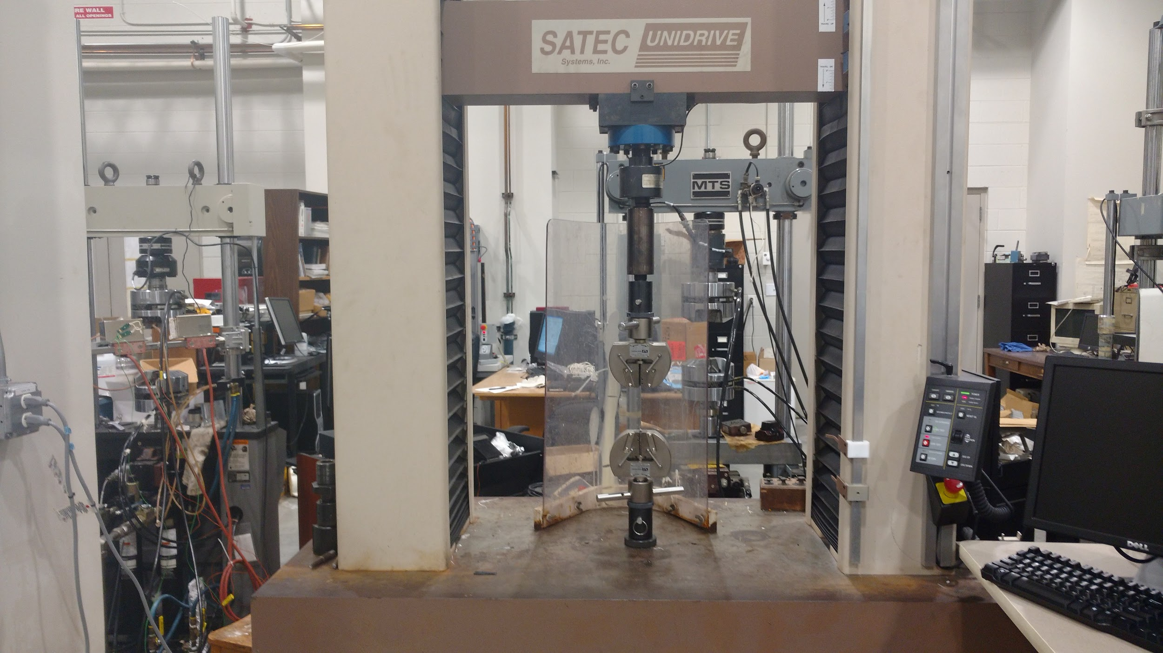
Tensile Testing
All Dogbone samples scaled down to 75% size in X and Y axis
After preliminary testing, performed at a strain rate of 1 in/min (~25mm/min)
Tests performed at STP, ASTM D638
Performed tests on four samples of each composition
SATEC Instron Unidrive tensile tester

Slide 22
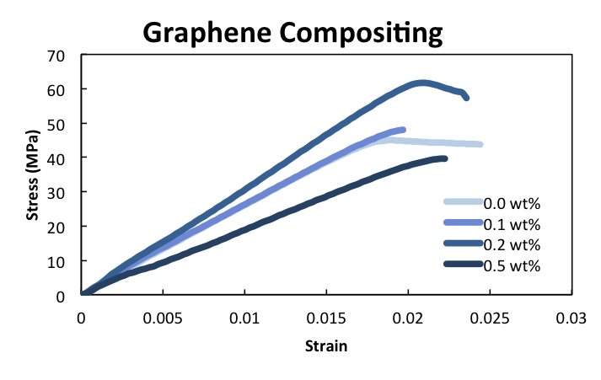
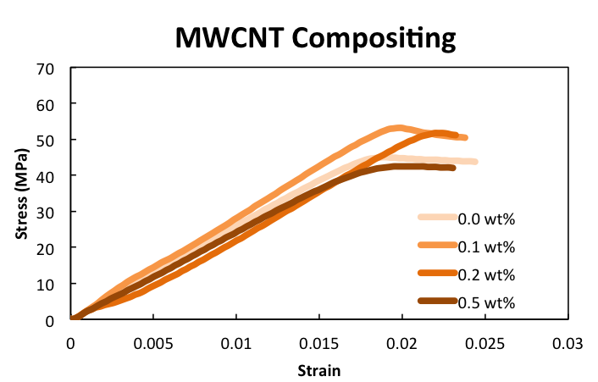
Tensile Testing
Representative Stress-strain curves for Graphene, MWCNT/PLA Composites
Notes:
Much variance in both, especially graphene

Slide 23
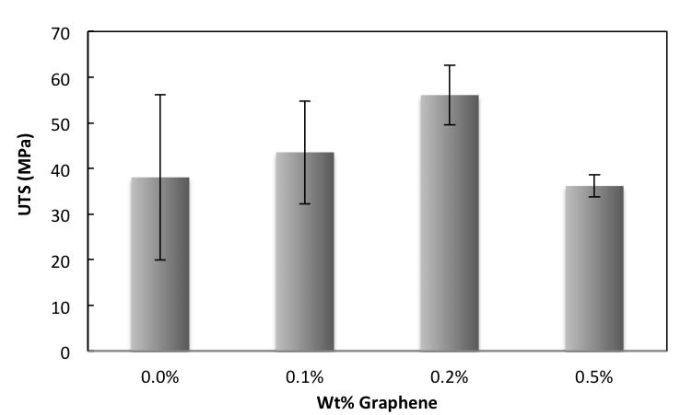
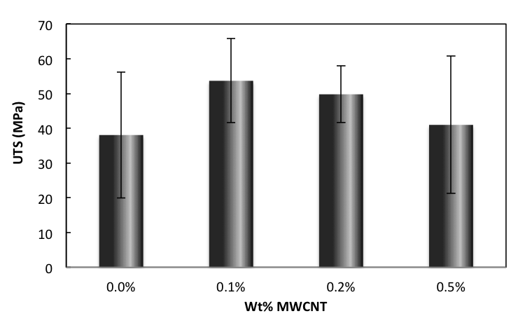
Tensile Testing: Ultimate Tensile Strength
Highest average strength in 0.2wt% Graphene and 0.1wt% MWCNT

Slide 24
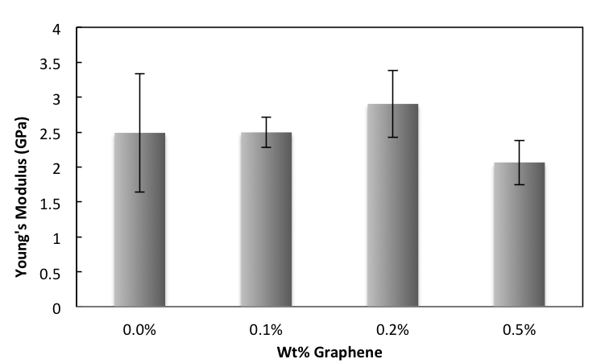
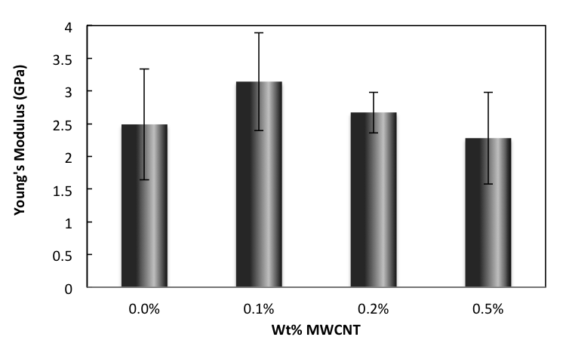
Tensile Testing: Young’s Modulus
Highest average modulus in 0.2 wt% Graphene and 0.1 wt% MWCNT

Slide 25
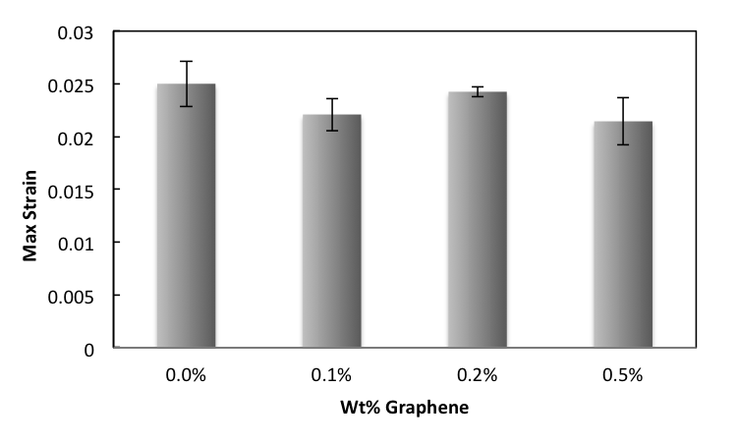
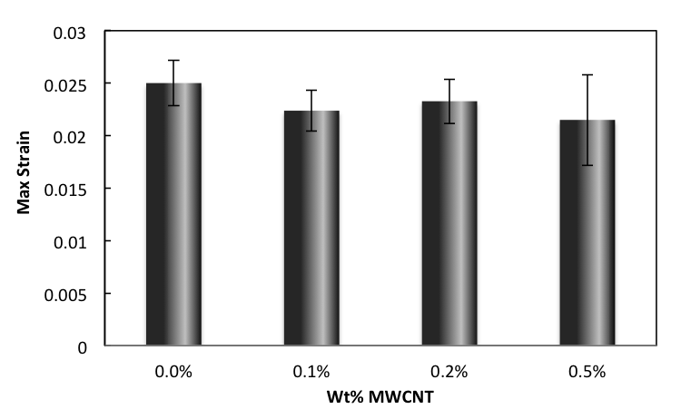
Tensile Testing: Elongation
Slight decrease in ductility in composites

Slide 26
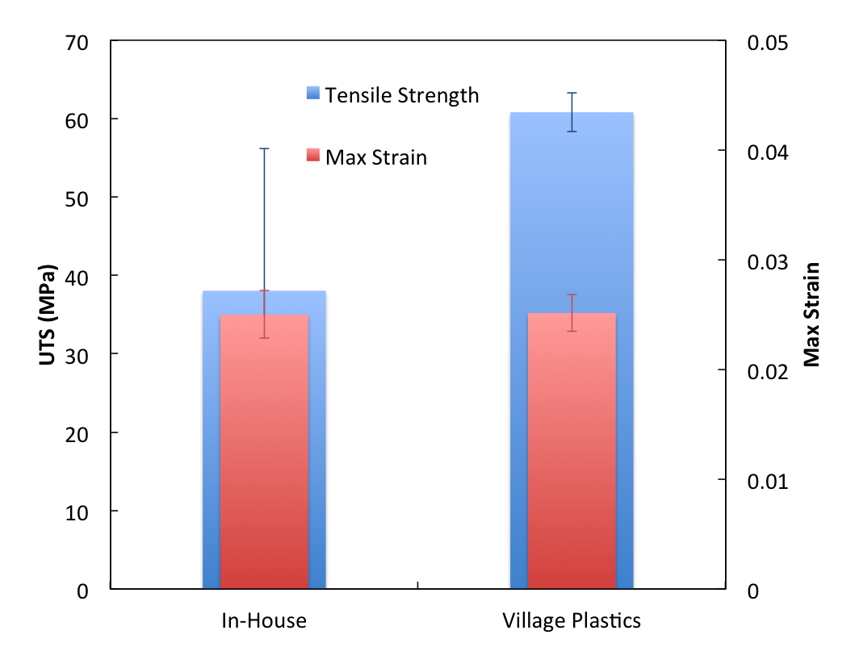
Tensile Testing: In-house vs. Village Plastics
Tensile tested Village Plastics produced filament to compare to our In-House fabricated filament for PLA
Results showed that elongation was consistent, but there was a decrease in UTS and a significant increase in the variation of the UTS

Slide 27
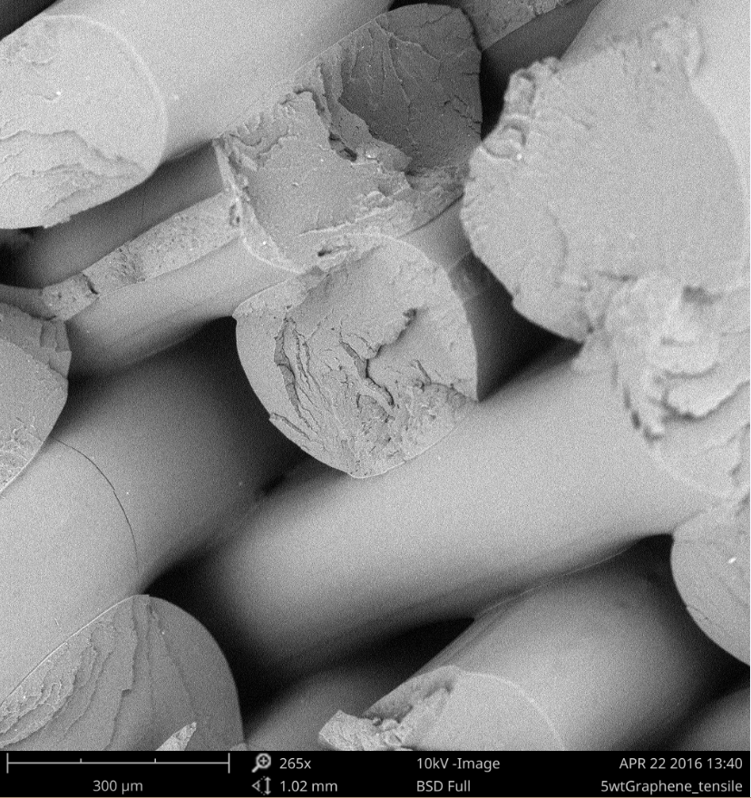
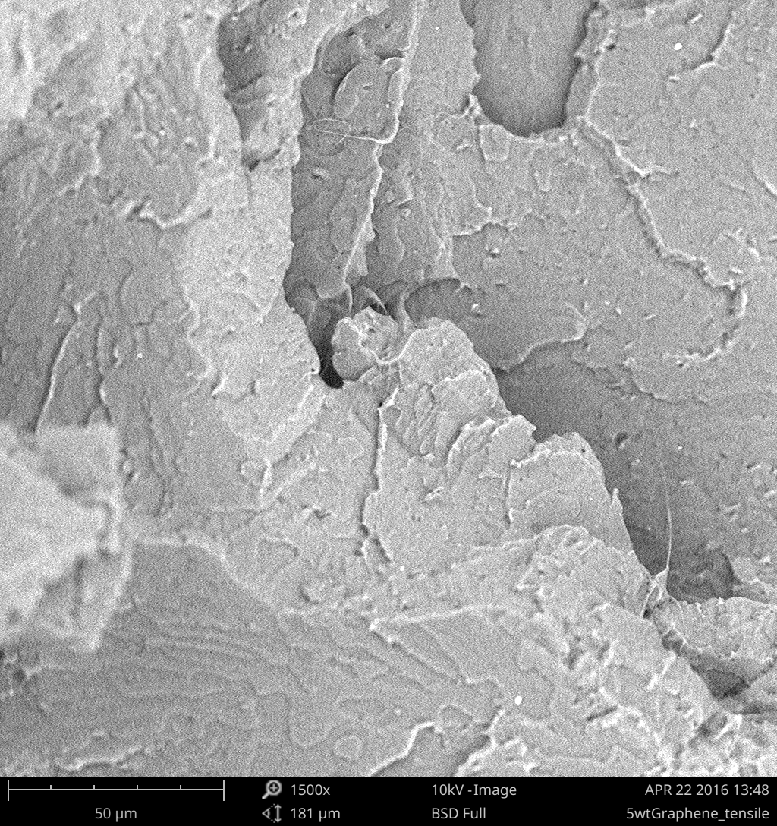
Tensile Fracture Surface
0.5 wt% Graphene
300 𝛍m
50 𝛍m

Slide 28
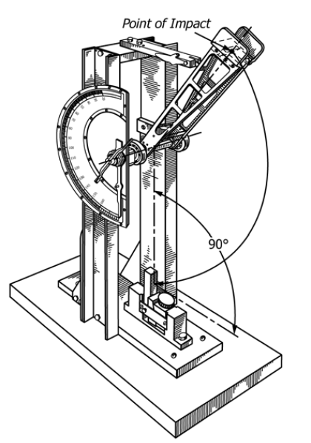
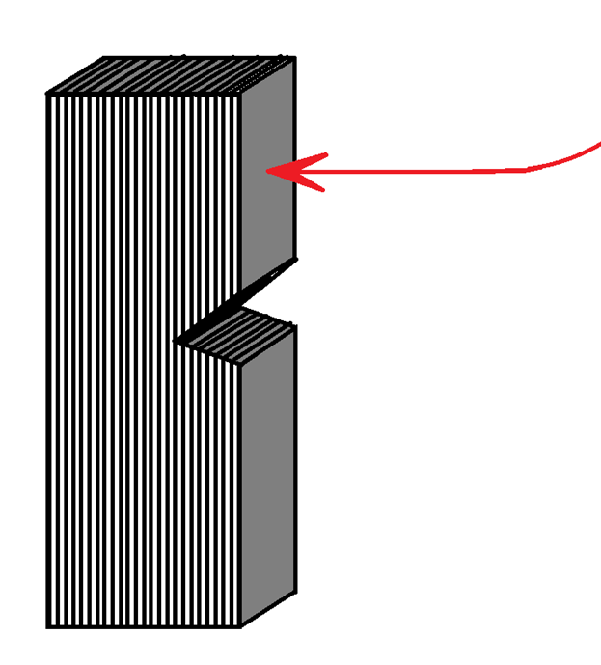
Impact Testing
Testing performed to ASTM D256
Notch applied after printing
Impact direction perpendicular to print orientation

Slide 29
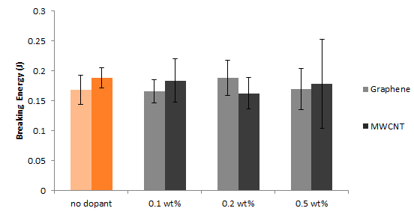
Impact Data
11.7% increase for 0.2% graphene over neat PLA
Village Plastics
In-House PLA

Slide 30
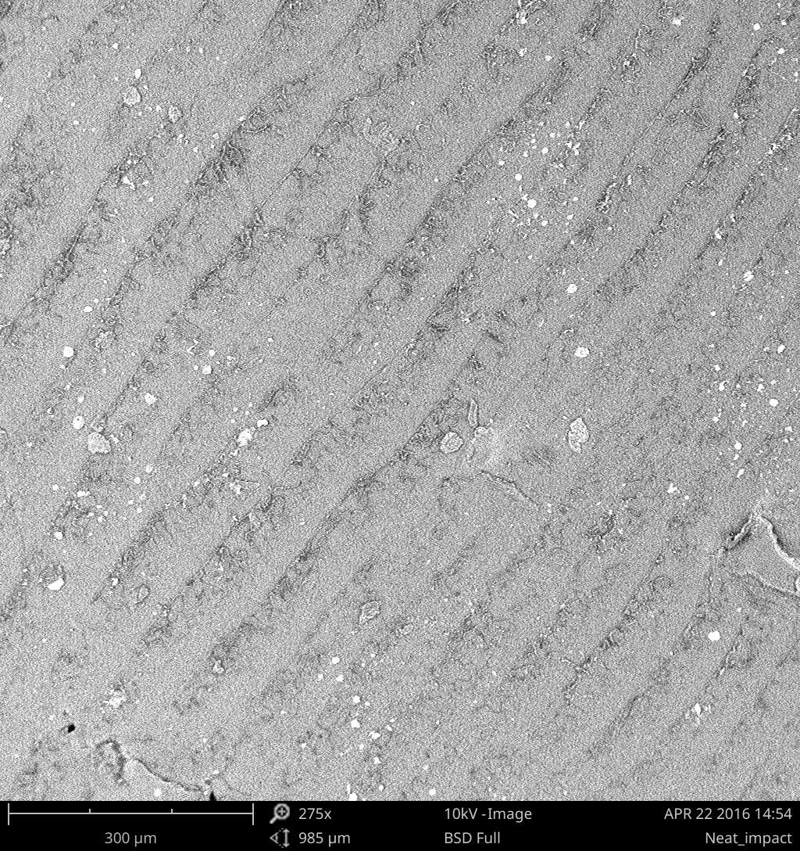
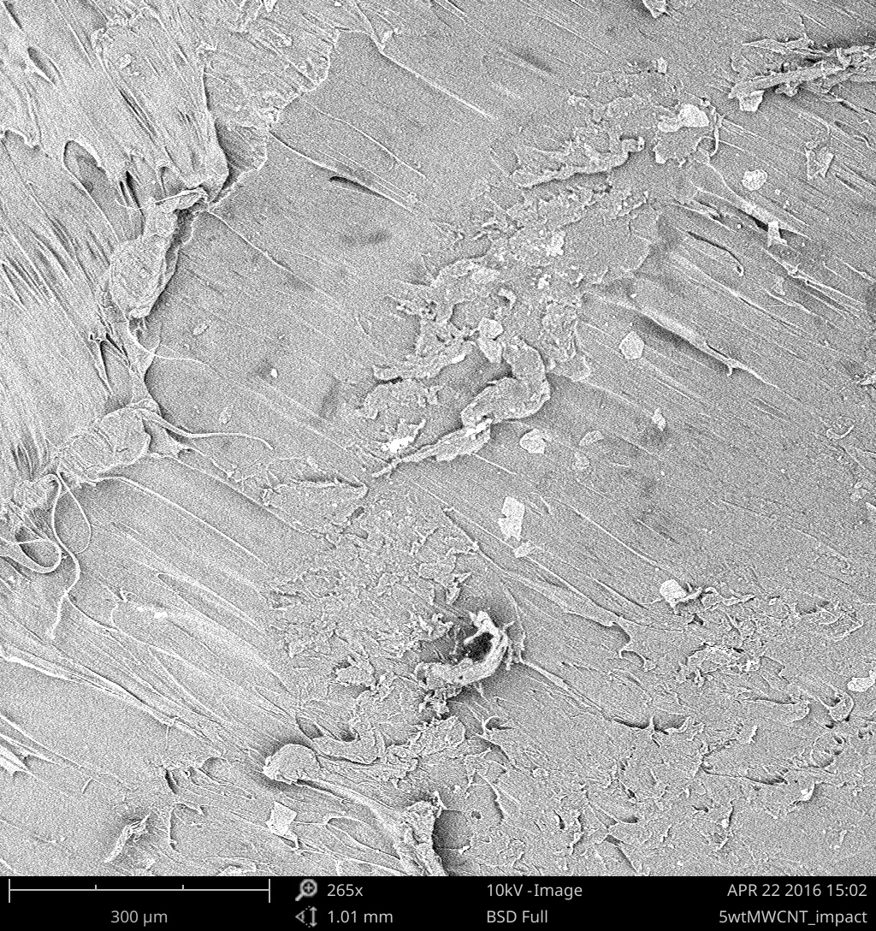
Impact Fracture Surface
No Dopant
0.5 wt% MWCNT
300 𝛍m
300 𝛍m

Slide 31
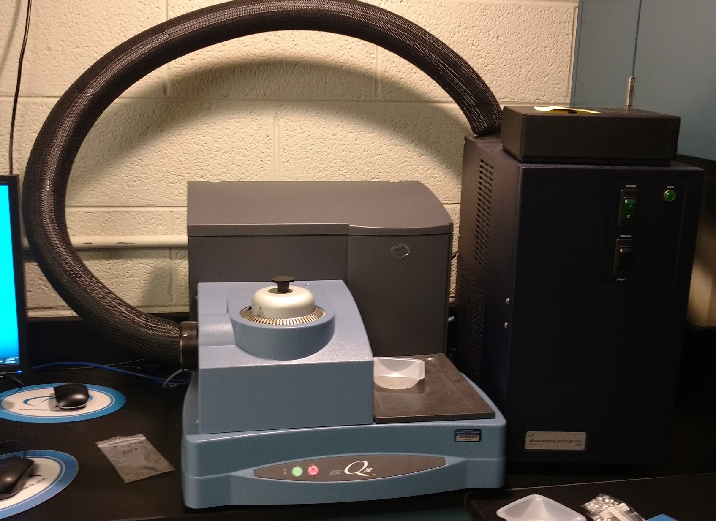
Differential Scanning Calorimetry (DSC)
DSC - thermoanalytical technique in which heat (through power) is applied to a sample linearly and cyclically
Helps identify phase transitions
Widely used in industry to evaluate sample purity and crystallinity
Used to confirm the phase of our samples
If a significant change occurs, then it warrants further investigation or could be the reason for a significant change in properties
TA Waters Q20MFC DSC
30°C to 200°C, ramp rate 5°C/min

Slide 32
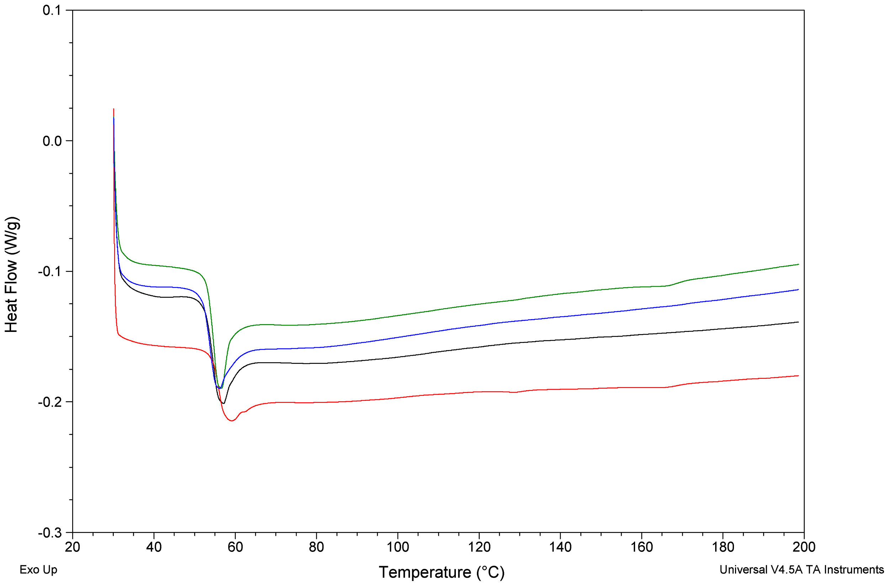
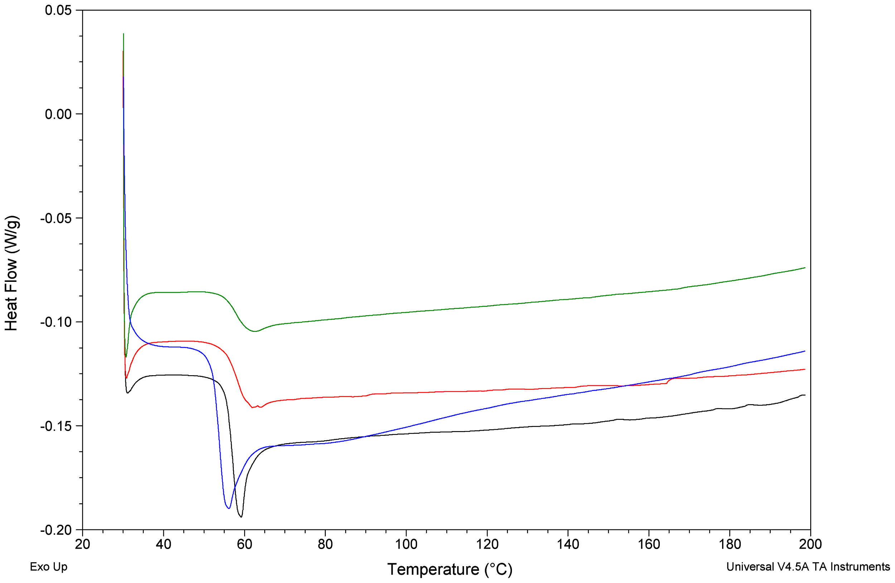


Heat Flow (W/g)
Temperature (ºC)

Slide 33
Outline
Introduction
Additive manufacturing concepts
  Filament - PLA
  Common additives
Objective and project description
1
Fabrication Process
Raw material to printed part
Extruder complications and filament reduction
1
Testing
Methods
Results
1
Conclusions
Testing conclusions
  Difficulties/Retrospective
  Recommendations

Slide 34
Conclusions
Successful proof of concept
Moderate improvement in mechanical properties
  0.2% Graphene - 47% UTS, 17% Modulus, 11.7% Fracture Energy,
  0.1% MWCNT - 41% UTS, 26% Modulus, 9% Fracture Energy
  Large deviation makes reaching statistical conclusions difficult
Graphene and MWCNT reinforcement had no discernable effect on Tg
Similar fracture patterns across loadings
No observable clumping of MWCNTs or graphene under SEM

Slide 35
Difficulties/Retrospective
Positives
Much was accomplished during the semester
  Were as consistent with testing as possible
Areas for Improvement
Uniformity of loading is difficult to evaluate
Ultimately need better statistics
  Would yield better results
  More testing samples, more filament, more time
Better extruder set-up would easily yield this
Potential Future Work
Improve statistics
Conductivity
Dimensional Stability
Residual Stress
Uniformity test

Slide 36




Extruder Recommendations
Remove protruding portion
Allows for direct water bath
Continuous extrusion = multiple prints
Easier to clean/access to the screw
Current placement is fixed
Purging is insufficient
More control over screw speed
Larger motor or better controller
Current controller seems to be faulty
Specialized screw for better mixing (such as a Maddock Mixer)
Notes:
Rob

Slide 37
Special Thanks
The University of Tennessee and the MSE Department
Dr. Bhat: Group advisor
Stephen Sheriff: Process Engineer - UTNRL
  Assistance with Tandec laboratory
Chris Wetteland and Zane Palmer
  Assistance with Dougherty laboratories
Oak Ridge National Laboratory
Carbon and Composites Group
  Dr. Halil Tekinalp
Deposition Science & Technology Group
  John Lindahl and Dr. Kunc
Notes:
Evans

Slide 38
References
I. Gibson, D. Rosen, B. Stucker, Additive Manufacturing Technologies: 3D Printing, Rapid Prototyping, and Direct Digital Manufacturing. 2e. 2015
Tymrak, B. M., M. Kreiger, and J. M. Pearce. "Mechanical Properties of Components Fabricated with Open-source 3-D Printers under Realistic Environmental Conditions." Materials and Design 58 (2014): 242-46.
ASTM D638-14, Standard Test Method for Tensile Properties of Plastics, ASTM International, West Conshohocken, PA, 2014
ASTM D256-10e1, Standard Test Methods for Determining the Izod Pendulum Impact Resistance of Plastics, ASTM International, West Conshohocken, PA, 2010
ASTM D3418-15, Standard Test Method for Transition Temperatures and Enthalpies of Fusion and Crystallization of Polymers by Differential Scanning Calorimetry, ASTM International, West Conshohocken, PA, 2015
Person, and Jim Frankland. "Single-Screw Mixing 101." Plastics Technology. Plastics Technology, May 2010. Web. 24 Apr. 2016.
Photo-references:
http://dupress.com/articles/additive-manufacturing-3d-opportunity-in-aerospace/
https://www.additively.com/en/learn-about/fused-deposition-modeling
http://store.makerbot.com/filament
http://p.globalsources.com/IMAGES/PDT/B1065615140/Glass-Fiber.jpg
http://www.carbonallotropes.com/39-122-thickbox/single-wall-carbon-nanotubes.jpg
http://core0.staticworld.net/images/article/2014/04/graphene_structure-100263091-orig.png

Slide 39

Thanks for Your Time and Attention
Do You Have Any Questions?

