Slide 1



How the palliative care consult is created by nursing staff in the emergency department for cancer patients:
Effects of Nurse-Led Triage Tool to Initiate Palliative Care Consult for Cancer Patients Being Treated in the Emergency Department
Kelsie Peterson BSN, RN; Samantha Bauer, DNP, FNP-C
BACKGROUND
INTERVENTIONS
Adult cancer patients coming to the emergency department (ED) for uncontrolled cancer-related symptoms are not receiving palliative care consults early in their hospital stay, if at all. This can lead to delayed patient care, uncontrolled symptoms, increased length of stay, and readmission rates within 30 days (El Majzoub et al., 2018).
A literature review suggests that among the adult cancer patient population, rates of using ED exceed those of the general population (Lash et al., 2017).
Cancer patients seeking care in the ED are experiencing a delay in palliative care consults, resulting in a delay of care and increased length of stay. In addition, they have a higher risk of returning to the ED within ten days, a higher length of stay within the hospital, and higher mortality rates when compared to patients being seen for non-cancer related diagnosis’ (Van der Meer et al., 2015).
An investigation that was completed in 2016 on ED visits for cancer patients in California showed a higher rate of this patient population returning to the ED within seven days (Nene et al., 2021).
An investigation that was completed in 2016 on ED visits for cancer patients in California showed a higher rate of this patient population returning to the ED within seven days (Nene et al., 2021).
A screening tool was created and added to the triage charting system. It is a modified version of the SPEED instrument. The created screening tool will only focus on uncontrolled cancer-related symptoms. The symptoms chosen were discussed with Dr. Tyson and Dr. Reed-Day with palliative care at UTMC and selected based on their expert recommendation.
RESULTS
Current UTMCK Data: Current Palliative Care Consults for 2023
  2260 consults YTD, or an average of 53 consults per week
  UTH, UFP, and Internal Med place 47% of consults
  ER places 4.7%
Length of stay from December 2021 to August 2022
  Palliative care consults initiated in the ER
    LOS for patient 6.15 days
  Palliative care consults initiated on Floor
    LOS for patient 11.12 days
  Palliative Care consult initiated in ICU
    Length of stay 20,9 days
Since the Implementation of the Triage Tool:
  83 consults created from January-April 2023
  LOS for the project was 6.08 days (no significant or clinical difference)
  Clinically significant in early identification of palliative needs.
  The project group had a lower percentage of deceased patients (22.9%) than the control group (36.4%), indicating the tool's effectiveness in identifying early palliative needs . This clinical significance is a key factor in improving patient outcomes.
  The project found that a higher percentage of patients in the project group (12.8%) had a cancer stage other than IV compared to the control group (3.9%).
LOCAL PROBLEM
Adult cancer patients presenting to the Emergency Department with uncontrolled cancer-related symptoms.
Examples of symptoms: Uncontrolled Pain with a pain scale score of 6 or greater, dyspnea, Uncontrolled Nausea and Vomiting, severe Fatigue
*Exclusion criteria include adult cancer patients being seen for any other reason unrelated to uncontrolled cancer symptoms.
Is the patient a current cancer patient?
If “yes,” the nurse will choose from the list which symptoms the patient is experiencing
Once the symptom(s) are selected, the nurse will save the pop-up.
If 2 or more symptoms were saved, palliative care receives a consult.
If “yes,” the nurse is directed to a pop-up that asks “Does the patient have any uncontrolled symptoms (pain/nausea/vomiting/fatigue/SOB) related to cancer
METHODS
To verify and compare data, 50 randomized patients will be selected from the same time period the project began a year before compare results from the screening tool.
Limitations are noted, and data will be collected on patients discharged from the emergency department after receiving a palliative care consult.
Readmission rates can only be calculated for those returning to UT Medical Center.
Whether the patient was discharged alive or deceased.
Number of patients presenting with uncontrolled symptoms that received a palliative care consult. A chi-square test to compare the % during pre who received a consult to % of those who received a consult
Mann-Whitney U test:
The total length of stay and median length of stay for patients who meet the criteria:
The emergency department length of stay
CONCLUSIONS
Increase in palliative consults from 4% of all Palliative consults in 2023 to 15% as of May 2024
Clinically significant in early identification of early palliative needs:
Can be modified to include other disease processes
ACKNOWLEDGEMENTS/FUNDING DISCLOSURE:
If you would like to thank anyone for their support (i.e., the project site staff, etc.) or received funding state it here

Slide 2
Guidelines for Poster Development and Submission
The template is consistent with the abstract headers used in SQUIRE 2.0 Guidelines. Please do not change the headers or content.
We ask that you use the provided template to ensure uniformity and program representation of the DNP Scholarly Project. Do not modify branding, colors, font type, or section headers.
  You may move headers up or down to accommodate the amount of content you have for each section.
  You may modify the text size of the content you enter for each section, but the font size used should be the same for each section.
  Use the center section creatively to highlight the big takeaway, such as a specific data visual. Use icons or pictures that draw someone in and are relevant to the problem/key takeaway/results. If you are in the project's planning stages, what is a statement to grab the audience's attention?
  You are not required to use a QR code, but it is highly recommended you use one to link to your references.
  While acknowledging your project site (or specific individuals) is a nice gesture, please ensure they are OK with their name being used in an acknowledgment that will be public. If they are not or you are not sure, simply state ”project site” (i.e., The authors which to thank the staff and providers of the project site for their dedication and commitment to this practice change). An acknowledgment of thanks is not required. However, if you received funding, this must be acknowledged.
  Please send
Consider these additional guidelines for more effective visual presentation and reader understanding:
  BE CONCISE, consider use of bullets or short passages and focus on ”must know” key points.
  Leave some “white space” between sections for better readability.
  Minimum font size for content is 24pt, the typical range is 24-36, erring toward the upper range when possible. The exception to this is for captions and acknowledgments which can be smaller but not less than 14-18pt.
  Use data visuals to tell the story with less words and more interest.
You may view the next slide for an example poster using this template. Please remember examples as just that, examples. Do not copy exact wording. Make your poster your own and a tool to best highlight YOUR project.

Slide 3
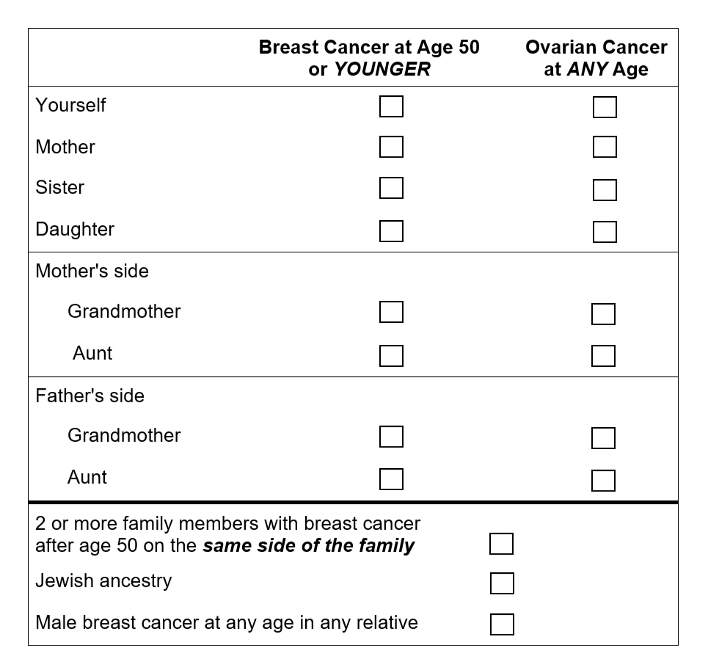
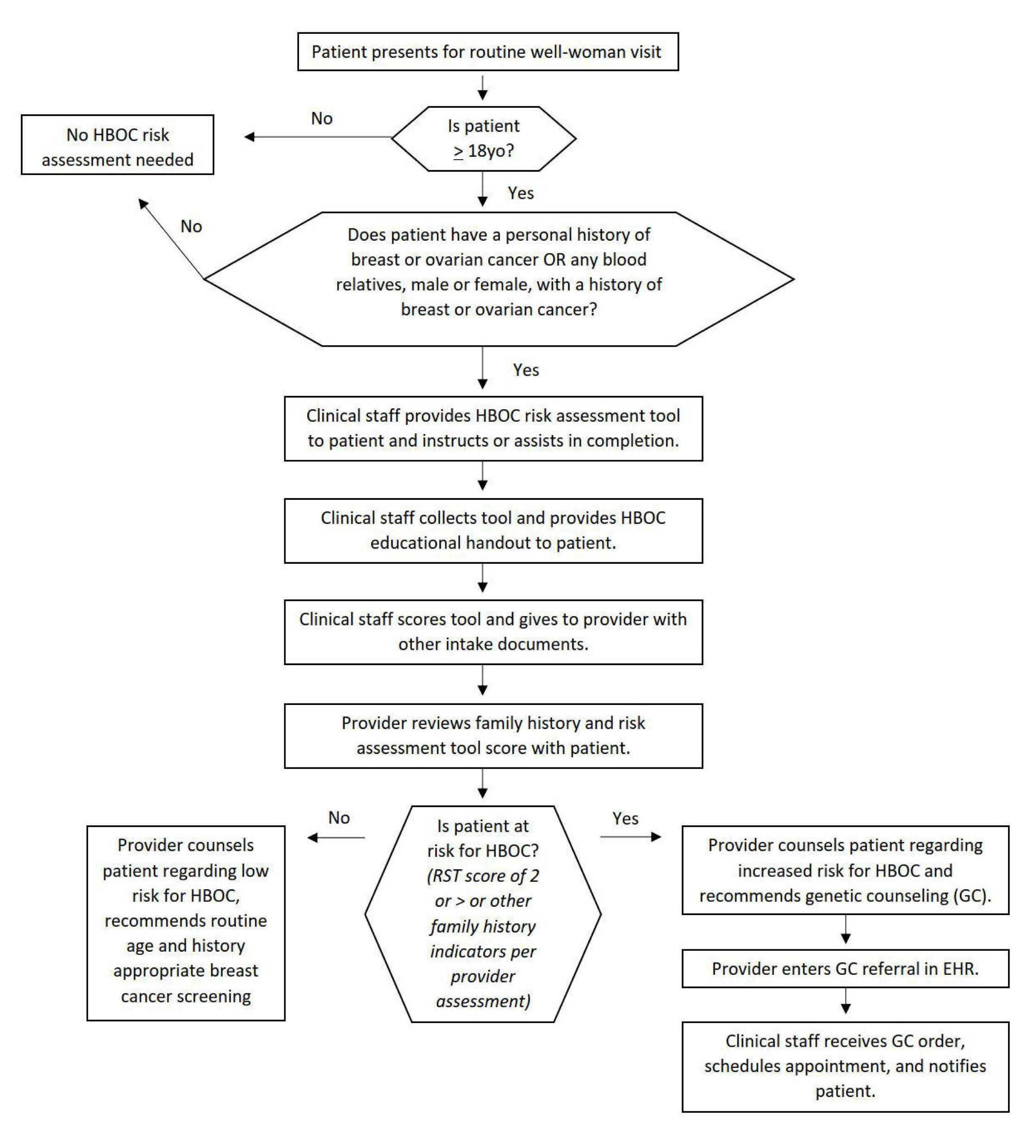



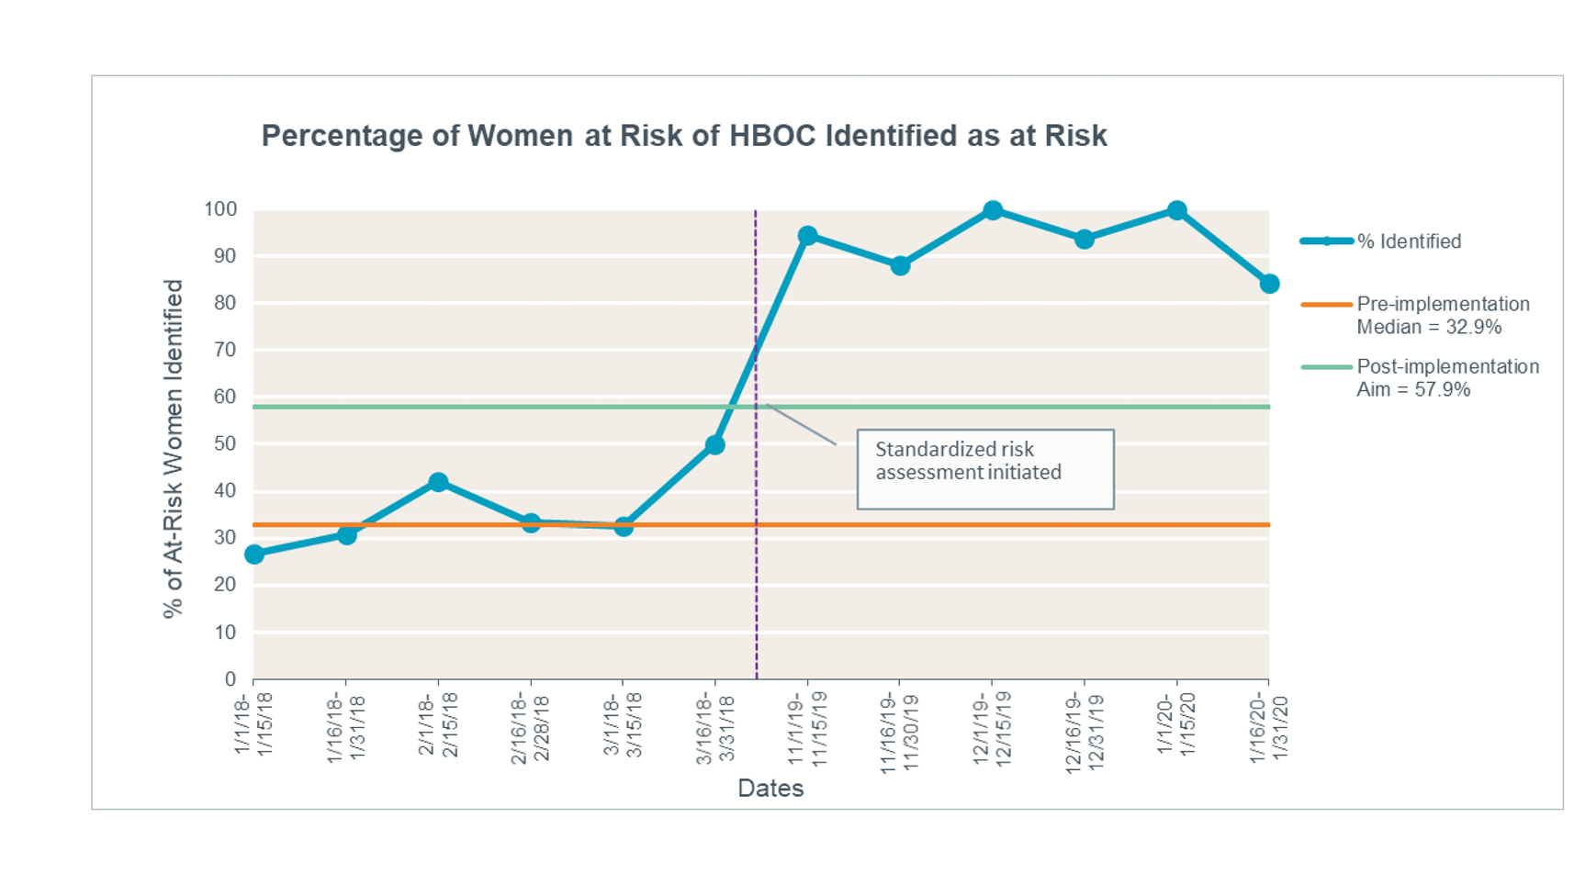
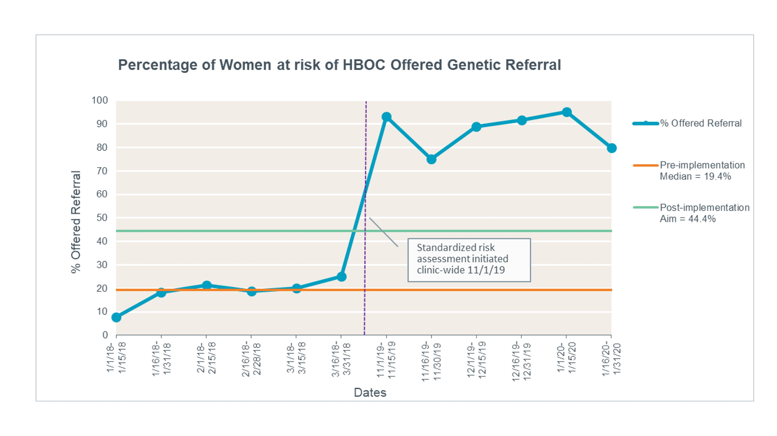


Women at risk of HBOC were significantly more likely to be identified and referred for genetic counseling after the implementation of a standardized HBOC risk assessment tool.
Implementation of Standardized Hereditary Breast and Ovarian Cancer (HBOC) Risk Assessment and Genetic Referral
MELISSA HESSOCK DNP, APRN, FNP-C; TRACY BREWER DNP, RNC-OB, CLC; SADIE HUTSON PHD, WHNP-BC, FAANP; JEFF ANDERSON, MD
BACKGROUND
INTERVENTIONS
Up to 10-15% of breast and ovarian cancers are due to HBOC syndrome.³⁵
Early detection of HBOC can reduce HBOC-related cancer morbidity and mortality through the use of enhanced screening and preventive measures.²¹⁻²⁴
HBOC risk assessment and genetic counseling referral are vastly underutilized in the United States.^{2,9,11,29,34}
Underutilization of screening and genetic referral contributes to missed opportunities to reduce HBOC-related cancer risks.
All women (> 18yo) presenting for well-woman visits were screened for HBOC risk using the RST tool.
Women with an RST score of > 2 were referred for genetic counseling.
LOCAL PROBLEM
The site for this practice improvement project is a private suburban OB/GYN practice in Tennessee.
Prior to implementation of the practice change intervention, HBOC identification and referral rates were low at, 35.1% and 18.2%, respectively.
The purpose of this project was to implement the use of a standardized HBOC risk assessment tool for use during preventive visits.
The aims of the project were:
    Increase identification of women at risk of HBOC by 25%
    Increase genetic referral for women at risk of HBOC by 25%
HBOC Referral Screening Tool (RST). A score of 2 or greater warrants genetic counseling referral. Adapted by permission from Springer Nature, “Evaluation of a breast/ovarian genetics referral screening tool in a mammography population,” by C. A. Bellcross, A. A. Lemke, L. S. Pape, A. L. Tess, and L. T. Meisner, 2009, Genetics in Medicine, 11, p. 784, Copyright 2009.
RESULTS
Identification rates of HBOC risk increased from 35.1% to 93.3; a 165.8% increase, far surpassing our aim of 25%.
Genetic referral rates for women at risk of HBOC increased from 18.2% to 87.5%; a 380.8% increase, which also far surpassed our aim.
Compliance with use of the RST was 85.9%.
METHODS
The Evidence-based Practice Improvement process model was used as the framework for this project.
Literature search and critical appraisal demonstrated good and consistent evidence supporting use of HBOC risk assessment tools.¹³
HBOC risk assessment tool selection and clinical decision-making algorithm development were made via PDSA (Plan-Do-Study-Act) Cycles.
Outcome measures of identification rates and referral rates were measured for a 3 month period pre-implementation and post-implementation.
Provider compliance with use of the risk assessment tool was measured for 3 months post-implementation.
CONCLUSIONS
Use of a standardized risk assessment tool resulted in a significant increase in the identification and referral of women at risk of HBOC in this setting
The RST and clinical-decision making algorithm were integrated into standard care at the practice site.
Early identification of women with HBOC is a crucial first step in HBOC-associated cancer morbidity and mortality.
Scan for full presentation and reference list.
ACKNOWLEDGEMENTS/FUNDING DISCLOSURE:
Many thanks to the staff and providers of Premier Medical Group, Clarksville, TN & the graduate faculty of the College of Nursing, University of Tennessee, Knoxville
No funding was received for this project

