Slide 1

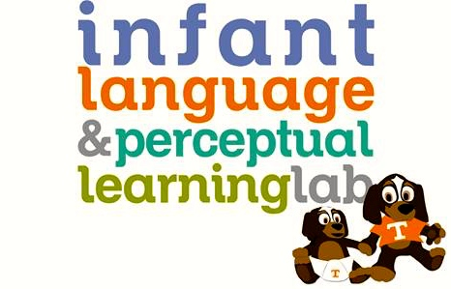
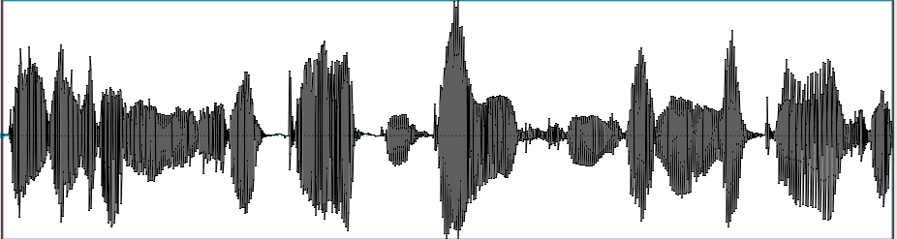
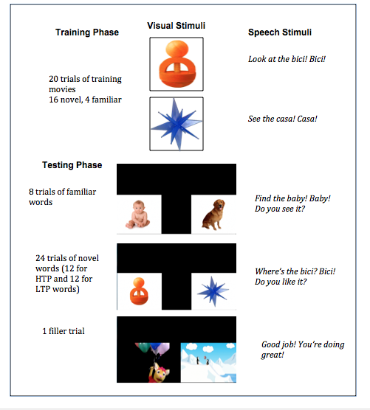
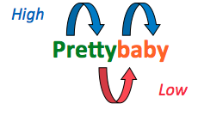
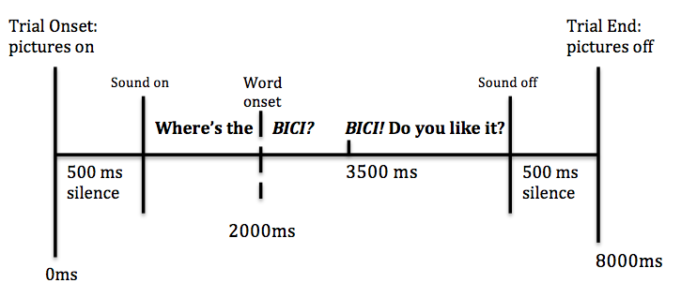
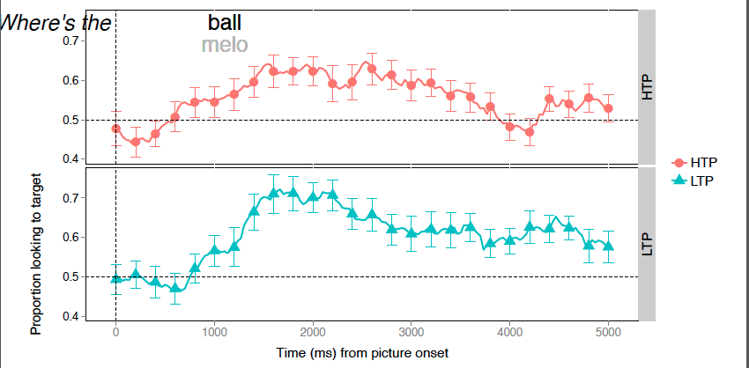
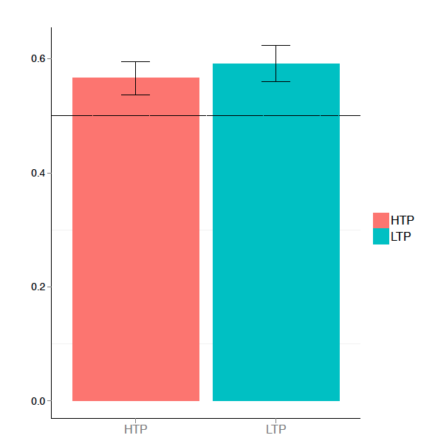
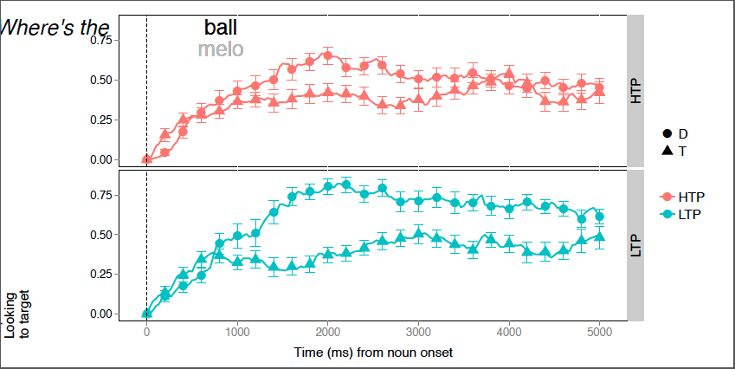
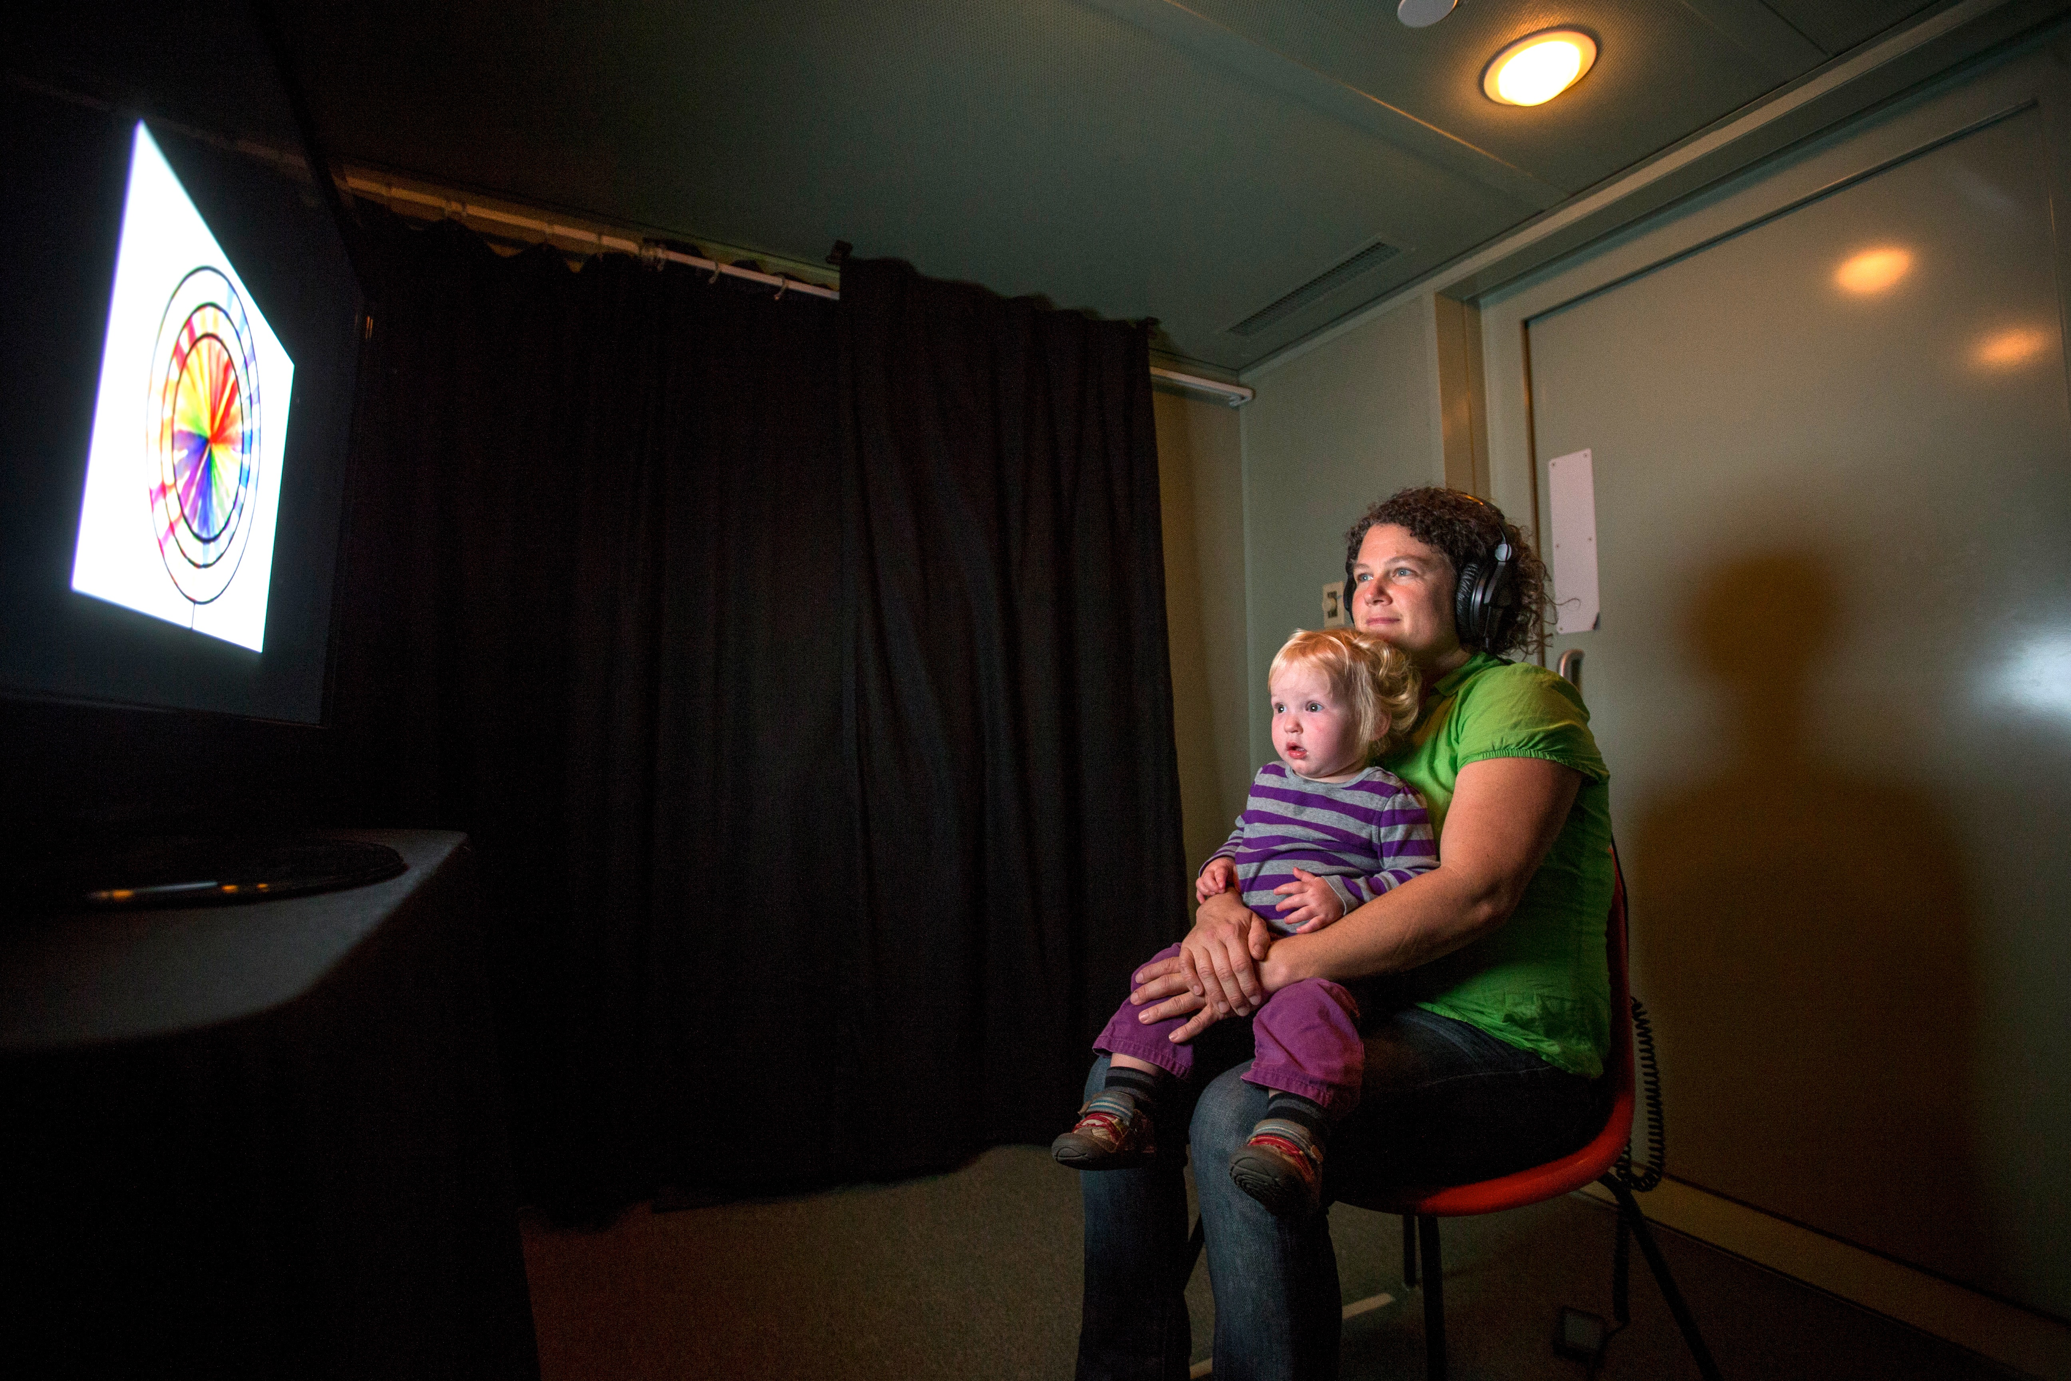
Word Learning in Quiet and in Noise: A Preliminary Study
Presenter: Grace M. Wholley Advisor: Jessica F. Hay
Department of Psychology, The University of Tennessee, Knoxville
Email: gwholley@vols.utk.edu Email: jhay@tennessee.edu
How do infants find words in continuous speech?
The majority of speech heard by infants is spoken continuously with few reliable acoustic cues to word boundaries.
Previous research has demonstrated that infants can track the transitional probability (TP) between syllables (i.e., the likelihood two syllables will co-occur) in continuous artificial (Saffran, Aslin, & Newport, 1996) and natural languages (Pelucchi, Hay & Saffran, 2009) to discover word boundaries.
Can infants map newly segmented words to meaning?
Finding words in continuous speech is just the first step in word learning. Word learning also involves mapping newly extracted sound sequences to meaning.
Previous research from our lab suggests that sound sequences that have stronger TP patterns do in fact make better object labels for 17-month-olds than those with with weaker TP patterns (Hay, Pelucchi, Graf Estes, & Saffran, 2011).
How does background noise affect statistical learning and subsequent word learning?
The infants’ acoustic environment is exceedingly complex and noisy, yet much of what we know about statistical learning comes from laboratory studies conducted in artificially quiet listening conditions.
Thus, it is unclear whether infants can track statistical regularities to extract candidate words under more ecologically valid listening conditions.
In the current study, we seek to establish a paradigm that we can use to test how statistical learning feeds into subsequent word learning in more ecologically valid listening conditions.
Previous work by Hay et al (2011)
used the Switch Paradigm,
which provides only gross
measures of dishabituation
to mapping violations,
and a between
subjects design to
measure word learning.
  Picture: Infant and parent
  participating in study in
  the Infant Language and
  Perceptual Learning Lab
Purpose:
To develop a sensitive within subjects methodology to test the relationship between statistical learning and subsequent word learning.
Participants:
20- to 24-month-old monolingual English-learning infants (n = 20) were recruited from the greater Knoxville area.
Materials:
We used a naturally produced Italian corpus in which the TP between syllables was manipulated in 4 target words: two high TP (HTP; TP=1.0) words with component syllables only occurring within those words, and two low TP (LTP; TP=.3) words with component syllables occurring in other words throughout the corpus.
A female native Italian speaker produced 2 counterbalanced languages, target novel words (casa, bici, fuga, and melo), familiar words (shoe, book, baby and doggie), and all English carrier phrases (e.g. Look at the)
Figure1: Schematic timeline for the test trials
Infants were successfully able to learn both the HTP, t(19) = 2.26, p = .036, and LTP words, t(19)=2.89, p = .009. Although accuracy performance appears to be somewhat better in the LTP than HTP condition this difference was not significant.
In both the HTP and LTP conditions, the infants showed the correct pattern of quickly shifting from the distractor to the target word after word onset in distractor onset trials and staying on the target word after word onset in target onset trials. This indicates that the infants were successful in recognizing the object-label pairings.
Methods
Introduction
P
Procedures:
Infants were first familiarized to one of the languages while watching an unrelated silent video (~2mins 15 sec).
Following familiarization infants were trained to pair 2 HTP and 2 LTP novel Italian words heard in the corpus to novel objects on the screen. Familiar words and objects were presented intermittently as fillers.
Finally, we used a Looking-While-Listening procedure (Fernald et al., 2008), to test accuracy and eye-gaze patterns to find the labeled object.
Order of test trials was counterbalanced across participants.
Learning was assessed by tracking eye movement using off-line coding on the iCoder software.
General Discussion
We were successful in developing a within subjects design using the more sensitive Looking-While-Listening procedure.
Infants were able to learn both HTP and LTP words from a novel natural language. However, our predictions that HTP words would make better object labels than LTP words was not supported.
Previous work has demonstrated that HTP words make better object labels that LTP word. Why did our infants learn both the HTP and LTP words?
The infants tested in this study were much older (20-24 months) than those tested in the Hay et al. (2011) study (17 months). Children at this age could be at a developmental level that makes them better word learners. They may be adept at using several cues other than just statistical probability.
Additionally, we provided referential support that was not used in the previous study. Referential support may have overridden the supportive effects statistical regularities have during early word learning. To address this issue, we would need to test infants using an unrelated corpus (i.e. one without statistical probability cues).
While the HTP words had a higher TP than the LTP, the LTP syllables appeared 3 times more often in the corpus than the syllables of the HTP words. Thus, syllable familiarity may have been driving learning in this study.
To address the role of syllable frequency in word learning we have developed test words in which the TPs of the target words are violated, but the syllable frequency is maintained (e.g., pair the first syllable of one LTP word with the last syllable of another LTP word – caci and bisa instead of casa and bici). This experiment would help elucidate the relative roles of syllable frequency and transitional probability during early word learning.
What next?
After running the appropriate control conditions, we will present background during the familiarization phase to test the resilience of statistical learning. This will help us understand statistical learning and subsequent word learning in a more natural setting.
Sp e sso l i s a ca pi ta in f u g a n e l l a c a s a
P(by|ba) = frequency of pair baby
frequency of ba
P(ba|ty) = frequency of pair tyba
frequency of ty
Results
Target window: 300-2000 (ms)
References
Hay, J. F., Pelucchi, B., Estes, K. G., & Saffran, J. R. (2011). Linking sounds to meanings: Infant statistical learning in a natural language. Cognitive Psychology, 63(2), 93-106. doi:10.1016/j.cogpsych.2011.06.002
Fernald, A., Zangl, R., Portillo, A. L., & Marchman, V. A. (2008). Developmental Psycholinguistics: On-line methods in children’s language processing (I. A. Sekerina, E. M. Fernandez, & H. Clahsen, Eds.). Amsterdam: John Benjamins (pp. 97-135.). doi:10.1075/lald.44
Pelucchi, B., Hay, J. F., & Saffran, J. R. (2009). Statistical Learning in a Natural Language by 8-Month-Old Infants. Child Development, 80(3), 674-685. doi:10.1111/j.1467-8624.2009.01290.x
Saffran, J. R., Aslin, R. N., & Newport, E. L. (1996). Statistical Learning By 8-Month Old Infants. Science, 274(5294), 1926-1928. doi:10.1126/science.274.5294.1926
Mean Accuracy for HTP and LTP conditions
Time (ms) from word onset
Figure 3: Eye-gaze plot shows the proportion of looking to the target across test trials. Both the HTP and LTP conditions show a pattern that indicates word learning. Again, the LTP seems to show a higher proportion of looking but it is not significantly higher than the HTP.
Mean proportion of looking to target
Target Windw: 300-200 (ms)
Acknowledgements
Proportion of shifting following label onset
We would like to extend a warm thank you to all participating families and the members of the Infant Language and Perceptual Learning Lab at the University of Tennessee, Knoxville.
This work was supported by a grant to JFH (1R01HD083312) from NICHD.
Poster presented at the Exhibition of Undergraduate Research and Creative Achievement (Eureca) at the University of Tennessee in Knoxville, Tennessee.
Time (ms) from word onset
Figure 2: The mean accuracy of HTP and LTP words measured by proportion of time looking at target. Accuracy window was 300-2000ms following word onset. Error bar represent standard error of the mean.
Figure 4: Proportion of shifting following word onset on target initial trials (i.e., trials in which infants were looking at the target at word onset) and on distractor initial trials (i.e., trials in which infants were looking at the distractor at word onset). This graph shows the typical separation expected in word learning. In distractor initial trials, infants were quick to shift their gaze to the target, and in target initial trials, the infants inhibited shifting behavior and maintained fixation on the target.
Notes:
large variations in pitch are occurring over a long time frame (i.e., 100s of milliseconds), whereas consonant distinctions occur on a short timeframe (i.e., 10s of milliseconds)
The low dipping contour may also have pragmatic, intonation usage in English (Fernald, 1992)
We hope to further test falling verses dipping pitch contours and falling versus level pitch contours.
The results of these experiments may suggest all learning is attributed to a rising pitch contour, possibly because of its pragmatic, intonational usage in American English.
The low dipping contour may also have pragmatic, intonation usage in English (Fernald, 1992).
These data suggest infants learning may be carried by the rising, English salient pitch contour.
We hope to further test falling verses dipping pitch contours and falling versus level pitch contours.
Since previous research suggests falling versus rising is learnable (REF), these further tests will help us understand if learning is attributed to a rising contour.
This further tests will help guide our understanding if the prosodic characteristics of an infants native language shapes their willingness to contrastively use pitch contours.
Purpose: To explore the hypothesis that rising vs falling pitch contours have privileged status for contrastive use
No acoustic overlap, have distinct starting and ending pitch, opposite pitch trajectories
Distinction shows some resistance to perceptual narrowing (ref)
Experience with rising and falling contours in infant directed speech may support their contrastive use
Results→ In Experiment 2, the 14 month olds significantly differed in looking times between same (M=6.03) versus switch (M=8.40) trials, t(13)=___, p=.003 These data suggest the infants learned the level versus rising contours contrastively.

