Slide 1


Connecting islamic technology & the history of robotics in Wikidata via Wikidatabot
Anchalee (Joy) Panigabutra-Roberts
Associate Professor
Head of Cataloging
The University of Tennessee Libraries
apanigab at utk dot edu
ORCID: 0000-0002-9333-1102
Grant number: RE-246419-OLS-20
Notes:
Project Presentation Note (five minutes)
July 16, 2021
Title: Connecting Islamic Technology and the History of Robotics in Wikidata via Wikidatabot.
Good morning, sabah el kheir, ni hao and ola.
My name is Anchalee Panigabutra-Roberts with the Thai nickname, Joy. I’m the Head of Cataloging at the University of Tennessee Libraries on our beautiful Knoxville campus here. Today I will share with you my project during this IDEA Institute on AI.

Slide 2
Outline
Part I. al-Jazari and his contribution to robotics
a. First encounter at AUC Libraries
b. Donald Hill & Islamic technology
Part II. Wikidata as a platform to understand the power of linked data in action
a. al-Jazari, automatons and Scholia in Wikidata (SWIB2020)
b. GLAM’s convergence in Wikidata via working on ‘al-Jazari’
Part III. vanderbot: batch processing data into Wikidata & name authority’s creation
a. Learning & testing vanderbot
b. Future plans
  1) increase the presence of works on Islamic technology in Wikidata via vanderbot & in collaboration with Iman Dagher, Arabic & Islamic Studies Catalog Librarian, UCLA via Excel sheet
  2) @UTK: automate the creation of authority records using the new authority macro to create ‘NACO Lite’ records from Wikidata

Slide 3
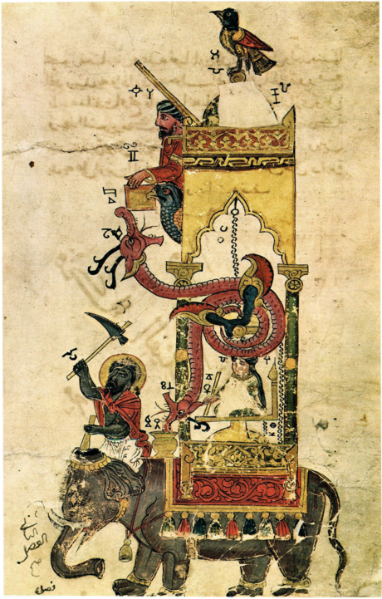
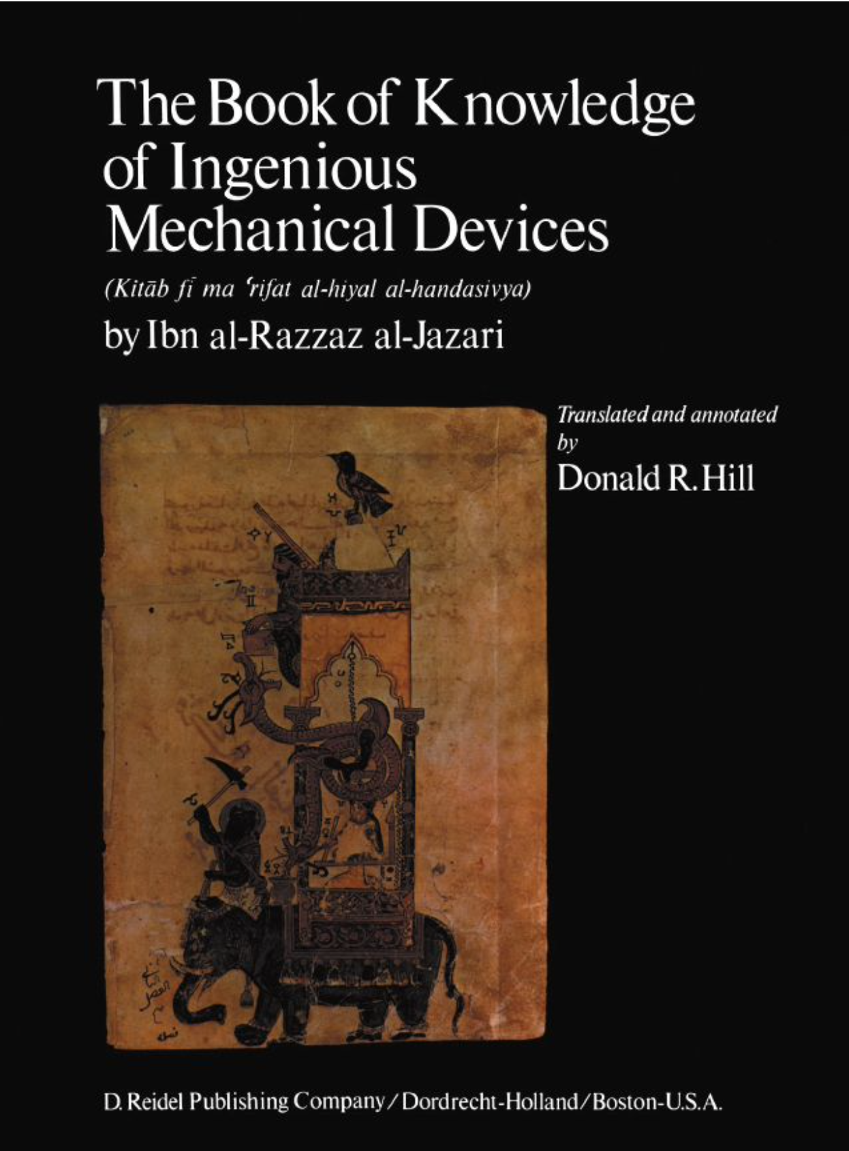
OCLC #610263351
al-Jazari’s Elephant Clock:
https://commons.wikimedia.org/wiki/File:Al-Jazari_Automata_Elephant-Clock_1315.jpg
https://www.trtworld.com/magazine/why-ismail-al-jazari-is-called-the-father-of-medieval-robots-36840
al-Jazari’s Exhibit at Istanbul Museum
Notes:
My current study is on the connection between the history of robotics and Islamic technology. I focused on early Muslim inventors, such as al-Jazari, from Artuqid Dynasty of Jazira in Mesopotamia (modern day Iraq, Syria and Turkey) who is considered to be the father of robotics based on his manuscript treaty , al-Jāmiʻ bayna al-ʻilm wa-al-ʻamal al-nāfiʻ fī ṣināʻat al-ḥiyal, published after his passing in 1206, translated by Donald R. Hill, a British engineer and scholar on Islamic technology, with the title, the Book of Knowledge of Ingenious Mechanical Devices in 1974.
Here is one of his famous invention called the elephant clock, or this elaborate structure with multiple moving parts using hydro power, starting from a water basin with a deep bowl with a hole in it to start all the actions. This bowl floats above the water at the beginning. When the water fills up the bowl, it will sink and pull a string that start to create the movements throughout the structure to hit the drum to tell a half or full hour.
You can see the new exhibit at the Istanbul Museum that recreate the devices from his book via the link to a Youtube video.
The manuscript from 1206 is now in the Bodeliean Libraries, University of Oxford in United Kingdom.

Slide 4
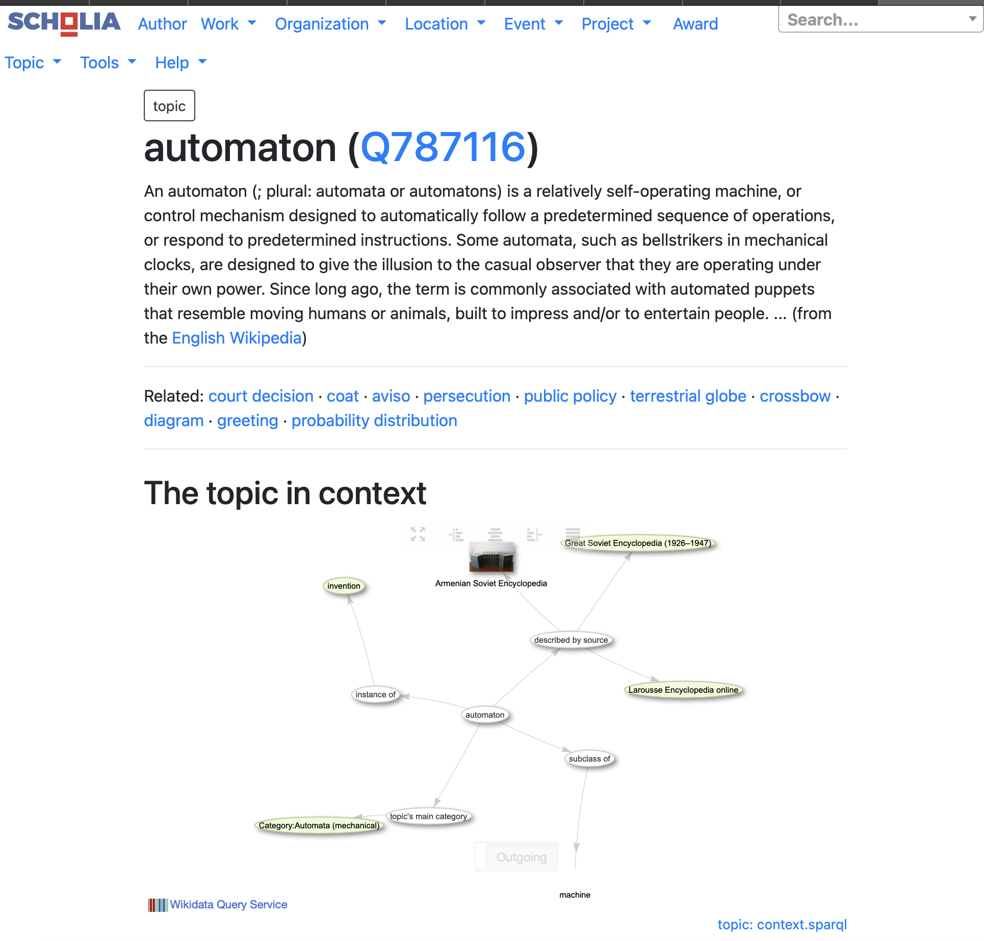
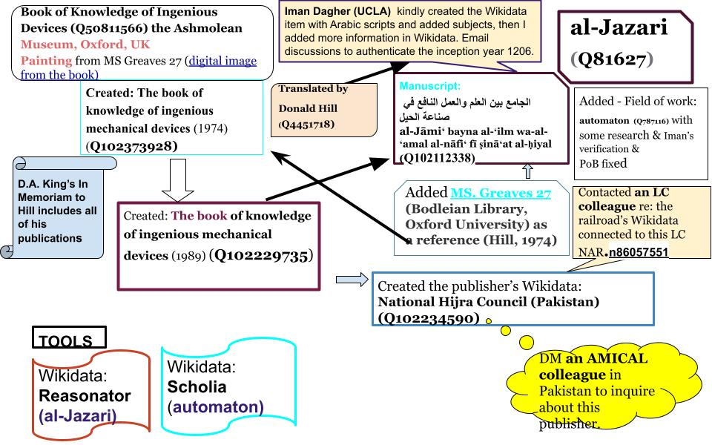
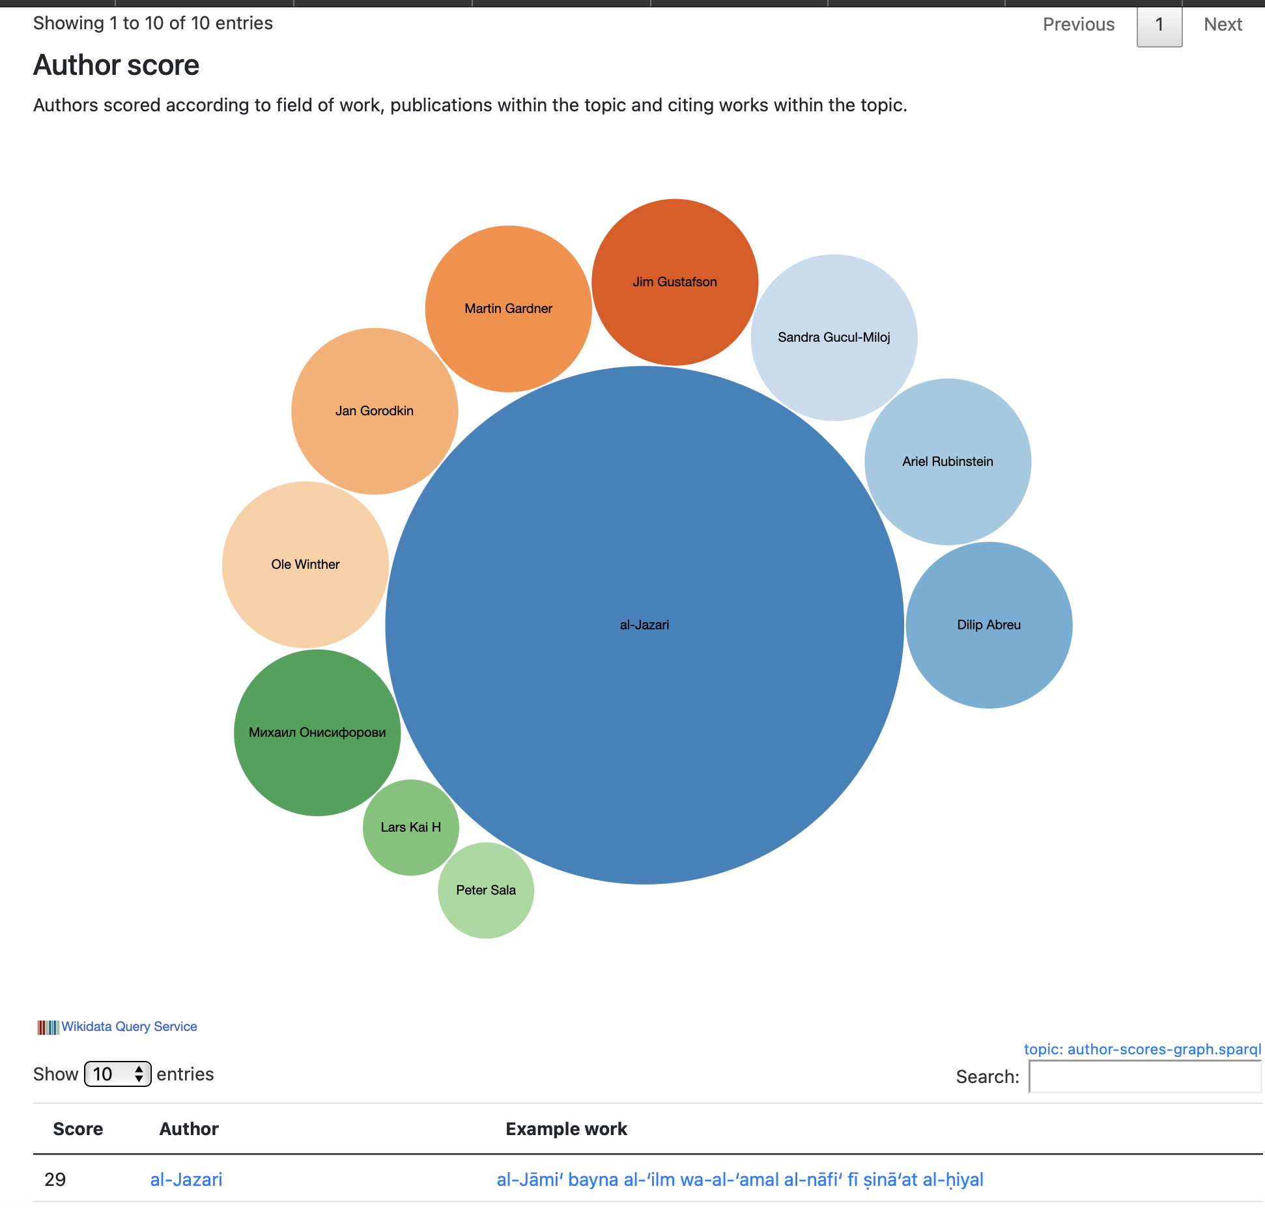
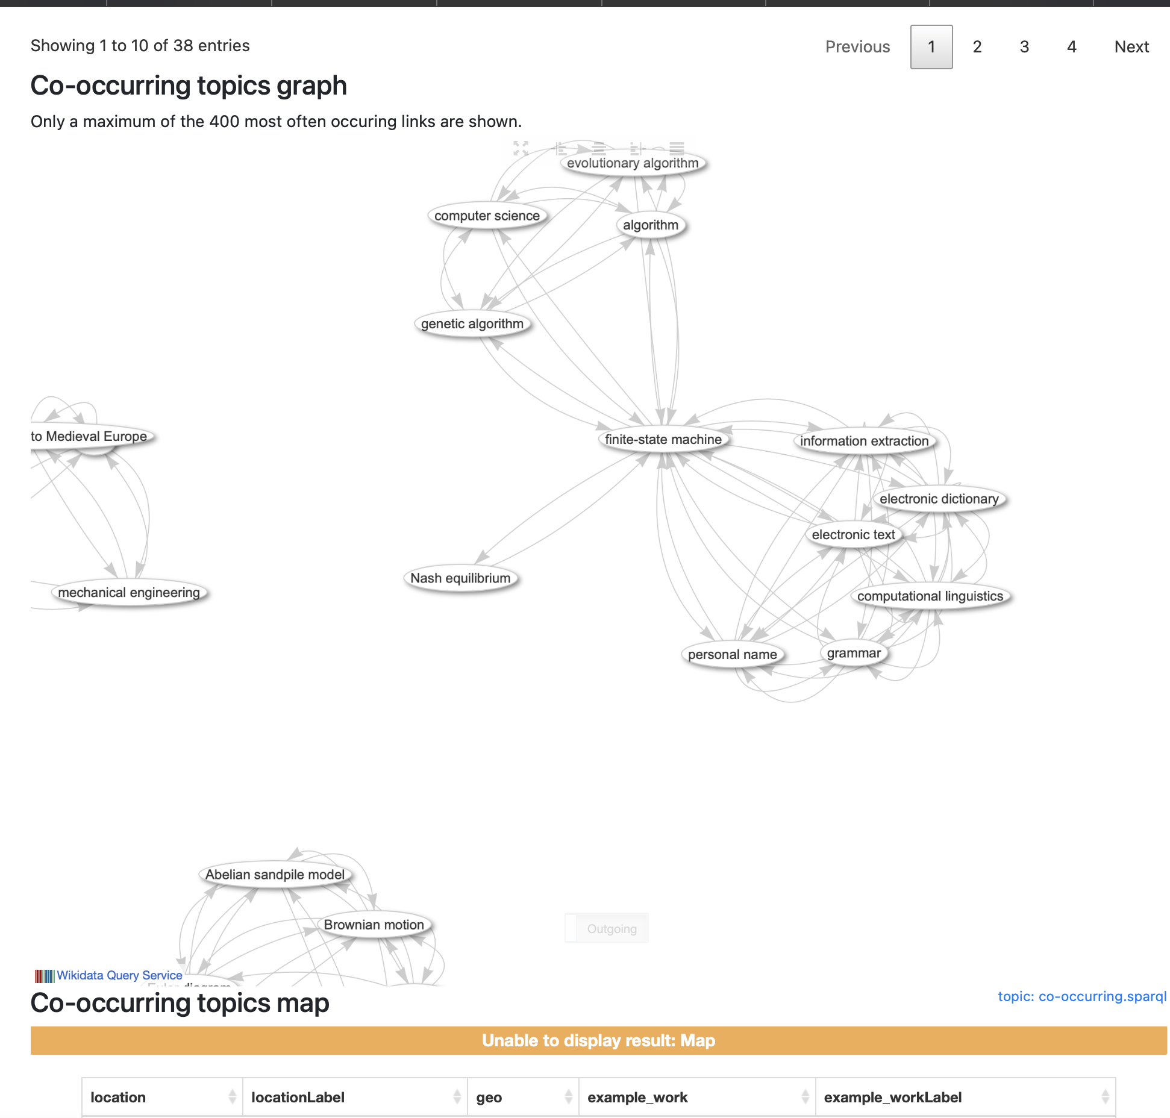
https://scholia.toolforge.org/topic/Q787116
Wikidata & Scholia
Scholarly publications & visualization tools in Wikidata
al-Jazari: https://www.wikidata.org/wiki/Q81627
Notes:
In this institute, I explored tools to build knowledge graphs for my current research on robotics and Islamic technology in Wikidata.
My project would demonstrate how linked data can reveal interdisciplinary connections among our library collections for our users as well as connecting them to the linked open data beyond our collections.
Prior to this institute, I worked on a small project with Iman Dagher, Arabic & Islamic Studies Catalog Librarian at UCLA Libraries for a presentation at Semantic Web in Libraries Conference last year. I added al-Jazari’s subject areas including automaton and his works and related materials to Wikidata.
The impact on this work added to the subject clustering and change the visualization of the network concept on ‘automaton’ in Scholia which is a tool within Wikidata for data visualization of scholarly publications as you can see here.
My addition of al-Jazari’s expertise in Wikidata ‘automaton’ changed the dynamics of the knowledge graph on this subject in Scholia.

Slide 5
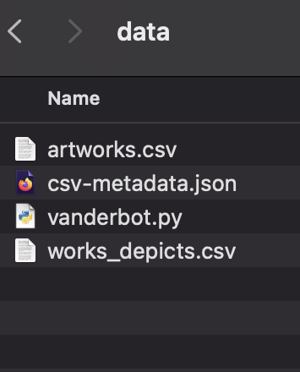
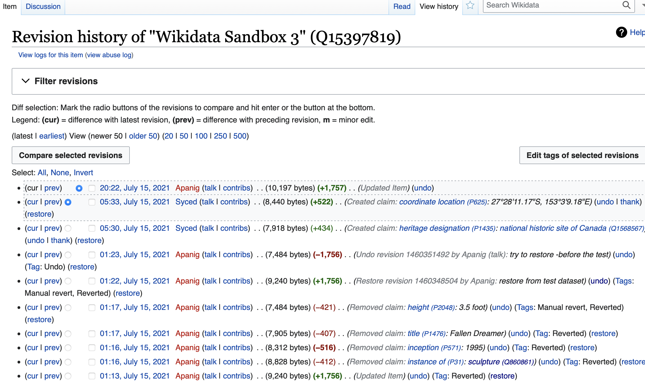
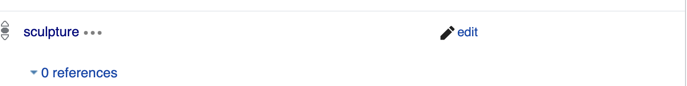
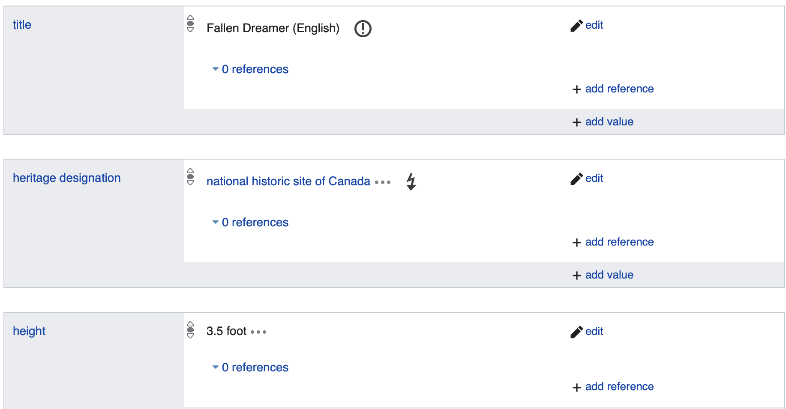
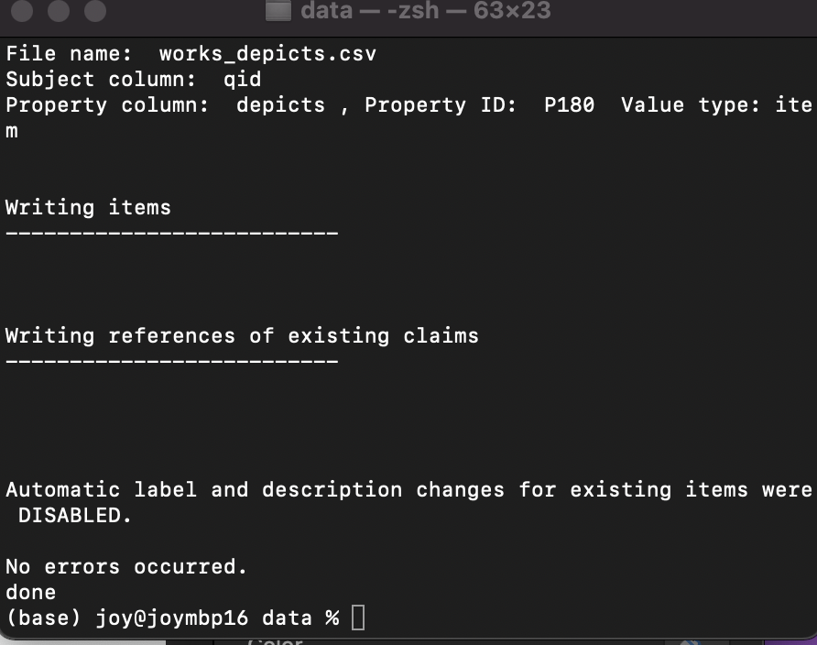
Working with vanderbot & Wikidata Sandbox
https://www.wikidata.org/wiki/Q15397819
Notes:
During the institute, the tool I explored is called VanderBot, a Python script created by Steven Baskauf, Data Science and Data Curation Specialist, Heard Libraries, Vanderbilt University to batch process data input in Excel/csv file format into Wikidata.
The additional benefit is to use Wikidata we create via VanderBot to create name authorities to add to the Library of Congress Name Authority File with a new macro created by Gary Strawn, from Northwestern University Libraries, to generate data and URIs from Wikidata to add to LC authority file.
To work on this project, I took the online tutorial Steve Baskauf created for VanderBot and tried to get the result to work in Wikidata sandbox. I needed to work with Python in my computer terminal to run the VanderBot Python script. It also needed the json file for the metadata, the actual data and metadata that you need to create in .csv and then convert the data into the Python script.
Then I could run VanderBot to add my new data into Wikidata.
It took me twice to get it right. Here I could add my test metadata as you can see in the Wikidata Sandbox’s results. After the institute I will contact Steve Baskauf for his help with adding the Arabic script to our data model.
Thank you so much again to all involved in this institute. I truly, truly appreciate this opportunity to learn about AIs in the libraries and also for the time and opportunity to test VanderBot for my own projects. I will also treasure the friendship I created during this institute. Thank you so much.

