Slide 1

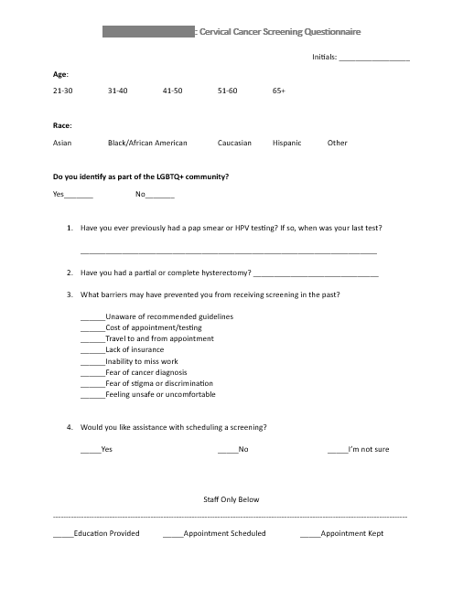
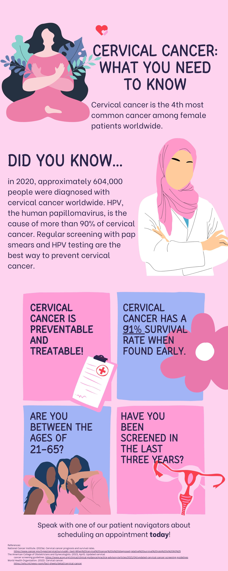



Patient navigation programs are an evidence-based way to increase uptake of cervical cancer screenings.
Increasing Uptake of Cervical Cancer Screening:
An Improvement Project
Devin M. Hammonds, BSN, RN, Dr. Samantha Bauer, DNP, FNP-C, Sister Mary Lisa Renfer, RSM, DO
BACKGROUND
INTERVENTIONS
Cervical cancer is the fourth most common cancer among biologically female people worldwide.
The five-year survival rate is 91% when cervical cancer is found early.
If not found until the cancer reaches distal organs and tissues, the survival rate is only 19%.
Screening using Papanicolaou (pap) and human papillomavirus (HPV) testing is necessary for positive patient outcomes.
Regular screening reduces the incidence of cervical cancer and death by 80%.
During the registration process, the questionnaire (translated into English, Spanish, and Vietnamese) was used to screen every woman aged 21-65 who presented for appointments.
Patients also received an educational infographic.
Any patient identified for screening was offered testing at the appointment or the opportunity to schedule a later appointment for screening.
LOCAL PROBLEM
The quality improvement project was implemented within a mobile clinic serving uninsured patients in East Tennessee.
Prior to implementation, cervical cancer screening rates at the site were 45%.
The administration of the mobile clinic has identified cervical cancer screening as an area for quality improvement for their patient population.
This project aimed to increase the uptake of cervical cancer screening to 60% using a patient navigation program.
RESULTS
Screening Rates increased by
110 women were assessed for cervical cancer screening needs.
35% of patients were in the 41-50 year age range, and 33% were in the 51-60 year age range.
The most common barriers to previous screenings were the lack of insurance and the cost of screening.
Post-intervention screening rate was 56.25%, which was an increase of 11.25% over the pre-intervention rate.
11.3%
METHODS
The IHI Model for Improvement was used as the framework for this project.
Literature search and critical appraisal using the Johns Hopkins Research evidence appraisal tool demonstrated reliable evidence to support the use of a patient navigation program.
Using Plan, Do, Study, Act (PDSA) cycles, a questionnaire was developed to assess the need for screening.
Outcome measures were measured for three months post-implementation.
CONCLUSIONS
Patient navigation programs are an evidence-based way to increase the uptake of cervical cancer screenings.
The project site plans to edit its intake form to include all cancer screenings.
ACKNOWLEDGEMENTS/FUNDING DISCLOSURE:
Thank you to my project chair, project site staff, volunteers, and providers for your support. No funding was received for this quality improvement project.

