Slide 1
Working with VanderBot
to Add Multilingual Content
(in English and Arabic)
to Wikidata
LD4 2022 Virtual Conference
July 14, 2022
Notes:
Hello. My name is Anchalee Panigabutra-Roberts with the Thai nickname Joy. I am the Head of Cataloging at the University of Tennessee Libraries in Knoxville, Tennessee, United States. I have a privilege to work with two of my senior colleagues to work on this presentation on “Working with VanderBot to Add Mulilingual Content in English and Arabic to Wikidata.”

Slide 2

Steve Baskauf
Data Science and Data Curation Specialist
Jean & Alexander Heard Libraries
Vanderbilt University
Nashville, Tennessee, U.S.A.
steve.baskauf@Vanderbilt.Edu
Iman Dagher
Arabic & Islamic Studies Metadata Librarian
University of California, Los Angeles
Los Angeles, California, U.S.A
idagher@library.ucla.edu
Anchalee Panigabutra-Roberts
Head of Cataloging
The University of Tennessee Libraries
Knoxville, Tennessee, U.S.A.
apanigab@utk.edu
Notes:
Steve Baskauf, Data Science and Data Curation Specialist at Vanderbilt University and Iman Dagher, Arabic & Islamic Studies Metadata Librarian at the University of California, Los Angeles and I collaborated on this project to apply VanderBot for works of translations in Engllish from the original in Arabic.
Steve and I will go through the presentation and we will be happy to answer questions from Q&As at the end of our presentation.
I also like to acknowledge Iman who also attends this session.

Slide 3
Outline
The project’s background and goals
VanderBot and workflow
Object-relationship data modeling for works of translation
Case examples of English translations of the original works in Arabic and the workflow
Reflection on required workload, quality control issues and required skill sets
Conclusion & additional Work for VanderBot

Slide 4
Background
Joy’s and Iman’s mutual interest in Wikidata and in Medieval Islamic science and technology
Joy’s project to learn how to apply VanderBot (from Steve’s blog ) to work with multilingual content in Arabic and English, as a fellow at the IDEA Institute on AI 2021
Notes:
My interest in Wikidata came from my general interest in linked data and how it can transform our practices in describing information objects and how we can build the relationships among the objects to trace scholarly communication of ideas.
I also got interested in Islamic technology from my past job working for the American University in Cairo Libraries where I first encountered the work of al-Jazari, the Muslim inventor of the elephant clock as a precursor of the modern robotics.
Working in Cairo, Egypt led me to get connected with Iman who shares the interest in Medieval Islamic technology and Wikidatta.
I’m thankful for Iman’s support for my work and for her contribution to add Arabic information into this and other Wikidata projects.
Steve has also been supportive of my learning to apply VanderBot and very generous to share his time and expertise with us throughout this process.
I heard about VanderBot through LD4 Wikidata Affinity Group and PCC Wikidata Pilot earlier in 2021. But I didn’t have a chance to learn how to use it until July 2021 when I attended the IDEA Institute on AI at UTK. I dedicated my time at the institute to learn how VanderBot worked in the Wikidata sandbox. It’s not until this year that I could get back into working with Steve and Iman to apply VanderBot to create Wikidata items with the real data and decided as a group to submit a conference proposal to this conference. Thank you again for this opportunity to share with you our initial analysis from this experiment and work-in-progress with VanderBot with works of English translations of the original works in Arabic.

Slide 5
The Goals
To explore tools to add Wikidata items for English translations of original works in Arabic language.
To reduce the barrier for Arabic-language speakers to contribute to Wikidata by using spreadsheets to input data into Wikidata.
To enrich some underrepresented topics in Wikidata such as Medieval Islamic technology with multilingual data/labels.
Notes:
Our initial goals are (three goals in the slide).
After we applied VanderBot with our datasets on translations, we learned many lessons from this initial test and will share our lessons learned with you in this presentation.
Next, Steve will present on his work with VanderBot in this project.

Slide 6
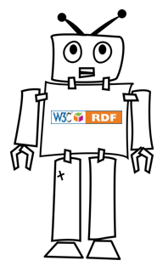
VanderBot
Notes:
The Python script nicknamed “VanderBot” is not really a bot in the typical sense because it doesn’t operate on its own. Rather, it is a tool that works alongside a human to reduce the amount of time and work required to create items, statements, and references.

Slide 7
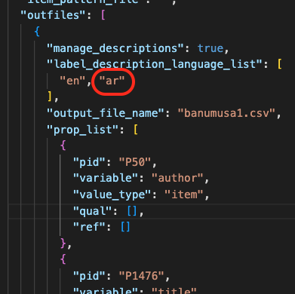
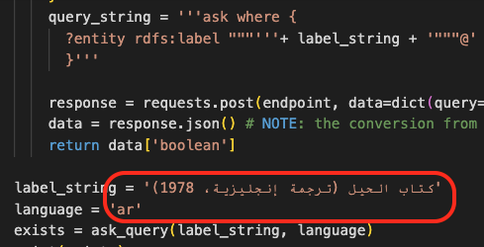
Upload workflow in Python script
VanderBot
CSV source data
Wikidata items
1. Map table columns to Wikidata properties
2. Use SPARQL ASK to check for duplicates
3. Upload via API
Notes:
The source of the data is a CSV spreadsheet and the end product is Wikidata items whose claims correspond to the data in the CSV.
There are three stages of the process that are relevant to the topic of this talk: mapping the CSV columns to Wikidata properties, checking to make sure that there are no existing items with the same labels and descriptions, and actually uploading the data using the Wikidata application programming interface, or API.

Slide 8
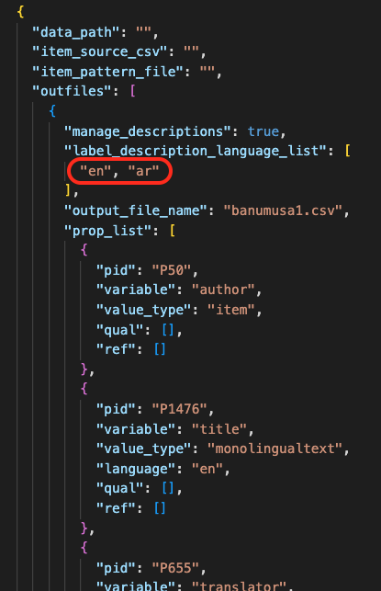
1. Map table columns
Specify languages to be used for labels and descriptions
This simplified configuration file is used to generate a W3C standard mapping file used by VanderBot.
Notes:
A simplified JSON configuration file is used to map the labels that are used for the column headers to Wikidata PIDs for the properties whose values are listed in that column. For each property, the type of value, such as item, string, date, etc. is indicated. There is also an opportunity to associate columns containing qualifier data and reference information with that property.
The configuration file is also used to indicate a list of languages in which the labels and descriptions will be provided. In the case of our project, we are providing both English and Arabic, so the language codes “en” and “ar” are listed.
Although the JSON file looks complicated, it isn’t that hard to use if you start with an existing file, and copy and paste the appropriate information for your model. Once the configuration is set, this file is used to create both a blank spreadsheet with the appropriate headers and a more complicated standardized file that is used by the VanderBot script to do the actual column mapping.

Slide 9
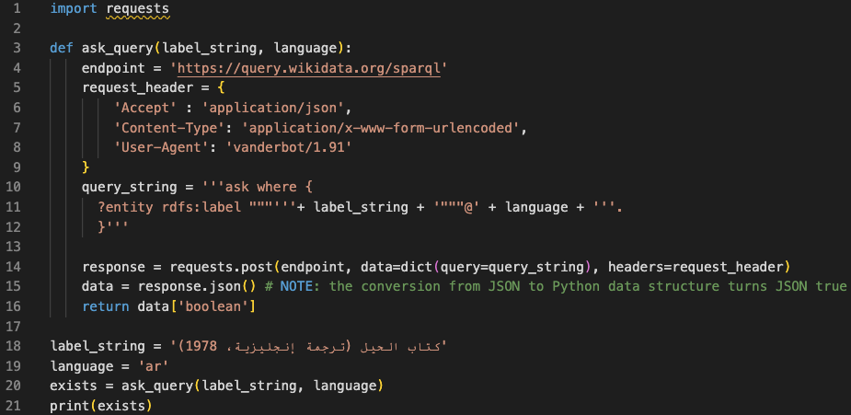
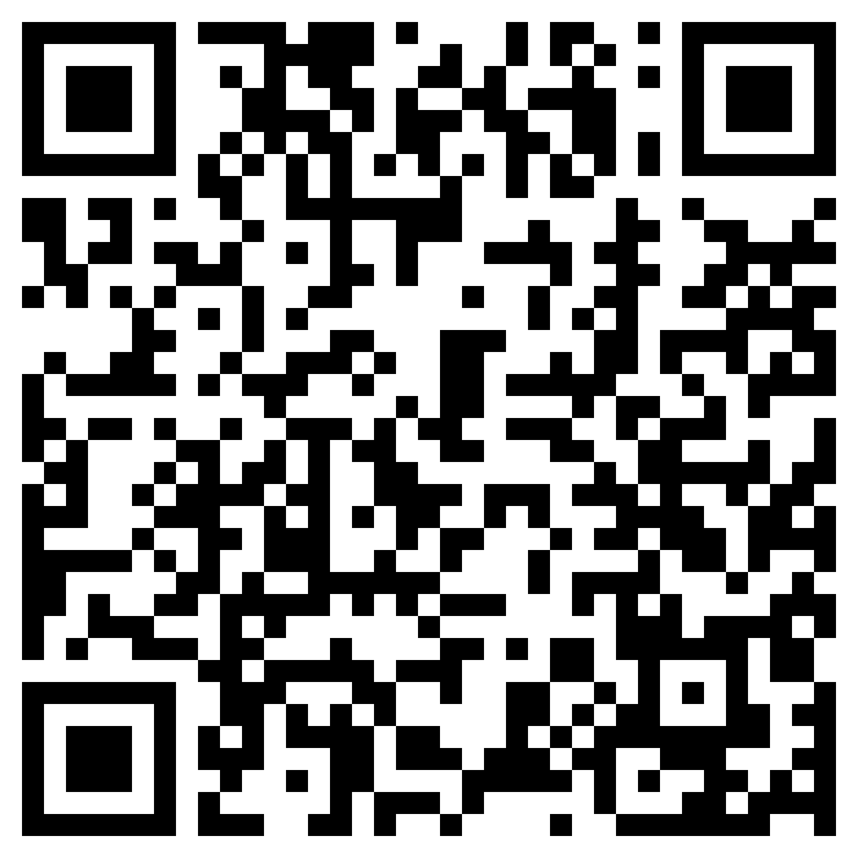
2. Check for duplicates
Using this format is necessary for successful queries with non-Latin characters.
ASK SPARQL query form determines whether a pattern exists.
Scan for blog post on this topic.
Wikidata items must have unique label/description combinations in each language.
Notes:
Wikidata only allows one item to have a particular combination of label and description in a language. If you try to create a new item that duplicates the label and description of an existing item, the API will throw an error. For this reason, before attempting to create each new item, the VanderBot script sends SPARQL queries to the Wikidata Query Service to find out if the label/description combination in any of the target languages already exists. Most people who use the Query Service are familiar with SELECT queries, which retrieve information. In this case, we use a less common query form called ASK. An ASK query simply asks whether a particular pattern exists in the Wikidata graph. The response from the Query Service is either True or False.
If the Query Service is asked whether the label/description combination in a row in the spreadsheet already exists and the response is True, VanderBot will skip trying to upload that row and log a warning.
In the process of working with non-Latin character sets, we made several interesting observations. One is that the method used to send the query to the Query Service is important. If raw UTF characters are sent, they sometimes fail to match identical strings in the Wikidata graph. Instead, the non-Latin labels and descriptions must be sent as URL-encoded strings. The other interesting discovery is that two identical-looking strings written in Arabic script may not match if one is encoded using the Arabic character set and the other is encoded using the Farsi character set. This can happen if a Persian keyboard is used to enter an Arabic-tagged string. For more details about querying Wikidata using Python, scan the QR code to read a blog post on the subject.

Slide 10
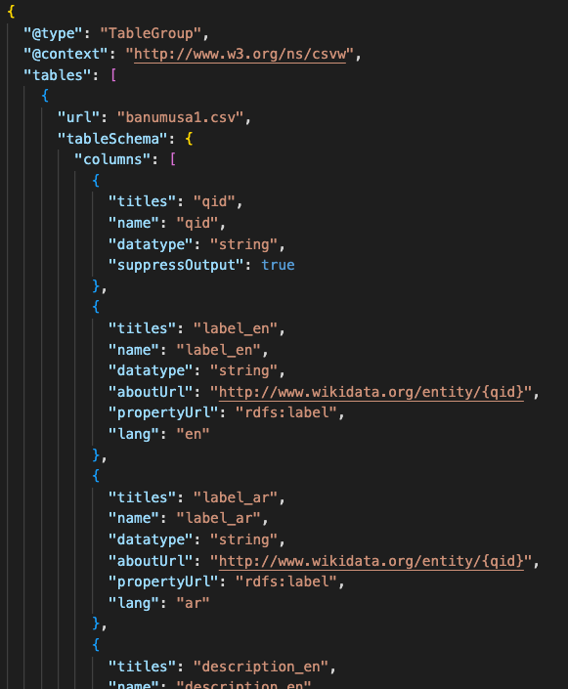
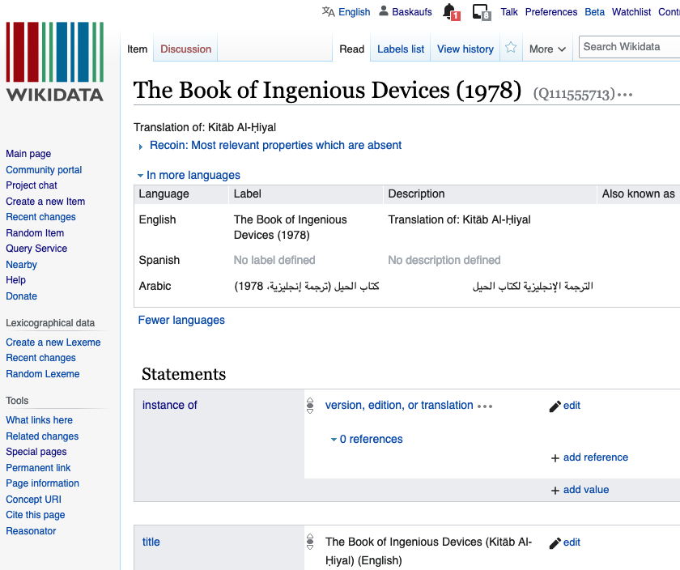
3. Upload via API
CSV spreadsheet
Wikidata API
VanderBot
W3C standard mapping file
Wikidata item
vanderbi.lt/vanderbot
Notes:
Once the check for duplicates is completed, the VanderBot script sends the data to the Wikidata API in the correct format and the new item is created. The script also captures the claim and reference identifiers that are sent back from the API and records then in the CSV so that they can be used in the future if that particular information needs to be changed or deleted.

Slide 11
The Object-Relationship Model for English Translations of
Original Works in Arabic
Original Work in Arabic
English Translation
Translation of
Ex. Book of Ingenious Devices (Q4116191)
كتاب الحيل
Ex. Q111555713
translation of (P9745)
edition or translation of (P629)
Notes:
Thank you so much, Steve, for your explanation for the technical aspects of working with VanderBot in this project.
The first lesson I learned in this project is that it is important to model the datasets to design the spreadsheets and to decide on the Wikidata requirements for the types of work you are working with.
In this case, I chose to work with works of translations from Arabic to English.
This data model illustrates the relationships between the English translations in the triples of English translations as Q Wikidata items, with translation of property P975 or edition or translation of property P629 to connect with the Q item for the original work in Arabic.
And I’d recommend using edition or translation of (P629) instead of translation of (P9745), since the inverse relationship has edition or translation (P747) works better with edition or translation of (P629)
There is the inverse label: translated as (Q107567880), but it is not a property and the case example in Wikidata does not even include this label/item.

Slide 12

Pushing the Limit of Our Data Modeling for VanderBot & Other Problems
This title includes the English translation and interpretation, the Arabic transcription and interpretation, the facsimile of the Arabic manuscript, and an interactive DVD-ROM (3 volumes and 1 DVD-ROM).
It would require adding the following data elements:
number of parts of this work (P2635)
has part or parts (P527)
  English translation
  Arabic transcription
  facsimile (Q194070) of
    Original work (Q item. Ex. Q3831834)
  DVD-ROM (Q2144513)
An example to base our new/extended data model on:
The album amicorum of Jacob Heyblocq : introduction, transcriptions, paraphrases & notes to the facsimile (Q82260552)
The Book of Secrets in the Results of Ideas: Incredible Machines from 1000 Years Ago (Q112831378)
Notes:
Steve and I tweaked the spreadsheet based on an example as shown in Steve’s presentation. Then he used the data Iman and I supplied to run VanderBot for additional two items for this project. Then I verified the results and analyzed our work based on the three results, so far. And here are some of my observations. For this title, I found that it is more complex than our current data model for a single translation from Arabic to English can be used to represent it. The set has three books; the English translation and interpretation, the Arabic transcription and interpretation, the facsimile of the Arabic manuscript, and an interactive DVD-ROM.
To completely represent this title’s set, I would need to add the following properties and data:
-number of parts of this work (P2635)
-has part or parts (P527)
--English translation
--Arabic transcription
--facsimile (Q194070) of Original work (Q item. Ex. Q3831834)
--DVD-ROM (Q2144513)
I found this example in Wikidata to learn about these additional properties from the Wikidata item Q82260552.
We also need to add another value for: Instance of: book (Q571) to all of our Wikidata items.

Slide 13
Not All Required Data Nor Desired Properties Are Readily Available
The Book of Secrets in the Results of Ideas: Incredible Machines from 1000 Years Ago (Q112831378)
The manuscript’s information from
Dr. Silvia Scipioni, Director of Biblioteca Medicea Laurenziana, Florence, Italy.
The manuscript has the shelfmark
‘Orientali 152’ with this bibliographic information:
http://opac.bmlonline.it/Bibliografia.htm?idlist=0&record=445712426399
Two translators are not in Wikidata:
Dr. Ahmed Ragab. Associate Professor, Institute of the History of Medicine, the Johns Hopkins University has his LC Name Authority:
http://id.loc.gov/authorities/names/no2016003240
Email confirmation that he is the translator of this book along with Dr. Soha Bayoumi: https://scholar.harvard.edu/files/sbayoumi/files/soha_bayoumi_-_cv_0.pdf
Dr. Soha Bayoumi is listed in Wikidata as the author name string in https://www.wikidata.org/wiki/Q39042839
*There is no equivalent property for:
translator name string.
Notes:
For additional research for this English translation of al-Muradi’s work and its original text in Arabic, I contacted the Biblioteca Medicea Laurenziana of Florence, Italy to ask for the manuscript’s information and received the manuscript’s information from Dr. Silvia Scipioni, the director, that the manuscript has the shelfmark Orientali 152 and included the bibliographic information in her email:
http://opac.bmlonline.it/Bibliografia.htm?idlist=0&record=445712426399
I also emailed Dr. Ahmed Ragab to confirm that he is the translator of this work with Dr. Soha Bayoumi, but they both don’t have Wikidata items we could readily use.
Dr. Ragab has his LC name authority that can be used to create a Wikidata item.
Dr. Soha Bayoumi has her name in Wikidata in the author name string, so she also needs to have a Wikidata item created for her.
It would be good if the Wikidata property for ‘translator name string’ can be created for future use.

Slide 14
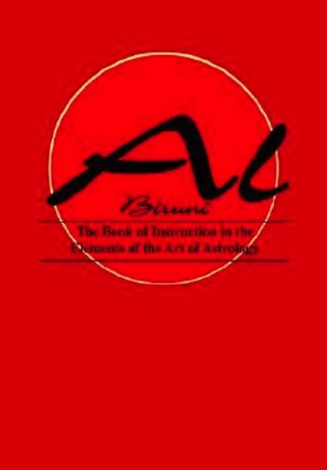
The Book of Instruction in the Elements of the Art of Astrology (1998) (Q112831309)
Translator: Robert Ramsay Wright, zoologist (Q7349157)
Wikipedia’s reference to his life and works in the Dictionary of Canadian Biography: http://www.biographi.ca/en/bio/wright_robert_ramsay_16E.html
Originally published: London : Luzac, 1934. (OCLC no. 3109131)
Publisher not in Wikidata: Institut für Geschichte der Arabisch-Islamischen Wissenschaften (Frankfurt am Main, Germany): http://id.loc.gov/authorities/names/n86023255
Credit for the book cover image: Goodreads: tiny.utk.edu/vod1S
Notes:
For the Book of Instruction in the Elements of the Art of Astrology (1998), it is a reprint of the original translation in 1934.
In Wikidata, I revised the title to add (1998) to distinguish this reprint edition from its original publication in 1934.
I could not add the publisher due to the lack of Wikidata item for the publisher that I need to create later.
I did not add the translator in VanderBot due to missing his information on this publication, when I found his Wikipedia page including his biographical information, but with no mentioning of his background on this subject nor his works of translations.
It was not until I explored further through the references listed in his Wikipedia that I would find this translation. It was mentioned in his Wikipedia’s reference, in the Dictionary of Canadian Biography: http://www.biographi.ca/en/bio/wright_robert_ramsay_16E.html The original translation in 1934 is listed on his list of publications at the end of his biography. The biography itself does not include his expertise in Arabic language nor anything else related to this work. This discovery led me to his Wikidata item Q7349157 to add him as the translator to this translation’s Wikidata item after we already created it with VanderBot.

Slide 15
Adding More Values to Existing Properties
Example: Adding more main subjects to the newly created Wikidata item
https://www.wikidata.org/wiki/Q111555713
qid | label_en | mainSubject_uuid | mainSubject
Q111555713 | The Book of Ingenious Devices (1978) | 8873FAB0-1B40-4620-9965-F63865A67B87 | Q101333
Q111555713 | The Book of Ingenious Devices (1978) |  | Q184199
Q111555713 | The Book of Ingenious Devices (1978) |  | Q43302
Q111555713 | The Book of Ingenious Devices (1978) |  | Q170196
Notes:
Another known issue is that VanderBot won’t work with multiple values for the same property.
The workaround is to add additional values to the same property, in this case, the main subject, AFTER we completed the initial upload by VanderBot to create the item.
This example shows how we created the second spreadsheet to put the Q item information for the newly created item in the CSV file to add more main subjects.
**Adding the existing main subject in Wikidata is to prevent Wikidata from creating a new item from the additional values alone.

Slide 16
Reflection on Required Workload and Quality Control Issues
The data are mostly Q item numbers; missing visual clues to do quality control based on the textual description and metadata.
Quality control can be done after VanderBot processed the data from the spreadsheet.
Not all required information are readily available as Wikidata items and may need to be created manually.
Required elements for some complex item description may not be included in the data model and need to be manually input into Wikidata.
It still requires some extensive research.

Slide 17
Required Skill Sets to Work with VanderBot
Required skills to input the data into the spreadsheets
Basic knowledge of Wikidata.
Recommendation
Learn how to create Wikidata items before working with the spreadsheets to input data to create Wikidata items from the batchload.
Working as a team
In a team setting, it maybe a good idea to include a team member who has the basic knowledge of Python and Wikidata to process the data with VanderBot.

Slide 18
Conclusion
Working with VanderBot with spreadsheets for translations still requires a basic understanding of Wikidata and familiarity with the best metadata practices for translations, their original works, and also for manuscripts in our cases.
For multilingual descriptions, it also requires expertise in the language and culture of the original works.
For works of translations, VanderBot can work with the basic data requirements.
For more complex translation works (e.g. works including facsimiles of the original texts), the model can be modified to add more Wikidata properties, or to manually input additional data elements.

Slide 19
Additional Work to Complete the Data Model for Translations
Original Work
Translation
edition or translation of /has edition or translation
We still need a basic data modeling for the original works to create another set of spreadsheet for original works for VanderBot.
Manuscript Properties
Notes:
Per Iman’s recommendation, we will consult the manuscript properties from the Wikidata:WikiProject Books to form our data modeling for VanderBot for the manuscript of the original work.

Slide 20
References
Baskauf, Steven J. LD4 VanderBot Tutorial, https://heardlibrary.github.io/digital-scholarship/script/wikidata/ld4/
Baskauf, Steven J. and Jessica K. Baskauf, “Using the W3C Generating RDF from Tabular Data on the Web Recommendation to Manage Small Wikidata Datasets,” Semantic Web, September 7, 2021, https://content.iospress.com/articles/semantic-web/sw210443
British Library, “Arabic scientific manuscripts go live in Qatar Digital Library,” Asian and African Studies Blog, November 3, 2014, https://blogs.bl.uk/asian-and-african/2014/11/arabic-scientific-manuscripts-go-live-in-qatar-digital-library.html
Court, John P. M., “WRIGHT, ROBERT RAMSAY, zoologist, university professor and administrator, and author,” in Dictionary of Canadian Biography, vol. 16, University of Toronto/Université Laval, 2003– , http://www.biographi.ca/en/bio/wright_robert_ramsay_16E.html
Websites accessed on: July 14, 2022

Slide 21
References (2)
IDEA Institute on Artificial Intelligence (2021), Panigabutra-Roberts was a fellow funded by the Institute of Museum and Library Services grant: RE-246419-OLS-20, https://idea.infosci.utk.edu/institute2021/fellows2021/
Unicode converter: https://www.branah.com/unicode-converter
University of Tennessee, Knoxville, “Anchalee Panigabutra-Roberts,” Discover Our Faculty website, https://faculty.utk.edu/Anchalee.Panigabutra-Roberts/publications
W3C, “1.1. Graph-based Data Model,” RDF 1.1 Concepts and Abstract Syntax: W3C Recommendation 25 February 2014, https://www.w3.org/TR/rdf11-concepts/#data-model
Wikimedia Foundation, “Manuscript properties,” Wikidata:WikiProject Books, https://www.wikidata.org/wiki/Wikidata:WikiProject_Books#Manuscript_properties
Wikimedia Foundation, Wikidata:Introduction, https://www.wikidata.org/wiki/Wikidata:Introduction
Websites accessed on: July 14, 2022

Slide 22
Thank you!
Any questions?

Slide 23
Credits
Special thanks to all the people who made and released these awesome resources for free:
Presentation template by SlidesCarnival
Photographs by Unsplash

