Slide 1
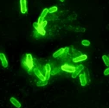
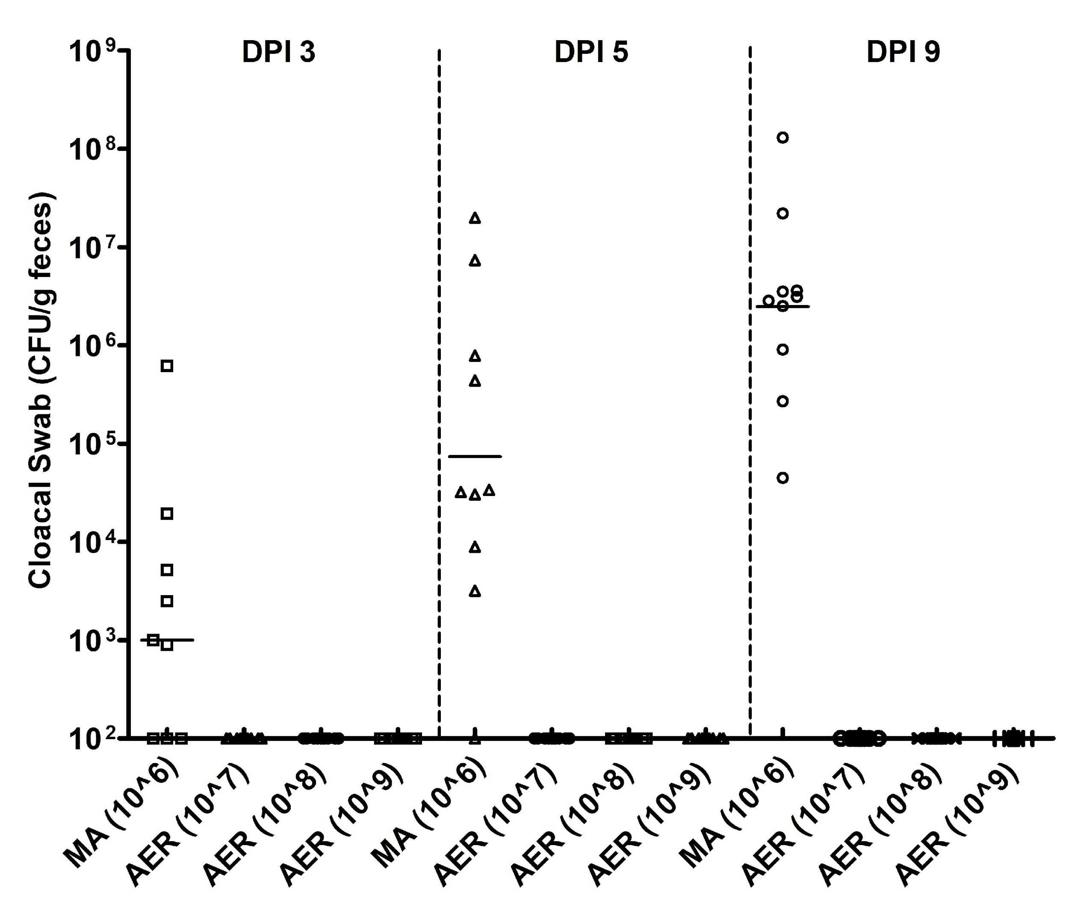
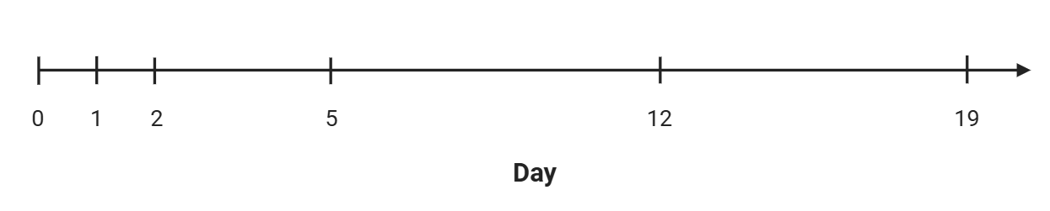
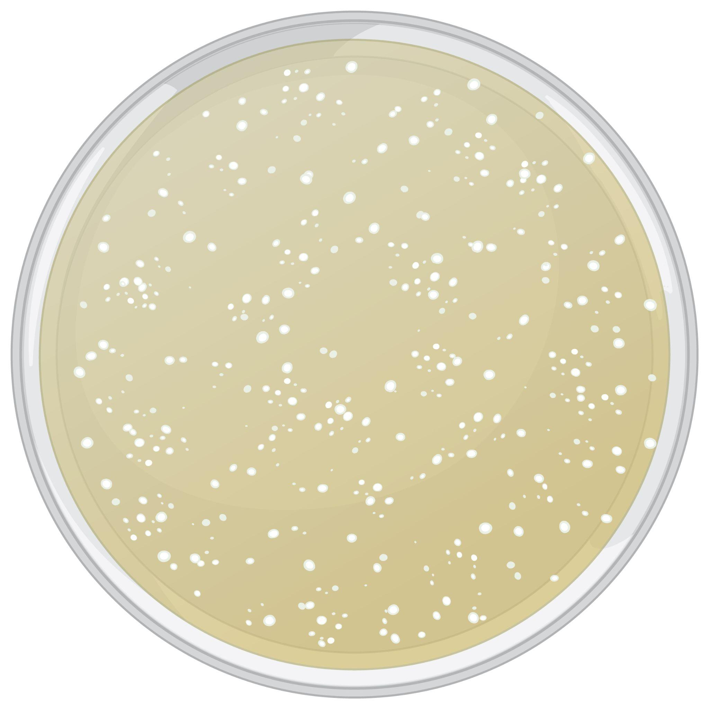
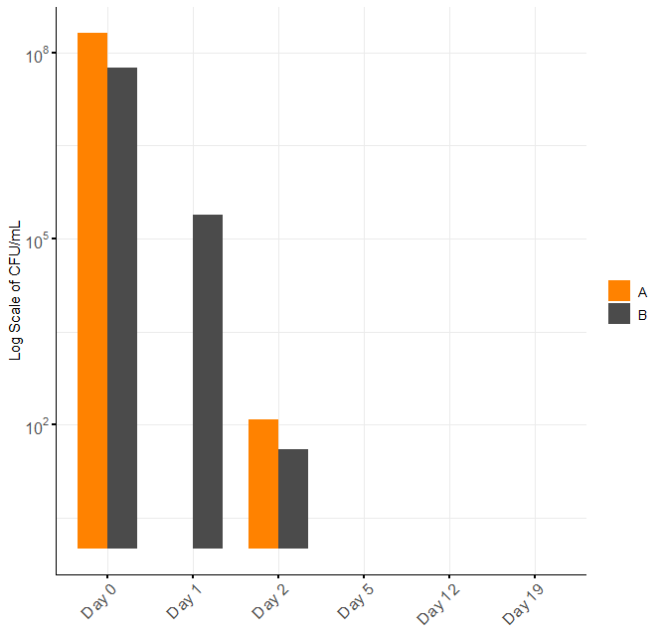
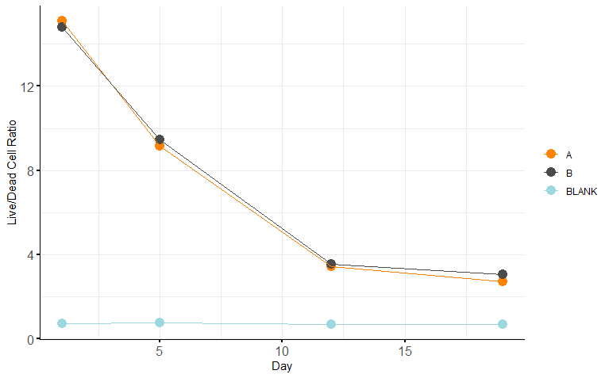
Aerobic Exposure Induced Viable but Nonculturable (VBNC) State in Campylobacter jejuni
Noah Sherman, Ximin Zeng, Wei Wang, Xinge Hu, Jun Lin
Department of Animal Science, The University of Tennessee, Knoxville, TN
Abstract
Campylobacter jejuni is a leading foodborne bacterial pathogen in the United States and developed countries. C. jejuni is considered a microaerophilic bacterium. However, under aerobic stresses, it can enter into a viable but non culturable state (VBNC), which makes C. jejuni persist in environments, and difficult to detect and control. To study development of the VBNC state, C. jejuni strain NCTC 11168 was incubated in MH broth in a shaking incubator (100 rpm) at 25°C (aerobic condition). At different time points, samples were collected for culturability assessment using the plating method (on days 0, 1, 2, 5, 12, and 19) and live/dead cell ratio measurement using the BacLightTM Bacterial Viability Kit on days 1, 5, 12, and 19. It’s observed that the culturability continued to decrease and no colonies formed after day 5, while the live/dead cell ratio decreased but stayed at a relatively high level, indicating a significant portion of C. jejuni cells were in VBNC state. A chicken study was performed to explore the possible resuscitation under in vivo conditions. Different doses (10⁸, 10⁹ , and 10¹⁰ cells/mL) of VBNC C. jejuni 11168 were inoculated into 3-day old chicks by oral gavage. However, no culturable C. jejuni 11168 cells were detected in the cloacal swabs of chickens during the whole experiment period. In summary, aerobic exposure promotes C. jejuni to enter VBNC state. Understanding the persistence and resuscitation of VBNC C. jejuni is critical for improving detection methods, ensuring food safety, and mitigating public health risks.
Introduction
Campylobacter jejuni is a leading foodborne bacterial pathogen in the United States and developed countries. C. jejuni is considered a microaerophilic bacterium. However, under aerobic stresses, it can enter into a viable but non culturable state (VBNC). It was determined that they could enter the VBNC when put under oxygenic stress (Zhang and Lu, 2017). The importance of this is exemplified when it is recognized that once the Campylobacter enters this state it may pass detection in food and confuse epidemiological studies (Yagi et al, 2022) as C. jejuni becomes persistent in environments and evade detection and control methods. This makes the study of this viable but nonculturable state important to help strengthen our understanding of food borne pathogens and possibly prevent future outbreaks from occurring.
Since bacteria in VBNC state still maintain their membrane integrity, it’s possible to differentiate the viable cells from dead cells by using staining dyes with different membrane permeability. The LIVE/DEAD BacLight Bacterial Viability Kits contains 2 two-color fluorescent dyes, propidium iodide (PI) and SYTO™ 9. Cells with a compromised membrane that are dead or dying will stain red with propidium iodide, whereas cells with an intact membrane will stain green with SYTO™ 9. Using such kit, we can study the dynamics of live/dead cells ratio during the bacteria enter VBNC state.
Previous studies had found bacteria can resuscitate from VBNC state, which may pose a hidden risk for food safety and public health. The favorable conditions for resuscitation include nutrient supplementation, external stress elimination, or supplementation with resuscitation-promoting substances. In this study, we also tested possible resuscitation out of VBNC state in an in vivo (chicken) model.
Stress C. jejuni Aerobically
C. jejuni was originally grown by spreading 100 μL of an isolated culture on 3 Mueller Hinton (MH) agar plates which were placed in a trigas incubator at 42°C for 48 hours. These cells were harvested using 3 mL of MH broth. The collected broth was then put through a 10 fold dilution. The OD₆₀₀ of this solution was measured and the solution was adjusted to have an OD₆₀₀ of 0.1. This was then split into 2 flasks (labeled A and B) each containing 30 mL of solution. These flasks were placed in a shaking incubator set to 25°C and 100 rpm. This provided an unfavorable oxygen rich environment. The flasks remained in the shaking incubator for the remainder of the experiment.
Decreased culturability of C. jejuni 11168 when incubating aerobically
No resuscitated VBNC C. jejuni 11168 in a chicken model
Viability Measurement
Culturability Measurement
Culturability Measurement
Figure 1. Culturability change of C. jejuni 11168 over the course of the aerobic stress. A and B represent each of the two replicate C. jejuni cultures. A sample of each flask was serially diluted to 10⁻⁶. 100 μL of these dilutions were spread onto MH agar plates and allowed to grow in a 42°C trigas incubator for 48 hours. These plates were then counted and used to determine the CFU. The CFU/mL decreased daily and by day 5 there were no visible colonies on any plates.
Figure 3. In vivo experiment of aerobically stressed Campylobacter jejuni. 3-day old chickens were split into four group (10 birds each). Each group received different treated C. jejuni 11168: group 1 chickens were inoculated with 100 μL of C. jejuni NCTC 11168 cultivated in microaerobic (MA) condition (85% N₂, 10% CO₂, and 5% O₂), group 2-4 chickens were inoculated with 100 μL of aerobically stressed (AER) VBNC C. jejuni 11168 with 10⁷, 10⁸ and 10⁹ cells/chicken, respectively. This measurement was calculated on Day post infection (DPI) 3, 5, and 9. The detection limit is 10² CFU/gram feces.
Conclusion
At Day 5, there are no colonies detected on the plates indicating that the bacteria is no longer culturable (Fig. 1).
Despite the Live/Dead Cell ratio continuing to decrease from Day 5 to Day 12, the curve not being flat indicates that there are still a decent amount of viable cells at Day 5 (Fig. 2).
When these VBNC C. jejuni were fed to 3-day old chicken, no resuscitated C. jejuni were detected in fecal samples (Fig. 3).
Discussion
There are a lot of studies reporting the resuscitation of VBNC bacteria under in vitro conditions. When these VBNC C. jejuni 11168 were introduced into the 3-day old chicks, they remained undetected in fecal samples, which suggested that these bacteria were not able to be resuscitated when passing through the chicken GI tract. It would be beneficial for further studies on the resuscitation of Campylobacter out of the VBNC state in elder chicken or other animal models, or possible by using a GI tract tissue model.
Acknowledgements
This research was supported by the University of Tennessee AgResearch. Care of chickens upheld by Wei Wang and Xinge Hu.
References:
CDC. “About Campylobacter Infection.” Campylobacter Infection (Campylobacteriosis), 16 May 2024, www.cdc.gov/campylobacter/about/index.html.
Yagi, Sayo, et al. “Role of Temperature, Nutrition, Oxygen, Osmolality, and Bacterial Strain in Inducing a Viable but Non-Culturable State in Campylobacter Jejuni.” Journal of Microbiological Methods, vol. 195, Apr. 2022, p. 106456, https://doi.org/10.1016/j.mimet.2022.106456. Accessed 25 Oct. 2022.
Zhang, Jingbin, and Xiaonan Lu. “Susceptibility of Campylobacter Jejuni to Stressors in Agrifood Systems and Induction of a Viable-But-Nonculturable State.” Applied and Environmental Microbiology, vol. 89, no. 5, 31 May 2023, https://doi.org/10.1128/aem.00096-23. Accessed 5 Feb. 2024.
Aerobically stressed C. jejuni 11168 displayed decreased viability
Figure 2. Cell viability assessment (live/dead cell ratio) through Experiment. Weekly, a sample of each of the flasks was also collected. The cultures were diluted so the OD₆₀₀ was equal to 0.1. Using a fluorescent microplate reader centered at 485 nm, intensity at 530 nm and 630 nm was measured. After measuring the fluorescence intensity using the fluorescence microplate reader each value was ascribed to represent live or dead cells. The intensity at 530 nm (from SYTO 9) represents to the number of total cells (both live and dead cells) in the well, and the intensity at 630 nm (from PI) represents to the number of dead cells in the well. Similarly to the last figure, A and B represent the two C. jejuni 11168 cultures.

