Slide 1


GreenCAP in the House:
Resilience Tools to Unify the Black Community
Presented by:
John Floersh, Rick Held, Treasure Hightower, Ida Miles
Notes:
UT Black Issues Conference Outline
GreenCAP in the House: Resilience Tools to Unify the Black
Community
ABSTRACT: This presentation describes how a small, scruffy youth development organization is leveraging its community outreach and engagement efforts around environmental literacy in the 'hood to build a coalition of inner city organizations aligned to identify and address a broad array of community resilience issues.
Introduction
What is SEEED?
What is GreenCAP?
What is resiliency?
Why is this important?
Purpose
Identify and address community issues
Provide tools to address energy/water conservation, emergency preparedness, home health, and social challenges to vulnerable communities
Develop young adults in GreenCAP as resilience leaders. These leaders will be fully immersed in the community they serve by conducting surveys, providing minor energy audits, and equipping community members with conservation and resilience techniques
Create a coalition of individuals and organizations to implement resilience practices and policy
Strengthen under-represented and marginalized voices to influence government, utility and agency policy
Identify and track issues and resolutions
Practical Application
Sample size results
1000 Surveys
Community Conversations
Cohort Workshops
Green House Calls
Core resiliency audit
Mini-retrofits
Expanded Community Issues Survey
Invitation to cohort workshops
Next Steps and How to get involved

Slide 2


Socially Equal Energy Efficient Development
SEEED creates pathways out of poverty for young adults through career readiness training, while equipping communities with environmental literacy skills.

Slide 3
Socially Equal Energy Efficient Development
Founded in 2009 by Stan Johnson, Jerome Johnson, Jarious Bush, and Joshua Outsey
Provides training in life, job, and placement skills for young adults, ages 18-28
Focuses on increasing affordable housing, decreasing energy costs, and creating sustainable employment for local communities

Slide 4
GreenCAP Community Engagement
The Green Community Awareness Program is SEEED’s social enterprise for community engagement and marketing services: Outreach, education, and marketing to low and moderate income residents, BY low and moderate income residents.

Slide 5
Promoting Voting and Challenging Racism Project
A Collaboration with UT College of Social Work, League of Women Voters, Urban League, and NAACP

Slide 6
Promoting Voting and Challenging Racism Project
Campaign Elements
Surveys Identify voting issues Voting attitudes Targeted infrequent young voters Door-to-door & stationary events | Voter Registration Online Paper Door-to-door & stationary events
Voter Education and Removing Barriers Early voting information Candidate forums Help with getting acceptable forms of ID Record expungement information and restoration of voting rights

Slide 7
Election cycles | Aug. 2nd / Nov. 6th
New voters registered | 193
Surveys completed | 210
Outreach shifts completed (mixed methods) | 35
GOTV contacts made (follow ups from surveys completed) | 150

Slide 8
Voter Issues Survey 2018:
A Sample Size of Issues

Slide 9
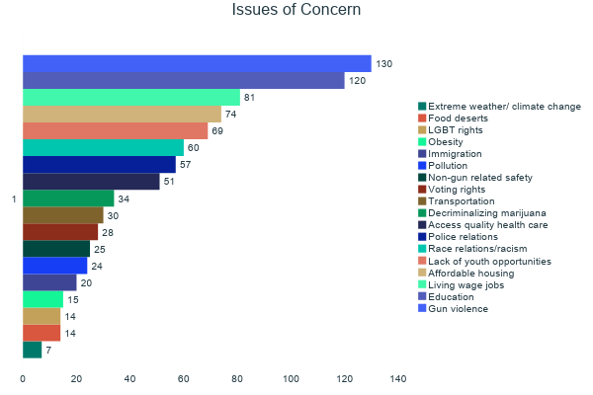

Slide 10
Top Issues
1. Gun violence | 130
2. Education | 120
3. Living wage jobs | 81
4. Affordable housing | 74
5. Youth opportunities | 69
6. Race relations | 60

Slide 11
GreenCAP in the House
Project Objective:
Leverage community outreach and engagement efforts in environmental literacy to build a coalition of inner city organizations aligned to identify and address a broad swath of community resilience issues.

Slide 12
Resilience
Using your energy productively to emerge from adversity stronger than ever
-Patterson and Kelleher, Resilient School Leaders

Slide 13
GreenCAP in the House
Project Purposes:
  Identify and address community issues
  Provide tools to address energy/water conservation, emergency preparedness, home health, and social challenges to vulnerable communities
  Develop young adults in GreenCAP as resilience leaders. These leaders will be fully immersed in the community they serve by conducting surveys, providing minor energy audits, and equipping community members with conservation and resilience techniques

Slide 14
GreenCAP in the House
Project Purposes:
  Create a coalition of individuals and organizations to implement resilience practices and policy
  Strengthen under-represented and marginalized voices to influence government, utility and agency policy
  Identify and track issues and resolutions

Slide 15
Green House Calls
For residents who have not received weatherization of their homes
Core resiliency audits
Mini-retrofits
Expanded Community Issues Survey
Invitation to Community Conversations and Cohort Workshops

Slide 16
Community Conversations
Based on the expanded Community Issues Survey, Community Conversations will convene neighborhood agencies, nonprofits, community members, and experts to learn, discuss, and develop solutions. Those who attend these forums will be invited to dive deeper by participating in Cohort Workshops.

Slide 17
Cohort Workshops
A series of workshops that will initially focus on energy/water conservation, healthy homes, and emergency preparedness led by community and agency experts that will culminate in providing integral feedback to effect policy change.

Slide 18
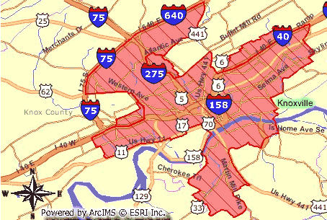
Campaign Primary Target Area:
Inner-city Knoxville districts with largest concentration of people of color

Slide 19
Next Steps

Slide 20
How to Get Involved

Slide 21

Keep Up With SEEED
seeedknox.com
@seeedknox

