Slide 1



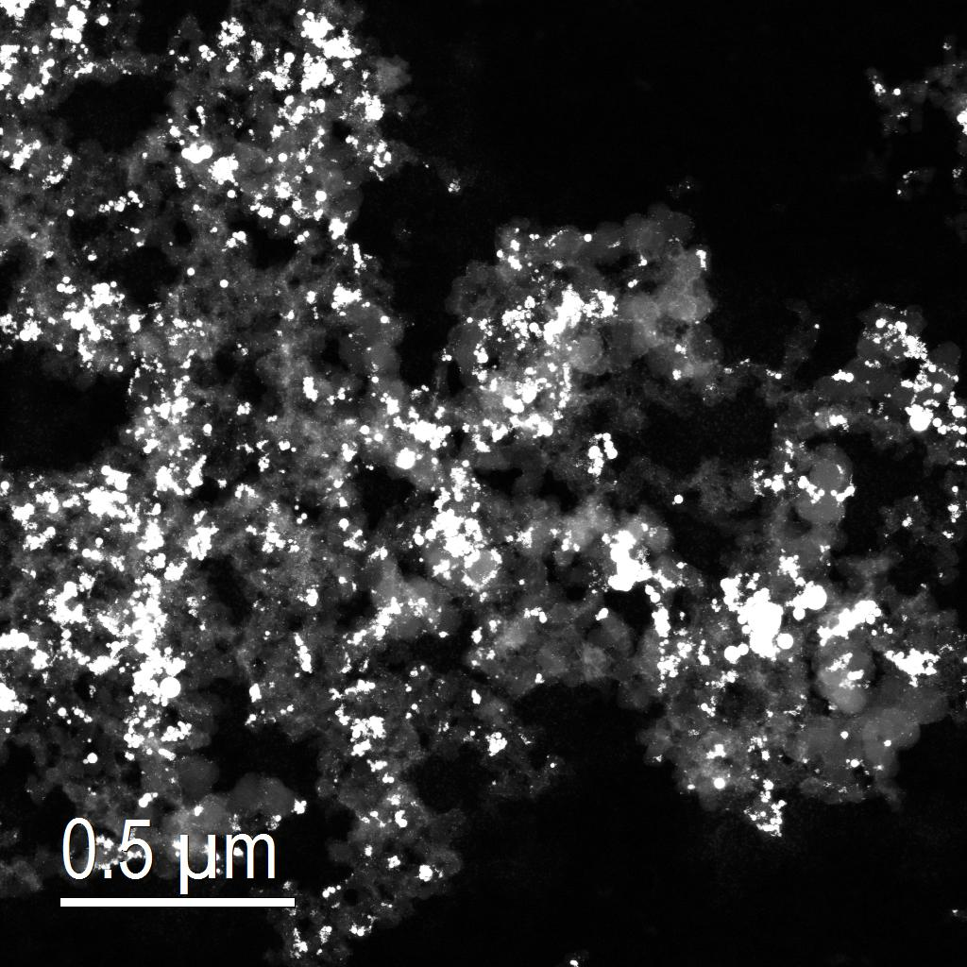
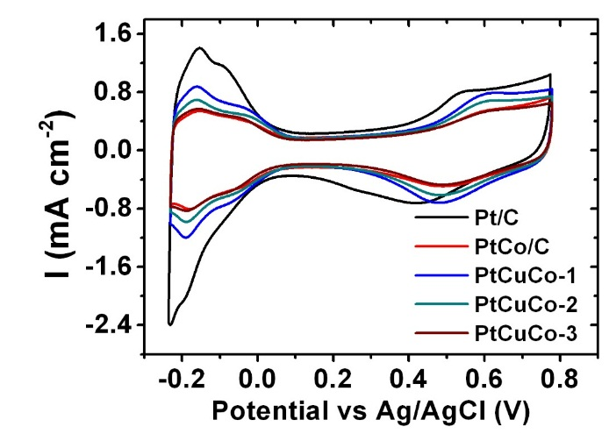
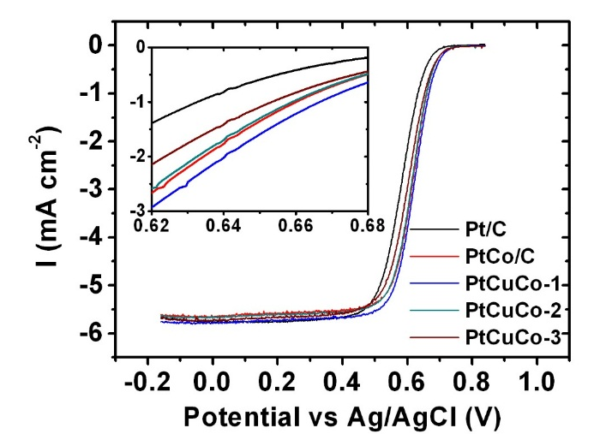
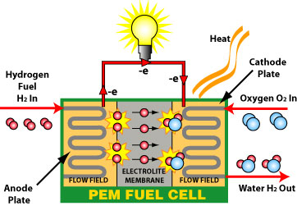
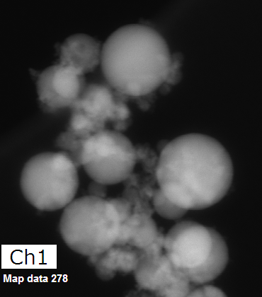
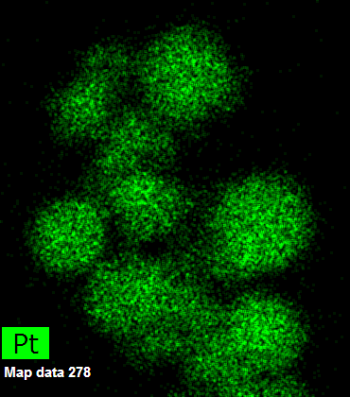
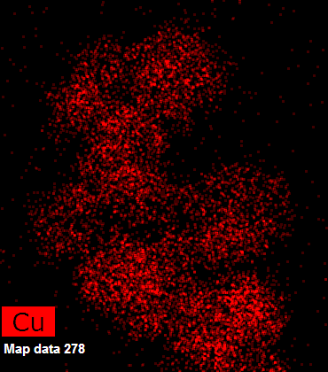
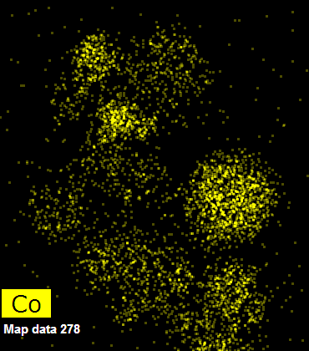
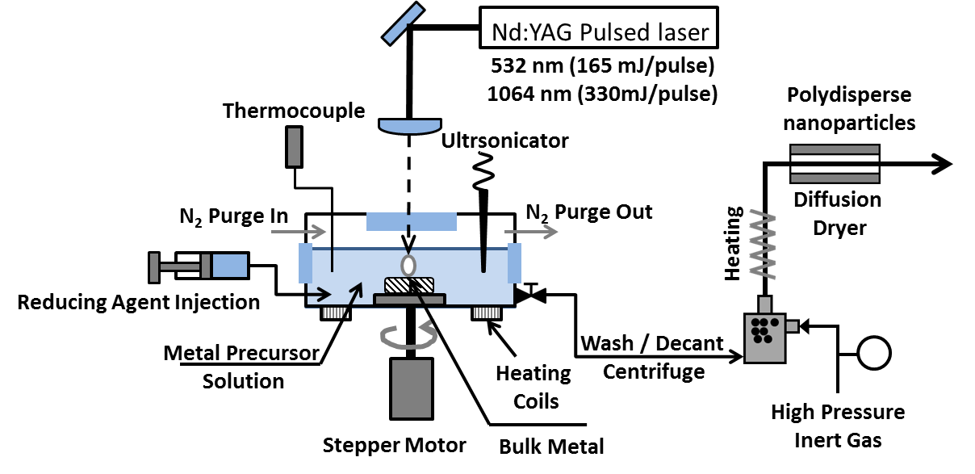
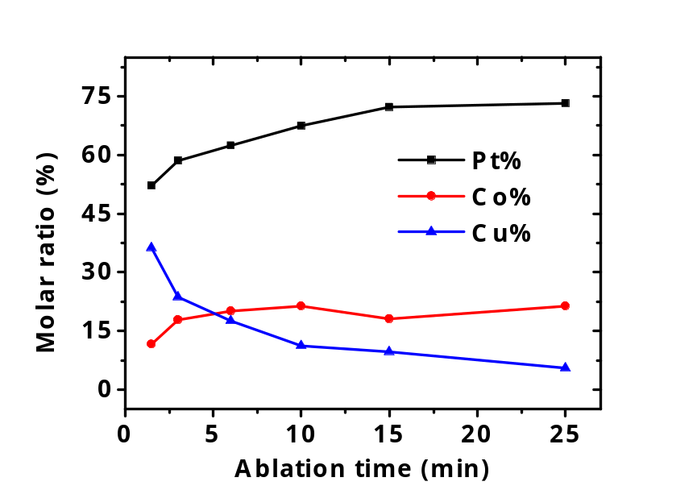
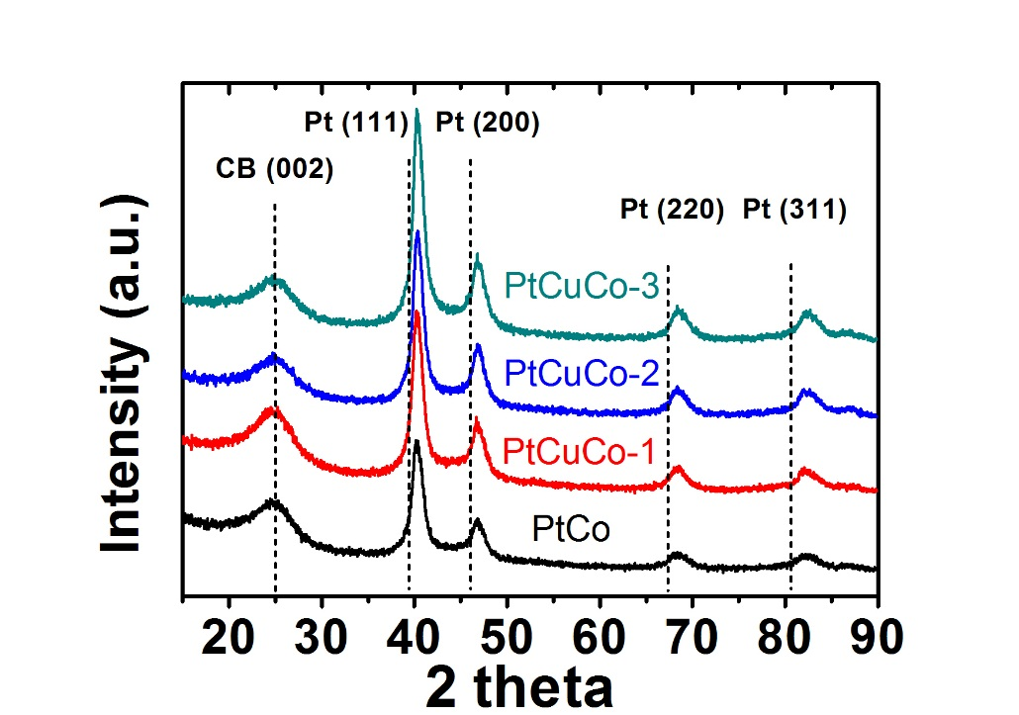
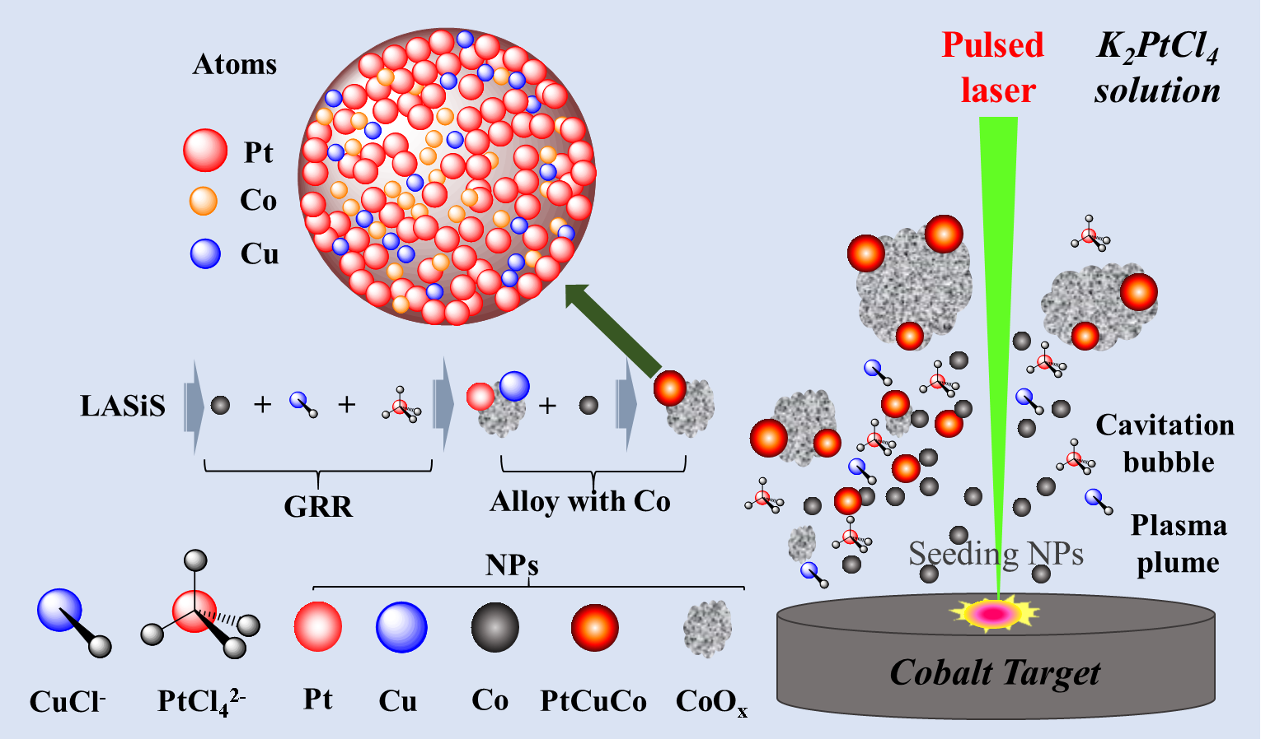

Synthesis of PtCuCo ternary alloy using laser ablation synthesis in solution-galvanic replacement reaction(LASiS-GRR)
Kangmin Cheng^{1,3,4}, Sheng Hu^{2,3,4} , Dibyendu Mukherjee*^{1,2,3,4}
¹Department of Mechanical, Aerospace, and Biomedical Engineering, ²Department of Chemical and Biomolecular Engineering,
³Nano-BioMaterials Laboratory for Energy, Energetics & Environment, ⁴Sustainable Energy Education and Research Center (SEERC)
Introduction and Experimental Set-up
Results
Results
Proton exchange membrane fuel cell (PEMFC)
In PEMFC, hydrogen and oxygen enters into the anode and cathode respectively. At the anode, electrons are separated from protons that flow through the external circuit towards the cathode. At the cathode, the electrons combine with protons passing through the membrane to carry out oxygen reduction that forms water. This sluggish 4-electron transport oxygen reduction reaction (ORR) plays a crucial role in determining the fuel cell efficiency. Traditionally, Pt catalysts have been used to accelerate the reaction rate. But Pt is an expensive metal, and is not very durable under acidic conditions.
Shapes and elemental distribution of nanoalloy (via Electron Transmission Microscopy (TEM))
Catalytic activities: Electrochemistry Results
Cyclic voltammetry curves
ORR polarization curves
Alloying Pt with other transition metals such as Co, Cu modifies the respective oxygen and hydroxide binding energies and meanwhile increase the surface sites for the ORR to occur due to the shrinkage of lattice parameters. Besides, forming nanoalloys also lower the cost of the expensive noble metal Pt.
 | Pt loading | ECSA | I_{k} at 0.9 V | MA | SA (mA/cm²)
 | (μg/cm²) | (m²/g) | (mA/cm²) | (A/mg)
Pt | 25 | 38.32 | 1.84 | 0.07 | 0.19
PtCo | 22.93 | 17.36 | 5.03 | 0.22 | 1.26
PtCuCo-1 | 22.09 | 28.13 | 6.06 | 0.27 | 0.98
PtCuCo-2 | 21.63 | 23.28 | 4.72 | 0.22 | 0.94
PtCuCo-3 | 21.46 | 18.04 | 3.43 | 0.16 | 0.89
Tuning of Pt:Cu:Co ratio
By changing CuCl salt concentration
http://www.tech-etch.com/photoetch/fuelcell.html
Tuning | Sample | K₂PtCl₄ (mM) | CuCl (mM) | Ablation time (min) | Pt% | Co% | Cu%
CuCl salt | PtCo | 0.3 | 0 | 6 | 77 | 23 | 0
 | PtCuCo-1 |  | 0.03 |  | 70 | 24 | 6
 | PtCuCo-2 |  | 0.12 |  | 67 | 15 | 18
 | PtCuCo-3 |  | 1.92 |  | 66 | 11 | 23
Cyclic voltammetry compares the electrochemical surface areas (ECSA) for the synthesized PtCuCo ternary alloys through the hydrogen adsorption/desorption area.
ORR polarization curves indicate that all synthesized NAs outperform the catalytic activities of commercial Pt/C.
While binary PtCo NA indicates the best specific activity (SA), the ternary PtCuCo-1 NAs exhibit the best ORR mass activity (MA).
The superior MA and SA for the as-synthesized ternary PtCuCo NAs can be attributed to the green synthesis technique of LASiS-GRR that uses no harsh chemicals and surfactants that are known to be detrimental to surface catalytic activities.
Finally, elemental ratios in the alloy can be readily tailored for optimizing the O/OH⁻ adsorption energies and therefore achieving the best catalytic performances.
LASiS-GRR setup and mechanism
2. By changing ablation time
The reduced Cu atoms will go through GRR with K₂PtCl₄ during ablation, therefore the Cu ratio decreases and the Pt ratio increases with ablation time.
Tandem laser ablation synthesis in solution-galvanic replacement reaction (LASiS-GRR) is a facile, green yet, efficient route for synthesizing binary/ternary nanoalloys. An in-house designed multifunctional LASiS-GRR cell is used in the current study for the synthesis of PtCuCo ternary alloys as ORR catalysts. Briefly, a Co target is ablated by a 1064 nm pulsed laser in water with PtCl₄²⁻ and Cu⁺ ions. A liquid-confined plasma plume expanding with extremely high temperature and pressure thermally vaporizes the metal target and initiates ultrafast propagation of cavitation bubbles. Seeding NPs within the bubble go through GRR with PtCl₄²⁻ and Cu⁺ ions from the precursor salts to form Pt and Cu NPs. These NPs rapidly alloy with the Co NPs in the solution to form the NAs.
Summary
We develop LASiS-GRR as a facile, green synthesis technique for the synthesis of ternary PtCuCo NAs with tailored composition and alloying as excellent ORR catalysts.
The combination of Cu and Co as non-precious transition metals showed promising results in lowering Pt % (wt.) while enhancing the catalytic activities, which is ascribed to the modified O/OH⁻ binding energies and increased surface sites due to alloying.
X-ray Diffraction
XRD patterns indicate a clear shift of PtCuCo characteristic peaks to higher angles. This indicates a shrinkage of lattice parameter of Pt due to the alloying of the three elements, as can be explained by the Bragg’s law.
References
LASiS-GRR occurs when the redox potential of the target metal is less than the metal salts.
Redox Potentials
[PtCl₄]²⁻/Pt = 0.755
Cu⁺/Cu = 0.52
Co²⁺/Co = -0.28
S Hu, G Goenaga, C Melton, TA Zawodzinski, D Mukherjee. Applied Catalysis B: Environmental 182, 286-296.
S Hu, M Tian, EL Ribeiro, G Duscher, D Mukherjee. Journal of Power Sources 306, 413-423.
S Hu, C Melton, D Mukherjee. Physical Chemistry Chemical Physics 16 (43), 24034-24044.
Acknowledgement: Partial support for Kangmin Cheng comes from the Center for Materials Processing (CMP).
$$nλ=2dsinθ$$

