Slide 1

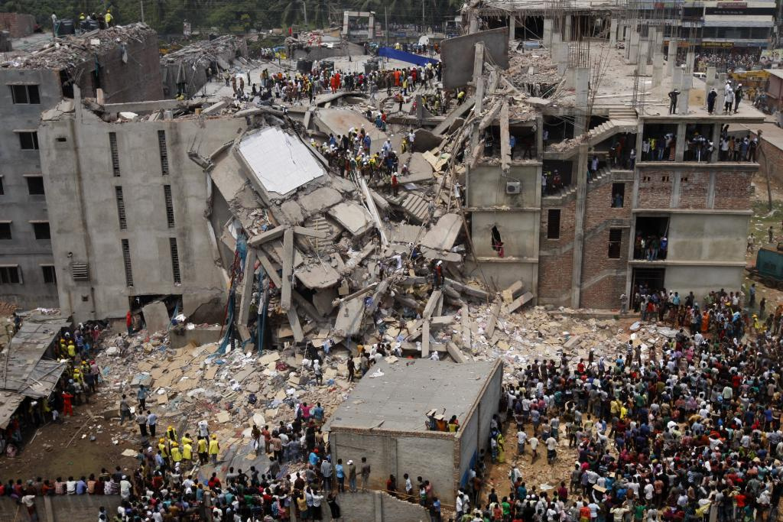
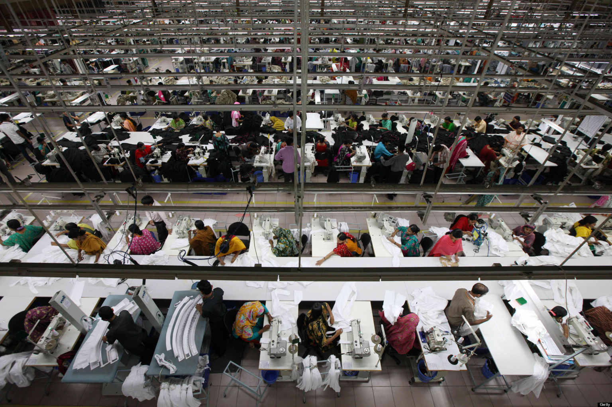
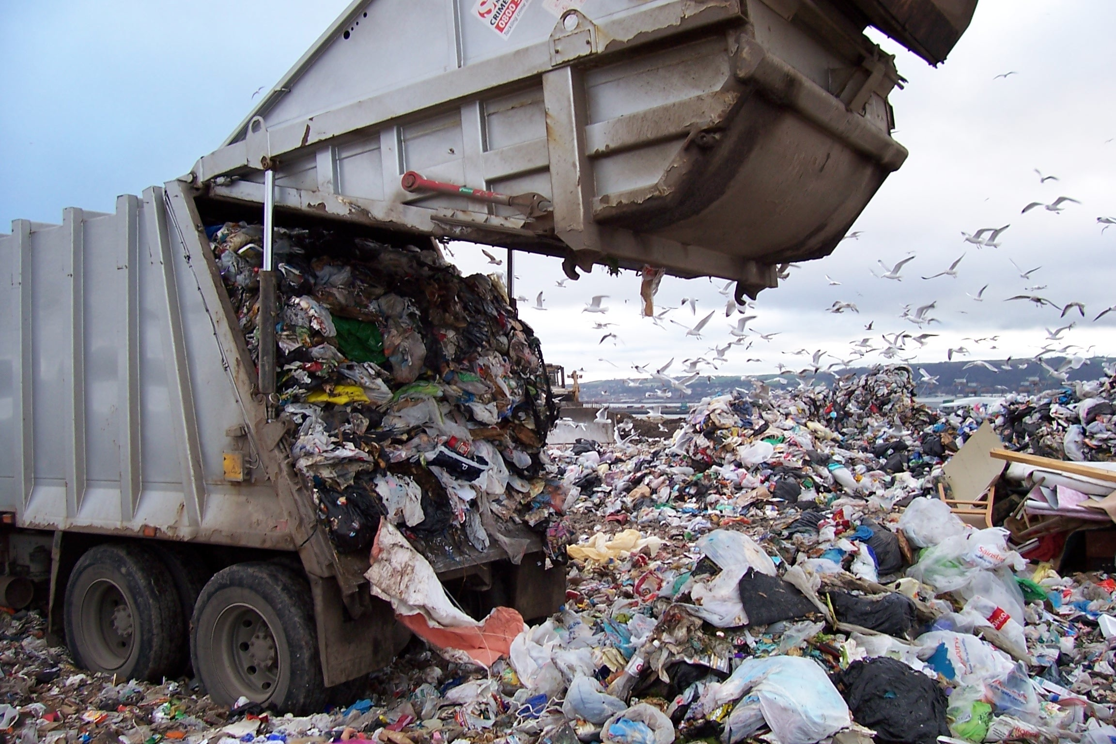







Is Cheap Fashion Too Good to be True? Consumer Perceptions of Sustainability in the Fast Fashion Industry
Author: Katrina Laemmerhirt
Thesis Advisor: Dr. Youn-Kyung “Lydia” Kim
Background and Literature
Conclusions Thus Far
Introduction
Fast fashion refers to, “low- cost clothing collections that mimic current luxury fashion trends”
Sustainably has become an exceedingly important value in companies and for consumers
Objective | Signifigant Outcomes
1 | Compulsive buying Fashion orientation
2 | Ecological consciousness Social consciousness Social responsibility
3 | Shopping as social activity Uniqueness Trendy Style
4 | H&M Conscious Collection Zara’s Organic Cotton ASOS Africa
Factory collapse in Bangladesh, 2013
Textile factory in Bangladesh
Textile landfill in Canada
2012→ 14.3 million tons or 5.7% of the total municipal solid waste was textile
Behavior
.
Attitude
.
Behavior Gap
Globalization has “distanced the consumer from the social and environmental consequences of the goods consumed”
Unaware or lack knowledge of problems in sustainability
Economic rationalization overrides ethical beliefs (H&M sells clothing for a low as $4.95)
Volume purchasing, impulse buying, and short-term thinking are difficult behaviors to change
Research Question
Contact
Do consumers care about sustainability in fast fashion or if they will continue to ignore lack of sustainable practices for low prices?
Katrina Laemmerhirt
Email: klaemmer@utk.edu
Dr. Youn-Kyung ‘Lydia’ Kim
Email: ykim13@utk.edu
References
Objectives
Fletcher, Kate. "Durability, Fashion, Sustainability: Processes and Practices of Use."Fashion Practice 4.2 (2012): 221-38. Web. 12 Oct. 2015.
Joy, Annamma, John F. Sherry, Jr., Alladi Venkatesh, Jeff Wang, and Ricky Chan. "Fast Fashion, Sustainability, and the Ethical Appeal of Luxury Brands." Fashion Theory16.3 (2012): 273-96. Web. 12 Oct. 2015.
Kim, Hye- Shin, and Mary Lynn Damhorst. "Environmental Concern and Apparel Consumption." Clothing & Textiles Research Journal 16.3 (1998): 126-33. Web. 12 Oct. 2015.
Walker, Stuart, and Ed Dorsa. "Making Design Work: Sustainability, Product Design, and Social Equity." The Journal of Sustainable Product Design 1 (2001): 41-48. Web. 12 Oct. 2015.
1) To compare between high fast fashion group and low fast fashion group in consumer behavior
2) To compare between high fast fashion group and low fast fashion group in sustainable behavior
3) “ ” in clothing attributes when purchasing
4) “ ” in consumer knowledge
5) “ ” in consumption patterns
Methods Quantitative Research: Surveys
Fast fashion consumers: compulsive buying, fashion orientation, price consciousness, value consciousness
Sustainable behavior: social responsibility, ecological consciousness, social consciousness
Low group (1) : 1→1, 2→ 1, 3→ 1
High group (2) : 4→2, 5→2, 6→2

