Slide 1




Research Data Services and The Role of Libraries
Carol Tenopir
University of Tennessee
ctenopir@utk.edu

Slide 2

Thanks to…
DataONE Usability & Assessment Working Group: Assess the needs and motivations of various stakeholders for science data. (dataone.org)
Working Group on Scientific Information Infrastructures: …collects good practices and lessons learned in the area of research data management in libraries.
Notes:
DataONE mission: Enable new science and knowledge creation through universal access to data about life on earth and the environment that sustains it. (dataone.org)
WG: collects good practices and lessons learned in the area of research data management in libraries. The Working Group collaborates with other initiatives to evaluate and support skills development.

Slide 3
Research Data Services are..
…services that address the full data lifecycle, including the data management plan, digital curation (selection, preservation, maintenance, and archiving), and metadata creation and conversion.

Slide 4


Data LifeCycle
Plan
Analyze
Collect
Integrate
Assure
Discover
Describe
Preserve

Slide 5

Library Challenges
Level of my knowledge & skills ?
DMP tools?
Level of participation with data?
Plan
Analyze
Partnering with researcher?
Collect
What to do about metadata?
Integrate
Assure
Is there a repository for data?
Develop tools for data discovery?
Describe
Discover
Stewardship role (select & deselect)?
Preserve
How to ensure preservation?
Notes:
Librarians also have questions about their role. We wanted to find out, through Academic university librarian survey
Do librarians have the background, skills and education to provide RDS?
What are librarian attitudes regarding the importance of RDS?
What factors contribute to or inhibit engagement of librarians in RDS?s

Slide 6
Research Data Services are…
…services that address the full data lifecycle, including the data management plan, digital curation (selection, preservation, maintenance, and archiving), and metadata creation and conversion.
Services can be informational or technical

Slide 7
Informational RDS
Collaboration and outreach
Policy development and planning
Discussing RDS with others
Reference for finding and citing data
Creating web guides and finding aids
Directly participating on a project
Consulting on DMPs and metadata
Training co-workers on data issues

Slide 8
Technical RDS
Providing tech support for RDS systems/data repositories
Identifying datasets for deposit in repositories
Preparing datasets for deposit
Deselecting datasets for removal from a repository
Creating or transforming metadata

Slide 9

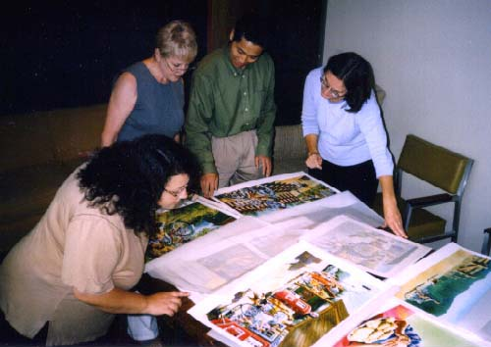
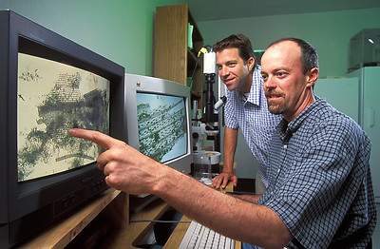

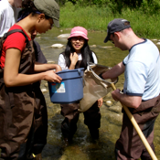
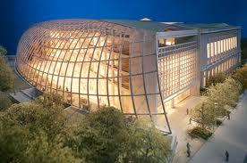

Assessment of Stakeholders
Public Officials
Publishers
Data Managers
Citizen-scientists
Libraries
& Librarians
Scientists
Students
& Teachers

Slide 10
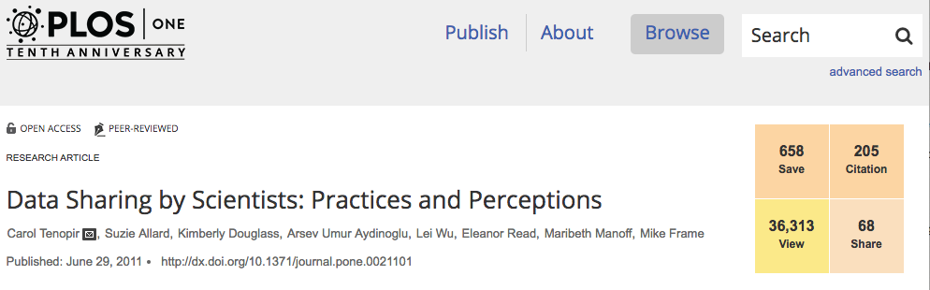
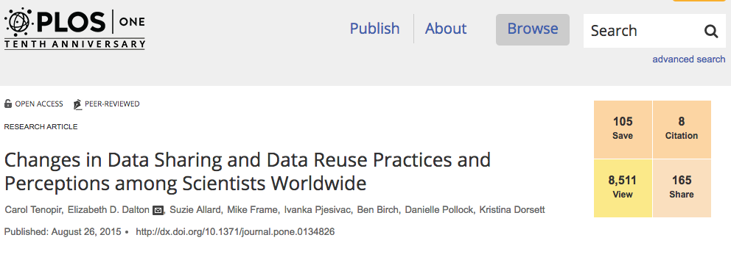
We are learning about scientists
1st Scientist Survey (2011)
Views: 41,449
Citations: 273
Shares: 75
(pub. Jun. 2011)
2nd Scientist Survey (2015)
Views: 10,868
Citations: 27
Shares: 175
(pub. Aug. 2015)
Notes:
Data Sharing by Scientists: Practices and Perceptions
Carol Tenopir, Suzie Allard, Kimberly Douglass, Arsev Umur Aydinoglu, Lei Wu, Eleanor Read, Maribeth Manoff, Mike Frame
Research Article | published 29 Jun 2011 PLOS ONE
https://doi.org/10.1371/journal.pone.0021101
Views: 41449 • Citations: 273 • Saves: 722 • Shares: 75
OLD METRICS
Views: 36,313 Citations: 205 Shares: 68
Changes in Data Sharing and Data Reuse Practices and Perceptions among Scientists Worldwide
Carol Tenopir, Elizabeth D. Dalton, Suzie Allard, Mike Frame, Ivanka Pjesivac, Ben Birch, Danielle Pollock, Kristina Dorsett
Research Article | published 26 Aug 2015 PLOS ONE
https://doi.org/10.1371/journal.pone.0134826
Views: 10868 • Citations: 27 • Saves: 178 • Shares: 175
OLD METRICS CHANGES
Views: 8,511
Citations: 8
Shares: 165

Slide 11
Results of DataONE scientists surveys show opportunities for universities and libraries…

Slide 12
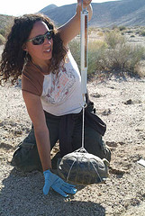
Researchers might…
Plan
Analyze
Collect
Integrate
Assure
Discover
Describe
Preserve
Notes:
But stakeholders don’t always follow all. Researchers, for example, may be focused on collecting and analyzing; so this is a key stakeholder group and I’ll give just a few highlights of the original survey of scientists.
Personas are a representation of the objectives and behavior of a real group of users; DataONE working group members created these fictional representations by synthesizing data collected from users, particularly from surveys. DataONE WG members also used nterviews collected by researchers in the Digital Curaiton Profiles project at Purdue and UIUC. Creating these personas was actually a means of engagement & collaboration.
Scenarios differ from personas because they are focused on the context and process of an activity rather than on the individual engaged in the activity. We create these narratives to describe the expected flow of an activity based on the characteristics of the researcher when it was aligned with the information lifecycle. Scenarios are projections of expected behaviors to portray user behavior with respect to the system interface and represent the workflow indicating usage of a product by the users in a real life situation.
Here is an example of an early career field scientist where the current data practices are in blue and pink represents the places in the data lifecycle that can be augmented by tools or infrastructure from DataONE.

Slide 13
Scientists say lack of access to data… …
… is a major impediment to progress in science
75% agree or strongly agree.
… has restricted my ability to answer scientific questions
53% agree or strongly agree.
Notes:
Impediment to progress to science: M=4
Restricted my ability to answer scientific questions: M=3.4

Slide 14
Most are willing to share at least some data…
I am willing to (2015):
Notes:
2014/15

Slide 15
Gap between willingness to share and accessibility
  Although 80% of scientists agree “I share my data”
  Only 46% agree “Others can access my data easily”
Notes:
n=743; 2014-15

Slide 16
What metadata do you currently use to describe your data? (2015)

Slide 17
Barriers to sharing (2015)
Notes:
2014/15

Slide 18
Libraries…
Facilitate interdisciplinary work and data knowledge through collections and services
Understand metadata
Know how to find information about data
In partnership with other administrative units can take a leadership role in a variety of research data services

Slide 19

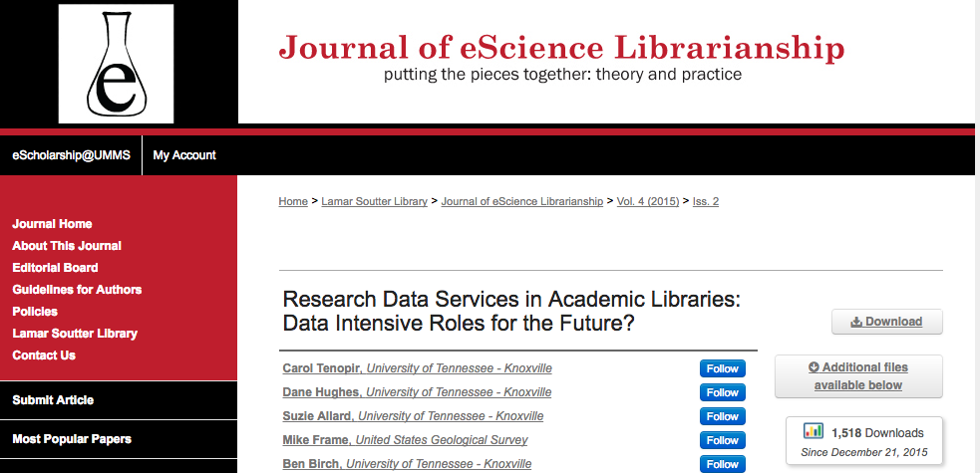
European Library Survey builds on…
1st Library (2012)
Citations: 104
(published June 2012)
2nd Library (2015)
Citations: 23
2,148 downloads
(published Dec 2015)
Notes:
On “Current Practices…” according to GoogleScholar, has been cited=104. I checked Web of Science and ACRL sites.
On “RDS” article, JeSL only lists downloads; Google Scholar has citation count of 23.)

Slide 20


Tenopir, C. et al., (2017). Research Data Services in European Academic Research Libraries. LIBER Quarterly. 27(1), pp.23–44. DOI: http://doi.org/10.18352/lq.10180

Slide 21

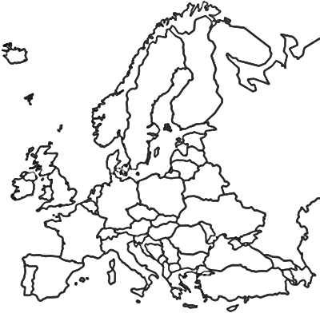
LIBER Survey of European Academic Research Libraries: 2016-2017
Survey Respondents
LIBER Academic Library Membership
North: 19%
North: 15%
West: 51%
West: 53%
East: 17%
East: 16%
South: 13%
South: 17%
Notes:
n=119; (answered both a demographic & analysis questions) n=109 answered by country
West: 51% North: 19% East: 17% South: 13%
n=333 (LIBER pop)
West: 177 (53.1%) East: 52 (15.6%) North: 49 (14.7%) South: 55 (16.5%)

Slide 22
Key Findings
LIBER academic libraries offer a range of Research Data Services, but…
Consultative RDS are most common
Libraries use a variety of strategies for developing staff skills

Slide 23
1) LIBER academic libraries offer a range of Research Data Services

Slide 24
RDS offered by most libraries currently
Consultative
Consultative
Consultative
Consultative
Consultative
Consultative
Notes:
*yes only responses*
Outreach/collaboration with other RDS providers (n=107)
Consulting on data and metadata standards (n=105)
Consulting on data mgt plans (n=107)
Training colleagues on RDS (n=95)
Involved in policy development/planning (n=95)
Discussing RDS with others (n=95)

Slide 25

RDS offered, continued
Technical
Consultative
Consultative
Consultative
Technical
Notes:
*Yes only*
ID datasets (n=106)
Direct participation with researchers (n=94)
Creating web guides (n=100)
Providing tech support for finding/citing data (n=101)
Providing ref. support for RDS (n=101)

Slide 26
2) Consultative are more commonly offered than technical RDS

Slide 27
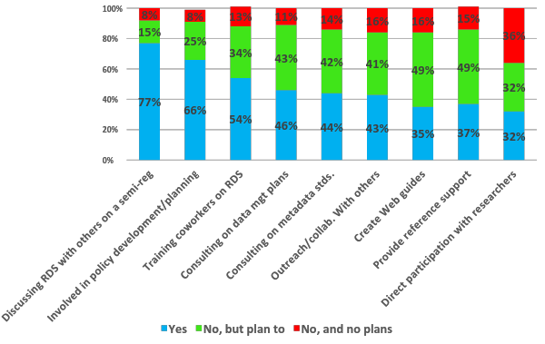
Currently offered and future plans for consultative-type services
Notes:
Outreach/collaboration with other RDS providers (n=107)
Consulting on data and metadata standards (n=105)
Consulting on data mgt plans (n=107)
Training colleagues on RDS (n=95)
Involved in policy development/planning (n=95)
Discussing RDS with others (n=95)
Creating web guides (n=100)
Provide reference support (n=101)
Direct participation with researchers (n=94)

Slide 28
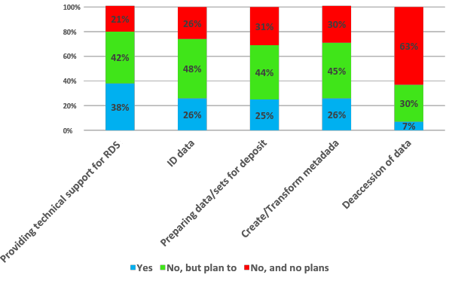
Currently offered and future plans for technical-type services
Notes:
Providing technical support (n=101)
Preparing data/sets for deposit (n=100)
ID data (n=106)
Create/transform metadata (n=103)
Deaccession of data (n=97)

Slide 29
Libraries in North and West are more likely to be:
Currently training colleagues on RDS
Discussing RDS with others
Collaborating with other RDS providers
Active in policy development and strategic planning for RDS

Slide 30
Libraries in South and West are more likely to be:
Active in consulting with academic staff or students about data management plans and metadata standards
Identifying datasets for deposit
Creating or transforming datasets and metadata

Slide 31


We also know…
There is great variation between libraries
Some universities and some countries within a region are ahead in RDS

Slide 32
3) Libraries have a variety of strategies for developing staff skills

Slide 33
Hiring for RDS positions…
Have you hired staff for RDS in the last 12 months?
Notes:
n=85

Slide 34
Professional development for RDS…
Has your library provided opportunities for library staff to develop skills related to RDS?
Notes:
n=87

Slide 35
Types of skills development…
Which of the following opportunities has your library provided for library staff to develop skills related to RDS?
Notes:
n=87
Collaboration with others with skills related to RDS (n=8)
In-house staff workshops (n=41)
Support for staff to join working groups related to RDS (n=51)
Support for staff to take courses related to RDS (n=52)
Support for staff to attend conferences/workshops (n=68)

Slide 36
Staff Skills Development
Dramatically increase the workload of some poor individual librarian
Collaborated with another institution to develop a skills-based MOOC
Moved staff from other support unit [ITS]
Strategies
Hired staff for projects (not permanent)
Refocused an existing role

Slide 37




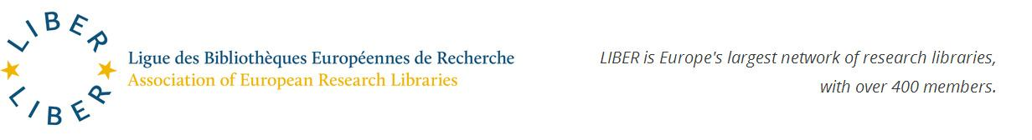
Assistance with training
http://datalib.edina.ac.uk/mantra/
Working Group on Scientific Information Infrastructures
Notes:
The FOSTER portal is an e-learning platform that brings together the best training resources for those who need to know more about Open Science, or who need to develop strategies and skills for implementing Open Science practices in their daily workflows. Here you will find a growing collection of training materials to meet the needs of many different users, from early-career researchers, to data managers, librarians, funders, and graduate schools. FOSTER (Facilitate Open Science Training for European Research) is a 2-year, EU-Funded (FP7) project, carried out by 13 partners across 8 countries. The primary aim is to produce a European-wide training programme that will help researchers, postgraduate students, librarians and other stakeholders to incorporate Open Access approaches into their existing research methodologies.

Slide 38
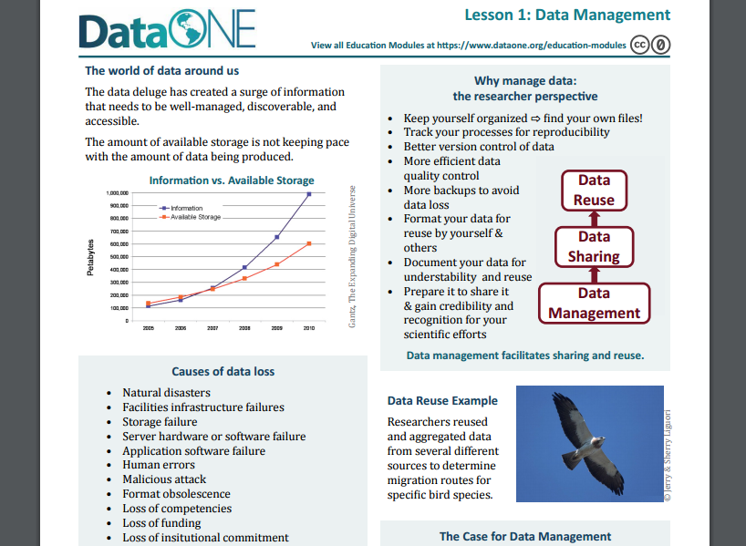
Tools for RDS Education
https://www.dataone.org/education-modules

Slide 39
DataONE Education Modules
Why Data Management
Data Sharing
Data Management Planning
Data Entry and Manipulation
Data Quality Control and Assurance
Protecting Your Data
Metadata
How to Write Quality Metadata
Data Citation
Analysis and Workflows
Legal and Policy Issues

Slide 40
Thanks to the LIBER Study Team!
Research Data Services in European Academic Research Libraries. https://www.liberquarterly.eu/articles/10.18352/lq.10180/
Carol Tenopir-University of Tennessee
Sanna Talja-University of Tampere
Wolfram Horstmann-University of Gottingen
Birgit Schmidt-University of Gottingen
Elina Late-University of Tampere
Lynn Baird- University of Idaho
Robert Sandusky- University of Illinois-Chicago
Suzie Allard-University of Tennessee
Dane Hughes-University of Tennessee
Danielle Pollock-University of Tennessee

Slide 41
Carol Tenopir
University of Tennessee
ctenopir@utk.edu

