Slide 1


Connecting islamic technology & the history of robotics in Wikidata via Wikidatabot
Anchalee (Joy) Panigabutra-Roberts
Associate Professor
Head of Cataloging
The University of Tennessee Libraries
apanigab at utk dot edu
ORCID: 0000-0002-9333-1102
7/16/2021
Grant number: RE-246419-OLS-20

Slide 2
Outline
Part I. al-Jazari and his contribution to robotics
a. First encounter at AUC Libraries
b. Donald Hill & Islamic technology
Part II. Wikidata as a platform to understand the power of linked data in action
a. al-Jazari, automatons and Scholia in Wikidata (SWIB2020)
b. GLAM’s convergence in Wikidata via working on ‘al-Jazari’
Part III. vanderbot: batch processing data into Wikidata & name authority’s creation
a. Learning & testing vanderbot
b. Future plans
  1) increase the presence of works on Islamic technology in Wikidata via vanderbot & in collaboration with Iman Dagher, Arabic & Islamic Studies Catalog Librarian, UCLA via Excel sheet
  2) @UTK: automate the creation of authority records using the new authority macro to create ‘NACO Lite’ records from Wikidata

Slide 3
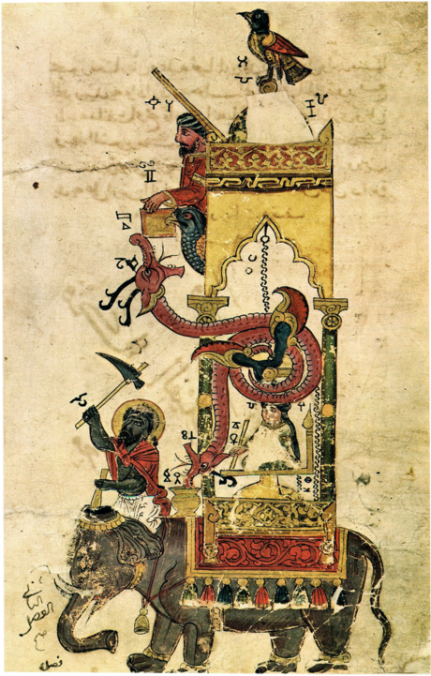
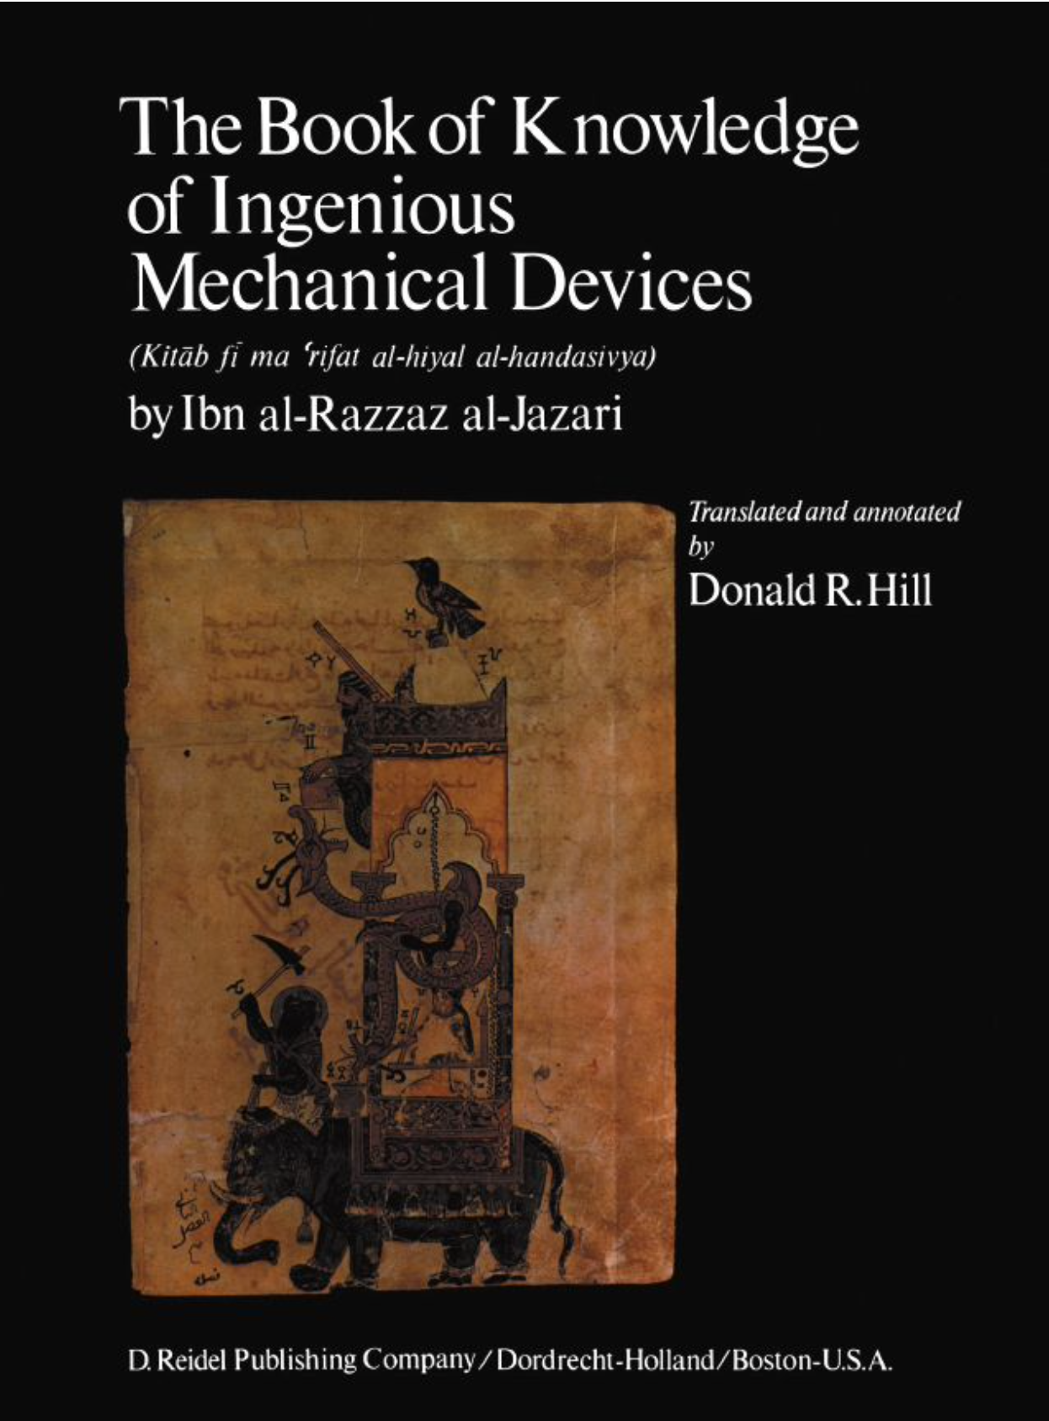
OCLC #610263351
al-Jazari’s Elephant Clock:
https://commons.wikimedia.org/wiki/File:Al-Jazari_Automata_Elephant-Clock_1315.jpg
https://www.trtworld.com/magazine/why-ismail-al-jazari-is-called-the-father-of-medieval-robots-36840
al-Jazari’s Exhibit at Istanbul Museum

Slide 4
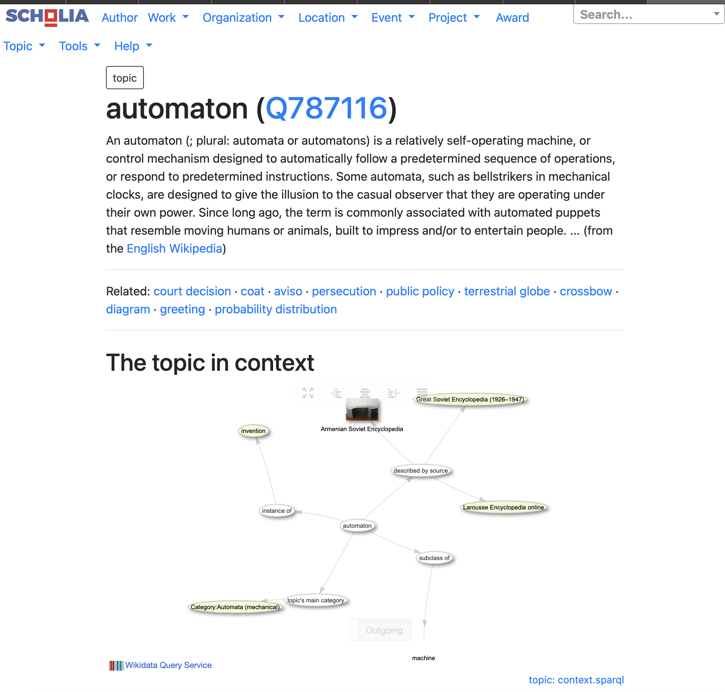
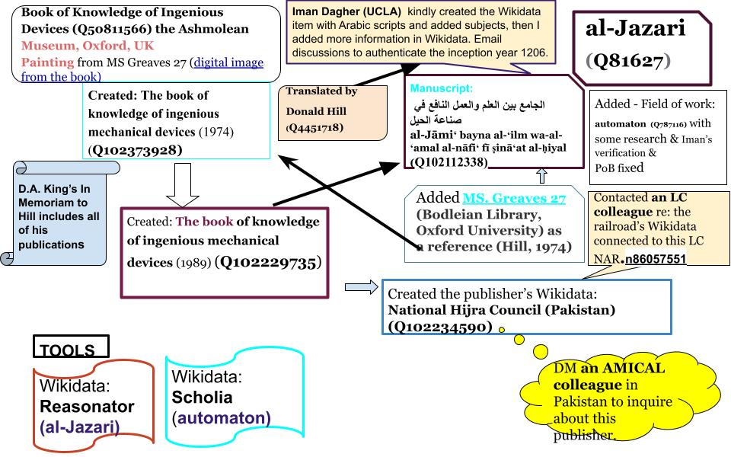
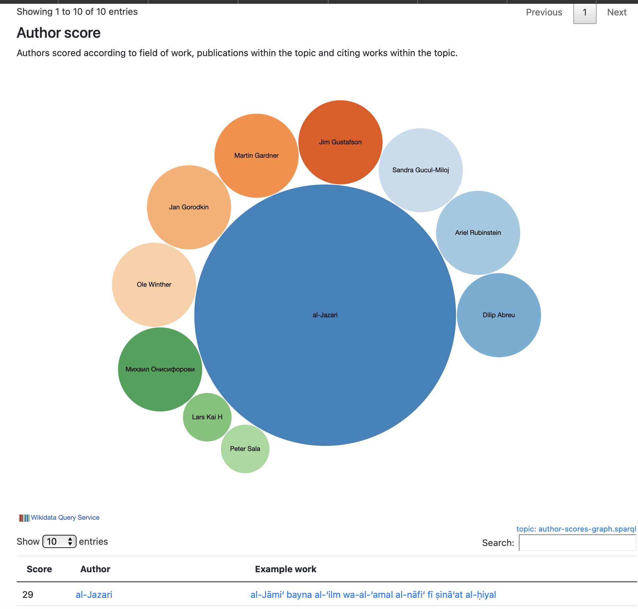
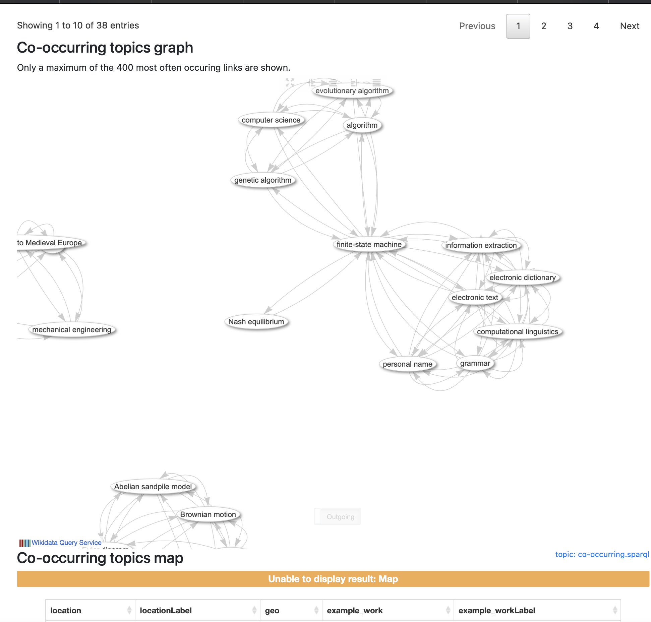
https://scholia.toolforge.org/topic/Q787116
Wikidata & Scholia
Scholarly publications & visualization tools in Wikidata
al-Jazari: https://www.wikidata.org/wiki/Q81627

Slide 5
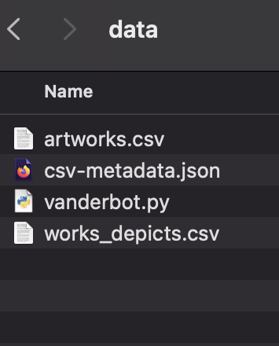
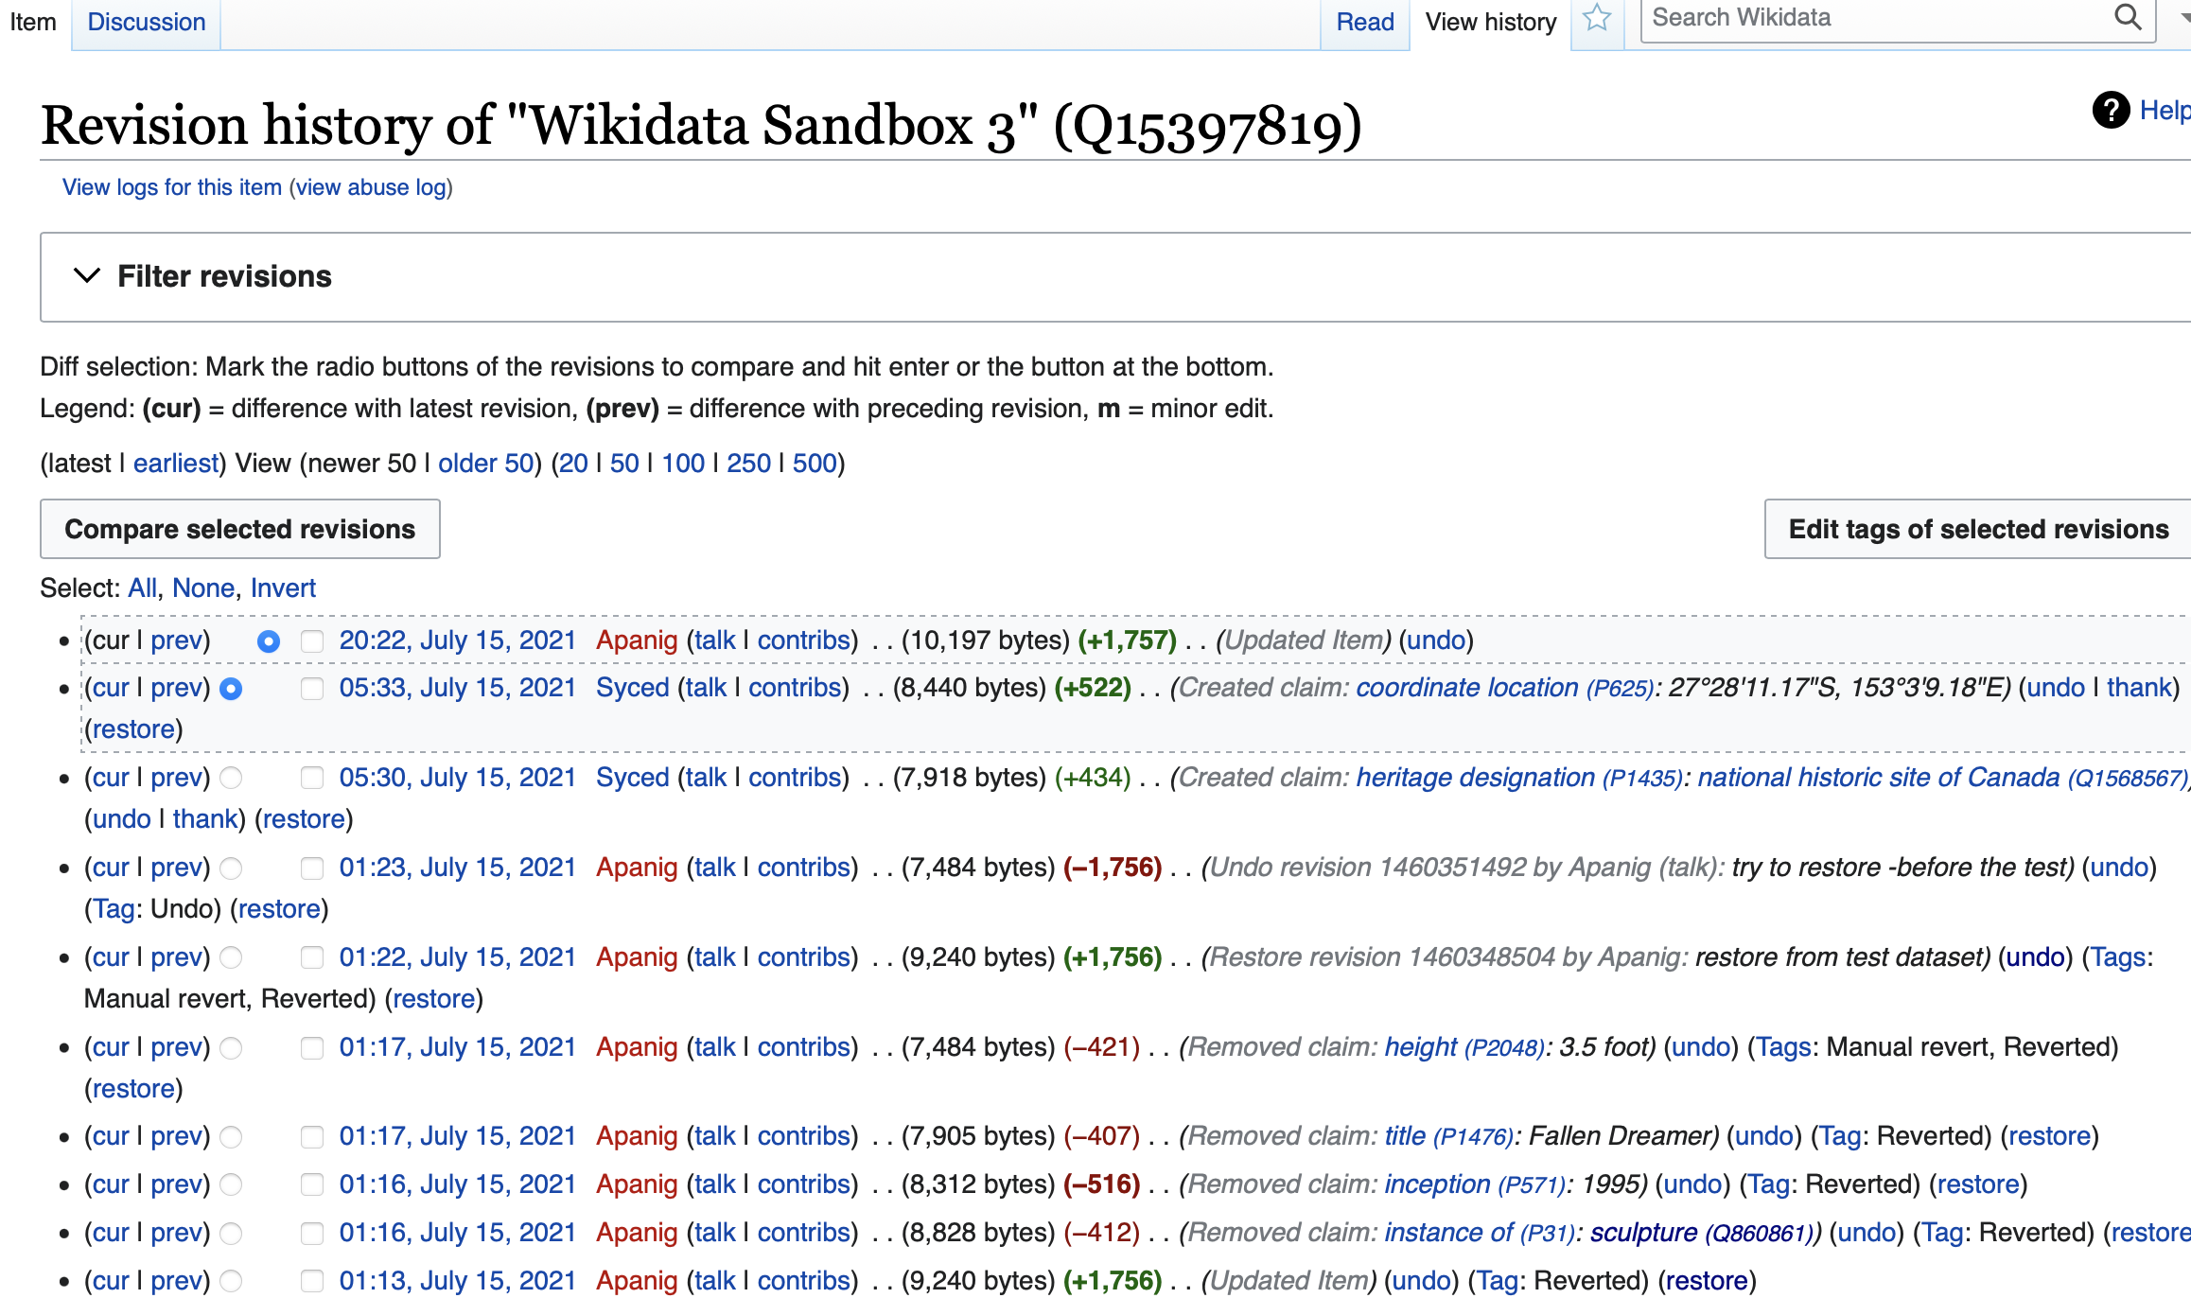

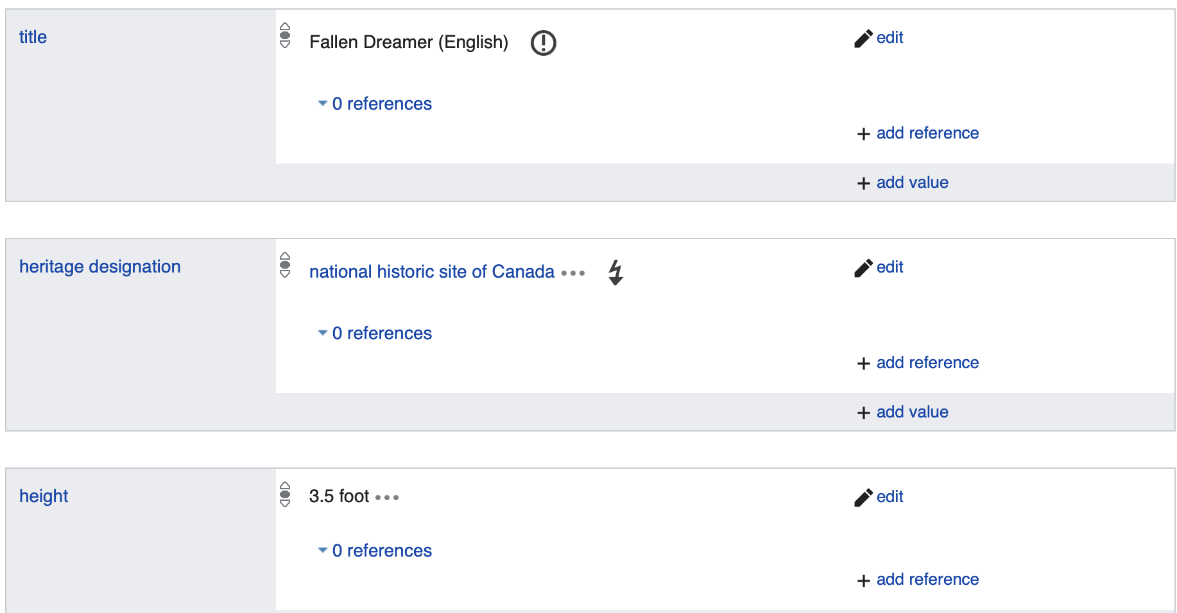
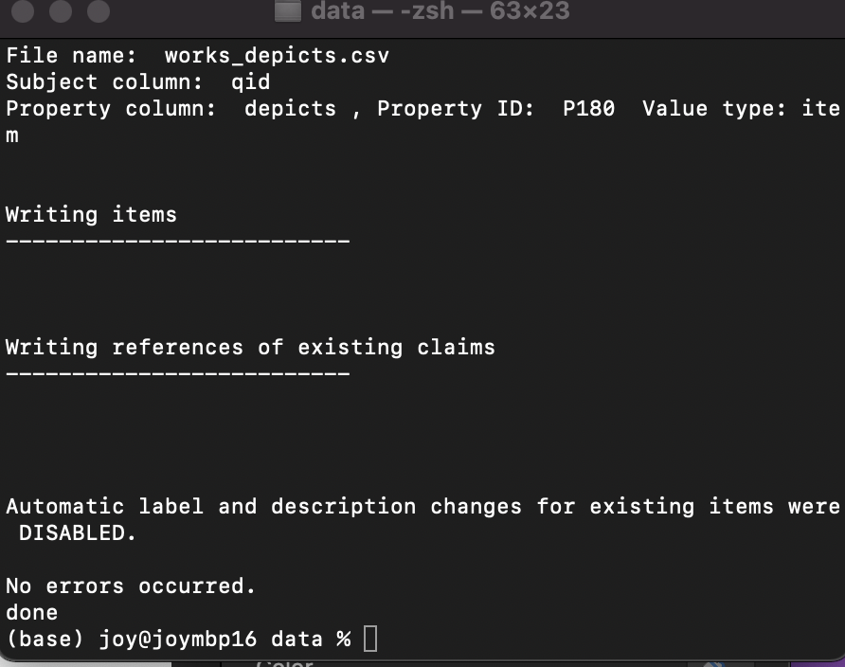
Working with vanderbot & Wikidata Sandbox
https://www.wikidata.org/wiki/Q15397819

