Slide 1
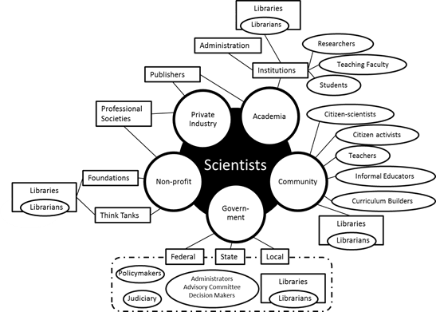
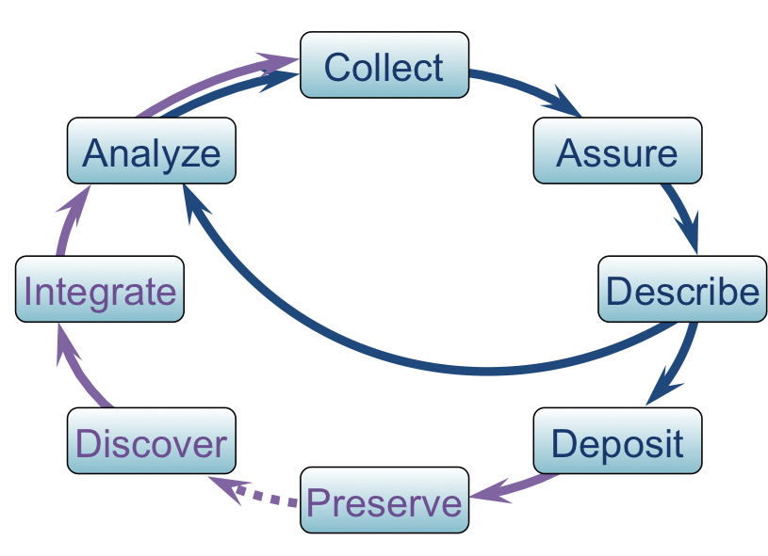
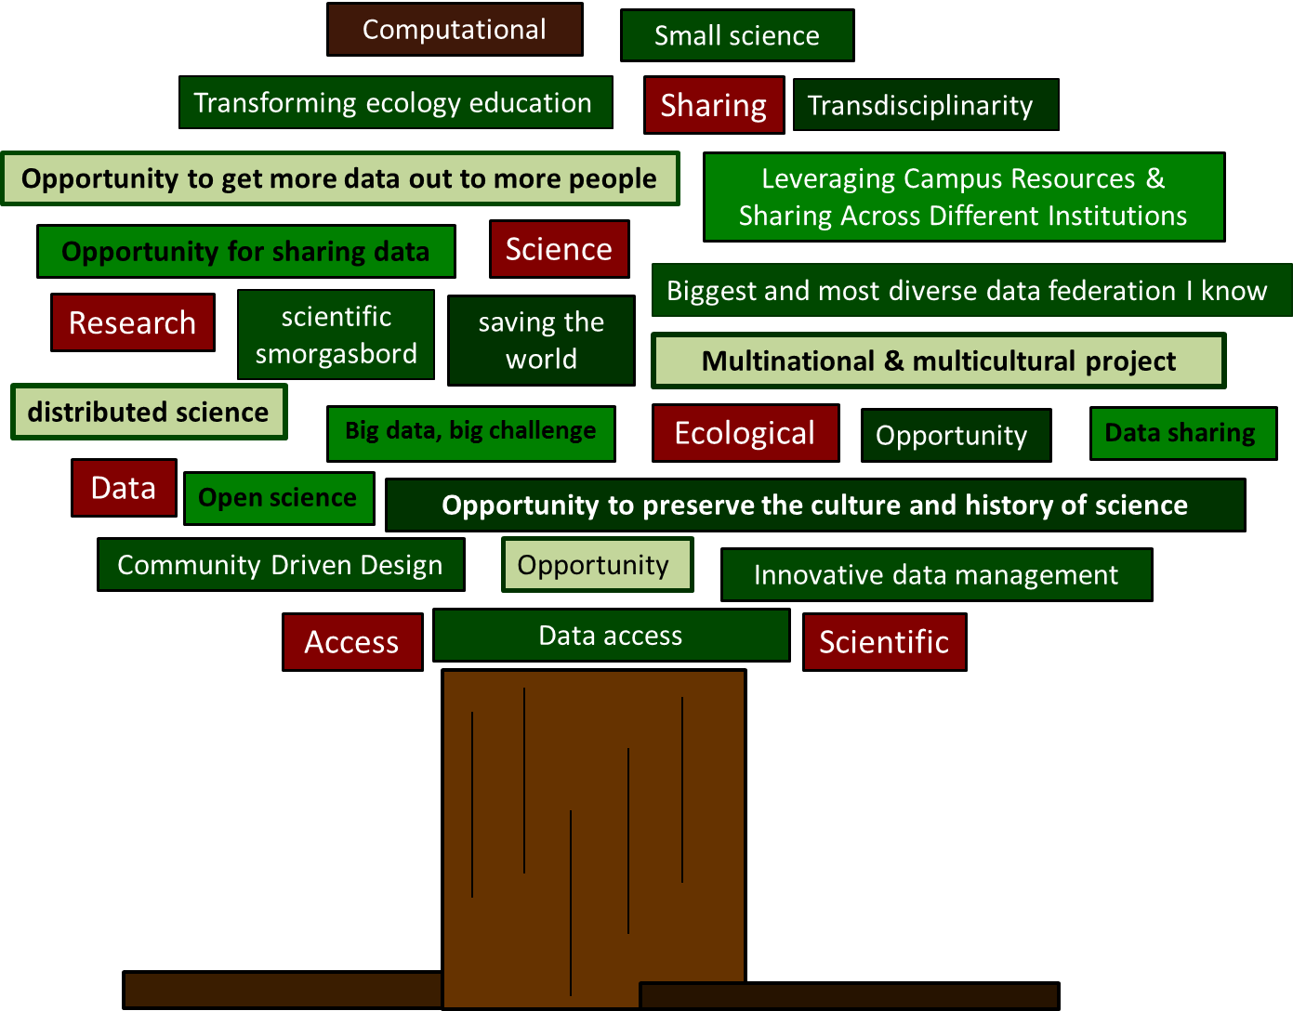
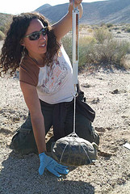
Sociocultural WG Update
Goal
Products
1. Understand DataONE environment
2. Understand Scientists & the Data Life Cycle
3. Understand potential reach of DataONE
4. Empower project members
5. Communicate with other DataNETs
1. Stakeholder Network
2. Personas
3. COI Network
4. Sociocultural view
5. Intergroup collaborations
6. Body of applied research
7. Data ONE Principles
This Meeting
Going Forward
Further identify & organize accomplishments
Examine objectives laid out in charter
Highlight inter-working group collaborations
What message should DataONEconvey?
How do we use survey & usability data?
How do we keep members engaged?

