Slide 1
Diabetes Management in Preoperative Hospitalized Patients: Improving Quality Measures on an Orthopedic Trauma and Surgical Unit
Caroline Kinkaid RN
The University of Tennessee, Knoxville

Slide 2
Overview of Problem
Diabetes mellitus (DM) is a major public health concern as it is the seventh leading cause of death in the United States
Diabetes adversely affects the outcome of all orthopedic surgery subspecialities including foot and ankle, upper extremity, adult reconstructive, pediatrics, spine surgery, and sports medicine
(CDC, 2020; Wukich, 2015)

Slide 3
Clinical significance
Diabetic patients undergoing surgery are at risk for increased morbidity and longer hospital stays
Perioperative mortality rate for DM patients is significantly higher than mortality seen in patients without DM
Patients with complicated DM (neuropathy, PAD, or nephropathy) have seven times higher likelihood of surgical site infection (SSI) and nearly a four times higher likelihood of SSI compared with patients with uncomplicated DM
Effective diabetes management in patients without comorbidities have similar outcomes to those without diabetes
(Wukich, 2015; Sudhakaran & Surani, 2015)

Slide 4
Project Purpose and Goal
Purpose
  To implement nursing education for the staff nurses to improve preoperative patients diabetes management (as defined as holding short acting insulin without an order to do so)
Goals
  To improve staff nurses knowledge of preoperative diabetes management
  To improve outcomes of surgical patients who receive insulin

Slide 5
Aims of Recommended Practice Change
To improve staff nurses knowledge over preoperative diabetes management
To improve patient outcomes through a reduction of adverse events related to withholding short acting insulin in the preoperative period

Slide 6
PICOT Question
“In nurses employed on an orthopedic trauma and surgical unit, how does the implementation of unit wide nursing diabetic pre-operative care education affect perioperative diabetes management (as defined as short acting insulin held without an order to do so) over four weeks?”

Slide 7
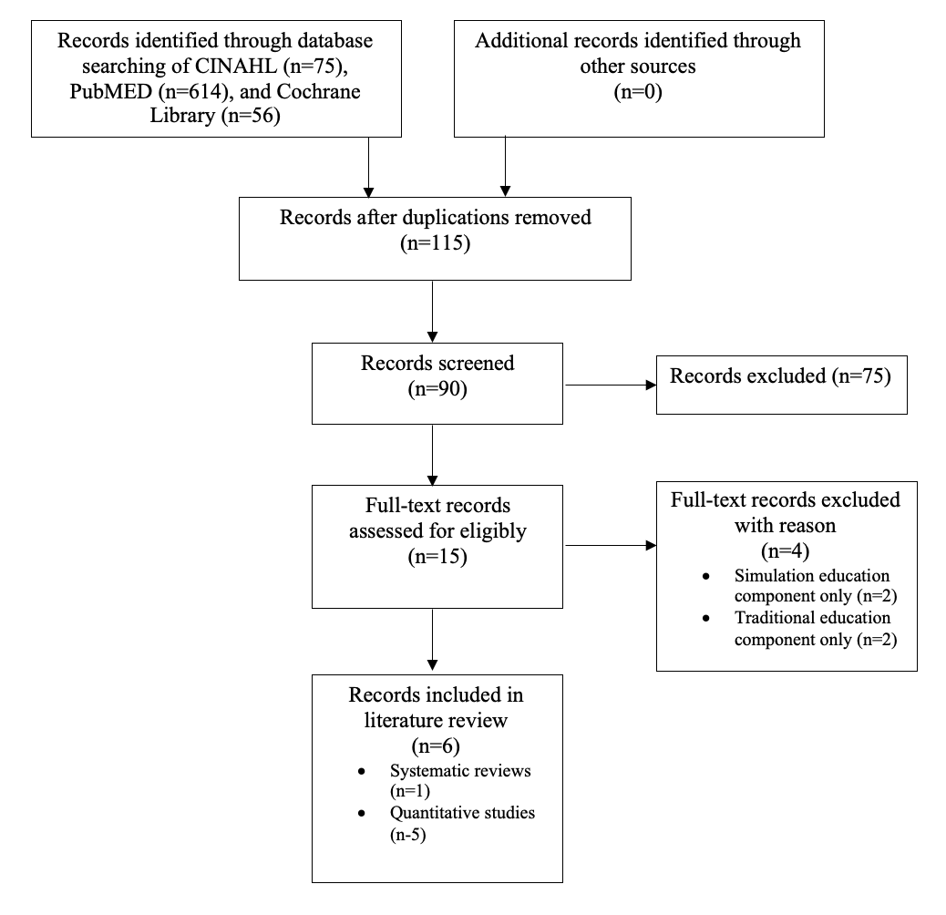
Literature search

Slide 8
Critical Appraisal
All of the studies were appraised using the Johns Hopkins Nursing Evidence-based Practice Model and Guidelines tool
After appraisal each study was given a level and quality rating
  All studies are a level I or II
  All given quality ratings of A or B indicating good and high quality evidence
Appraisal of non research evidence like clinical practice guidelines or clinical expertise was graded using the Appraisal of Guidelines for Research and Evaluation (AGREE) II instrument

Slide 9
Synthesis
E-learning instruction is effective in improving knowledge and provides a convenient way for individuals to receive instruction

Slide 10
Clinical Expertise
The American Diabetes Association (ADA) recommends a target blood glucose of 80-180 mg/dL (4.4-10.0 mmol/L) in the perioperative period.
In patients that receive insulin, half of NPH or 75-80% doses of long-acting analog or pump basal insulin should be given.
Blood glucose should be monitored at least every 2-4 hours while the patient is NPO (nothing by mouth) and dose with short or rapid acting insulin as needed.
Short acting insulin should not be held routinely
(ADA, 2021)

Slide 11
Patient Preferences
Patients diagnosed with DM prefer treatment that generates benefits with controllable parameters (Gomez-Peralta et al., 2021)
Some patients are hesitant to continue taking insulin when they are NPO. Properly informing the patient that the ADA does not recommend holding short acting insulin and that their blood sugar will be monitored might help ease their mind (ADA, 2021)
If the patient is not used to receiving insulin additional education as why the ADA does not recommend withholding short acting insulin might be needed (ADA, 2021).
  Metformin
  Non-diabetic receiving insulin
(Gomez-Peralta et al., 2021; ADA, 2021)

Slide 12
Guiding Theoretical Framework
Iowa Model
  This cyclical model begins by identifying problem focused triggers through risk management data, process improvement data, internal or external benchmarking data, financial data, or a clinical problem.
  After these triggers are identified, the topic is assessed to see if it is a priority for the organization
  Next, relevant research is collected for critique and critical appraisal for use in practice. If there is a sufficient research base, an EBP project can be conducted.
  After the outcomes are evaluated, the change to practice is assessed to see if it is appropriate for adoption. If it is not appropriate, the topic is continued to be evaluated and the process will restart.
(Titler et al., 2001)
Notes:
Organizational and Needs assessment

Slide 13
Recommendations for Practice change
There is good and consistent evidence to support implementation of an e-learning module to increase preoperative diabetes education in staff nurses

Slide 14
Implementation Process
Pre posttest
  10-questions
  Targeted at perioperative diabetes management, insulin education, and enhancing patient outcomes
Educational Module
  Voiced over PowerPoint embedded into Qualtrics
Posttest will be made available immediately after completing educational component
Chart reviews during the 4-week project period
  Included all diabetic/trauma patients receiving insulin who went to surgery

Slide 15
Findings
15 nurses completed the pre-posttest and viewed the educational module. Before analysis, there were 19 responses but four were excluded due to insufficient data
There was a statistically significant difference in the nurses’ examination score pretest [14.00 (1.732)] and posttest [16.00 (1.639)] (paired T-test: p <0.004)
66 charts were reviewed that met the criteria (diabetic, receiving insulin, and going to the OR)
  48.5% of cases insulin was not required
  27.35% of cases insulin was given
  16.7% of cases the blood sugar was not checked
  7.5% of cases insulin was withheld

Slide 16
Findings
Question | Pretest, n (%) | Posttest score, n (%)
Recommended target blood glucose in perioperative patients is: | 5 (33.3) | 13 (86.7)
How often should blood glucose be monitored in NPO patients? | 5 (33.3) | 11 (73.3)
Short acting insulin should be routinely held prior to surgery in NPO patients? | 3 (20.0) | 11 (73.3)
Complications of poorly controlled diabetes includes: | 11 (73.3) | 14 (93.3)
Treatment for hypoglycemia should be initiated at: | 11 (73.3) | 13 (86.7)
The BEST nursing intervention to prevent hyperglycemia in a hospitalized patient is: | 5 (33.3) | 10 (66.7)
The most appropriate treatment for hypoglycemia in an asymptomatic NPO patient is: | 9 (60.0) | 7 (46.7)
Reasons for postoperative hyperglycemia include: | 8 (53.3) | 9 (60.0)
Physicians should be notified when: | 6 (40.0) | 13 (86.7)
Your patient has been kept NPO for an upcoming surgery. The patient’s sugar is 220 at 0900. What is the most appropriate treatment? | 7 (46.7) | 12 (80.0)

Slide 17
Implications
The results of this project demonstrated that an e-learning module was an effective tool in educating nurses about perioperative diabetes management as previously shown by evidence
The educational module took about 15 minutes to the participants to complete and was relatively easy to operate. Based off needs assessments, implementation of e-learning modules with pre-posttests to measure success could be applied to any subject

Slide 18
Limitations
Staff participation, high nurse turnover rate, and time constraints
  Identified as a potential barrier and measures including continuous reinforcement and streamlining the pre-posttest e-learning module were implemented

Slide 19
Dissemination
Plan
Key stakeholder presentation
Presentation to other medical surgical units, stepdown units, and the emergency center at project site

Slide 20
Conclusion
Management of glycemic levels in the perioperative setting is essential to improve surgical outcomes.
Evidence and guidelines support keeping target blood glucose at 80-180 mg/dL (4.4-10.0 mmol/L) in the perioperative period and not withholding insulin.
In the chosen practice, implementation of an e-learning module increased perioperative diabetes management nursing knowledge. This led to a reduction in adverse events consequently improving patient outcomes.
(ADA, 2021)

Slide 21
Questions?

Slide 22
References
Please refer to page 13-14 of manuscript document

