Slide 1

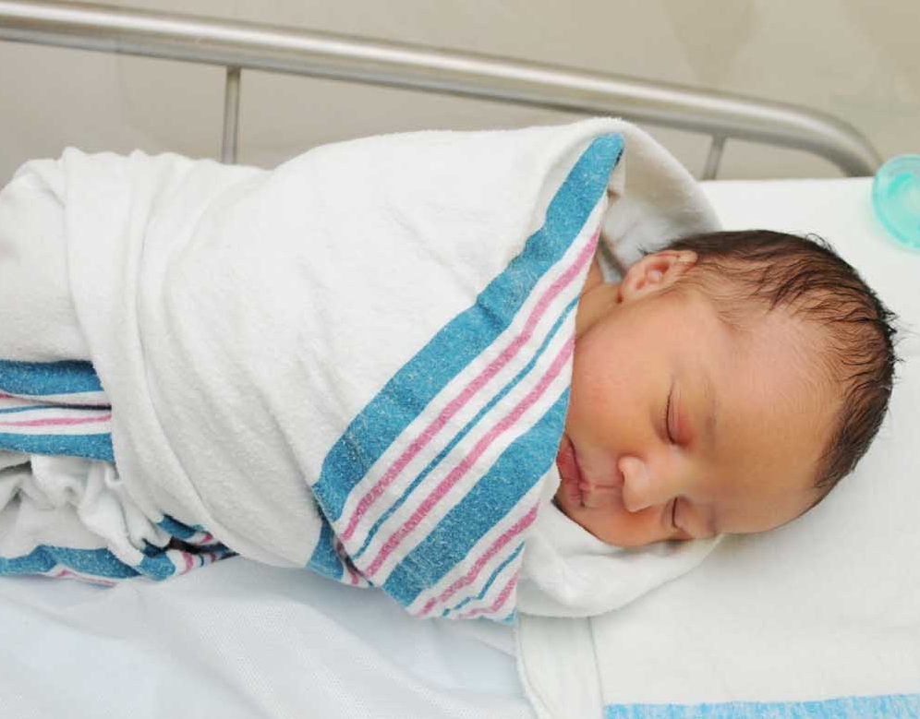
The Effects of Music Therapy and Cuddling on Symptoms of Neonatal Abstinence Syndrome
Allie Tasket
Faculty Advisor: Dr. Jennifer Tourville DNP, CPNP
Background & Significance
Methods
Neonatal Abstinence Syndrome (NAS) is a group of withdrawal symptoms infants can experience after birth due to the abrupt discontinuation of opioids exposed to in utero.
There has been a 15.4% increase in reported NAS cases in Tennessee between 2013-2017.
Many of the symptoms, including pain, nausea, irritability, vomiting, and tremors, can be severe and require hospitalization for treatment.
Finnegan scoring is a way to assess and monitor an infants’ withdrawal symptoms.
Pharmacological treatment with opioid replacement is the current standard of practice for NAS.
In low birth weight and pre-term infants, music therapy has shown increased oxygen saturation, promoted weight gain, improved sleep, and stabilized physiologic measures such as heart rate and respiratory rate.
Music therapy involves live singing and holding a swaddled infant while standing. Cuddling involves a trained cuddler holding a swaddled infant while sitting in a rocking chair.
Each infants’ HR, RR, and FS was recorded prior to and after each intervention. Demographic characteristics and medical history information was also obtained.
Results
Purpose
There was a decrease in HR after any intervention (t=68.112, df= 49, p<0.001). Mean pre-intervention HR was 181 (s.d.= 22) and mean post-intervention HR was 137 (s.d.= 15).
There was a significant decrease (t= 28.006, df= 49, p<0.001) in RR from pre-intervention RR of 51 (s.d.= 15) compared to post-intervention RR of 51 (s.d.= 13).
There was a significant increase in FS (t=19.435, df= 47, p< 0.001). Mean pre-intervention FS was 6 (s.d.= 2) compared to mean post-intervention of 7 (s.d.= 3).
The purpose of this study is to evaluate the effects of music therapy and cuddling on heart rate (HR), respiratory rate (RR), and Finnegan scores (FS) in infants being treated for NAS.
Hypothesis
It is hypothesized that music therapy and cuddling will decrease HR, RR, and FS from pre-test to post-test for infants being treated for NAS.
Sampling
Discussion/ Conclusion
A nonprobability convenience sample of 25 participants from East Tennessee Children’s Hospital was used used for this study.
Participants could receive multiple interventions at different times on different day. From this, music therapy was performed 28 times and cuddling was performed 22 times for a total of 50 interactions.
These findings show that both music therapy and cuddling are effective in decreasing infants’ HR.
When comparing the two interventions to see if one was more effective than the other, statistical significance was not found.
The effects of the interventions on FS is unclear. Future studies should focus on the effects on specific measure within FS.
Notes:
1st picture- https://www.hollywoodpresbyterian.com/our-services/maternity-services-at-cha-hollywood-presbyterian-medical-center/nicu-and-high-risk-pregnancy/
2nd picture- https://www.everytinything.com/nicu-articles/sids-and-your-nicu-baby

