Slide 1

E-Scholarship and New Roles for Research Libraries
Carol Tenopir
University of Tennessee, Knoxville, USA
and
Hanken School of Economics, Helsinki, Finland
ctenopir@utk.edu
Notes:
1

Slide 2
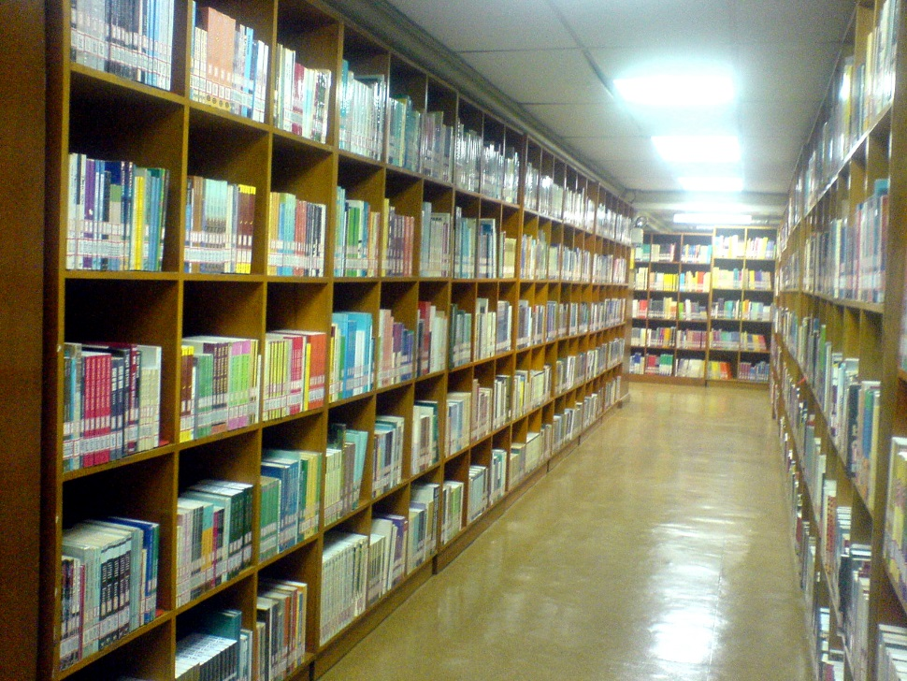

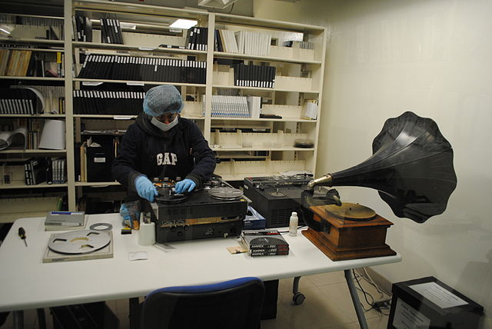
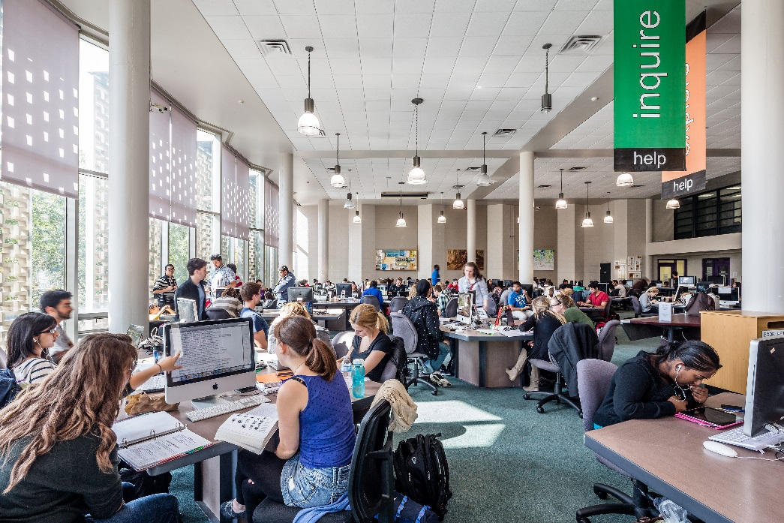
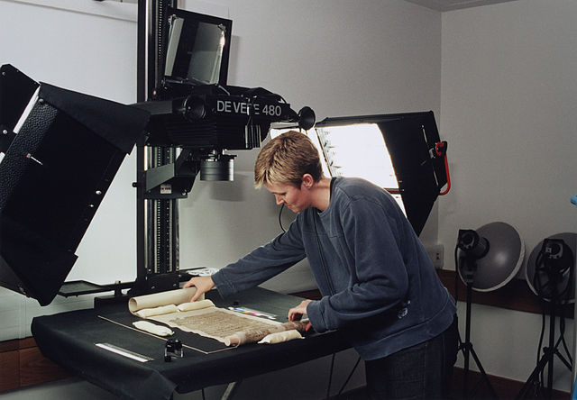

Slide 3
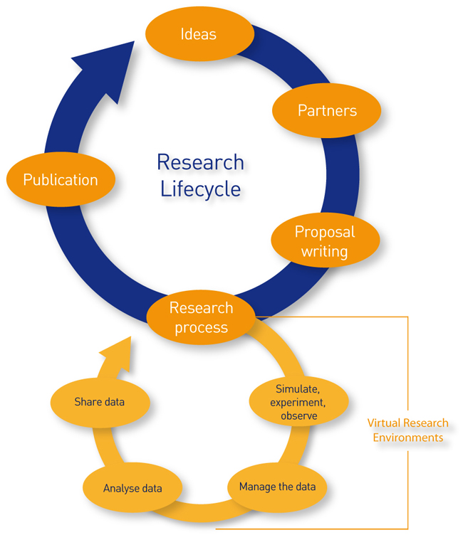
Jisc 2014 http://www.jisc.ac.uk/whatwedo/campaigns/res3/jischelp.aspx

Slide 4
Areas transforming scholarship:
Awareness of Research Data Management
Increase in Open Access alternatives
Growth of Collaborative Scholarship

Slide 5

Research Data Management
DataONE mission: Enable new science and knowledge creation through universal access to data about life on earth and the environment that sustains it. (dataone.org)

Slide 6
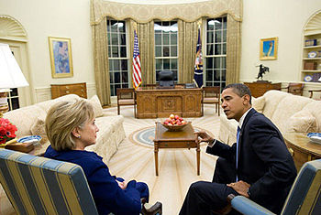
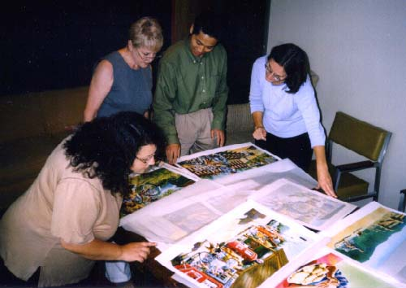
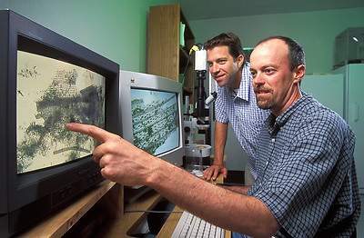
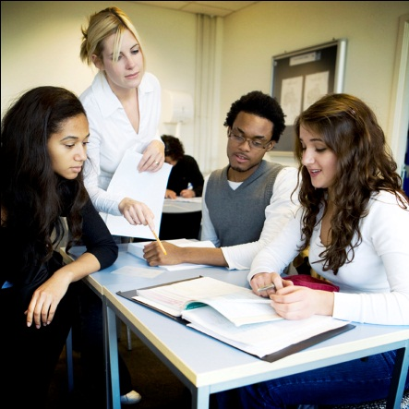
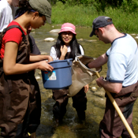
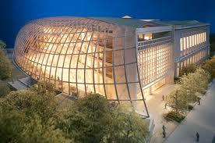

DataONE Assessment of Stakeholders
Public Officials
Publishers
Data Managers
Citizen-scientists
Libraries
& Librarians
Scientists
Students
& Teachers
Notes:
Survey of academic libraries in US and Canada.
What the libraries are actually doing or planning to do re: Research Data Services
A stratified panel of library directors in all types of academic libraries
223 ACRL libraries in 2011
128 ACRL libraries in 2014

Slide 7

Data Lifecycle
Collect
Discover
Integrate
Analyze
Plan
Assure
Preserve
Describe
Notes:
Like the research lifecycle, data has its own lifecycle—starting with the data management plan, and moving to collecting, assuring quality, describing, preserving, discovering, integrating, analyzing and using data. DataONE strives to understand key behavior and levels of knowledge at each step of this lifecycle.

Slide 8
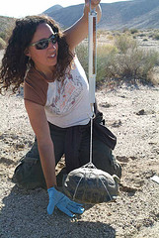
Researchers might…
Plan
Analyze
Collect
Integrate
Assure
Discover
Describe
Preserve
Notes:
It is clear that key stakeholders may follow different paths in this lifecycle or be unaware of all steps or at least less concerned about certain steps. A researcher, for example, may often ignore parts of the lifecycle like describing data with metadata, preserving, discovering other’s data, or integrating data from disparate sources. They want to plan, collect good data and get right to analysis.

Slide 9
What metadata do you currently use to describe your data? (2014)

Slide 10
Gap between willingness to share and accessibility (2014)
  Although 80% of scientists agree “I share my data”
  Only 46% agree “Others can access my data easily”
Notes:
N=743

Slide 11
Reasons for Not Making Data
Electronically Available (2014)

Slide 12

Librarian & Library Roles
data management plans
Collect
Preserve
Discover
Integrate
Analyze
Plan
Assure
Describe
Partnering with researchers
Collecting best practices
Metadata services
Systems for discovery
Instruction
Stewardship role (select & deselect)

Slide 13
RDS offered by most European libraries currently
Consultative
Consultative
Consultative
Consultative
Consultative
Consultative
Notes:
*yes only responses*
Outreach/collaboration with other RDS providers (n=107)
Consulting on data and metadata standards (n=105)
Consulting on data mgt plans (n=107)
Training colleagues on RDS (n=95)
Involved in policy development/planning (n=95)
Discussing RDS with others (n=95)

Slide 14
RDS offered in European libraries
Technical
Consultative
Consultative
Consultative
Technical
Notes:
*Yes only*
ID datasets (n=106)
Direct participation with researchers (n=94)
Creating web guides (n=100)
Providing tech support for finding/citing data (n=101)
Providing ref. support for RDS (n=101)

Slide 15
Research Data Services in libraries
RDS are important and consistent with library mission and role
Libraries are at an early point in transition to RDS—requiring resetting of priorities, realignment of responsibilities, and opportunities to develop skills
A new generation of data services librarians are being educated
Other librarians need opportunities to develop RDS skills

Slide 16
2. Increase in Open Access alternatives coupled with conflicting views of open access

Slide 17







Pay It Forward: Imagining a Gold Open Access World
The Andrew W. Mellon Foundation

Slide 18
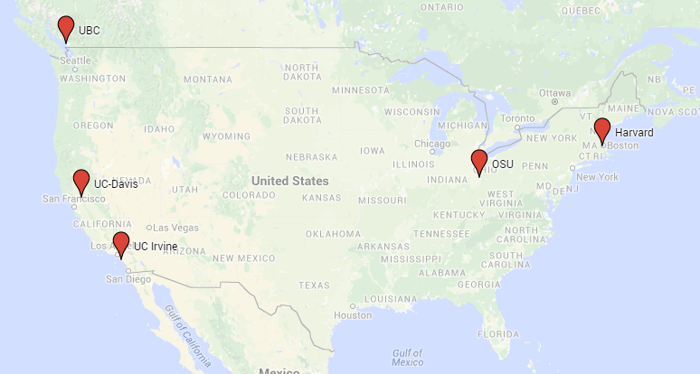
“Pay It Forward” project: Attitudes and Knowledge about gold OA

Slide 19
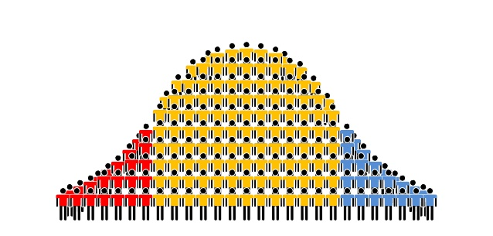
Wide Range of Opinions of Gold Open Access
“It matters heavily to me that my papers are open access. From my value standpoint, I care less about the impact factor and I care more about having it peer reviewed but open access”.
“If a particular venue becomes associated with a vanity press--if you have enough money, you can get it published there--and then it loses credibility in academic circles or elsewhere.”

Slide 20
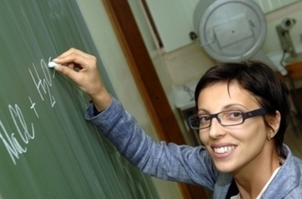

Range of Opinions
I am totally for open access, and not just because it is good for me, even though my citations go up because of it and I can find things easier. I really do think that we have an obligation to developing countries to make it easier for them to get access to journals.
I see the first world countries having even more of a monopoly over publishing than they do now because institutions from third world countries would not have money. That would exacerbate the problem we have now unfortunately.

Slide 21
Importance of Factors When Selecting Where to Publish*
  Quality and reputation of journal
  Fit with Scope of journal
  Audience
  Impact Factor
  Likelihood of acceptance
  Time from submission to publication
  Editor or editorial board
  Open Access
*Listed highest to lowest
Notes:
N=2021

Slide 22
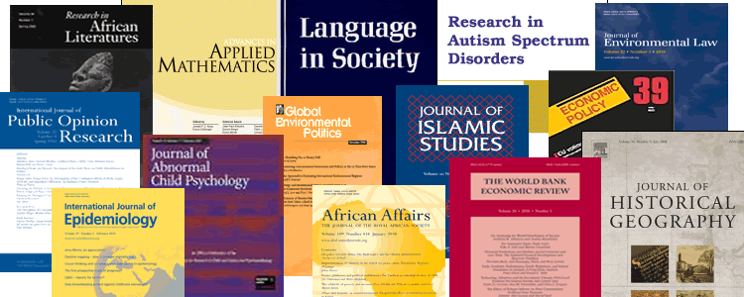
Open Access and libraries
Educating about options and the good and the bad of open access.
The library can help all understand the economic consequences and coordinate funds for gold OA fees.

Slide 23
3. Growth of Collaborative Scholarship and sharing

Slide 24
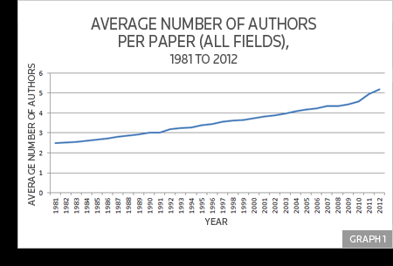
Growth in Co-Authorship
http://sciencewatch.com/articles/single-author-papers-waning-share-output-still-providing-tools-progress

Slide 25
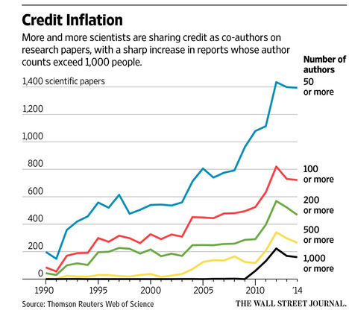
Growth in Co-Authorships
http://www.wsj.com/articles/how-many-scientists-does-it-take-to-write-a-paper-apparently-thousands-1439169200

Slide 26

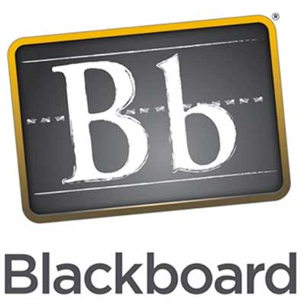

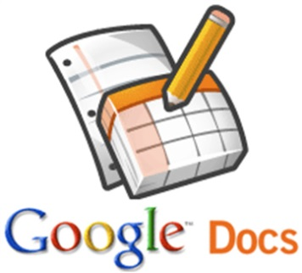

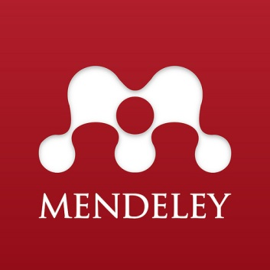
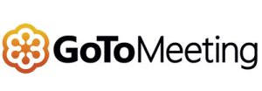




Slide 27

Beyond Downloads
What are COUNTER download counts missing?
How much do scholars share and what do they share?
How might sharing be measured?
What is a more complete value of articles?

Slide 28
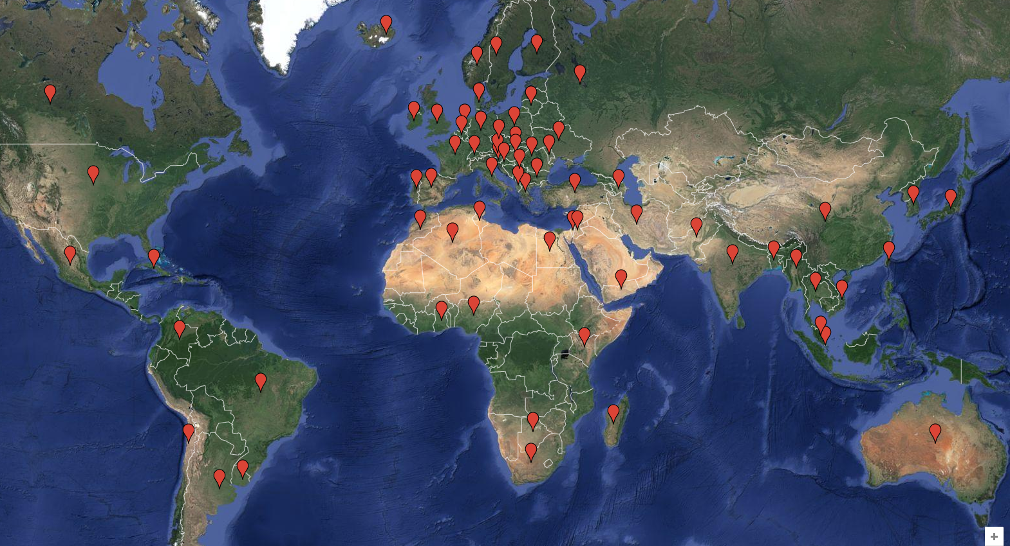
Beyond Downloads focus groups in US and UK and International Survey with 1000 responses
Notes:
The project included focus groups and interviews in the United States and United Kingdom and an international survey with 1000 responses.
31 October 2014 through 16 January 2015
Invitation to a mailing list of 32,956 authors published in an Elsevier journal.
1000 responses for a response rate of 3.03%.
Respondents came from 69 Countries,
Top 5 countries:
United States = 27.1%
Italy = 7.1%
China = 7.0%
Canada = 4.0%
United Kingdom = 3.8% tied with India 3.8%
Subject disciplines:
33.8% sciences;
20.8% medical sciences
21.4% engineering
22.4% social sciences
1.7% humanities
Respondents ages ranged from 18 to 83, Average age of respondents was 48 years, with a quarter under 39.
81% were academic ranks, 3.4% students, 11.2% private or non-academic researcher
A range of subject disciplines, but most from STEM disciplines. 82% hold a phd.

Slide 29
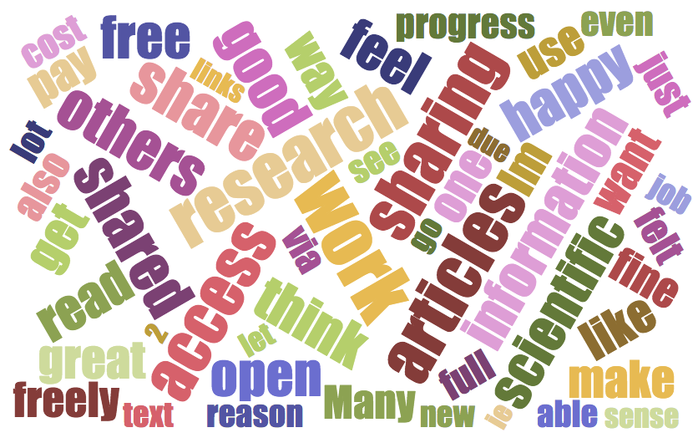

Slide 30

“If I have got it, I will just share it. It is easier than having them go track it down, even if I have got the citation.”
“It’s not like I’m giving away something that they could not get anyhow. But it never dawned on me that in effect, you know in theory, I am violating copyright.”
Notes:
Scholars find sharing useful to further scientific and academic discovery, to facilitate collaboration, and to advance their own work.
Sharing is often initiated by others who are interested in an author’s work and the sharing is by the author. But not always—if a scholar has access to an article by someone else that they think is particularly good or useful or that another person wants they will likely share it either as a full text or a link.
Why do they share? Sharing is a natural part of scholarship—they mainly share materials to further scientific and academic discovery.
Another reason is to pass on what they feel is good or noteworthy, that is to promote the reading of their own or someone else’s good work.
And the next most common reason is because someone asks either for a copy of their own article or for a copy of someone else’s article that is behind a paywall and they don’t have access. To help a colleague fulfill an information need, was mentioned by many.
Again, these top reasons, reflect the very nature of scholarship and both formal and informal systems that make it easier to do are widely adopted. These reasons were also reflected by the survey respondents.
Key findings include:
Participants most often use multiple sources to find and to share.
Sharing is necessary to the work of many and they do it.
Convenience, fitting in with work, helping others are more important than the letter of the law.

Slide 31
Why do scholars share?
Sharing...
... is a cornerstone of the research process
...facilitates collaboration
...advances scholars’ own work
...helps my colleagues
...is convenient
...is fair (even if it isn’t strictly legal)

Slide 32

Their most recent full-text is shared …
Email
Research social networks
an average of 10.5 (8.4 minus outliers) times per download.
an average of 10.8 (5.3 minus outliers) times per download.

Slide 33
When working in a research group …
Percent
N=771

Slide 35
But, library download counts may underestimate use, because when returning to an article …

Slide 37

Libraries and sharing
  Sharing supports disseminating results—a key mission of libraries
  Library value needs to be beyond downloads and collections
  Convenience is a key concern; libraries can provide tools that fit work styles
  Librarians have a role to play as a research team member

Slide 38
Libraries…
facilitate interdisciplinary work, data access, and knowledge sharing through new services
Can take a leadership role in education and services relating to research data, open access, and enabling collaborative scholarship
Carol Tenopir

