Slide 1


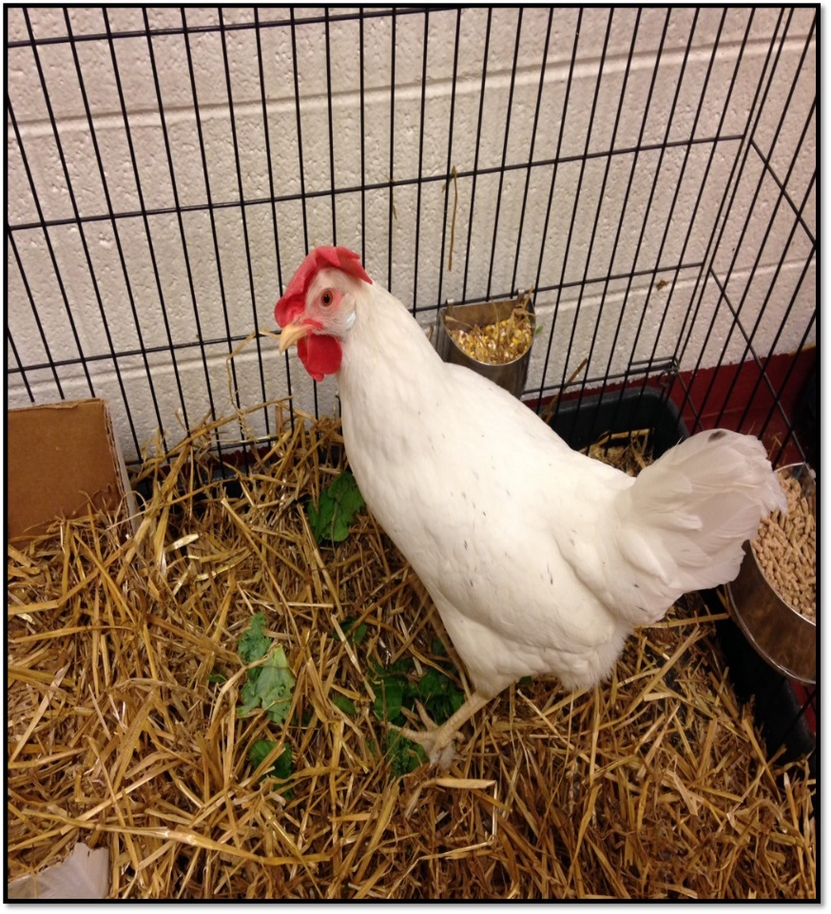

Meloxicam Residues in Eggs
Sherry Cox, Joan Bergman, Molly White, Kristen Gordon, Marcy Souza
College of Veterinary Medicine, University of Tennessee
Abstract
Introduction
Materials & Methods
One Health is the integrative effort of multiple disciplines working locally, nationally, and globally to attain optimal health for people, animals, and the environment. The importance of One Health is highlighted by many factors in our world today including vigilant protection of our food supplies. With the increasing popularity of backyard poultry ownership, veterinarians are faced with how to treat these animals with regard to drug withdrawal times for egg consumption. A recent review describes allowable medications for use in egg-laying poultry; however, few drugs have recommended doses or withdrawal times for use in laying hens. Meloxicam is an NSAID that is commonly used in avian medicine. A commercially available liquid form is readily available and is easily administered to birds. A recent publication reported that the Food Animal Residue Avoidance Databank received more requests for egg withdrawal intervals for hens following meloxicam administration than for any other drug. In the study reported herein, we determined egg concentrations of meloxicam following a single oral dose and following oral dosing at 1 mg/kg Q12H for a total of 9 doses (5 days). Meloxicam was detected in egg whites up to 4 days and in egg yolks up to 8 days after single dosing. Drug was detected in egg whites up to 3 days and in egg yolks up to 8 days after multiple doses. Based on these results a 2-week withdrawal time should be adequate to avoid drug residues in eggs meant for consumption.
Studies indicate that meloxicam is a safe and effective choice for analgesia in chickens, but limited information is available on dosing or drug withdrawal times for eggs. In the study reported herein, we determined egg concentrations of meloxicam following a single oral dose and following oral dosing at 1 mg/kg Q12H for a total of 9 doses (5 days).
Meloxicam was extracted from egg yolks using a solid phase extraction technique. Egg yolk (1 mL) was placed in a tube, followed by 75 µL of the internal standard (piroxicam, 5 µg/mL) and 200 µL of 1 M HCl and 2 mL acetonitrile. Samples were vortexed and centrifuged, and then the supernatant was removed and evaporated. The residue was re-dissolved in methanol:water (1:9) and added to an Oasis HLB (3 cc) extraction cartridge. The sample was eluted with 2 mL acetonitrile:methanol (90:10, v/v), then evaporated with nitrogen, and re-dissolved in mobile phase. Standard curves for egg yolk analysis were prepared by fortifying untreated egg yolks with meloxicam to produce a linear concentration range of 5–1500 ng/mL. The lower limit of quantification during validation was 5 ng/mL and the limit of detection was 2.5 ng/mL. Intra- and inter-assay variability ranged from 1.8 to 7.8%, and the average recovery for meloxicam was 85%.
Table 2. Meloxicam concentration (ng/mL) in egg yolks and egg whites of chickens following 5 days of twice daily dosing of meloxicam at 1 mg/kg orally. Day 1 collection occurred the first day after meloxicam administration ceased.
 |  |  | Yolks
Day | Hen 1 | Hen 2 | Hen 4 | Hen 5 | Hen 6 | Hen 7 | Hen 8
1 | 39 | 57 | 67
2 |  | 132 |  |  |  | 43
3 | 88 | 146 | 77 |  |  | 78 | 44
4 |  |  |  | 124 |  |  | 63
5 | 97 | 116 | 54 |  |  | 51 | 71
6 | 145 | 79 |  |  |  | 24
7 |  |  | 8 | 79 |  |  | 39
8 |  | 24 |  |  |  | 10 | 15
9 |  | BLQ | ND | 9 |  | BLQ | BLQ
10 |  | BLQ |  | ND |  |  | ND
11 |  |  | ND |  | ND | ND | ND
12 |  | BLQ |  | ND |  | ND
13 |  | ND | ND |  |  |  | ND
14 |  |  |  | ND
 |  |  | Whites
1 | 29 | 24 | 8
2 |  | BLQ |  |  |  | 15
3 | BLQ | BLQ | ND |  |  | BLQ | BLQ
4 |  |  |  | BLQ |  |  | BLQ
5 | BLQ | ND | ND |  |  | ND | ND
6 | ND | ND |  |  |  | ND
7 |  |  | ND | ND |  |  | ND
8 |  | ND |  |  |  | ND | ND
9 |  | ND | ND | ND |  | ND | ND
10 |  | ND |  | ND |  |  | ND
11 |  |  | ND |  | ND | ND | ND
12 |  | ND |  | ND |  | ND
13 |  | ND | ND |  |  |  | ND
14
Materials & Methods
Results
Hen 3 did not lay eggs; ND = nothing detected in sample; BLQ = below the limit of quantification of assay which is 5 ng/mL. Empty space indicates no egg was laid.
Eight adult, white leghorn hens were obtained from a commercial source and housed in a climate-controlled facility for 2 weeks prior to any procedures being performed. Hens were determined to be healthy based on physical examination. Birds were housed individually in large wire cages (61 × 122 × 91.5 cm; 24 × 48 × 36 inches) but adjacent to each other so that all hens could see all other hens. Birds were provided water, layer pellets, and scratch ad lib. Fresh greens were provided daily, and mealworms were provided intermittently as enrichment. Animals were kept on a 14-hour light–8-hour dark schedule to encourage egg laying. All study procedures were approved by the University of Tennessee Institutional Animal Care and Use Committee.
At the start of the study, hens were weighed, and a dose of 1 mg/kg of meloxicam was calculated. A blood sample (0.3 mL) was collected from each hen on day 0, and the medication was then administered via syringe into the oral cavity distal to the glottis. For the multi-dose study 1 mg/kg oral meloxicam was administered every 12 hours for a total of 9 doses. The medication was administered via syringe with attached metal gavage feeding tube into the crop. Eggs laid by the dosed hens were collected for 3 weeks starting on the day of meloxicam administration (day 0). There was a 4 week washout between the single and multi-dose study. Eggs were kept refrigerated until analyzed.
Analysis of egg white samples was conducted using a method developed by Cox et al. Briefly, analysis of meloxicam in egg samples was conducted using reversed-phase HPLC. The system consisted of a 2695 separations module, a 2487 ultraviolet absorbance detector, and a computer equipped with analytic software (Waters). The compounds were separated on an Xbridge C₁₈ (4.6 × 250 mm, 5 µm) with a 5-µm Xbridge guard column. The mobile phase was a mixture of 10 mL glacial acetic acid in 1 L H₂O (pH 3.0, adjusted with sodium hydroxide) (50%) and acetonitrile (50%). Absorbance was measured at 360 nm with a flow rate of 1 mL/min.
Standard curves for egg white analysis were prepared by fortifying untreated egg whites with meloxicam to produce a linear concentration range of 5–1500 ng/mL. The lower limit of quantification during validation was 5 ng/mL. The intra- and inter-assay variability ranged from 0.5 to 6.6%, and the average recovery for meloxicam was 90%.
No adverse effects occurred during the study. Only 5 hens consistently laid through the collection period for the single dose study. Hens did not lay eggs daily, and 1 hen (#5) laid only 1 egg during the collection period. No drug was detected in yolks and whites after 8 days and 4 days, respectively. Yolk and egg white concentrations of drug for all hens are shown in Table 1. Only 6 hens laid consistently through the multi-dose study and hens did not lay eggs daily. Meloxicam was not detected in yolks and whites after 8 and 3 days, respectively. Yolk and white drug concentrations are shown in Table 2. The HPLC analysis of eggs was discontinued once at least 2 consecutive eggs had no detectable meloxicam. The HPLC analysis of eggs was discontinued once 2 consecutive eggs from a hen had no detectable meloxicam concentrations.
Discussion
This study was the first to examine drug residues in eggs following the oral administration of meloxicam. Drug was present in yolks for a longer period than in whites, which is consistent with the formation of eggs. The white (albumin) is laid onto the yolk later in egg formation; therefore, once drug is no longer present systemically, presence of drug in the egg white quickly decreases. Residues could persist in eggs for longer periods due to the length of yolk (follicle) formation, but residues typically persist for less than 2 weeks for reported drugs. Although the number of eggs collected and analyzed each day was small, the evidence is consistent that a 2-week withdrawal time should be adequate to avoid meloxicam residue in eggs following a single oral dose of 1 mg/kg.
The convergence of people, animals and our environment has created a new dynamic in which the health of each group is interconnected. One Health calls for the collaborative efforts of multiple disciplines working locally, nationally, and globally to attain optimal health for people, animals and our environment. Many factors have changed interactions between people, animals and our environment and vigilant protection of our food supplies is an important aspect of the One Health concept. This study provides a starting point for the use of meloxicam in laying hens, but additional research is needed to establish species-specific therapeutic plasma concentrations by pairing pharmacokinetic and pharmacodynamics studies.
Introduction
One Health is the integrative effort of multiple disciplines working locally, nationally, and globally to attain optimal health for people, animals, and the environment. Because of their expertise, veterinarians play critical roles in the health of animals, humans, and even the environment. As the human population continues to increase and expand across our world, the interconnection of people, animals, and our environment becomes more significant and impactful. The importance of One Health is highlighted by many factors in our world today including vigilant protection of our food supplies. The demand for animal-based protein is expected to increase by 50% by 2020.
Backyard poultry are becoming increasingly popular and few guidelines exist for appropriate dosing or egg withdrawal time for commonly used medications. A recent review describes allowable medications for use in egg-laying poultry; however, few drugs have recommended doses or withdrawal times for use in laying hens. Veterinarians are faced with how to treat these animals with regard to drug withdrawal times for egg consumption.
Meloxicam is an NSAID that is commonly used in avian medicine. A commercially available liquid form is readily available and is easily administered to birds. A recent publication from Marmulak et al reported that the Food Animal Residue Avoidance Databank received more requests for egg withdrawal intervals for hens following meloxicam administration than for any other drug. Although one study examined meloxicam in chickens following IV administration, no published pharmacokinetic studies are available to aid in recommendations regarding dosing or withdrawal times for oral meloxicam administration.
Table 1. Meloxicam concentration (ng/mL) in egg yolks and egg whites of chickens following a single dose of 1 mg/kg oral meloxicam.
 |  |  | Yolks
Day | Hen 1 | Hen 2 | Hen 4 | Hen 5 | Hen 7 | Hen 8
0 | ND | ND | 6
1 |  |  | 7
2 | 6 | 5 |  |  | ND
3 | 8 | 12 |  |  | BLQ
4 |  |  | 14 | BLQ
5 |  | 24 |  |  | BLQ
6 | ND | 22 | 19 |  | 16
7 | BLQ | 8 | ND |  | 12
8 |  | ND |  |  | BLQ | ND
9 | ND |  | ND
10 | ND | ND |  |  | ND | ND
11 |  | ND
12 | ND | ND |  |  | ND | ND
13 |  |  |  |  |  | ND
 |  |  | Whites
0 | BLQ | BLQ | BLQ
1 |  |  | BLQ
2 | BLQ | BLQ |  |  | 8
3 | ND | BLQ |  |  | BLQ
4 |  |  | BLQ | BLQ
5 |  | ND |  |  | ND
6 | ND | ND | ND |  | ND
7 | ND | ND
8 |  | ND |  |  |  | ND
9 | ND
10 | ND | ND |  |  |  | ND
11 |  | ND
12 | ND | ND |  |  |  | ND
13 |  |  |  |  |  | ND
Hens 3 and 6 did not lay eggs; ND = nothing detected in sample; BLQ = below the limit of quantification of assay which is 5 ng/mL. Empty space indicates no egg was laid.

Slide 2
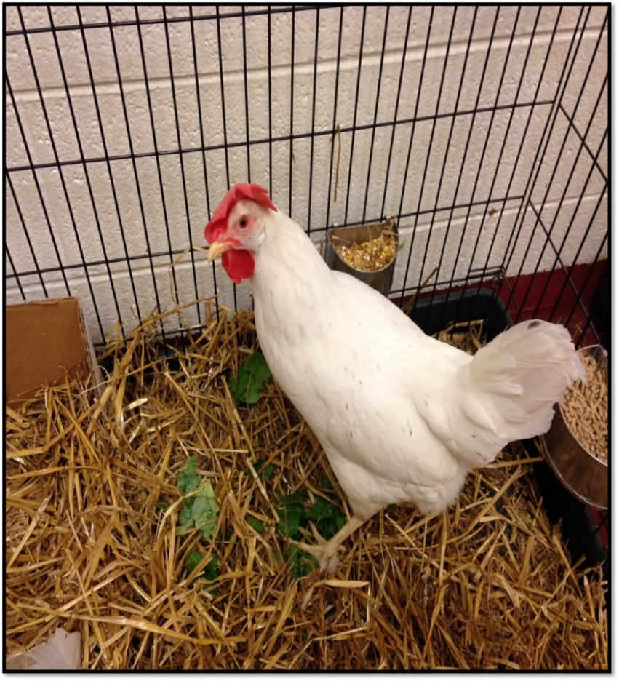
Meloxicam Residues in Eggs
Sherry Cox, Joan Bergman, Molly White, Kristen Gordon, Marcy Souza
College of Veterinary Medicine, University of Tennessee
Abstract
Introduction
Materials & Methods
One Health is the integrative effort of multiple disciplines working locally, nationally, and globally to attain optimal health for people, animals, and the environment. The importance of One Health is highlighted by many factors in our world today including vigilant protection of our food supplies. With the increasing popularity of backyard poultry ownership, veterinarians are faced with how to treat these animals with regard to drug withdrawal times for egg consumption. A recent review describes allowable medications for use in egg-laying poultry; however, few drugs have recommended doses or withdrawal times for use in laying hens. Meloxicam is an NSAID that is commonly used in avian medicine. A commercially available liquid form is readily available and is easily administered to birds. A recent publication reported that the Food Animal Residue Avoidance Databank received more requests for egg withdrawal intervals for hens following meloxicam administration than for any other drug. In the study reported herein, we determined egg concentrations of meloxicam following a single oral dose and following oral dosing at 1 mg/kg Q12H for a total of 9 doses (5 days). Meloxicam was detected in egg whites up to 4 days and in egg yolks up to 8 days after single dosing. Drug was detected in egg whites up to 3 days and in egg yolks up to 8 days after multiple doses. Based on these results a 2-week withdrawal time should be adequate to avoid drug residues in eggs meant for consumption.
Studies indicate that meloxicam is a safe and effective choice for analgesia in chickens, but limited information is available on dosing or drug withdrawal times for eggs. In the study reported herein, we determined egg concentrations of meloxicam following a single oral dose and following oral dosing at 1 mg/kg Q12H for a total of 9 doses (5 days).
Meloxicam was extracted from egg yolks using a solid phase extraction technique. Egg yolk (1 mL) was placed in a tube, followed by 75 µL of the internal standard (piroxicam, 5 µg/mL) and 200 µL of 1 M HCl and 2 mL acetonitrile. Samples were vortexed and centrifuged, and then the supernatant was removed and evaporated. The residue was re-dissolved in methanol:water (1:9) and added to an Oasis HLB (3 cc) extraction cartridge. The sample was eluted with 2 mL acetonitrile:methanol (90:10, v/v), then evaporated with nitrogen, and re-dissolved in mobile phase. Standard curves for egg yolk analysis were prepared by fortifying untreated egg yolks with meloxicam to produce a linear concentration range of 5–1500 ng/mL. The lower limit of quantification during validation was 5 ng/mL and the limit of detection was 2.5 ng/mL. Intra- and inter-assay variability ranged from 1.8 to 7.8%, and the average recovery for meloxicam was 85%.
Table 2. Meloxicam concentration (ng/mL) in egg yolks and egg whites of chickens following 5 days of twice daily dosing of meloxicam at 1 mg/kg orally. Day 1 collection occurred the first day after meloxicam administration ceased.
 |  |  | Yolks
Day | Hen 1 | Hen 2 | Hen 4 | Hen 5 | Hen 6 | Hen 7 | Hen 8
1 | 39 | 57 | 67
2 |  | 132 |  |  |  | 43
3 | 88 | 146 | 77 |  |  | 78 | 44
4 |  |  |  | 124 |  |  | 63
5 | 97 | 116 | 54 |  |  | 51 | 71
6 | 145 | 79 |  |  |  | 24
7 |  |  | 8 | 79 |  |  | 39
8 |  | 24 |  |  |  | 10 | 15
9 |  | BLQ | ND | 9 |  | BLQ | BLQ
10 |  | BLQ |  | ND |  |  | ND
11 |  |  | ND |  | ND | ND | ND
12 |  | BLQ |  | ND |  | ND
13 |  | ND | ND |  |  |  | ND
14 |  |  |  | ND
 |  |  | Whites
1 | 29 | 24 | 8
2 |  | BLQ |  |  |  | 15
3 | BLQ | BLQ | ND |  |  | BLQ | BLQ
4 |  |  |  | BLQ |  |  | BLQ
5 | BLQ | ND | ND |  |  | ND | ND
6 | ND | ND |  |  |  | ND
7 |  |  | ND | ND |  |  | ND
8 |  | ND |  |  |  | ND | ND
9 |  | ND | ND | ND |  | ND | ND
10 |  | ND |  | ND |  |  | ND
11 |  |  | ND |  | ND | ND | ND
12 |  | ND |  | ND |  | ND
13 |  | ND | ND |  |  |  | ND
14
Materials & Methods
Results
Hen 3 did not lay eggs; ND = nothing detected in sample; BLQ = below the limit of quantification of assay which is 5 ng/mL. Empty space indicates no egg was laid.
Eight adult, white leghorn hens were obtained from a commercial source and housed in a climate-controlled facility for 2 weeks prior to any procedures being performed. Hens were determined to be healthy based on physical examination. Birds were housed individually in large wire cages (61 × 122 × 91.5 cm; 24 × 48 × 36 inches) but adjacent to each other so that all hens could see all other hens. Birds were provided water, layer pellets, and scratch ad lib. Fresh greens were provided daily, and mealworms were provided intermittently as enrichment. Animals were kept on a 14-hour light–8-hour dark schedule to encourage egg laying. All study procedures were approved by the University of Tennessee Institutional Animal Care and Use Committee.
At the start of the study, hens were weighed, and a dose of 1 mg/kg of meloxicam was calculated. A blood sample (0.3 mL) was collected from each hen on day 0, and the medication was then administered via syringe into the oral cavity distal to the glottis. For the multi-dose study 1 mg/kg oral meloxicam was administered every 12 hours for a total of 9 doses. The drug was administered via syringe with attached metal gavage feeding tube into the crop. Eggs laid by the multi-dosed hens were collected for 3 weeks starting on the day of meloxicam administration (day 0). There was a 4 week washout between the single and multi-dose study. Eggs were kept refrigerated until analyzed.
Analysis of egg white samples was conducted using a method developed by Cox et al. Briefly, analysis of meloxicam in egg samples was conducted using reversed-phase HPLC. The system consisted of a 2695 separations module, a 2487 UV detector, and a computer equipped with analytic software (Waters). The compounds were separated on an Xbridge C₁₈ (4.6 × 250 mm, 5 µm) with a 5-µm Xbridge guard column. The mobile phase was a mixture of 10 mL glacial acetic acid in 1 L H₂O (pH 3.0, adjusted with NaOH) (50%) and acetonitrile (50%). Absorbance was measured at 360 nm with a flow rate of 1 mL/min.
Standard curves for egg white analysis were prepared by fortifying untreated egg whites with meloxicam to produce a linear concentration range of 5–1500 ng/mL. The LOQ during validation was 5 ng/mL. The intra- and inter-assay variability ranged from 0.5 to 6.6%, and the average recovery for meloxicam was 90%.
No adverse effects occurred during the study. Only 5 hens consistently laid through the collection period for the single dose study. Hens did not lay eggs daily, and 1 hen (#5) laid only 1 egg during the collection period. No drug was detected in yolks and whites after 8 days and 4 days, respectively. Yolk and egg white concentrations of drug for all hens are shown in Table 1. Only 6 hens laid consistently through the multi-dose study and hens did not lay eggs daily. Meloxicam was not detected in yolks and whites after 8 and 3 days, respectively. Yolk and white drug concentrations are shown in Table 2. The HPLC analysis of eggs was discontinued once at least 2 consecutive eggs had no detectable meloxicam. The HPLC analysis of eggs was discontinued once 2 consecutive eggs from a hen had no detectable meloxicam concentrations.
Discussion
This study was the first to examine drug residues in eggs following the oral administration of meloxicam. Drug was present in yolks for a longer period than in whites, which is consistent with the formation of eggs. The white (albumin) is laid onto the yolk later in egg formation; therefore, once drug is no longer present systemically, presence of drug in the egg white quickly decreases. Residues could persist in eggs for longer periods due to the length of yolk (follicle) formation, but residues typically persist for less than 2 weeks for reported drugs. Although the number of eggs collected and analyzed each day was small, the evidence is consistent that a 2-week withdrawal time should be adequate to avoid meloxicam residue in eggs following a single oral dose of 1 mg/kg.
The convergence of people, animals and our environment has created a new dynamic in which the health of each group is interconnected. One Health calls for the collaborative efforts of multiple disciplines working locally, nationally, and globally to attain optimal health for people, animals and our environment. Many factors have changed interactions between people, animals and our environment and vigilant protection of our food supplies is an important aspect of the One Health concept. This study provides a starting point for the use of meloxicam in laying hens, but additional research is needed to establish species-specific therapeutic plasma concentrations by pairing pharmacokinetic and pharmacodynamics studies.
Introduction
One Health is the integrative effort of multiple disciplines working locally, nationally, and globally to attain optimal health for people, animals, and the environment. Because of their expertise, veterinarians play critical roles in the health of animals, humans, and even the environment. As the human population continues to increase and expand across our world, the interconnection of people, animals, and our environment becomes more significant and impactful. The importance of One Health is highlighted by many factors in our world today including vigilant protection of our food supplies. The demand for animal-based protein is expected to increase by 50% by 2020.
Backyard poultry are becoming increasingly popular and few guidelines exist for appropriate dosing or egg withdrawal time for commonly used medications. A recent review describes allowable medications for use in egg-laying poultry; however, few drugs have recommended doses or withdrawal times for use in laying hens. Veterinarians are faced with how to treat these animals with regard to drug withdrawal times for egg consumption.
Meloxicam is an NSAID that is commonly used in avian medicine. A commercially available liquid form is readily available and is easily administered to birds. A recent publication from Marmulak et al reported that the Food Animal Residue Avoidance Databank received more requests for egg withdrawal intervals for hens following meloxicam administration than for any other drug. Although one study examined meloxicam in chickens following IV administration, no published pharmacokinetic studies are available to aid in recommendations regarding dosing or withdrawal times for oral meloxicam administration.
Table 1. Meloxicam concentration (ng/mL) in egg yolks and egg whites of chickens following a single dose of 1 mg/kg oral meloxicam.
 |  |  | Yolks
Day | Hen 1 | Hen 2 | Hen 4 | Hen 5 | Hen 7 | Hen 8
0 | ND | ND | 6
1 |  |  | 7
2 | 6 | 5 |  |  | ND
3 | 8 | 12 |  |  | BLQ
4 |  |  | 14 | BLQ
5 |  | 24 |  |  | BLQ
6 | ND | 22 | 19 |  | 16
7 | BLQ | 8 | ND |  | 12
8 |  | ND |  |  | BLQ | ND
9 | ND |  | ND
10 | ND | ND |  |  | ND | ND
11 |  | ND
12 | ND | ND |  |  | ND | ND
13 |  |  |  |  |  | ND
 |  |  | Whites
0 | BLQ | BLQ | BLQ
1 |  |  | BLQ
2 | BLQ | BLQ |  |  | 8
3 | ND | BLQ |  |  | BLQ
4 |  |  | BLQ | BLQ
5 |  | ND |  |  | ND
6 | ND | ND | ND |  | ND
7 | ND | ND
8 |  | ND |  |  |  | ND
9 | ND
10 | ND | ND |  |  |  | ND
11 |  | ND
12 | ND | ND |  |  |  | ND
13 |  |  |  |  |  | ND
Hens 3 and 6 did not lay eggs; ND = nothing detected in sample; BLQ = below the limit of quantification of assay which is 5 ng/mL. Empty space indicates no egg was laid.

Slide 3



Meloxicam Residues in Eggs
Sherry Cox, Joan Bergman, Molly White, Kristen Gordon, Marcy Souza
College of Veterinary Medicine, University of Tennessee
Abstract
Introduction Continued
Materials & Methods Continued
Table 2. Meloxicam concentration (ng/mL) in egg yolks and egg whites of chickens following 5 days of twice daily dosing of meloxicam at 1 mg/kg orally. Day 1 collection occurred the first day after meloxicam administration ceased.
One Health is the integrative effort of multiple disciplines working locally, nationally, and globally to attain optimal health for people, animals, and the environment. The importance of One Health is highlighted by many factors in our world today including vigilant protection of our food supplies. With the increasing popularity of backyard poultry ownership, veterinarians are faced with how to treat these animals with regard to drug withdrawal times for egg consumption. A recent review describes allowable medications for use in egg-laying poultry; however, few drugs have recommended doses or withdrawal times for use in laying hens. Meloxicam is an NSAID that is commonly used in avian medicine. A commercially available liquid form is readily available and is easily administered to birds. A recent publication reported that the Food Animal Residue Avoidance Databank received more requests for egg withdrawal intervals for hens following meloxicam administration than for any other drug. In the study reported herein, we determined egg concentrations of meloxicam following a single oral dose and following oral dosing at 1 mg/kg Q12H for a total of 9 doses (5 days). Meloxicam was detected in egg whites up to 4 days and in egg yolks up to 8 days after single dosing. Drug was detected in egg whites up to 3 days and in egg yolks up to 8 days after multiple doses. Based on these results a 2-week withdrawal time should be adequate to avoid drug residues in eggs meant for consumption.
Studies indicate that meloxicam is a safe and effective choice for analgesia in chickens, but limited information is available on dosing or drug withdrawal times for eggs. In the study reported herein, we determined egg concentrations of meloxicam following a single oral dose and following oral dosing at 1 mg/kg Q12H for a total of 9 doses (5 days).
Meloxicam was extracted from egg yolks using a solid phase extraction technique. Egg yolk (1 mL) was placed in a tube, followed by 75 µL of the internal standard (piroxicam, 5 µg/mL) and 200 µL of 1 M HCl and 2 mL acetonitrile. Samples were vortexed and centrifuged, and then the supernatant was removed and evaporated. The residue was re-dissolved in methanol:water (1:9) and added to an Oasis HLB (3 cc) extraction cartridge. The sample was eluted with 2 mL acetonitrile:methanol (90:10, v/v), then evaporated with nitrogen, and re-dissolved in mobile phase. Standard curves for egg yolk analysis were prepared by fortifying untreated egg yolks with meloxicam to produce a linear concentration range of 5–1500 ng/mL. The lower limit of quantification during validation was 5 ng/mL and the limit of detection was 2.5 ng/mL. Intra- and inter-assay variability ranged from 1.8 to 7.8%, and the average recovery for meloxicam was 85%.
 |  |  | Yolks
Day | Hen 1 | Hen 2 | Hen 4 | Hen 5 | Hen 6 | Hen 7 | Hen 8
1 | 39 | 57 | 67
2 |  | 132 |  |  |  | 43
3 | 88 | 146 | 77 |  |  | 78 | 44
4 |  |  |  | 124 |  |  | 63
5 | 97 | 116 | 54 |  |  | 51 | 71
6 | 145 | 79 |  |  |  | 24
7 |  |  | 8 | 79 |  |  | 39
8 |  | 24 |  |  |  | 10 | 15
9 |  | BLQ | ND | 9 |  | BLQ | BLQ
10 |  | BLQ |  | ND |  |  | ND
11 |  |  | ND |  | ND | ND | ND
12 |  | BLQ |  | ND |  | ND
13 |  | ND | ND |  |  |  | ND
14 |  |  |  | ND
 |  |  | Whites
1 | 29 | 24 | 8
2 |  | BLQ |  |  |  | 15
3 | BLQ | BLQ | ND |  |  | BLQ | BLQ
4 |  |  |  | BLQ |  |  | BLQ
5 | BLQ | ND | ND |  |  | ND | ND
6 | ND | ND |  |  |  | ND
7 |  |  | ND | ND |  |  | ND
8 |  | ND |  |  |  | ND | ND
9 |  | ND | ND | ND |  | ND | ND
10 |  | ND |  | ND |  |  | ND
11 |  |  | ND |  | ND | ND | ND
12 |  | ND |  | ND |  | ND
13 |  | ND | ND |  |  |  | ND
14
Materials & Methods
Hen 3 did not lay eggs; ND = nothing detected in sample; BLQ = below the limit of quantification of assay which is 5 ng/mL. Empty space indicates no egg was laid.
Eight adult, white leghorn hens were obtained from a commercial source and housed in a climate-controlled facility for 2 weeks prior to any procedures being performed. Hens were determined to be healthy based on physical examination. Birds were housed individually in large wire cages (61 × 122 × 91.5 cm; 24 × 48 × 36 inches) but adjacent to each other so that all hens could see all other hens. Birds were provided water, layer pellets, and scratch ad lib. Fresh greens were provided daily, and mealworms were provided intermittently as enrichment. Animals were kept on a 14-hour light–8-hour dark schedule to encourage egg laying. All study procedures were approved by the University of Tennessee Institutional Animal Care and Use Committee.
At the start of the study, hens were weighed, and a dose of 1 mg/kg of meloxicam was calculated. A blood sample (0.3 mL) was collected from each hen on day 0, and the medication was then administered via syringe into the oral cavity distal to the glottis. For the multi-dose study 1 mg/kg oral meloxicam was administered every 12 hours for a total of 9 doses. The medication was administered via syringe with attached metal gavage feeding tube into the crop. Eggs laid by the dosed hens were collected for 3 weeks starting on the day of meloxicam administration (day 0). There was a 4 week washout between the single and multi-dose study. Eggs were kept refrigerated until analyzed.
Analysis of egg white samples was conducted using a method developed by Cox et al. Briefly, analysis of meloxicam in egg samples was conducted using reversed-phase HPLC. The system consisted of a 2695 separations module, a 2487 ultraviolet absorbance detector, and a computer equipped with analytic software (Waters). The compounds were separated on an Xbridge C₁₈ (4.6 × 250 mm, 5 µm) with a 5-µm Xbridge guard column. The mobile phase was a mixture of 10 mL glacial acetic acid in 1 L H₂O (pH 3.0, adjusted with sodium hydroxide) (50%) and acetonitrile (50%). Absorbance was measured at 360 nm with a flow rate of 1 mL/min.
Standard curves for egg white analysis were prepared by fortifying untreated egg whites with meloxicam to produce a linear concentration range of 5–1500 ng/mL. Calibration samples were prepared exactly as egg white samples. The lower limit of quantification during validation was 5 ng/mL. The intra- and inter-assay variability ranged from 0.5 to 6.6%, and the average recovery for meloxicam was 90%.
Results
Discussion
No adverse effects occurred during the study. Only 5 hens consistently laid through the collection period for the single dose study. Hens did not lay eggs daily, and 1 hen (#5) laid only 1 egg during the collection period. No drug was detected in yolks and whites after 8 days and 4 days, respectively. Yolk and egg white concentrations of drug for all hens are shown in Table 1. Only 6 hens laid consistently through the multi-dose study and hens did not lay eggs daily. Meloxicam was not detected in yolks and whites after 8 and 3 days, respectively. Yolk and white drug concentrations are shown in Table 2. The HPLC analysis of eggs was discontinued once at least 2 consecutive eggs had no detectable meloxicam. The HPLC analysis of eggs was discontinued once 2 consecutive eggs from a hen had no detectable meloxicam concentrations.
This study was the first to examine drug residues in eggs following the oral administration of meloxicam. Drug was present in yolks for a longer period than in whites, which is consistent with the formation of eggs. The white (albumin) is laid onto the yolk later in egg formation; therefore, once drug is no longer present systemically, presence of drug in the egg white quickly decreases. Residues could persist in eggs for longer periods due to the length of yolk (follicle) formation, but residues typically persist for less than 2 weeks for reported drugs. Although the number of eggs collected and analyzed each day was small, the evidence is consistent that a 2-week withdrawal time should be adequate to avoid meloxicam residue in eggs following a single oral dose of 1 mg/kg.
The convergence of people, animals and our environment has created a new dynamic in which the health of each group is interconnected. One Health calls for the collaborative efforts of multiple disciplines working locally, nationally, and globally to attain optimal health for people, animals and our environment. Many factors have changed interactions between people, animals and our environment and vigilant protection of our food supplies is an important aspect of the One Health concept. This study provides a starting point for the use of meloxicam in laying hens, but additional research is needed to establish species-specific therapeutic plasma concentrations by pairing pharmacokinetic and pharmacodynamics studies.
Introduction
One Health is the integrative effort of multiple disciplines working locally, nationally, and globally to attain optimal health for people, animals, and the environment. Because of their expertise, veterinarians play critical roles in the health of animals, humans, and even the environment. As the human population continues to increase and expand across our world, the interconnection of people, animals, and our environment becomes more significant and impactful. The importance of One Health is highlighted by many factors in our world today including vigilant protection of our food supplies. The demand for animal-based protein is expected to increase by 50% by 2020.
Backyard poultry are becoming increasingly popular and few guidelines exist for appropriate dosing or egg withdrawal time for commonly used medications. A recent review describes allowable medications for use in egg-laying poultry; however, few drugs have recommended doses or withdrawal times for use in laying hens. Veterinarians are faced with how to treat these animals with regard to drug withdrawal times for egg consumption.
Meloxicam is an NSAID that is commonly used in avian medicine. A commercially available liquid form is readily available and is easily administered to birds. A recent publication from Marmulak et al reported that the Food Animal Residue Avoidance Databank received more requests for egg withdrawal intervals for hens following meloxicam administration than for any other drug. Although one study examined meloxicam in chickens following IV administration, no published pharmacokinetic studies are available to aid in recommendations regarding dosing or withdrawal times for oral meloxicam administration.
Table 1. Meloxicam concentration (ng/mL) in egg yolks and egg whites of chickens following a single dose of 1 mg/kg oral meloxicam.
 |  |  | Yolks
Day | Hen 1 | Hen 2 | Hen 4 | Hen 5 | Hen 7 | Hen 8
0 | ND | ND | 6
1 |  |  | 7
2 | 6 | 5 |  |  | ND
3 | 8 | 12 |  |  | BLQ
4 |  |  | 14 | BLQ
5 |  | 24 |  |  | BLQ
6 | ND | 22 | 19 |  | 16
7 | BLQ | 8 | ND |  | 12
8 |  | ND |  |  | BLQ | ND
9 | ND |  | ND
10 | ND | ND |  |  | ND | ND
11 |  | ND
12 | ND | ND |  |  | ND | ND
13 |  |  |  |  |  | ND
 |  |  | Whites
0 | BLQ | BLQ | BLQ
1 |  |  | BLQ
2 | BLQ | BLQ |  |  | 8
3 | ND | BLQ |  |  | BLQ
4 |  |  | BLQ | BLQ
5 |  | ND |  |  | ND
6 | ND | ND | ND |  | ND
7 | ND | ND
8 |  | ND |  |  |  | ND
9 | ND
10 | ND | ND |  |  |  | ND
11 |  | ND
12 | ND | ND |  |  |  | ND
13 |  |  |  |  |  | ND
Hens 3 and 6 did not lay eggs; ND = nothing detected in sample; BLQ = below the limit of quantification of assay which is 5 ng/mL. Empty space indicates no egg was laid.

