Slide 1
DataONE
Usability & Assessment
Socio-cultural Working Groups
Members:
Mary Beth, Bruce W., Dave, Roger, Rachael, Rob C., Rob O., Bruce G., Priyanki, Mike F. , Giri, Ranjeet
Mike Frame
April 30th – May 2nd, 2013
http://epad.dataone.org/Sp13-SCUAwg-usability

Slide 2
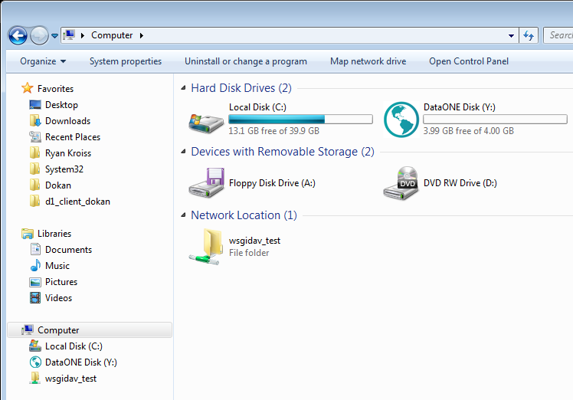
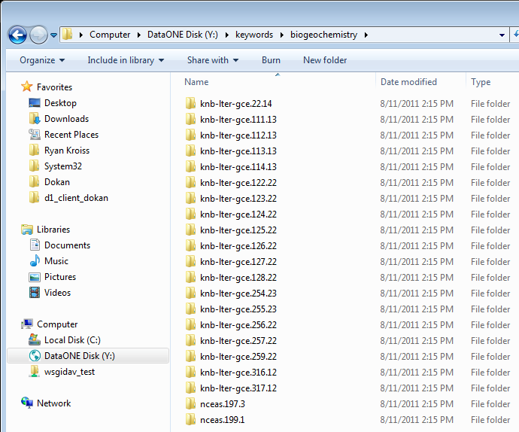
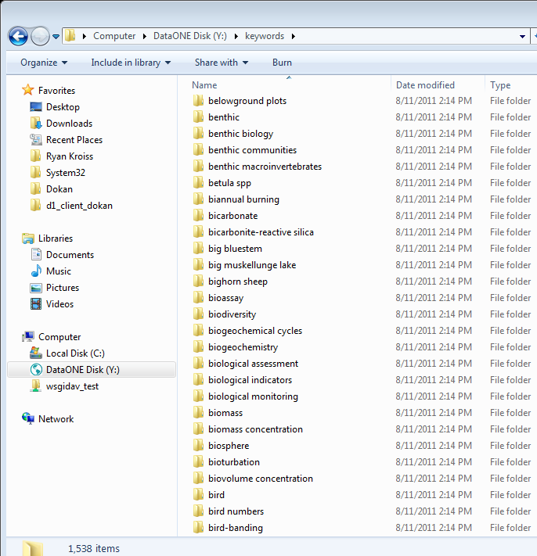
Our Primary Task Usability – ONEDrive http://epad.dataone.org/Sp13-SCUAwg-usability
Review Past Progress
Demonstration
Develop potential UI Mockups
Release Strategy
  Functionality Release v1
  Target Dates
  Documentation
  Resource Allocations
Anticipated Outcomes:
  Requirements Document
  Storyboards Designs
  Release Strategy Document
  Resource Allocation
Notes:
Mockups:
https://repository.dataone.org/software/cicore/trunk/itk/d1_client_onedrive/doc/build/html/mockup/index.html

Slide 3
ONEDrive High-level
Major Functionality
Search & Discovery in ONE Mercury/Web UI
Data Package
Folder View
*Workspace interaction
Concept of operations
Ties to DataONE Workspace
Prototype in OpenSearch for Workspace/Results
“read only” mode
Multi-platform support
Behaves as expected Explorer/Finder
Relies on DataONE Index
Requires DataONE metadata/facet improvements *
Basic versions, ongoing development strategy

Slide 4
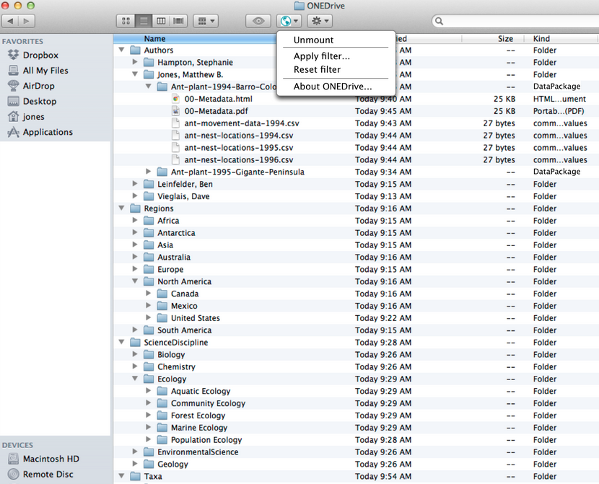
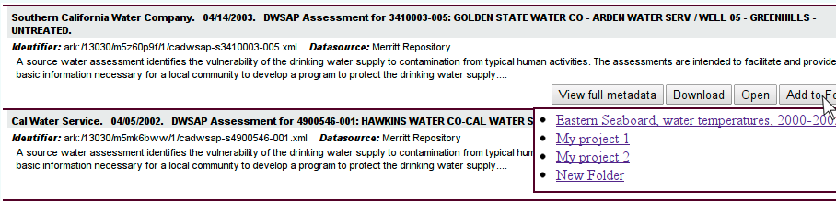
Potential Mockups

Slide 5
Timeframe DUG/ESIP – July 7/8th
Opportunity to gather feedback
Demonstrate “mock-ups”, “near-live” version
Focus Feedback/Discussions on:
  Value Statements – What users see as benefits, How they would use it… (Questionnaire)
  Fits within “their” existing workflows/context
  Additional Use Cases
Test for lightning round discussion from ESA/demo

Slide 6
Timeframe – ESA August
August Release/Prototype
  Demonstrate “live” –
    Working against Test Environment
    Alpha version
    Summary Capabilities / OS Requirements Sheet
    Screen shot/cast – youtube video – linked from DataONE.org of ONEDrive.
    Feedback Questionnaire/Interview sessions at DataONE Booth
RedMine subproject setup

Slide 7
Timeframe – DataONE All Hands (9/30 – 10/3)
Demonstrations & Feedback Gathering
Potential beta release ONEDrive for selected users
Potential DataONE Web UI feedback
Potential Morpho
Semantics Search Feedback/Demonstrations
Future Discovery/Market Analysis

Slide 8
Actions
Help Menu’s/Documentation on ONE Mercury (Mary Beth, Lisa, Bruce G)
Final ONEDrive Requirements Document (05/15) (Dave, Mike)
FINAL Story Boards/UI Mockups (05/15) (Rob, Rachel, Bruce G, others)
  Interaction points with Search/Results
  3 Major Features of ONEDrive
  Workflow interactions between results = workspace
  Google Document to allow for other input/evolution
Design Workspace Environment
Questionnaire/Interview Script for DUG/ESA (06/28) (Rachel, Mary Beth, Bruce G.)
Testing Methodology/Approaches/Timeframe (May-July)
  Alpha Release
  Beta Testers Identified
  DUG Approach
ONEDrive Release Strategy

