Slide 1
EMR Optimization in a Medical Clinic Environment: An Analysis of IT Support
By Lydia Maples
Senior Thesis
Fall 2014

Slide 2
Electronic Medical Records
The Electronic Medical Records System (EMR) is used by health care facilities to maintain electronic records on all of their patients. The system keeps track of everything from family medical history to potential interactions between the different types of medications the patient is taking.

Slide 3
Meaningful Use
In order to improve patient care through the use of EMR systems, the government provides financial incentives to meet Meaningful Use guidelines.
Meaningful Use is using an EMR system to improve quality, safety, and efficiency of healthcare. The goals of meaningful use are improving patient care and public health.
Meaningful Use requirements include maintaining an active medication list, protecting electronic health information, implementing drug-drug and drug-allergy interaction checks, and several other objectives.

Slide 4
Introduction
The Southeastern Medical School (SMS) currently owns three clinics.
  Acute Care Clinic
  Women and Children Clinic
  University Medicine Clinic

Slide 5
Introduction
Each of these clinics uses an EMR system to track patient information.
The goal of the EMR system is to achieve Meaningful Use requirements and receive funds through this program.
These clinics receive technical support from the Southeastern Medical School’s Information Technology (IT) Department.
The Server Manager for the IT department currently provides the majority of the technical support for EMR-related issues.

Slide 6
Problem
With the recent updates to the EMR system, the work load for the IT department has increased dramatically.
These updates occur frequently and require ongoing IT support. The updates are improvements to the EMR system that allow healthcare professionals to provide better care to their patients.
The following slides will show the increase in the work as well as the solution to alleviate the strain on the work load of the IT department.

Slide 7
From March 2014 to June 2014, EMR work orders represented the fourth highest support request made to the IT department.

Slide 8
In July 2014 there was an update to the EMR system, this update has required a significant increase in IT support.

Slide 9
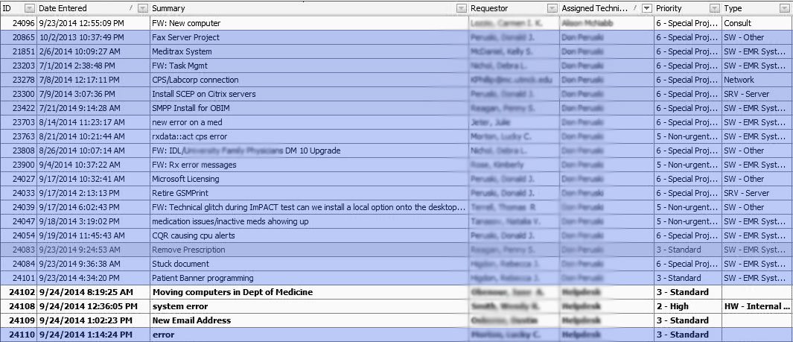
The blue highlighted work orders represent a typical day, after the recent EMR upgrade, for the server manager. There are 19 total work orders in this sample.

Slide 10
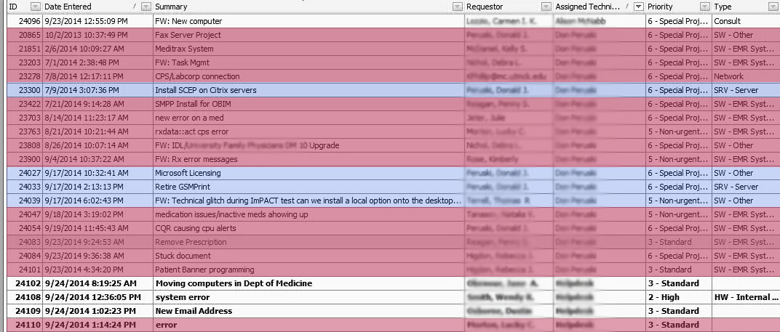
Of the 19 work orders handled by the server manager, 15 are related to the EMR system. Of the 15, 7 are not routine but related to the new upgrade.

Slide 11
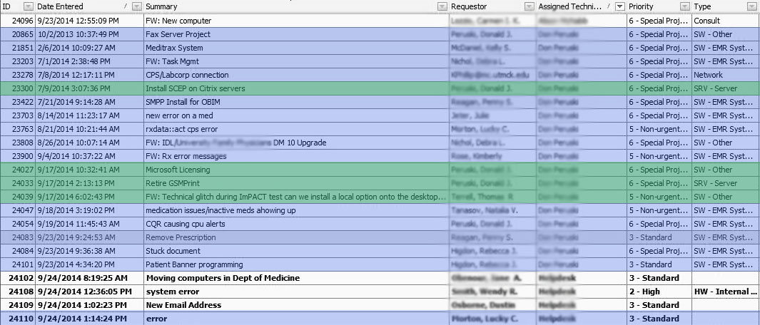
Only the work orders highlighted in green are related to the server manager’s assigned job duties.

Slide 12
Percent increase in Work Orders
Before the recent update, EMR work orders were 13.33% of the total work orders fulfilled by the IT department.
After the update, the EMR work orders increased to 16.61% of total work orders.
This is a 3% increase in work orders relating to the EMR system.

Slide 13
Solution
In order to alleviate the strain on the IT department and the server manager’s work load, the best solution is to hire a new employee whose primary focus is the EMR system utilized by the medical school-owned clinics.

Slide 14
Clinic Systems Administrator: Job Responsibilities
The primary duties of the Clinic Systems Administrator will be
  Program the system to meet the needs of the Physicians
  Assess and implement additional EMR/Billing Functionality
  Train new and existing users to correctly use the software
  Maintain data integrity while keeping users abreast of patient data safeguards
    Ensuring EMR “Meaningful Use” compliance
    Work with SMS Server Administrator to understand software interface builds and data transmission issues (HIPAA compliance)
  Work with Vendor(s) and IT department during software upgrades
  Provide suggestions to optimize usage to EMR/Billing Committee
The system upgrades will remain part of the role of the server manager

Slide 15
Clinic Systems Administrator: Qualifications
B.S. Degree preferred in Management, Nursing, or related field
Extensive medical office practice management experience (3-5 years minimum)
Experience using an electronic medical records and billing system
Knowledge of GE Centricity Practice Solutions with Form Editor or Visual Form Editor
Adherence to HIPAA rules and regulations

Slide 16
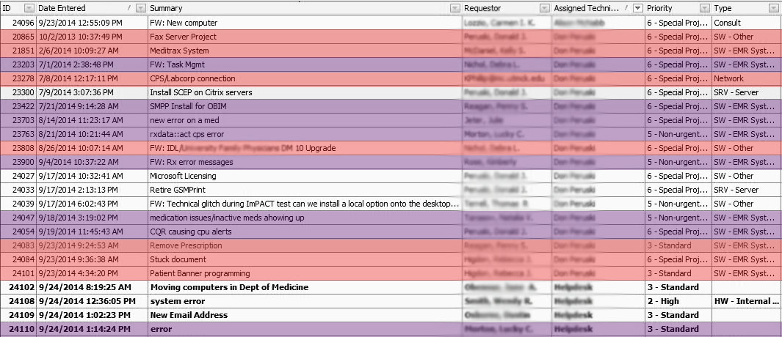
The Clinic Systems Administrator would be responsible for all of the work orders highlighted in purple, while the Server Manager would continue to assist with the work orders highlighted in red, as they pertain to EMR updates. This would decrease the Server Manager’s workload by 78.9%

Slide 17
Clinic Systems Administrator
The following slide is a chart depicting the support a new Clinic Systems Administrator (CSA) would provide the clinics.
The CSA would be 50% tech support and 50% clinic support
The CSA would focus on meaningful use compliance, EMR form development, and training for clinic staff.

Slide 18
Clinic Systems Administrator
GE
SPS
VAR (not on site)
App Issues
Meaningful Use Compliance
Form Development
Training
1st Pt. Person
Clinic
SMS
Infrastructure
Hardware Issues
Tech
Clinic

Slide 19
Server Manager
The Server Manager will be 75% tech support and 25% clinic support.
The Server Manager will primarily interact with the software vendor and the hospital and will then relay the information from these two organizations to the clinics as needed.
The Server Manager will work with the Application Specialist to ensure the EMR system meets the needs of the Acute Care Clinic for reporting meaningful use data.

Slide 20
GE
Application Specialist
Acute Care Clinic
Server Manager
Infrastructure
CPS upgrades/updates
Application Issues
Hardware Issues
University Medical Clinic
Women & Children Clinic
Southeastern
Medical
School
Tech
Clinic

Slide 21
Benefit to the Southeastern Medical School
With the assistance of a new Clinic Systems Administrator, the IT department can more quickly respond to the needs of the clinics regarding their EMR systems. A CSA would also allow the Server Manager to focus on his assigned job duties, and the IT team could more effectively meet the needs of the entire medical school. Making the IT department more efficient will make the work flow of the entire medical school more efficient.
The CSA would attend yearly conferences to maintain up-to-date information about Meaningful Use compliance. This would ensure the medical school has the best information when making decisions about the EMR system updates. With this information, the clinics will become Meaningful Use compliant and receive financial support from the government.

