Slide 1
Website Review
All Hands Meeting
Oct 18th 2011

Slide 2
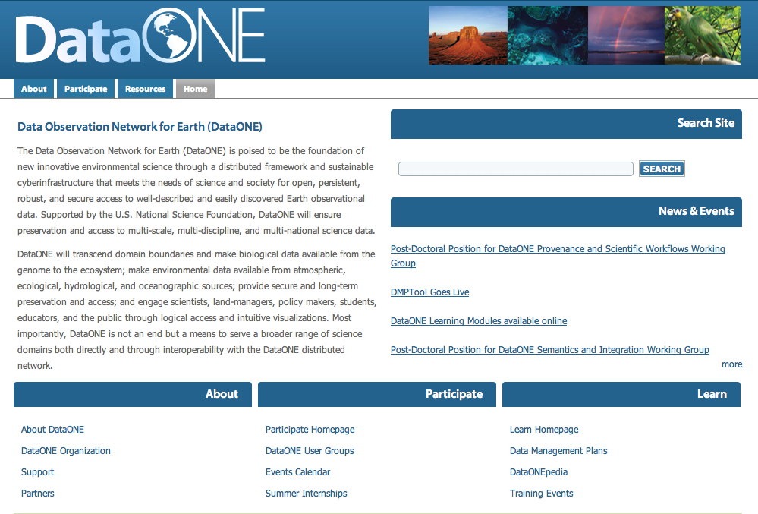

Slide 3
Rationale for redesign
Usability assessment provided recommendations for numerous changes
Current design did not allow for growth of project to be easily represented
  Lacking an area for Member Nodes
  Working Groups not sufficiently visible
  No area for ITK and software development to be highlighted
Color scheme not representative of DataONE logo and more recently designed materials

Slide 4
Rationale for redesign
Charge from Sustainability and Governance to develop a more accessible and user friendly website that appropriately reflects the professional image projected by DataONE, in advance of public release

Slide 5

The redesign process
Site map based on current website
with inclusion of areas undergoing
current and predicted growth
Incorporation of feedback from
usability assessments
Web aesthetic based on color
scheme of DataONE logo
Design being developed in Drupal 7 with mirrored shell around ONEMercury run from CNs
Design developed by Laura Arguelles and Chris Allen, UNM staff

Slide 6

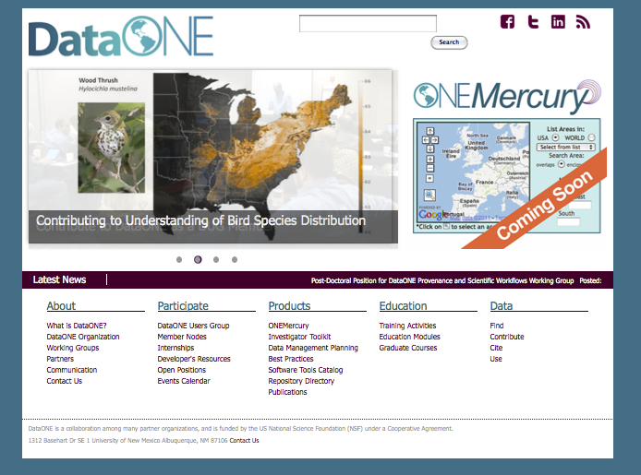

Slide 7
Feedback
Six representative pages printed as hardcopy posters
  Please use ‘sticky notes’ to provide feedback
Online functionality testing requested
  http://dataone-beta.nmepscor.net/
Provide feedback via shared epad
  http://epad.dataone.org/AHM10182011WebFeedback
  OR
  Bit.ly/D1Feedback

