Slide 1
Nutrition associated disease
Sarel Van Amstel

Slide 2
Introduction
Many approaches to camelid nutrition
  No to free choice grain
  No alfalfa
  Assessment of grass hay digestibility
  Choices and variability of feed supplements

Slide 3
Extremes in body condition, health and productivity:
  Many normal 3-3.5 BCS
  Some over conditioning – obese 5/5
  Too many - poor body condition (emaciation) – 1/5 BCS

Slide 4
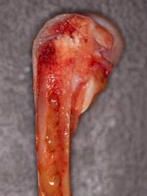
Under conditioning
Disease complex:
  Protein/Energy Malnutrition PEM (Failure to thrive/starvation)
      Mobilization & Serous atrophy of fat stores
        Fat stores including bone marrow turned into a gelatinous substance
      Fluid effusion into body cavities
  Nutritional osteodystrophy (Rickets)
    Osteopenia. Thinning of bones
  Trace mineral deficiencies

Slide 5
PEM:
  Poor body condition. BCS 1/5
  Growing animals cessation of gain
  Weak often down acutely
  Normal or depressed appetite
  Pregnant, lactating females hepatic lipidosis
  Often mild non-regenerative anemia and hypoproteinemia
  Joints feel prominent & swollen costochondral junctions

Slide 6
PEM
Animals predisposed
  Pregnant/lactating
  Growth
  Geriatric

Slide 7
Group dynamics
Social hierarchy
Different ages/sizes
Overcrowding
Feed space
Inadequate/faulty nutrition
Ambient Temperature
0-10⁰C (critical low temp)
Nutritional stress
Protein-Energy
Malnutrition
Parasitism
Disease
Epi
BVD
Genetics

Slide 8
PEM
Most common reason is poor quality forages
Forage - principal dietary component
100 pound camelid should have access to 2 pounds of good quality dry grass hay per day
Poorer quality hay; mix with alfalfa
Alfalfa, mature
Grain according to needs
Other supplements

Slide 9
Obesity
More common in llamas
Feeding too high quality forage relative to requirements
Overfeeding supplements – grain & readily fermentable fiber
Predisposes to:
  Heat stress
  Metabolic disease
  Infertility
  Lameness - arthritis
  Lactic acidosis (grain overload) – cracked corn, oats, barley or wheat in combination with low crude fiber (<12%)

Slide 10
PEM/Obesity control
Body condition score/body weights every 4-6 weeks (3-3.5 of 5)
Provide effective protective shelter during cold/wet conditions
Forage analysis
Feed lower quality forages before grazing pasture or increase stocking density/ grazing intensity/use mature pastures
Attend to other predisposing causes:
  Herd management
  Parasitism
  Dental /health checks

Slide 11
Polioencephalomalacia Vit B1 deficiency
Thiamine deficiency common in camelids resulting in polio.
Water soluble vitamins (B complex group including B1 - thiamine) produced by microbes in C1
Predisposing factors include:
  Excessive dietary sulphur or overdose with amprolium
  Rumen acidosis – thiaminase producing bacteria
  Thiaminase containing plants
Clinical signs:
Depression, seizures, blindness, hypersensitivity and sudden death
Treat with Vit B1 (10-20 mg/kg)

Slide 12
Urolithiasis
Over feeding grain –high in phosphate
Lush grass pastures heavily fertilized with potassium
Clinical signs:
  Straining and inability to urinate
  Dribbling urine
Increase water consumption by adding salt to diet
Urine acidification – ammonium chloride

Slide 13
Trace minerals
15 required. 5 associated with disease
  Copper; iodine; iron; selenium and zinc.
  Large proportion of forages deficient in zinc, selenium and copper but high in potassium which will depress magnesium uptake
  Excess Ca in diet such as legume hays (alfalfa) will depress Zn intake

Slide 14
Trace minerals
Well water
  Can be high in sulfur and iron
    Reduce Cu absorption
    High sulfur can predispose to polio-encephalomalacia
    Areas with rock phosphate can be high in fluoride
      Chronic fluorosis.
        Tooth decay
        Chronic lameness due to fluoride deposition in bone

Slide 15
Trace minerals
Disease states associated with mineral deficiencies:
  Immune dysfunction – Cu, Zn, Se
  Developmental abnormalities – Cu, Mn, I
  Abortion Cu, I, Se
  Retained placenta Cu, Se, I
  Metabolic disturbances Co, I, Fe, Zn

Slide 16
Trace mineral supplementation
Inorganic sources; sulfate and carbonate more bioavailable than oxide
Organic forms are protected from gastric alteration thus highly bioavailable
  Zinc methionine
Nutrient delivery calculations
  Amount fed x trace mineral content

Slide 17
Trace mineral supplementation
Nutrient delivery calculations
  None of mineral supplements and only 7/17pellet supplements provide sufficient copper
  50% of mineral and pellet supplements provide sufficient selenium
  67% of mineral and pellet supplements have sufficient iron
  Vit A & E generally adequately supplemented
  Zn adequate in all mineral and 10 of 12 pellet supplements
  25%of all supplements meet vitamin D requirements

Slide 18
Trace minerals
Zinc
  Normal immunity; skin integrity; fiber quality
  Can cause hair loss and hyperkeratosis on all body surfaces
  Secondary infection common
  Play a role in “munge”
  Diagnosed on skin biopsy – eosinophil infiltration diagnostic

Slide 19
Trace minerals
Zinc supplementation
Avalia – Zn 100. zinc-methionine.
  Greater bioavailability
  0.5 gram/day

Slide 20
Trace minerals
Copper (function)
  Necessary for hemoglobin formation along with iron (Hypochromic microcytic)
  Necessary for normal bone formation
  Necessary for normal keratinization in the feet (pads & nails)

Slide 21
Trace minerals
Copper (deficiency)
  Interaction of molybdenum, sulfur with dietary copper results in lower availability
  Anemia, altered hair coloration, impaired immune response and poor growth
Copper (excess)
  Causes hepatic necrosis without hemolysis
  Copper conc. higher than 20mg/kg and 16:1 Cu:Mo ratio

Slide 22
Trace minerals
Selenium
  Important biochemical component of enzyme system that protects body cell membranes against peroxidative damage (antioxidant)
  Clinical signs of deficiency: lameness; < activity; Dyspnea; colic; >suscept to heat stress; infertility
  Selenium supplementation @1mg/day/animal
  Soil should be tested for selenium
  Use BoSe strategically

Slide 23
References
Van Saun, R. Camelid Nutrition. Trace mineral supplementation: what are our targets? 2010 Intl. Camelid Health Conf. for Veterinarians. Ohio State Univ. CVM
Dr. Nancy A. Irlbeck. Basic of alpaca nutrition.
http://www.alpacaresearchfoundation.org/papers_reports/Basics%20of%20Alpaca%20Nutrition.html

Slide 24
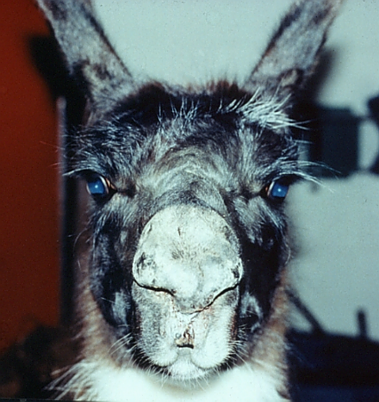
Questions?

