Slide 1
Education of Staff Nurses on the Implementation of a Standardized Clinical Care Pathway for Patients Who Undergo Correction of Pectus Excavatum
Amber N. Jones
Notes:
Hi everyone! My name is Amber Jones and my presentation is going to discuss the education of staff nurses on the implementation of a standardized clinical care pathway for patients who undergo correction of pectus excavatum.

Slide 2

Background
Notes:
First, I’ll be discussing background information.

Slide 3
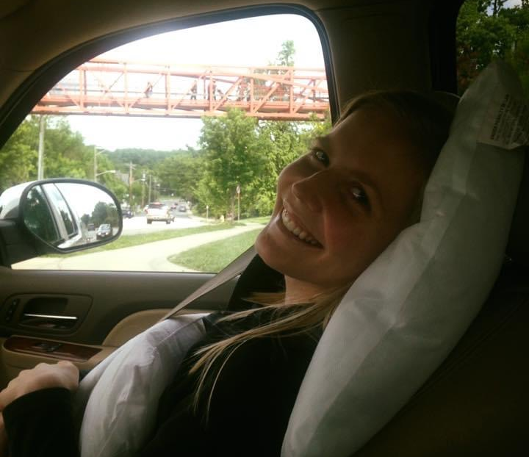
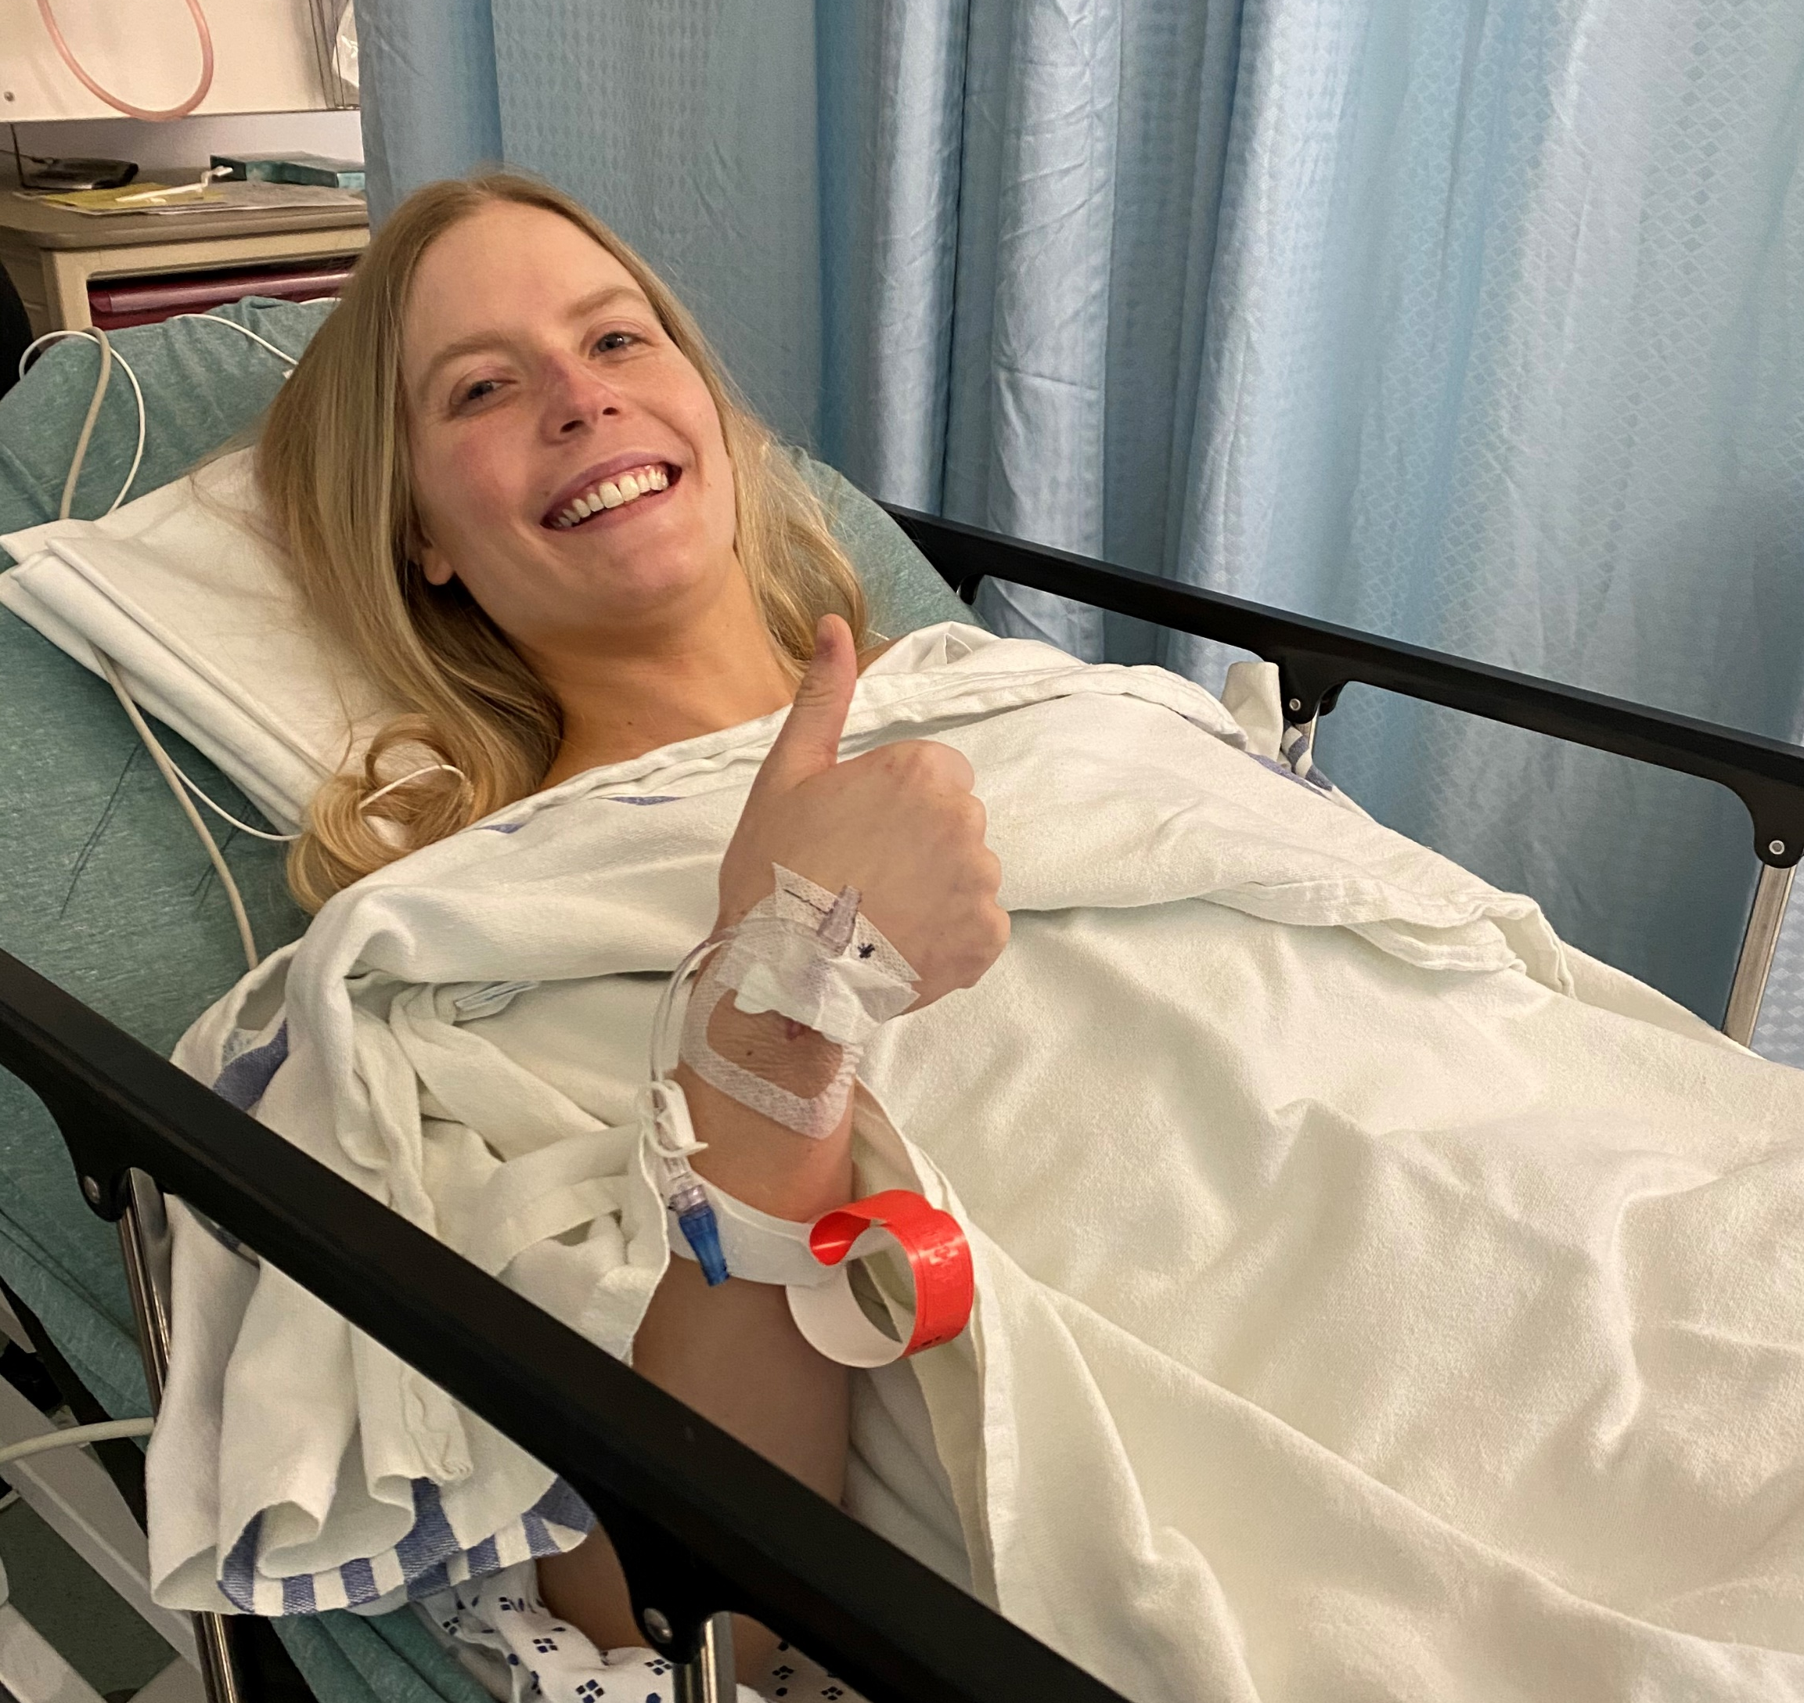
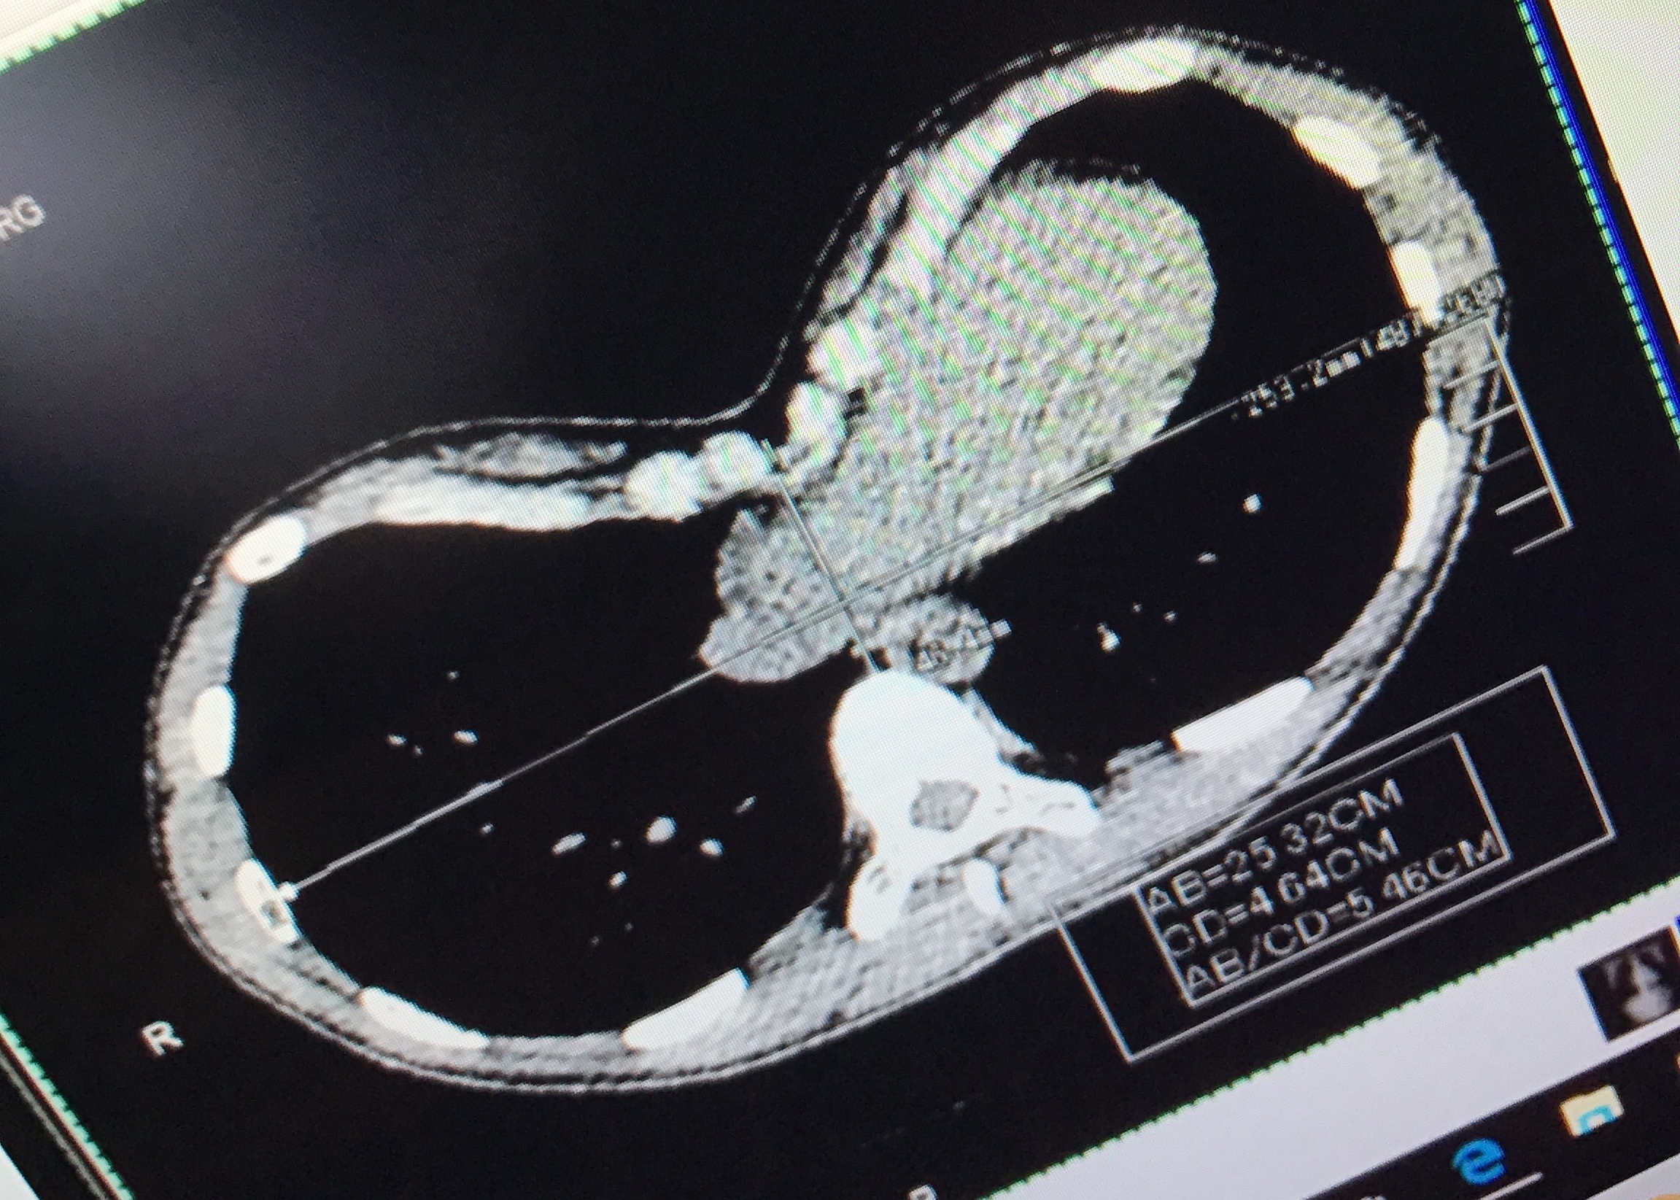
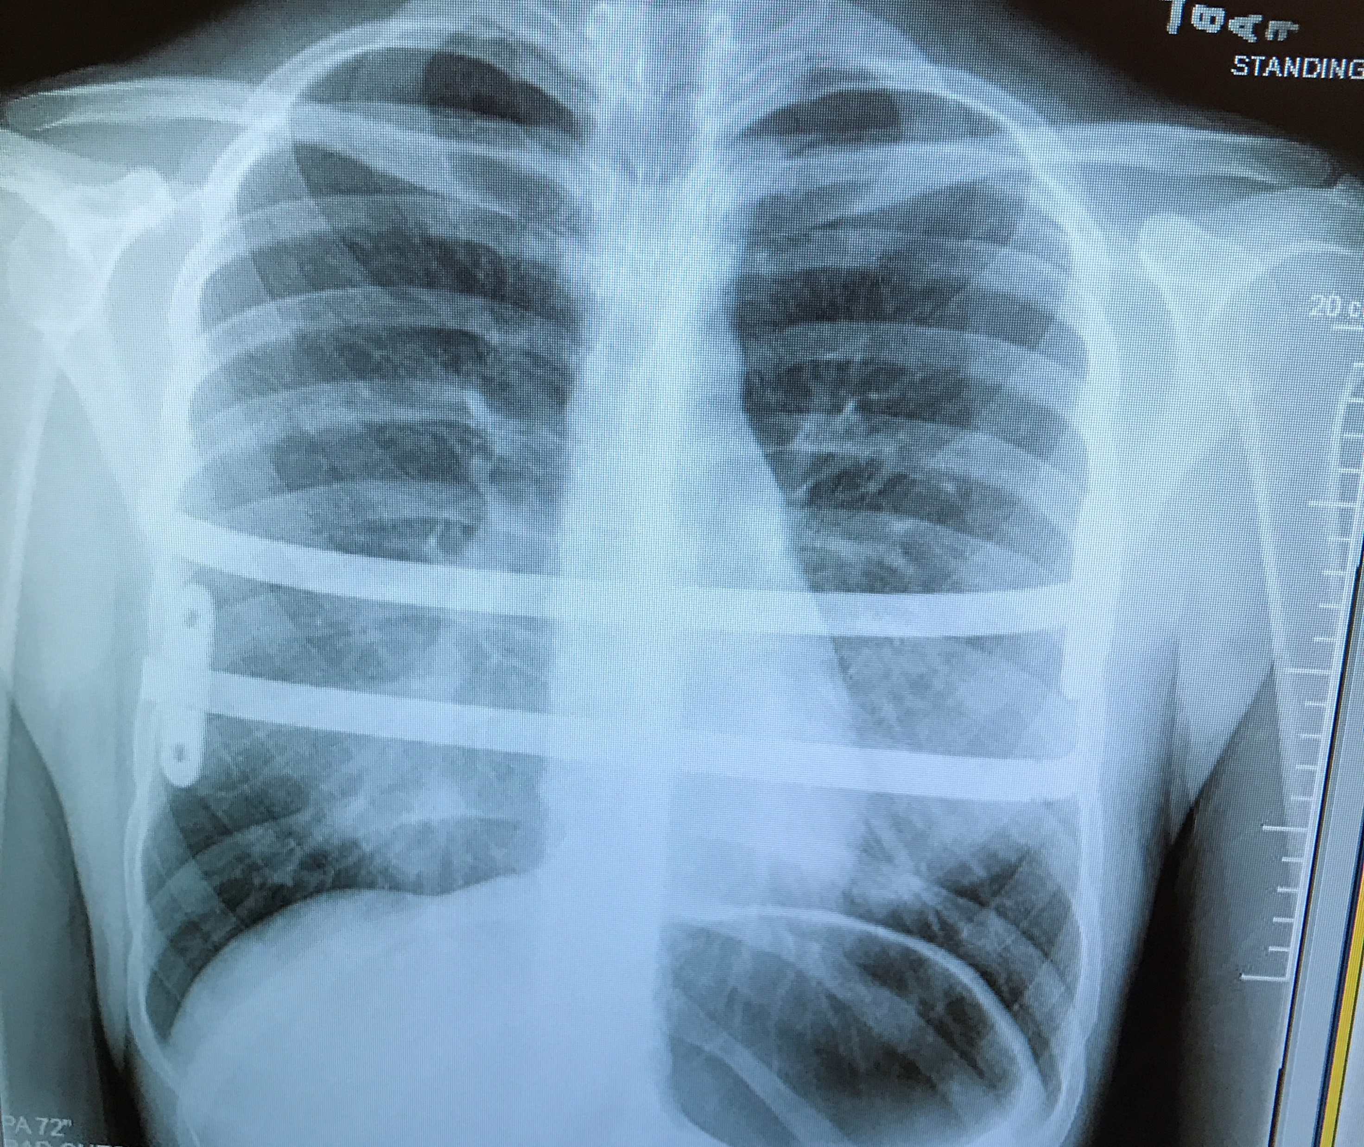
My Experience
In May 2016, I had the Nuss Procedure at Cincinnati Children’s Hospital Medical Center.
Two titanium bars were placed into my chest to reform my sternum.
In January 2022, I had both of my metal bars removed!
Notes:
Corrective surgery for pectus excavatum is very important to me and something that I am passionate about because it is something that I have personally experienced. In May of 2016, I had the Nuss procedure done at Cincinnati Children’s Hospital Medical Center. I had two titanium bars placed beneath my ribcage and sternum in order to reform my indented sternum. At the beginning of this year in January I had both of my metal bars removed! On the right are pictures from my experience. The bottom left photo shows the severity of my pectus deformity from a CT in 2016, as you can see the squished organ in the middle is my heart. The top left photo is right after I was discharged after my 5 day inpatient stay following bar placement. The bottom right photo is of an X-RAY showing the metal bars I had in my chest, and the top right photo was right after having my bars removed a little over a month ago. Going through this experience has impacted my life and the way that I care for patients, and I am thankful to be able to work with this patient population and have an impact on the care they receive.

Slide 4
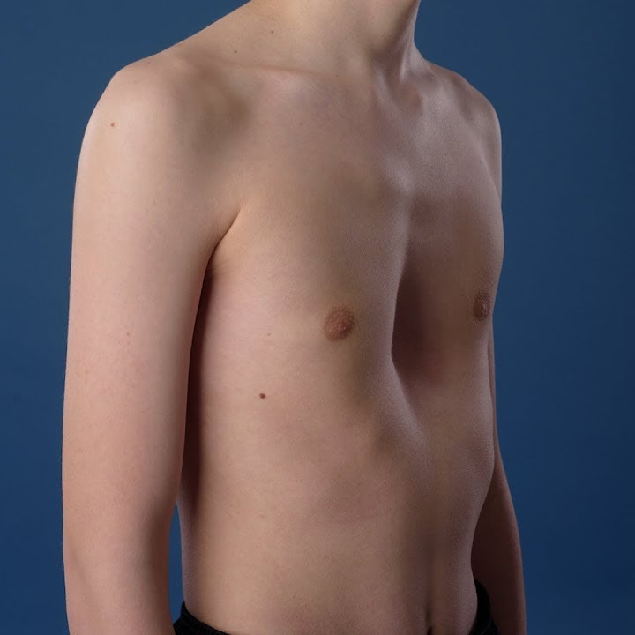
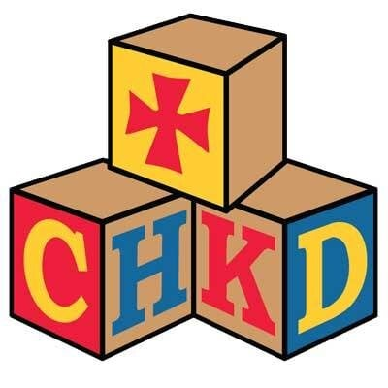

Pediatric Anomaly
Male Predominance
Surgical Correction
Pectus Excavatum is the most common chest wall anomaly, occurring in 1/8 children per 1,000 births
Pectus Excavatum has a male predominance of 4:1
The Nuss Procedure, a minimally invasive corrective surgery for pectus excavatum, was created in 1998 by Dr. Nuss in Norfolk, Virginia
(Gurria et al., 2020; Mangat et al., 2020; Nuss et al., 2016)
Notes:
So, pectus excavatum is the most common chest wall anomaly, exhibited through a centrally depressed sternum, and it occurs in 1 out of 8 children per 1,000 births. Pectus excavatum has a male predominance of 4:1. And, the Nuss Procedure is a minimally invasive corrective surgery for pectus excavatum, and was created by Dr. Nuss in 1998 at Children’s Hospital of the King’s Daughters in Norfolk, Virginia. During this surgery, substernal bars are placed and anchored to reform the sternum and rib cage, and eventually removed at the length of time that is determined by the surgeon performing the initial operation.

Slide 5

BACKGROUND
Lengthy, painful post-operative recovery time.
Lack of focus on the post-operative inpatient recovery period.
Creation of standardized clinical care pathways (SCCP) to guide post-operative care.
(Gurria et al., 2020; Mangat et al., 2020; Nuss et al., 2016; Rotter et al., 2010)
Notes:
One of the problems that surround corrective surgery for pectus excavatum is that the recovery time is historically lengthy and painful, which can even defer some patients from undergoing the surgery. Next, while there is an increasing academic focus on the Nuss Procedure, there is a lack of focus on the post operative inpatient recovery period. Many institutions and surgeons have perfected the intraoperative process, but little has been discussed about the painful and lengthy postoperative time period. Standardized clinical care pathways have recently gained credibility in guiding post-operative care. The standardization of the management of other pediatric surgical diseases, such as scoliosis, have demonstrated improved outcomes.

Slide 6

SIGNIFICANCE
Increased demand for surgical correction of PE.
Length of stay (LOS) for PE patients at East Tennessee Children’s Hospital (ETCH) from 2018-2020 was 5-7 days.
CCHMC implemented an SCCP for PE patients in 2016 and had a decrease in LOS from 4.5 to 3.4 days.
  In addition, patient satisfaction improved and total patient charges decreased by 30%.
Other studies also show a decrease in LOS following implementation of an SCCP for PE patients.
(Gurria et al., 2020; Mangat et al., 2020; Nuss et al., 2016; Rotter et al., 2010)
Notes:
Following acceptance of the Nuss Procedure, there has been increased demand for surgical correction of pectus excavatum. At East Tennessee Children’s Hospital, which was the setting for this DNP project, the average length of stay for pectus excavatum patients from 2018 to 2020 was 5-7 days. Cincinnati Children’s Hospital Medical Center implemented a standardized clinical care pathway for pectus excavatum patients in 2016 and had a successful decrease in length of stay from 4.5 to 3.4 days. In addition, patient satisfaction scores improved, and total patient charges decreased by 30%. There are multiple other studies that have also shown a decrease in length of stay following the implementation of a standardized clinical care pathway for pectus excavatum patients, referenced below.

Slide 7
SIGNIFICANCE CONTINUED
There was no education plan for staff nurses at ETCH regarding the new SCCP.
Surgical patients have been shown to have better outcomes when treated in hospitals in which staff nurses have higher levels of EBP nursing education.
Successful implementation of an SCCP requires thorough, continual education of the entire multidisciplinary team.
(Block et al., 2018; Francis et al., 2018; Kakkar et al., 2021)
Notes:
In 2021, a multidisciplinary team gathered at East Tennessee Children’s Hospital and created a standardized clinical care pathway for Nuss Procedure patients over a 9 month time period. Some aspects of the standardized clinical care pathway were driven by a team of surgeons, some aspects were driven by a team of anesthesiologists, and there was a team of nurses as well. There was no education plan for staff nurses at East Tennessee Children’s Hospital regarding the new standardized clinical care pathway. Surgical patients have been shown to have better outcomes when treated in hospitals in which staff nurses have higher levels of evidence-based practice nursing education. Continual education of the entire multidisciplinary team is imperative to the successful implementation of a standardized clinical care pathway.

Slide 8

Problem Statement
Lack of evidence-based education for staff nurses could compromise the successful implementation of the standardized clinical care pathway (SCCP) for patients who undergo the Nuss Procedure for correction of pectus excavatum (PE).
This evidence-based practice (EBP) project aims to explore the importance of educating staff nurses on the implementation of a SCCP for patients who undergo the Nuss Procedure for correction of PE to decrease length of stay, decrease hospital costs, decrease post-operative complications, and improve pain control.
Notes:
So, the problem is that the lack of evidence-based education for staff nurses could compromise the successful implementation of the standardized clinical care pathway for patients who undergo the Nuss Procedure for correction of pectus excavatum. Ultimately, this evidence-based practice project aimed to explore the importance of educating staff nurses on the implementation of a standardized clinical care pathway for patients who undergo the Nuss Procedure for correction of pectus excavatum to decrease length of stay, decrease hospital costs, decrease postoperative complications, and improve pain control.

Slide 9

Purpose and Frameworks
Notes:
Next, I’ll be discussing the purpose of this project and the guiding framework that was used.

Slide 10
Project Purpose and Aims
Aims
Develop and implement a pre-intervention knowledge assessment, eLearning module, and post-intervention knowledge assessment with associated application-based case study questions.
Assess adherence to the SCCP through chart audits over a three-month period.
Enhance policies and protocols and decrease Nuss patients’ length of stay, in turn improving patient outcomes and healthcare costs.
Purpose
  This evidence-based practice project aims to educate staff nurses on the use of the new standardized pathway, with the goal of increased quality of care and decreased length of hospital stay.
Notes:
The purpose of the evidence-based practice project was to educate staff nurses on the use of the new standardized pathway, with the goal of increased quality of nursing care and decreased length of patient hospital stay. There were three main aims for this project. The first aim was to develop and implement a pre-intervention knowledge assessment, eLearning module, and post-intervention knowledge assessment with associated application-based case study questions. Next, adherence to the standardized clinical care pathway was assessed through chart audits over a three-month period. Finally, the ultimate aim was to enhance policies and protocols and decrease Nuss patients’ length of stay, in turn improving patient outcomes and healthcare costs.

Slide 11
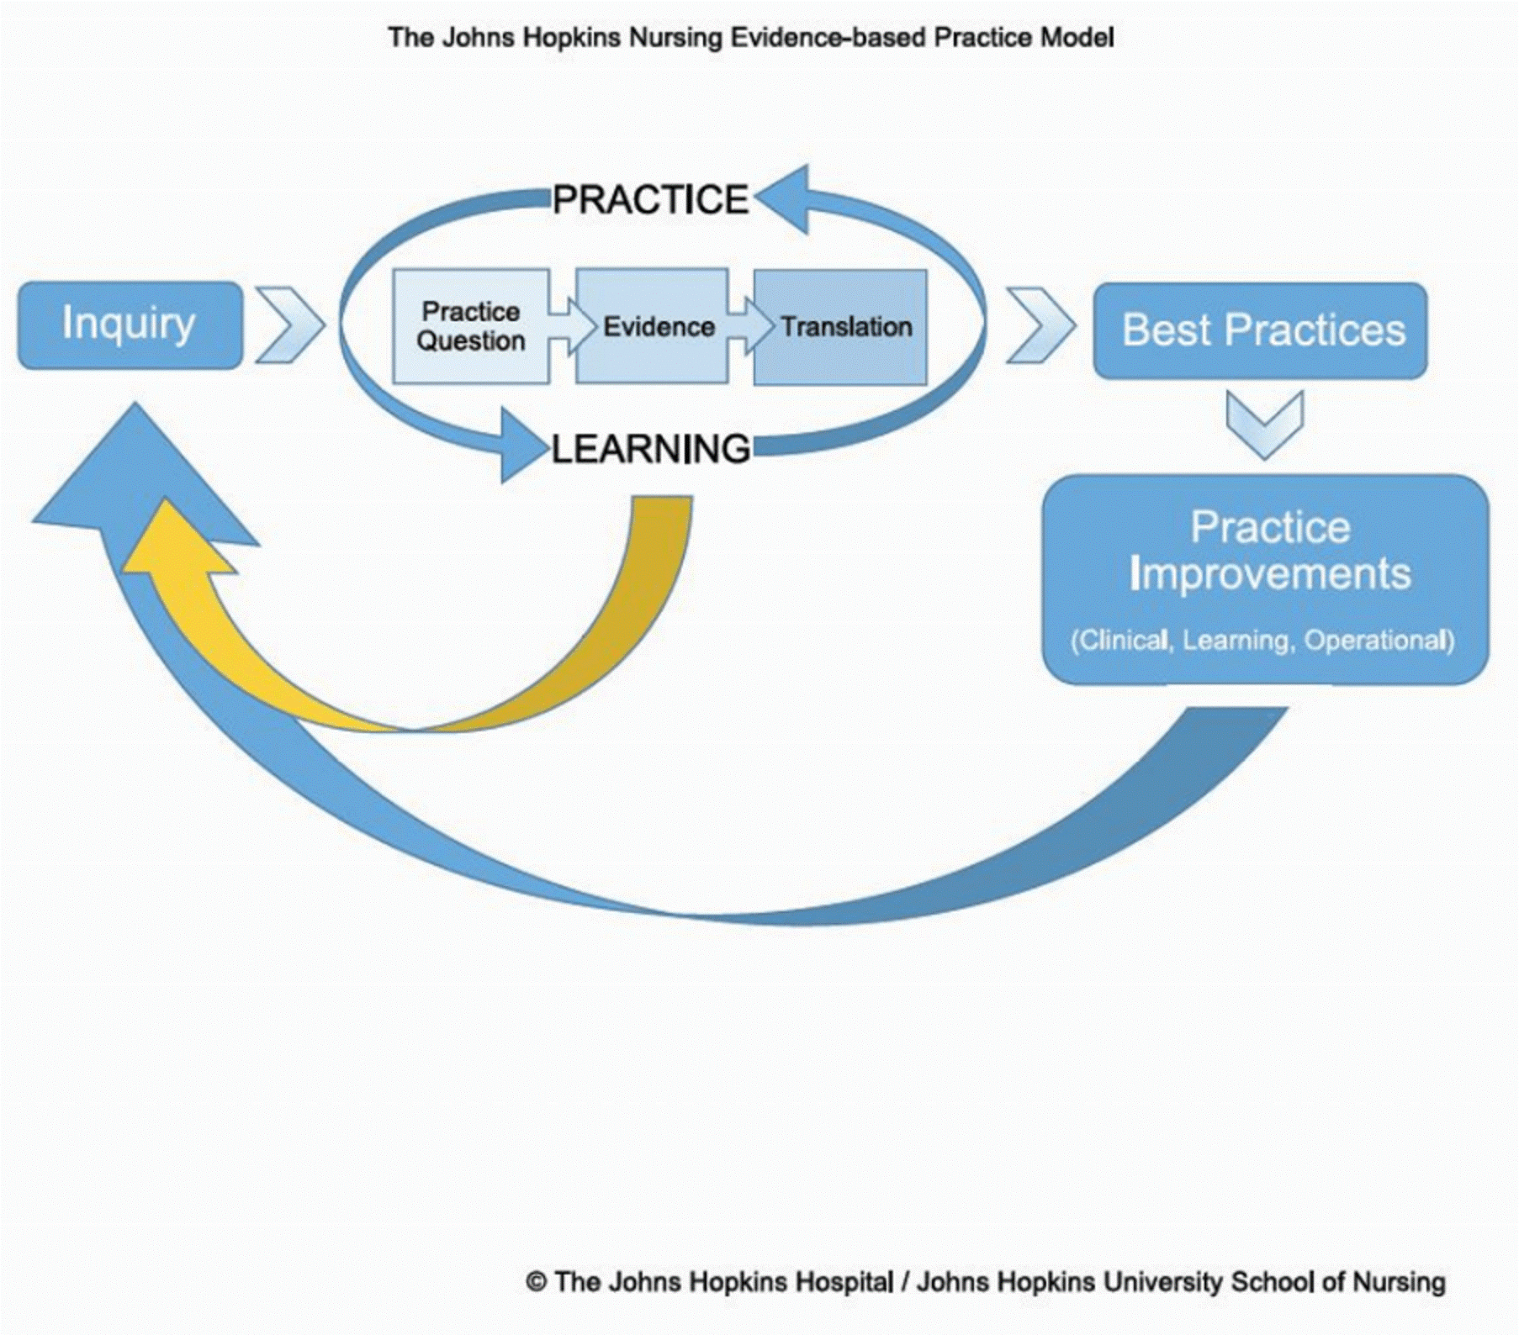
John’s Hopkins Nursing Evidence-Based Practice Model
Three overall steps: inquiry, practice, and learning.
Detailed problem-solving approach to clinical decision-making.
19 step process divided into 3 phases known as the PET process.
  Practice Question (P): steps 1-6
  Evidence (E): steps 7-11
  Translation (T): steps 12-19
(Dang & Dearholt, 2018)
Notes:
The John’s Hopkins Nursing Evidence-Based Practice Model was the guiding model for this evidence-based practice project. There are three overall steps within this model: inquiry, practice, and learning. This model is a detailed, problem-solving approach to clinical decision making, and utilization helped to facilitate the development and implementation of this evidence-based practice project, improve patient outcomes, and promote quality care. This John’s Hopkins model is not only provider and nurse focused, but it is patient focused. With the end goal to decrease length of stay, thus improving patient care and patient outcomes, utilization of this model helped facilitate reaching this goal. The entire John’s Hopkins Nursing Evidence Based Practice Model is a 19 step process, divided into three phases known as the PET process. Steps 1 to 6 fall under P, for practice question. The next set of steps, which are 7 to 11, fall under E, for evidence. Finally, steps 12 to 19 fall under T, for translation. Throughout this presentation, I will identify aspects of the PET process from this model that helped to guide my project. For example, one of the steps within the Practice question phase is to define the problem, which has already been explained thus far in my presentation.

Slide 12
In pectus excavatum patients, how does a standardized clinical care pathway following the Nuss Procedure compared to current standard of care affect length of hospital stay?
PICO QUESTION
Notes:
The last step of the practice question phase of the PET process is to develop the PICO question. The PICO question that was used to guide the literature search was, “in pectus excavatum patients, how does a standardized clinical care pathway following the Nuss Procedure compared to current standard of care affect length of hospital stay?”

Slide 13

Evidence
Notes:
Next, I will be discussing the evidence section of my project. The next 5 steps of the PET process include the evidence phase, and within the upcoming slides I will explain how each of those 5 steps guided the evidence portion of my project.

Slide 14
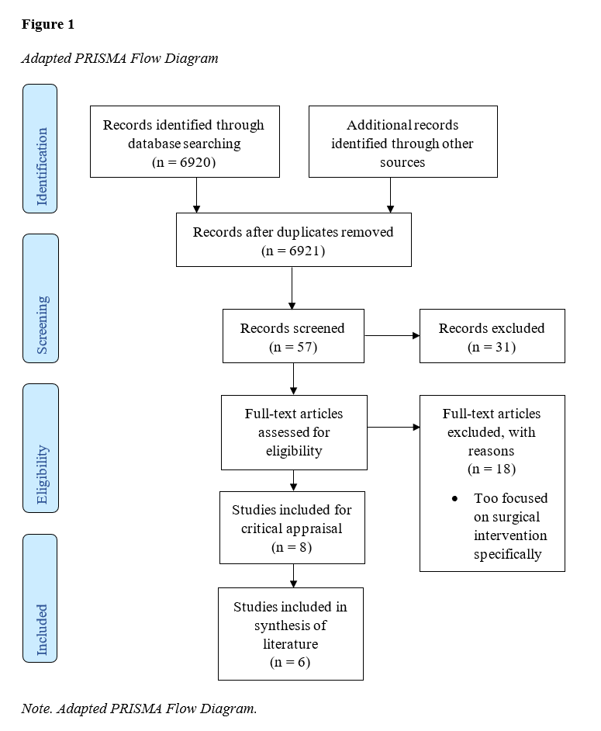

LITERATURE
SEARCH
Notes:
The databases that were used for my literature search were Cochrane, CINAHL, and PubMed. Inclusion criteria included articles specifically related to a clinical pathway, protocol, or standard of care recommendations for patients who undergo the Nuss Procedure for pectus excavatum. Articles were excluded for research relating more closely to the actual surgical process of the Nuss Procedure, rather than the post-operative time period. This image represents the PRISMA flow diagram, which is a flow chart created to represent the identification, screening, eligibility, and included articles. As you can see, a large number of articles were identified by using database searches. 57 of these articles were screen based on title or relation. 31 of these were excluded, using the exclusion criteria that I mentioned. There were 26 full-text articles that were assessed for eligibility, of which 18 were excluded. 8 of these full-text articles were included for critical appraisal, with 6 of these studies being included in synthesis of the literature.

Slide 15
Research Evidence
Eight articles met the PICO question components and inclusion criteria and were appraised using the JHNEBP Model critical appraisal tools.
Decrease in length of stay following SCCP implementation in a variety of settings and modalities (Holmes et al., 2019; Rotter et al., 2010; Wharton et al., 2020; Yu et al., 2020).
Hospital setting (Holmes et al., 2019; Mangat et al., 2020; Wharton et al., 2020; Wildemeersch et al., 2018; Yu et al., 2020).
Retrospective chart reviews most frequently used to gather data (Holmes et al., 2019; Mangat et al., 2020; Wharton et al., 2020; Yu et al., 2020).
Evidence Ratings
  Level II-III/A (high quality)
  Level III/B (good quality)
Notes:
Four tools were utilized from John’s Hopkins Evidence Based Practice model, including level and quality guide, the research evidence appraisal tool, the non-research evidence appraisal tool, and the synthesis process and recommendation tool. The Appraisal of Guidelines for Research and Evaluation II was also utilized. These tools were used to determine the level of evidence, which is based on the research study design, quality of evidence, and strength of evidence for the eight articles that I chose to focus on.
The eight articles were individually appraised. Common themes that I noted from the articles were that many articles discussed a decrease in length of stay following standardized clinical care pathway implementation in a variety of settings and modalities, the setting for most of the articles were in the hospital, and retrospective chart reviews were most frequently used to gather data. Through the critical appraisal process, all articles were assigned a level and quality grade. All of the research evidence that I collected fall under the Level 2 through 3, quality rating A, which is high quality, or level 3, quality rating B, which is good quality.

Slide 16
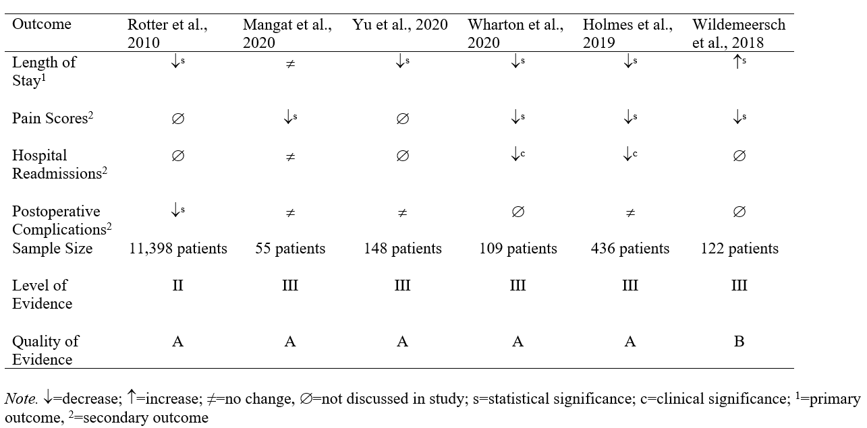
Evidence Synthesis
Notes:
After completion of literature evaluation tables and critical appraisal, a synthesis table was created through consideration of the level, quality, quantity, and consistency across the critically appraised evidence, and then determination of applicability to the pectus population and setting. The primary outcome is noted to be length of stay, with secondary outcomes of pain scores, hospital readmissions, and postoperative complications. You can see the level and quality ratings for each article at the bottom of the table. Findings from the synthesized evidence indicates that the implementation of a standardized clinical care pathway for patients who undergo the Nuss Procedure may significantly decrease length of stay, pain scores, and postoperative complications, and clinically significant decrease in hospital readmissions.

Slide 17

Non-Research Evidence
Literature reviews have shown that evidence supports decreased length of stay following implementation of an SCCP (Gurria et al., 2020; Medbery et al., 2019
Educating staff nurses with eLearning tactics increases knowledge level for associated topics, thus improving quality of care (Block et al., 2018; Francis et al., 2018; Kakkar et al., 2021)
Evidence Ratings
  Level III/A (high quality)
  Level III-V/B (good quality)
Notes:
Next, I am going to talk about non-research evidence. Literature reviews have shown that evidence supports decreased length of stay following implementation of a standardized clinical care pathway. Educating staff nurses with eLearning tactics increases knowledge level of associated topics, thus improving quality of care. These articles were rated with the non-research critical appraisal tool from the Johns Hopkins Nursing Evidence Based Practice Model. Evidence ratings for these articles were level 3, quality rating A, which are high quality, or levels 3 through 5, quality rating B, which are good quality.

Slide 18
It is recommended to implement a standardized clinical care pathway for pectus excavatum patients who undergo the Nuss Procedure to decrease length of stay.
(Holmes et al., 2019; Rotter et al., 2010; Wharton et al., 2020; Yu et al., 2020)
It is recommended to implement a standardized pain protocol for pectus excavatum patients who undergo the Nuss Procedure to improve post-operative outcomes.
(Mangat et al., 2020; Holmes et al., 2019; Wharton et al., 2020; Wildemeersch et al., 2018)
It is recommended to provide education to staff nurses regarding implementation of a standardized clinical care pathway for pectus excavatum patients.
(Block et al., 2018; Francis et al., 2018; Kakkar et al., 2021)
1
2
Recommendations
3
Notes:
Three recommendations for practice change have been created to support outcomes associated with this project. The first recommendation states that it is recommended to implement a standardized clinical care pathway for pectus excavatum patients who undergo the Nuss procedure to decrease length of stay. The second recommendation states that it is recommended to implement a standardized pain protocol for pectus excavatum patients who undergo the Nuss procedure to improve postoperative outcomes. And the third recommendation states that it is recommended to provide education to staff nurses regarding implementation of a standardized clinical care pathway for pectus excavatum patients. For all three of these recommendations, based on the John’s Hopkins Nursing Evidence Based Practice level of evidence and quality ratings, a good and consistent grade of evidence was found to support practice change. A pilot of change or further investigation was recommended.

Slide 19
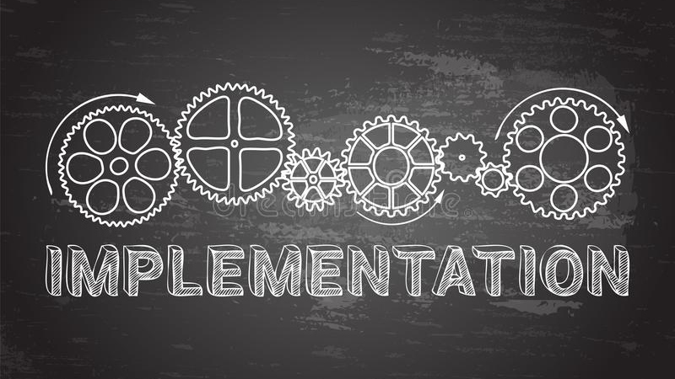
Notes:
Next, I am going to discuss the implementation portion of my project. Now, we are entering the final portion of the PET process, which is Translation.

Slide 20

East Tennessee Children’s Hospital
  Serves local counties, Southeast Kentucky, and Southeast Virginia
  152 inpatient beds
Inpatient Surgery Unit (IPS)
  24 bed unit
  32 registered nurses
All patients who undergo the Nuss Procedure for Correction of Pectus Excavatum
Pilot implementation reaching all 32 IPS nurses
Setting and Population
Notes:
The setting of my evidence-based practice project was East Tennessee Children’s Hospital. This facility serves local counties, Southeast Kentucky, and Southeast Virginia. There are 152 inpatient beds. This project is being proposed specifically for the Inpatient Surgery Unit at East Tennessee Children’s Hospital, which is a 24 bed unit with 32 total registered nurses. The population includes all patients who undergo the Nuss Procedure for correction of Pectus Excavatum, with pilot implementation reaching all 32 of the inpatient surgery unit staff nurses. There were 10 Nuss Procedure surgeries completed in 2021, with limitations on surgeries initially existing in 2021 from the Covid-19 pandemic. There were 5 Nuss Procedure surgeries in 2022 during the implementation period for this project.

Slide 21
Project Team and Stakeholders
Project Team Members
  DNP Student
  Faculty project chair
  Community committee member
Additional Stakeholders
  IPS staff nurses
  IPS management staff
  UTK statistician
Notes:
Team members for this project include myself, the DNP student, the faculty project chair, and the community committee member. Additional stakeholders include all inpatient surgery staff nurses, the inpatient surgery management staff, and the University of Tennessee statistician.
Earlier in my presentation I explained the multidisciplinary team that came together to create the standardized clinical care pathway, but what I am talking about now is the project team that was assembled specifically for my project.

Slide 22

Intervention Implementation
eLearning Module
  Pre-knowledge assessment
    11 questions highlighting key knowledge topics regarding pectus excavatum, the Nuss Procedure, and the SCCP created by the ETCH multidisciplinary team.
    6 demographic questions requesting the nurses' age, race, and years as a nurse.
  eLearning module with information regarding the SCCP and care for PE patients.
  Post-knowledge assessment
    Staff nurses answered all the same questions from the pre-knowledge assessment, then were required to apply the knowledge gained in two application-based case studies, with four questions each.
Notes:
Part of the translation of evidence phase of the PET process that I followed was the creation of an action plan, that was then implemented for my project, so here I will further explain the implementation process of my project.
The eLearning module that I created included a pre-knowledge assessment with 11 questions highlighting key knowledge topics regarding pectus excavatum, the Nuss Procedure, and the standardized clinical care pathway created by the East Tennessee children’s hospital’s multidisciplinary team. The pre-knowledge assessment also included 6 demographic questions requesting the nurses’ age, race, and years as a nurse. Next, an eLearning module was completed by staff nurses with information regarding the standardized clinical care pathway and care for pectus excavatum patients. Staff nurses then completed a post-knowledge assessment in which they answered the same questions from the pre-knowledge assessment, then applied the knowledge gained in two specific application-based case studies, with four questions each. Staff nurses completed this eLearning module throughout the month of May, with a due date of May 31, 2022. When developing the eLearning module, I solicited 2 experts on the topic and 1 education expert to review the education that I created, for face validity.

Slide 23

Intervention Implementation
Chart audits were completed from June 1, 2022 to August 31, 2022 to assess staff nurses’ utilization of the standardized clinical care pathway on patients who underwent the Nuss Procedure.
Data collected during chart audits included:
  Patients’ length of hospital stay.
  Nursing utilization of the patient intervention checklist to prepare for discharge:
    Incentive spirometry use, ambulation, diet, hygiene.
Chart audits were completed to address gaps between care interventions and nursing/patient capability, along with charting limitations.
Notes:
Following the completion of the eLearning module with pre- and post-knowledge assessments, chart audits were completed over a three-month period from June 1, 2022 to August 31, 2022 to assess staff nurses’ utilization of the standardized clinical care pathway for patients who underwent the Nuss Procedure during that time period. The unit manager ran a report to determine baseline length of hospital stay for patients who underwent the Nuss Procedure in 2020 and 2021. Length of stay for patients who underwent the Nuss Procedure during this project time period was identified both through retrospective chart reviews and a similar report that was run by the unit manager. Further data that were collected during chart audits included incentive spirometry use, ambulation, diet, and hygiene, which assessed nursing utilization of the patient intervention checklist to prepare for discharge. Chart audits were completed to address gaps between care interventions and nursing or patient capability, along with charting limitations.

Slide 24
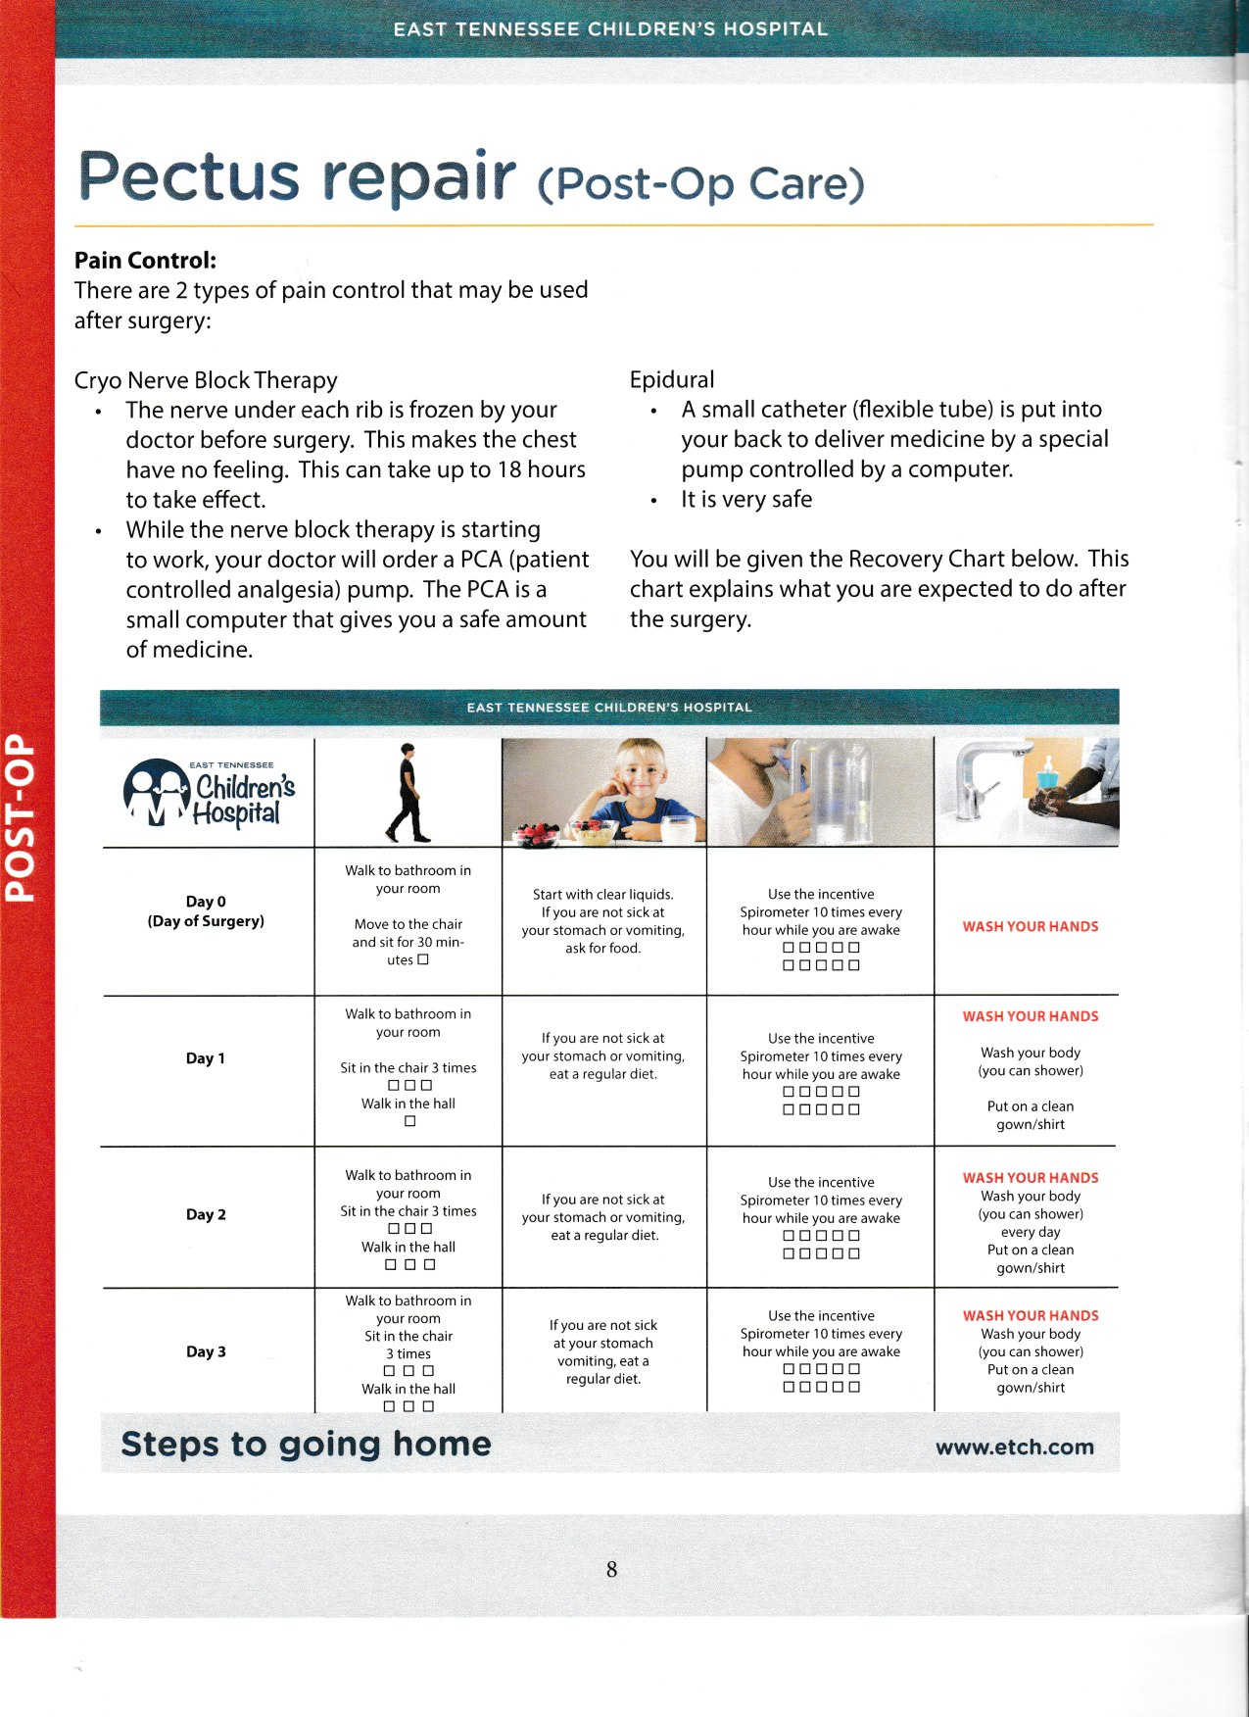

Steps to Going Home Discharge Checklist
Notes:
This is a copy of the steps to going home discharge checklist that is kept in the patient room during their admission. This is a document that is utilized so that progress toward discharge can be visibly tracked by nursing staff, patients, and their families.

Slide 25

Ethical Considerations
Determination from the University of Tennessee Institutional Review Board (IRB) and the IRB at ETCH was sought prior to the implementation of this project.
Data collection occurred at two points: pre-module completion and post-module completion.
Privacy and confidentiality protection through collection, storage, analysis, and transfer.
  Data were securely exported to Microsoft Excel and SPSS.
  All data were reported in aggregate.
Notes:
Determination from the University of Tennessee Institutional Review Board (IRB) and the IRB at ETCH was sought prior to the implementation of this project. Evidence-based practice improvement projects are typically not determined to be human subject research based on federal protection regulations; however, as accessing personal health information or personally identifiable information and future dissemination of findings was planned, IRB determination was requested in accordance with best practice. This initiative was determined to not meet the definition of research and thus did not require IRB review. Project site approval was obtained prior to implementation.
As I have discussed, data collection for this project occurred at two points: pre-module completion and post-module completion. There was privacy and confidentiality protection through collection, storage, analysis, and transfer of data. Data were securely exported to Microsoft Excel and to SPSS, which was used by the statistician to run tests on the data from my project. All data were reported in aggregate.

Slide 26

Findings
Notes:
An additional step in the translation phase of the PET process is to evaluate the outcomes. So next, I will be discussing the findings of my project.

Slide 27

Demographics
The mean age of participants was 31.31 years (SD = 6.85).
Of the nurses participating, 93% identified as female, White, and not Hispanic or Latino.
The mean years of nursing experience was 7.15 (SD = 5.56).
Three nurses had an associate degree, 10 had a bachelor’s degree, and one had a master’s degree.
Notes:
Demographics were collected during the pre-knowledge assessment and descriptive statistics were used to determine the mean and standard deviation for age, gender, race, ethnicity, years of registered nurse experience, and type of nursing degree. The mean age of participants was 31.31 years old, with a standard deviation of 6.85. Of the nurses that participated, 93% identified as female, white, and not Hispanic or Latino. The mean nursing experience was 7.15 years, with a standard deviation of 5.56. Three of the staff nursing participants had an associate degree, 10 had a bachelor’s degree, and one had a master’s degree.

Slide 28

Knowledge Assessment
Fourteen nursing staff completed the initial pre-and-post knowledge assessments indicating a 44% participation rate.
There was a statistically significant difference between the pre-and post-intervention learning assessments after completing the eLearning module.
  Scores on the pre-knowledge assessment were (M = 9.07, SD = 1.27) and ranged from a score of 7 to 11 out of a possible score of 11. Scores on the post-knowledge assessment were (M =10.71, SD = 0.47) and ranged from 10 to 11.
A paired sample t-test indicated a statistically significant difference between pre-and post-knowledge assessment scores (p = .001).
Notes:
14 out of 32 nursing staff members completed the initial pre- and post-knowledge assessments, indicating a 44% participation rate. There was a statistically significant difference between the pre- and post-intervention learning assessments after completing the eLearning module. The mean scores on the pre-knowledge assessment were 9.07, with a standard deviation of 1.27, and ranged from a score of 7 to 11 out of a possible score of 11. The mean scores on the post-knowledge assessment were 10.71, with a standard deviation of 0.47, and ranged from 10 to 11 out of a possible score of 11. A paired sample t-test indicated a statistically significant difference between pre- and post-knowledge assessment scores, with a p value of .001.

Slide 29

Assessment of Charting on Outcome Measures
Chart audits assessed nursing staff adherence to charting from the SCCP checklist over the three-day period.
Nurses charted the patient diet 100% of the time, patient shower/bath hygiene 20-100% of the time, and patient linen/clothing hygiene 0-100% of the time. Ambulation and incentive spirometry use were charted 0% of the time.
  Diet and hygiene charting interventions are pre-populated in the patient’s electronic health record (EHR).
  Ambulation and incentive spirometry use must be manually added to EHR.
Nurses were more compliant with charting items from the checklist that were pre-populated into the patient chart. However, there was a considerable amount of missing data in the patient’s chart as well as the paper copies of the bedside checklist were not scanned into the EHR.
Notes:
Chart audits assessed nursing staff adherence to charting from the standardized clinical care pathway checklist over the three-day period. Nurses charted the patient diet 100% of the time, patient shower and or bath hygiene 20 to 100% of the time, and patient linen and clothing hygiene 0 to 100% of the time. Ambulation and incentive spirometry use were charted appropriately 0% of the time. Of note, diet and hygiene charting interventions are pre-populated in the patient’s electronic health record. Ambulation and incentive spirometry use must be manually added to the electronic health record. These chart audits showed that nurses were more compliant with the charting items from the checklist that were pre-populated into the patient chart. However, there was a considerable amount of missing data in the patient’s chart as well as the paper copies of the bedside checklist were not scanned into the electronic health record.

Slide 30

Length of Stay
There was a statistically significant difference between the use of cryotherapy for pain management and the length of hospital stay following the Nuss Procedure.
Length of stay decreased from a mean of 4.28 days (SD = 0.49) in 2020 to 2 days (SD = 0.0) in both 2021 and 2022 following the implementation of cryotherapy in 2021.
This 2.28-day decrease in length of stay was a statistically significant difference in length of stay after beginning cryotherapy (p = .001).
Notes:
Assessment of length of hospital stay showed that there was a statistically significant difference between the use of cryotherapy for pain management and the length of hospital stay following the Nuss Procedure.
Cryotherapy use during the Nuss Procedure involves the intraoperative freezing of intercostal nerves, and the effects of pain management from cryotherapy can last up to three months, on average. A Kruskal-Wallis Test was conducted to determine that length of stay decreased from a mean of 4.28 days in 2020, with a standard deviation of 0.49, to 2 days in both 2021 and 2022, with a standard deviation of 0, following the implementation of cryotherapy in 2021. This 2.28 day decrease in length of stay was a statistically significant difference in length of stay after beginning cryotherapy, with a p value of .001.

Slide 31

Implications
Notes:
The last 2 steps of the translation phase of the PET process are to identify the next steps for the project and dissemination of findings, which will be discussed in the upcoming slides.

Slide 32
Practice Implications
Length of hospital stay was significantly decreased following the implementation of the cryotherapy pain management treatment from the SCCP.
  Suggests a likely decrease in post-operative pain scores during hospital admission.
Pectus excavatum is the most common chest wall anomaly – there will continue to be patients that require the Nuss Procedure for surgical correction.
Notes:
There are implications to practice that are important to note regarding this evidence-based practice project.
First, length of hospital stay was significantly decreased following implementation of the cryotherapy pain management treatment from the standardized clinical care pathway. This decrease in length of stay suggests a likely decrease in post-operative pain scores during the hospital admission, which can likely be attributed to the implementation of the cryotherapy aspect of the standardized clinical care pathway.
Next, pectus excavatum is the most common chest wall anomaly, so there will continue to be patients that require the Nuss Procedure for surgical correction. Continued education and growth of knowledge about this patient population could be invaluable to their standard of care and quality of life following surgery for generations to come.
In addition, there was no associated cost for the completion of this evidence-based practice project. However, the creation of educational modules and distribution is a paid role. Uploading the eLearning module to the eLearning platform and collecting results is associated with a paid role at the facility. Completing the eLearning module can be considered a non-productive time away for nurses away from patient care, indirectly affecting costs. The cost to create and implement the SCCP and educate staff nurses on the components of the SCCP may be offset due to the significantly decreased length of stay, which points to decreased patient charges.

Slide 33

Strengths and Limitations
Strengths
Limitations
Collaboration of the multidisciplinary team to create the SCCP.
Low cost of creating the SCCP and implementing nursing education.
Decrease in length of stay following the implementation of the cryotherapy feature of the SCCP.
Small sample size of nursing participants and patients receiving the Nuss Procedure at this pediatric facility.
All aspects of the eLearning module had to be completed at the same time.
  Restriction of the learning management system.
  Resulted in the inability to determine retention of knowledge.
Notes:
Next, I am going to discuss the strengths and limitations for my project.
The collaboration of the multidisciplinary team to create the standardized clinical care pathway, the low cost of creating the standardized clinical care pathway and implementing nursing education, and the decrease in length of stay following the implementation of the cryotherapy feature of the standardized clinical care pathway were all considered strengths of this evidence-based practice project.
There were also some limitations to my project. First, there was a small sample size of nursing participants and patients receiving the Nuss Procedure at this pediatric facility at the time of implementation of the project. Next, due to a restriction of the learning management system, all aspects of the eLearning module had to be completed at the same time. This means that staff nurses had to complete the pre-knowledge assessment, educational module, and post-knowledge assessment in one sitting, which resulted in the inability to determine the retention of knowledge.

Slide 34

Barriers
IPS unit switched floors to a unit with a higher number of beds.
Large amount of staff turnover.
Nurses expressed increased burnout.
The patient population on the IPS unit changed to include a wider variety of patient diagnoses.
Staff nurses were noted to adhere to charting interventions that were pre-populated into the chart, and there was poor adherence to charting interventions that did not pre-populate into the chart.
Discharge checklists were on paper and were misplaced at patient discharge.
Notes:
There were also some barriers to this evidence-based practice project. First, the inpatient surgery unit at ETCH switched floors to a unit with a higher number of beds, and there was a large amount of staff turnover during the project implementation and chart audit time periods. Nurses expressed increased burnout, and the patient population on the unit changed to include a wider variety of patient diagnoses. Upon completion of chart audits, staff nurses were noted to adhere to charting interventions that were pre-populated into the chart, and there was poor adherence to charting interventions that did not pre-populate into the chart. A final barrier to note is that all discharge checklists were on paper and were misplaced at patient discharge.

Slide 35

Areas for Further Examination and Sustainability
Creation of a specified intervention bundle for Nuss Procedure patients in the EHR or update current intervention bundle that is used at this time.
Charting interventions related to the SCCP, such as ambulation, incentive spirometry use, diet, hygiene, and education, should be pre-populated in the EHR.
The patient discharge checklist should be converted from paper to an electronic version within the EHR.
Addition of hands-on education and simulation of skills.
Continued chart audits for nursing adherence until sustained.
Notes:
Areas for further examination could include the creation of a specified intervention bundle for Nuss Procedure patients or an update to the current intervention bundle. Currently, staff nurses have to add a general musculoskeletal surgery care plan to the EHR for associated interventions to pre-populate. I would suggest either updating this general care plan to include interventions that are currently not pre-populated in the EHR, or to create an entirely separate Nuss Procedure care plan with inclusion of all aspects of the standardized clinical care pathway and charting interventions, such as ambulation, incentive spirometry use, diet, hygiene, education, and the patient discharge checklist, within the bundle. The patient discharge checklist should be converted from paper to an electronic version. In addition, increase in hands-on education and simulation of skills would be beneficial. And finally, continued chart audits for nursing adherence until sustained.

Slide 36

Dissemination
Notes:
Finally, I am going to discuss my dissemination plan. This completes the 19 steps of the PET process for the John’s Hopkin’s Nursing Evidence-Based Practice model.

Slide 37
Poster Presentation at University of Tennessee, Knoxville Research Day on November 8, 2022.
Executive Summary to be submitted to key stakeholders at the project facility by December 15, 2022.
Submission of manuscript and final defense PowerPoint presentation to Tennessee Research and Creative Exchange (TRACE).
1
2
Dissemination
3
Notes:
One deliverable that I have already completed for my dissemination plan is a poster presentation of the University of Tennessee, Knoxville Research Day that was on November 8, 2022.
Another deliverable that I will complete is an executive summary, which will be submitted to key stakeholders at the project facility by December 15, 2022.
The final deliverable that I plan to complete is submission of my manuscript and final defense powerpoint presentation to Tennessee Research and Creative Exchange, also known as Trace, which can be found in the UTK library but distributes project information worldwide.

Slide 38
QUESTIONS?
Thank you!
Notes:
Thank you for listening to my presentation! Does anyone have any questions?

