Slide 1

Educational Intervention on Pediatric Concussions for Providers
Melissa Callaway, RN, BSN, CPEN
Graduate College of Nursing
Notes:
Good morning this is Melissa Callaway, and I am doing my final defense on my DNP project titled

Slide 2
Population and Problem
3.8 million recreational and sports related concussions occur annually in children.
Estimated to cost 17 million dollars annually
Studies have shown that children who are seen in a specialty clinic have an overall faster recovery of post-concussive symptoms.
(Halstead, 2016)
Notes:
A concussion or a mild traumatic brain injury (mTBI) is a common injury among children and adolescents and is estimated to occur in 3.8 million children in the US and is estimated to cost 17 million dollars annually.
Concussions are diagnosed symptomatically, using validated tools
The medical management of concussions includes symptom management, cognitive rest, limited physical activity and conformity to return to play guidelines. Approximately 90% of all concussions have transient symptoms and resolve in 10-14 days. However, in some cases post-concussive symptoms may last longer than 3 months and are then diagnosed with post-concussive syndrome (PCS).
Studies have shown that children who are cared for in a specialty clinic have faster and less complicated recoveries.

Slide 3
Significance of the problem
Data exists
Non-compliance with return to play guidelines
Underdiagnosis and underreported
(Halstead et al., 2010, 2016)
Notes:
Concussions have been and remain an influential issue in media and medicine. They are a medical topic that has been well- studied in various settings. Despite the considerable amount of research, coverage and notoriety, concussions remain underdiagnosed, underreported and a continued public health problem.
A significant portion of head injuries in youth go unreported by athletes and coaches despite legal and regulatory requirements.
A study conducted by Halstead in 2016 assessing the impact of the Center for Disease Control’s campaign, demonstrated a positive impact with a significant decrease in the total number of concussions with the coaches who had completed the formal training.
Although there is an extraordinary amount of knowledge regarding concussions and subsequent care, only 15% of high school athletes comply with return to play recommendations (Halstead et al., 2010).

Slide 4
Purpose of Project
Use existing data to educate healthcare providers
Improve rates of appropriate diagnosis
Improved outcomes in children that have suffered a concussion
Notes:
The purpose of this project was to develop an online educational presentation for providers who diagnose concussions and educate families and also to promote awareness and knowledge.
The aim of this proposed project was to increase knowledge among providers on the dangers of unreported concussions, secondary injuries, and the dangers that ensue for children that may be returned to play too soon. Overall resulting in shorter MTBI recovery times and better outcomes for the youth in our community.

Slide 5
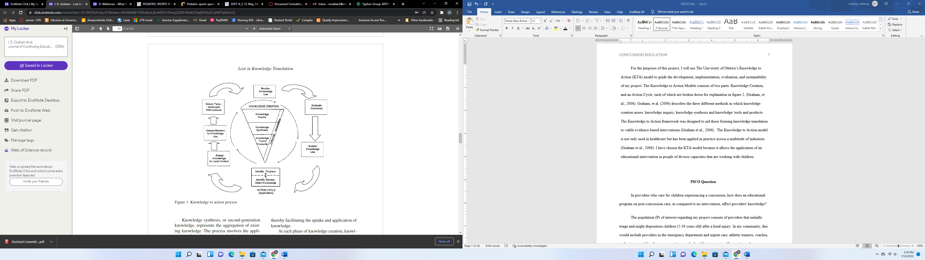
Theoretical Framework
(Graham, et al., 2006).
Notes:
The University of Ottawa’s Knowledge to Action model was be used to guide the development, implementation, evaluation, and sustainability of this project. The Knowledge to Action model consists of two parts: 1. Knowledge Creation, and 2 and Action Cycle- each of which are visually displayed here. Graham, (2006) describes the three different methods in which knowledge creation arises: knowledge inquiry, knowledge synthesis and knowledge/ tools and products. The Knowledge to Action framework was designed to aid those forming knowledge translation to viable evidence-based interventions
The Knowledge to Action model is not only used in healthcare but has been applied in practice across a multitude of industries. This model was chosen specifically because it allows the application of an educational intervention in people of diverse capacities that are working with children at risk for head trauma.

Slide 6
PICO Question
In providers who care for children experiencing a concussion, how does an educational program on post-concussion care, as compared to no intervention, affect providers' knowledge?
Notes:
The population (P) of interest for this project consists of providers that initially triage and might disposition children (5-18 years old) after a head injury. In my community, this includes providers in the emergency department and urgent care, athletic trainers, coaches, pediatricians and family nurse practitioners.
A plausible intervention (I) to mitigate the prolonged recovery or possibly worsening a concussion or mTBI, would be to teach those who initially evaluate the injured child. If the initial assessor of symptoms can appropriately assess a concussion, the child’s guardians can then be made aware and medical follow up will be more likely to ensue. Teaching for this intervention came in the form of an electronic presentation.
In contrast to my intervention, the comparison (C) was no educational program, with my population having been administered a pre-test to check baseline knowledge.
The outcome (O) is the post-educational knowledge is in the form of a survey administered after education. The desired outcome for this project was to increase knowledge of post-concussion guidance given by healthcare providers.
In order to measure an improvement, pre- and post- educational surveys were compared. The study conducted by Stead in 2016) confirms that if the initial assessor in a child’s head injury is aware of signs and symptoms of a concussion that there is a significant decrease in the total number of concussions.

Slide 7
Supportive Evidence
Search strategies
Critical appraisal- methods, tools, leveling and quality grade
Notes:
Using the developed PICO question, databases were searched for the most recent, relevant and applicable literature in PubMed, Cochrane, Scopus, and CINAHL.
The Johns Hopkins Nursing Evidence-Based Practice (JHNEBP), (Appendix E) research appraisal tool was used to evaluate literature used. Using this tool, levels of evidence and quality grading-was assigned to each piece of literature.

Slide 8
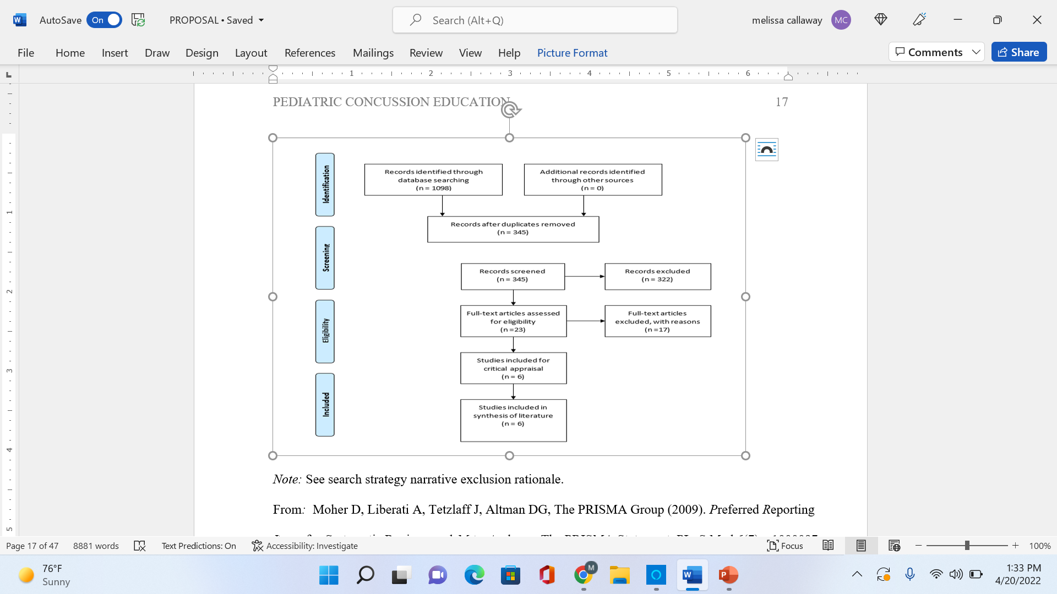
(Adapted from: Moher et al., 2009)
Notes:
This is the adapted PRISMA diagram that reflects my search.
The searches were conducted between June 1, 2021- June 15, 2021.
The search resulted in a total 1098 articles. Duplicates and articles that did not apply to PICO question (such as using interventions not relevant for my purpose, intervention led by peers, out of age range, not using an educational intervention) were deleted and 23 articles remained. Of the 23 abstracts, 5 were applicable to the PICO question and one set of guidelines that were useful to this project. I was able to find sufficient data by limiting my search to the last 5 years because the growing awareness in the field of concussions has led to a plethora of original research.

Slide 9
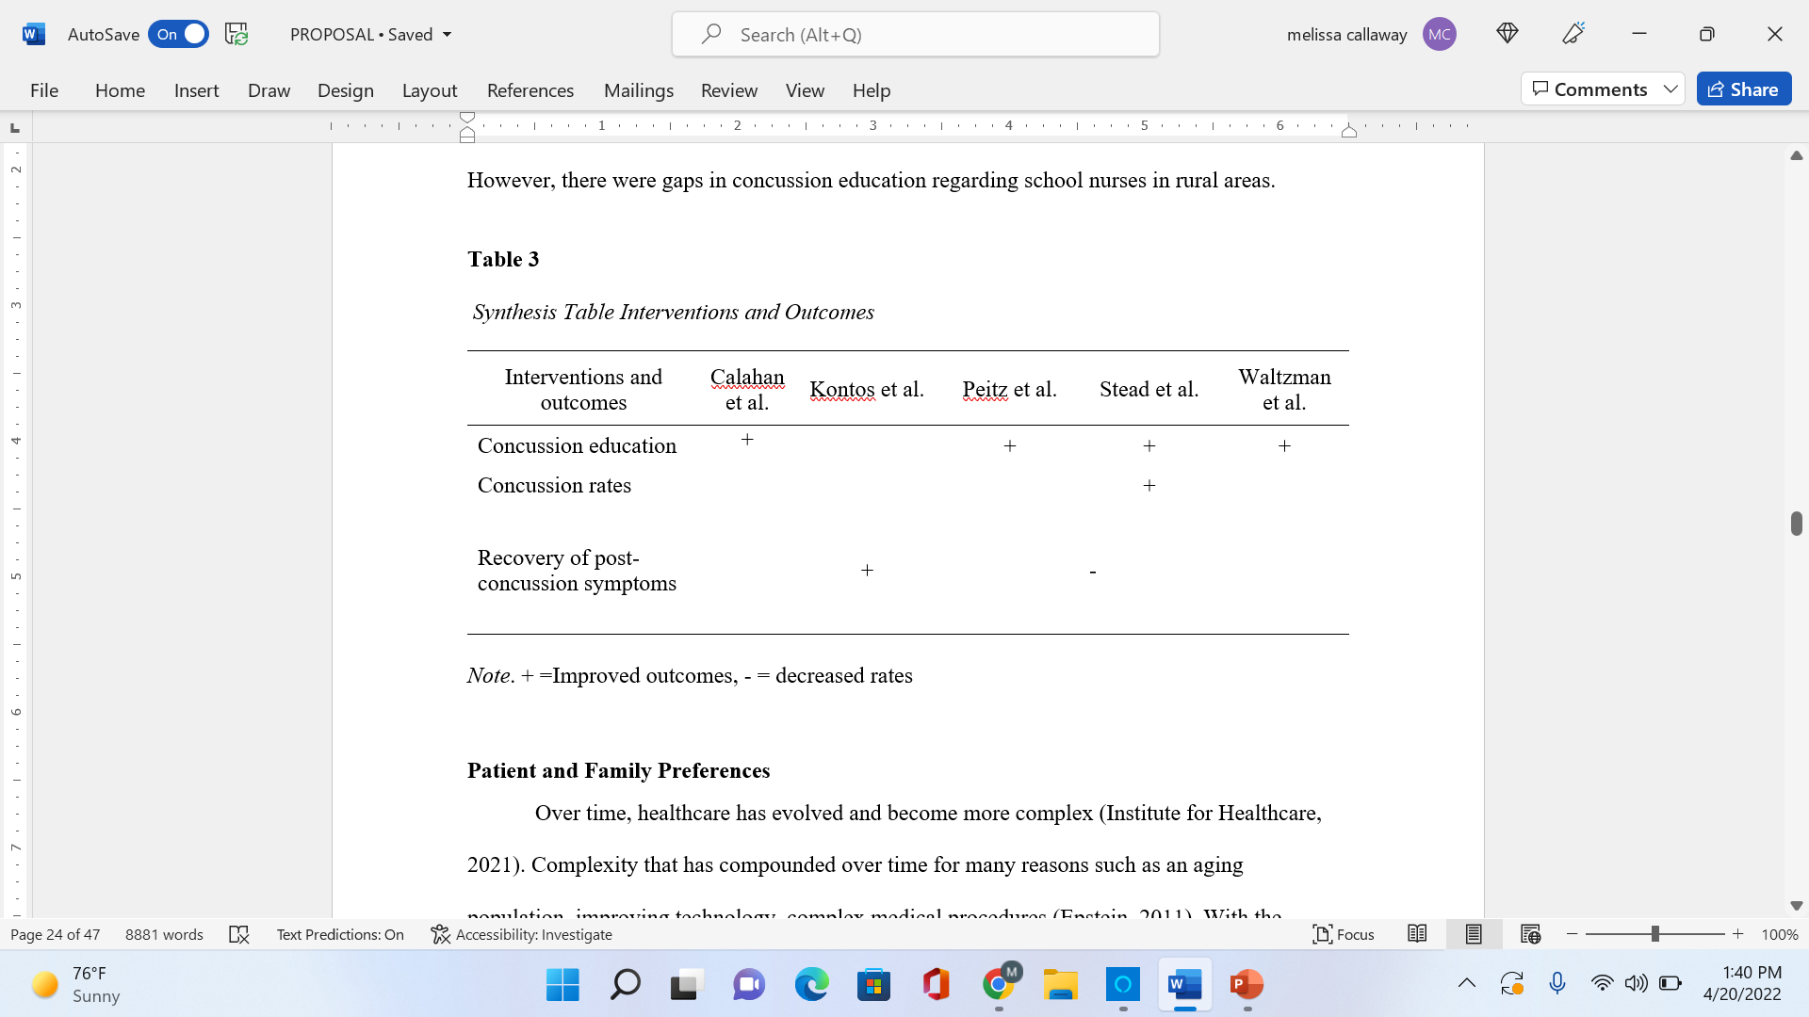
Synthesis Table- Interventions and Outcomes
Notes:
The synthesis table lists similarities among the literature used.
The calahan study was used to analyze whether the effects of concussion education exposure (CEE) affected post-concussion symptom care-seeking behavior. The findings of this study were that concussion education exposure was associated with more favorable outcomes regarding concussion seeking behaviors.
The Kontos study was used to examine how the timeliness of clinical evaluation affected recovery times post-concussion. Results of the study reflected that the earlier the initiation of clinical evaluation (< 7 days) proved faster symptom recovery post-concussion
The Peitz study used a mix of qualitative and quantitative evidence. The study’s aim was to compare concussion related knowledge and management confidence levels among urban and rural school nurses. This study highlighted the asset of nurses disseminated within our community, but also pointed out that continuing education on concussion management remains an important aspect among those caring for school-aged children.
The Stead study’s most significant finding is that the coaches reported that knowledge of these guidelines resulted in fewer concussions overall
The waltzmann study proved that the preferred routes for dissemination are health professionals or government resources. This study emphasized the room for improvement regarding concussion knowledge and prevention

Slide 10

Patient and Family Preferences
Notes:
In order to incorporate patient and family preferences in my DNP scholarly project, my efforts will be focused on the proximal outcomes of patients and the confidence that can be brought to a healthcare provider when given the appropriate tools.

Slide 11
Recommendation for Practice Based on Evidence
1. Concussion education of providers continues to be a priority.
2. An emphasis should be made among initial assessors of concussions that rapid clinical follow-up is necessary.
Notes:
Recommendations for practice change are based on the strength of the acquired evidence to support the proposed change. The intervention within my PICO question is consistent with the priorities of the community, to provide the safest possible outcomes for children that have sustained a traumatic injury. The following recommendations have been assimilated based on the evidence discussed.
For the first recommendation, there is strong, compelling evidence and consistent results. This is a solid indication that a practice change is indicated.
For the second recommendation there is good, consistent evidence and we could consider pilot of change or further investigation.

Slide 12
Methodology
Setting
Barriers and facilitators
Stakeholders
Tools
Intervention Implementation
Notes:
All the healthcare providers are rurally based and practice in St. George, Utah. All included were exposed to the intervention. The educational program presented to providers summarized care of the pediatric patient post-traumatic injury and addressed return to play guidelines. It was conducted virtually in a lecture-style teaching in one session, lasted 5 minutes and was voluntary.
The DNP project was conducted in coordination with a local neurologist serving as a community member for this project. The need for the improvement of post-concussive care in children was identified within the community.
A set of questions to measure baseline and post-educational knowledge were used from the Centers for Disease Control’s (CDC) providers education called “HEADS UP”. These questions were chosen from the CDC’s program because of it is public domain and because of thoroughness of the tools and education provided to medical professionals. It uses guidelines provided by the CDC and American Academy of Pediatric Association (AAP) summarizing 25 years of concussion research.
The participants inclusive of this project were healthcare providers that initially assess traumatic injuries in children. Initially, inclusion criteria roles were school nurses/aids, intermediate and high school athletic trainers, emergency department and urgent care providers which ideally would’ve included 50-100 participants and was dependent on how many healthcare providers chose to participate.

Slide 13
Outcome measures
Specific Outcomes measured
Difference made in improving health, costs patient, family or community outcomes
Data Collection and Security- collection procedure
Notes:
Baseline knowledge of healthcare providers was ascertained with a pre- educational survey and the same survey conducted post- education done via lecture with recommended guidelines summarized in a lecture.
The phases given by the KTA framework enabled the design for implementation. The framework provided the underpinnings necessary to better understand the evidence, change and how to apply it to the specific population relevant in this project.

Slide 14
Analysis of data
Statistical tests
Statistical platform
Notes:
The primary data gathered was the pre and post educational analysis and secondarily it was demographics/age/ experience and practice setting of the respondent.
The pre- and post- educational surveys were administered online as well as the education to rural healthcare providers. They were delivered via email and their responses and participation were recorded via Qualtrics. Qualtrics is a powerful online survey research tool. A basic Qualtrics account is available to students for university related work.
Once data was de-identified by Qualtrics, it was downloaded and stored in University of Tennessee (UT) one drive which uses UT security measures only allowing access using netid and password. Data was then analyzed with the assistance of UT’s statistics team using SPSS

Slide 15
Significance and Implications
Benefit to providers, patients, families and community
Cost effectiveness
Plan for sustainability
Notes:
The purpose of this project aligned with the community’s need for improved care for youth. This educational intervention is designed to aid providers who diagnose concussions and educate families post- concussion, and to promote awareness and ease the use of guidelines and data that already exists. There are an estimated 3.8 million concussions that occur annually in the nation(estimated because of underreporting and under recognition) , an educational impact could be exponential with this kind of prevalence.
There is no way to quantify how caring for this vulnerable population, with the best current practices will provide any positive economic outcome. However, when children are treated and monitored appropriately evidence shows a shorter post-concussive recovery time- resulting in less lost school/workdays and less medical costs associated with visits and therapy
There is no cost associated with this project. The survey and education were administered electronically and UT resources from the DNP student were used to organize the survey, data and implementation associated with the project.

Slide 16
Findings
  Two- fold increase in knowledge post-education
7 participants
  Two NPs
  Two PAs
  3 Physicians
Notes:
In analyzing the data from SPSS. There were 7 participants in the educational intervention during the 3-month implementation period. The participants included two physician assistants, two nurse practitioners and three physicians- five of the 7, practice in primary care and two of the 7 practicing in urgent care/emergency room setting. Results comparing the pre-implementation and post-implementation knowledge showed a two-fold increase in the knowledge among providers. This is of great statistical significance.

Slide 17

Implications for practice
Notes:
Applying post-intervention results gives us strong, compelling evidence and consistent results- the recommendation for practice includes concussion education of providers continues to be a priority and that an emphasis should be made among initial assessors of concussions that rapid clinical follow-up is necessary. Given the two-fold increase in knowledge after the educational intervention, the plan is to disseminate results and apply the same principles to other centers that care for pediatric traumatic injuries.

Slide 18
Dissemination plan
Disseminating
Clinical Decision Making
Applying Evidence
Pediatric Trauma Society’s Poster exhibition 2023 conference
YouTube for project’s stakeholders
(Graham 2006)
Notes:
In accordance with the theoretical Knowledge to action framework used throughout the project. Dissemination is termed ‘knowledge exchange’ is a sound and systematic alliance between researchers and exchange decision makers’ collaboration.
This effective knowledge exchange involves disseminating and applying evidence and most current data in clinical decision-making.
The plan for dissemination includes abstract submission to the Pediatric Trauma Society’s poster exhibition for the 2023 conference and an online presence with the video of the educational intervention available on YouTube for the stakeholders.

Slide 19
References
Barlow, K. M., Crawford, S., Stevenson, A., Sandhu, S. S., Belanger, F., & Dewey, D. (2010). Epidemiology of Postconcussion Syndrome in Pediatric Mild Traumatic Brain Injury. Pediatrics, 126(2), e374–e381. https://doi.org/10.1542/peds.2009-0925
Bretzin, A. C., Covassin, T., Fox, M. E., Petit, K. M., Savage, J. L., Walker, L. F., & Gould, D. (2018). Sex Differences in the Clinical Incidence of Concussions, Missed School Days, and Time Loss in High School Student-Athletes: Part 1. The American journal of sports medicine, 46(9), 2263–2269. https://doi.org/10.1177/0363546518778251Callahan, C., Kay, M., Kerr, Z. Y., Hinson, M. T., Linnan, L. A., Hennink-Kaminski, H., Gildner, P., Marshall, S. W., Houston, M., Cameron, K., Register-Mihalik, J. (2021) Association between previous concussion education and concussion care-seeking outcomes among national collegiate athletic association division I student-athletes. Journal of Athletic Training, 56(3), 294–301. https://doi.org/10.4085/1062-6050-0211.20
CDC Train. HEADS UP to healthcare providers online training for medical professionals. https://www.train.org/cdctrain/course/1091388/
Centers for Disease Control and Prevention. (2019). Brain Injury Basics. https://www.cdc.gov/headsup/basics/concussion_whatis.html

Slide 20
References continued
Centers for Disease Control and Prevention. (2014). Applying the knowledge to action (K2A) framework: Questions to guide planning. Centers for Disease Control and Prevention, US Dept of Health and Human Services. http://intranet.cdc.gov/nccdphp/home/WGOT/tools/index.html
Dang, D., & Dearholt, S. (2017). Johns Hopkins nursing evidence-based practice: model and guidelines. 3rd ed. Indianapolis, IN: Sigma Theta Tau International
Epstein, R. M., & Street, R. L.. (2011). The Values and Value of Patient-Centered Care. The Annals of Family Medicine, 9(2), 100–103. https://doi.org/10.1370/afm.1239
Gioia, G. A., Collins, M., & Isquith, P. K. (2008). Improving identification and diagnosis of mild traumatic brain injury with evidence: Psychometric support for the acute concussion evaluation. The Journal of Head Trauma Rehabilitation, 23(4), 230–242. https://doi.org/10.1097/01.HTR.0000327255.38881.ca
Google Maps. (n. d.) https://www.google.com/maps/dir/Las+Vegas,+Nevada/St.+George,+UT/@37.1041851,-113.7048906,10.87z/am=t/data=!4m13!4m12!1m5!1m1!1s0x80beb782a4f57dd1:0x3accd5e6d5b379a3!2m2!1d-115.1398296!2d36.1699412!1m5!1m1!1s0x80ca44d0984939e5:0x531707f2f8a11c1e!2m2!1d-113.5684164!2d37.0965278

Slide 21
References continued
Graham, I.D., Logan, J., Harrison, M.B., Straus, S.E., Tetroe, J., Caswell, W. & Robinson, N. (2006). Lost in knowledge translation: Time for a Map? J. Contin. Educ. Health Prof., 26: 13-24. https://doi.org/10.1002/chp.47
Grubenoff, J. A., Kirkwood, M., Dexiang G., Deakyne, S., & Wathen, J. (2010). Evaluation of the standardized assessment of concussion in a pediatric emergency department. Pediatrics, 126(4), 688–695. https://doi.org/10.1542/peds.2009-2804
Halstead, M. E., & Walter, K. D. (2010). Sport-Related concussion in children and adolescents. Pediatrics, 126(3), 597–615. https://doi.org/10.1542/peds.2010-2005
Institute for Healthcare Improvement. Person- and Family- Centered Care. http://www.ihi.org/resources/Pages/ImprovementStories/AcrosstheChasmAim3HealthCareMustBePatientCentered.aspx
Institute for Healthcare Improvement. (2020). L 101: Introduction to Health Care Leadership. http://app.ihi.org/lmsspa/#/6cb1c614-884b-43ef-9abd-d90849f183d4/c1164ba8-5af1-438b-8a1f-d409911a4948/lessonDetail/7486951a-e7e4-43b9-b110-c58acaae753f/page/2

Slide 22
References continued
Institute of Medicine (IOM) and National Research Council (NRC). 2014. Sports-related concussions in youth: Improving the science, changing the culture. Washington, DC: The National Academies Press.
Kontos, A.P., Jorgensen-Wagers K., Trbovich, A.M., Ernst, N., Emami, K., Gillie, B., French, J., Holland, C., Elbin, R. J., Collins, M.W. (2020). Association of time since injury to the first clinic visit with recovery following concussion. JAMA Neurology 77(4), 435-440. https://doi.org/10.1001/jamaneurol.2019.4552
Lumba-Brown A., Yeates K. O., Sarmiento K. (2018) Diagnosis and Management of Mild Traumatic Brain Injury in Children: A Systematic Review. JAMA Pediatrics. 172(11) https://doi.org/10.1001/jamapediatrics.2018.2847
Lumba-Brown, A., Yeates, K. O., Sarmiento, K., Breiding, M. J., Haegerich, T. M., Gioia, G. A., Turner, M., Benzel, E. C., Suskauer, S. J., Giza, C. C., Joseph, M., Broomand, C., Weissman, B., Gordon, W., Wright, D. W., Moser, R. S., McAvoy, K., Ewing-Cobbs, L., Duhaime, A. C., Putukian, M., Timmons, S. D. (2018). Centers for Disease Control and Prevention Guideline on the Diagnosis and Management of Mild Traumatic Brain Injury Among Children. JAMA pediatrics, 172(11), e182853. https://doi.org/10.1001/jamapediatrics.2018.2853

Slide 23
References continued
Manchester, J. (2014). Facilitating lewin’s change Model with Collaborative Evaluation in Promoting Evidence Based Practices of Health Professionals. Evaluation and program planning 47 82–90. Web.
McCrea, M., Hammeke, T., Olsen, G., Leo, P., & Guskiewicz, K. (2014). Unreported concussion in high school football players. Implications for Prevention, Clinical Journal of Sport Medicine. 14 (1), 13-17.
Mccrory, P., Meeuwisse, W., Johnston, K., Dvorak, J., Aubry, M., Molloy, M., & Cantu, R. (2009). Consensus Statement on Concussion in Sport: The 3rd International Conference on Concussion in Sport Held in Zurich, November 2008. Journal of Athletic Training, 44(4), 434–448. https://doi.org/10.4085/1062-6050-44.4.434
Melnyk, B., & Fineout-Overholt, E. (2019). Evidence-based practice in nursing & healthcare: a guide to best practice, 4th edition. Wolters Kluwer.
Mitchell, P. F. (2011). Evidence-based practice in real-world services for young people with complex needs: new opportunities suggested by recent implementation science. Children and Youth Services Review, 33(2), 207–216. https://doi.org/10.1016/j.childyouth.2010.10.003

Slide 24
References continued
Moreau, A., Carol, L., Dedianne, M., Dupraz, C., Perdrix, C., Lainé, X., & Souweine, G. (2011). What perceptions do patients have of decision making (DM)? Toward an integrative patient-centered care model. A qualitative study using focus-group interviews. Patient Education and Counseling, 87(2), 206–211. https://doi.org/10.1016/j.pec.2011.08.010
Permenter C., Fernández-de Thomas R., & Sherman A. (2021) Postconcussive syndrome. StatPearls. StatPearls Publishing. https://www.ncbi.nlm.nih.gov/books/NBK534786/
Pietz, K., Graves, J., Weybright, E., Pinkleton, B., Klein, T. (2021). Original research: Concussions at school: The experiences and knowledge of school nurses. American Journal of Nursing, 121(2), 28-38. https://doi.org/10.1097/01.NAJ.0000733428.67589.5e
Puga, P. A. (2011). Unreported concussion in high school football players. ProQuest Dissertations Publishing.
Rycroft-Malone, J., & Bucknall, T. (2010). Using theory and frameworks to facilitate the implementation of evidence into practice. Worldviews on Evidence-Based Nursing, 7(2), 57–58. https://doi.org/10.1111/j.1741-6787.2010.00194.x

Slide 25
References continued
Stead T. S., Rastogi V., Hedna V. (2016) Awareness of the CDC “Heads Up!” to youth sports campaign among pediatric sports coaches: A pilot survey study. Cureus 8(8): e755. https://doi.org/10.7759/cureus.755
Sylvia, M.L. & Terhaar, M.F. (2014). Clinical analytics and data management for the DNP (2nd ed.). Springer Publishing Company.
Tierney, R. T., Sitler, M. R., Swanik, C. B., Swanik, K. A., Higgins, M., & Torg, J. (2005). Gender differences in head-neck segment dynamic stabilization during head acceleration. Medicine and science in sports and exercise, 37(2), 272–279.
Waltzman, D., Daugherty, J. (2018) Concussion knowledge and experience among a sample of american adults. Journal of Concussion, 2(11). https://doi.org/10.1177/2059700218769218
Waltzman, D., & Sarmiento, K. (2019). What the research says about concussion risk factors and prevention strategies for youth sports: A scoping review of six commonly played sports. Journal of Safety Research, 68, 157–172. https://doi.org/10.1016/j.jsr.2018.11.005
Yen, P. (2019). Use and Effectiveness of the Teach-Back Method in Patient Education and Health Outcomes. Federal Practitioner: for the Health Care Professionals of the VA, DoD, and PHS., 36(6), 284–289.

Slide 26
References continued
United States Census Bureau. QuickFacts- St. George Utah. https://www.census.gov/quickfacts/stgeorgecityutah
Voss, J.D., Connolly, J., Schwab, K.A. (2015). Update on the epidemiology of concussion/mild traumatic brain injury. Current Headache and Pain Report. 19 (32). https://doi.org/10.1007/s11916-015-0506-z

Slide 27
Questions?

