Slide 1
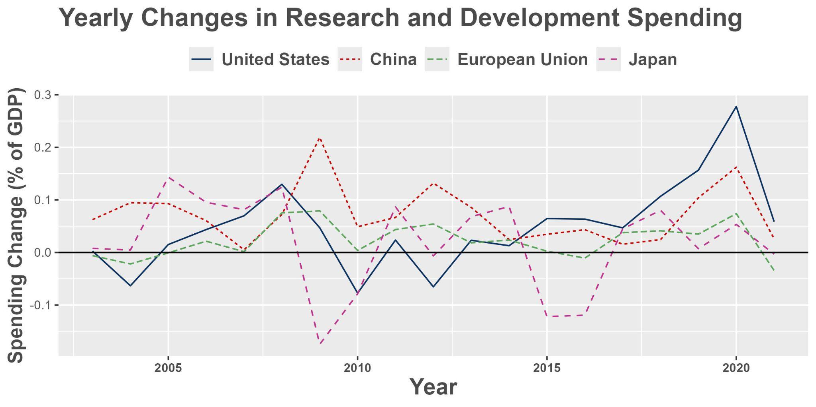
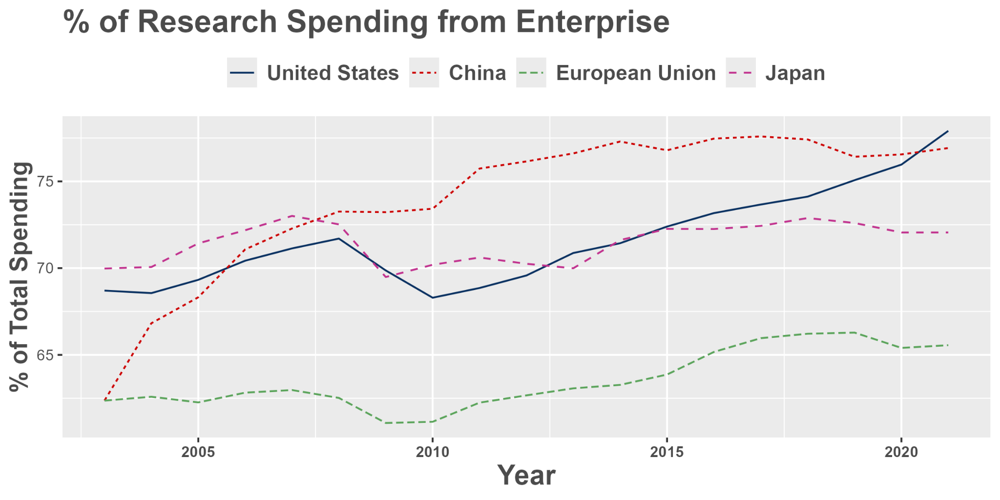
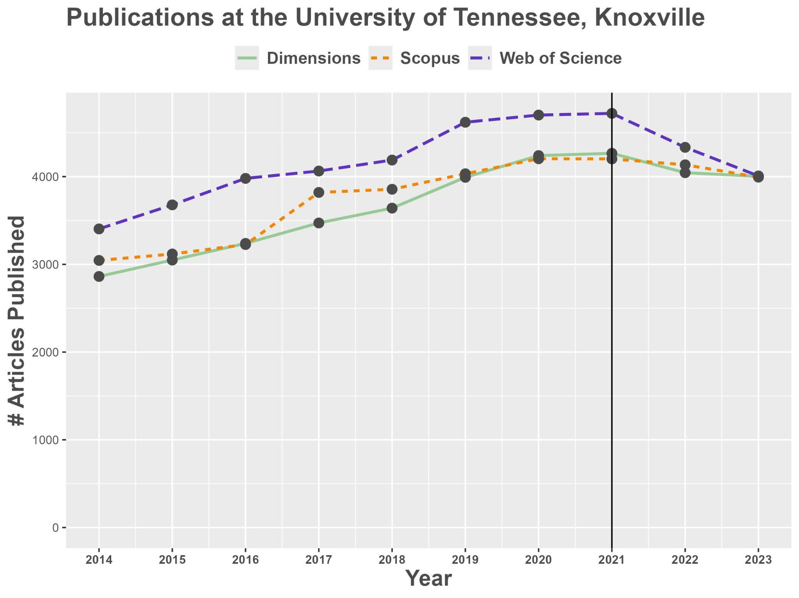
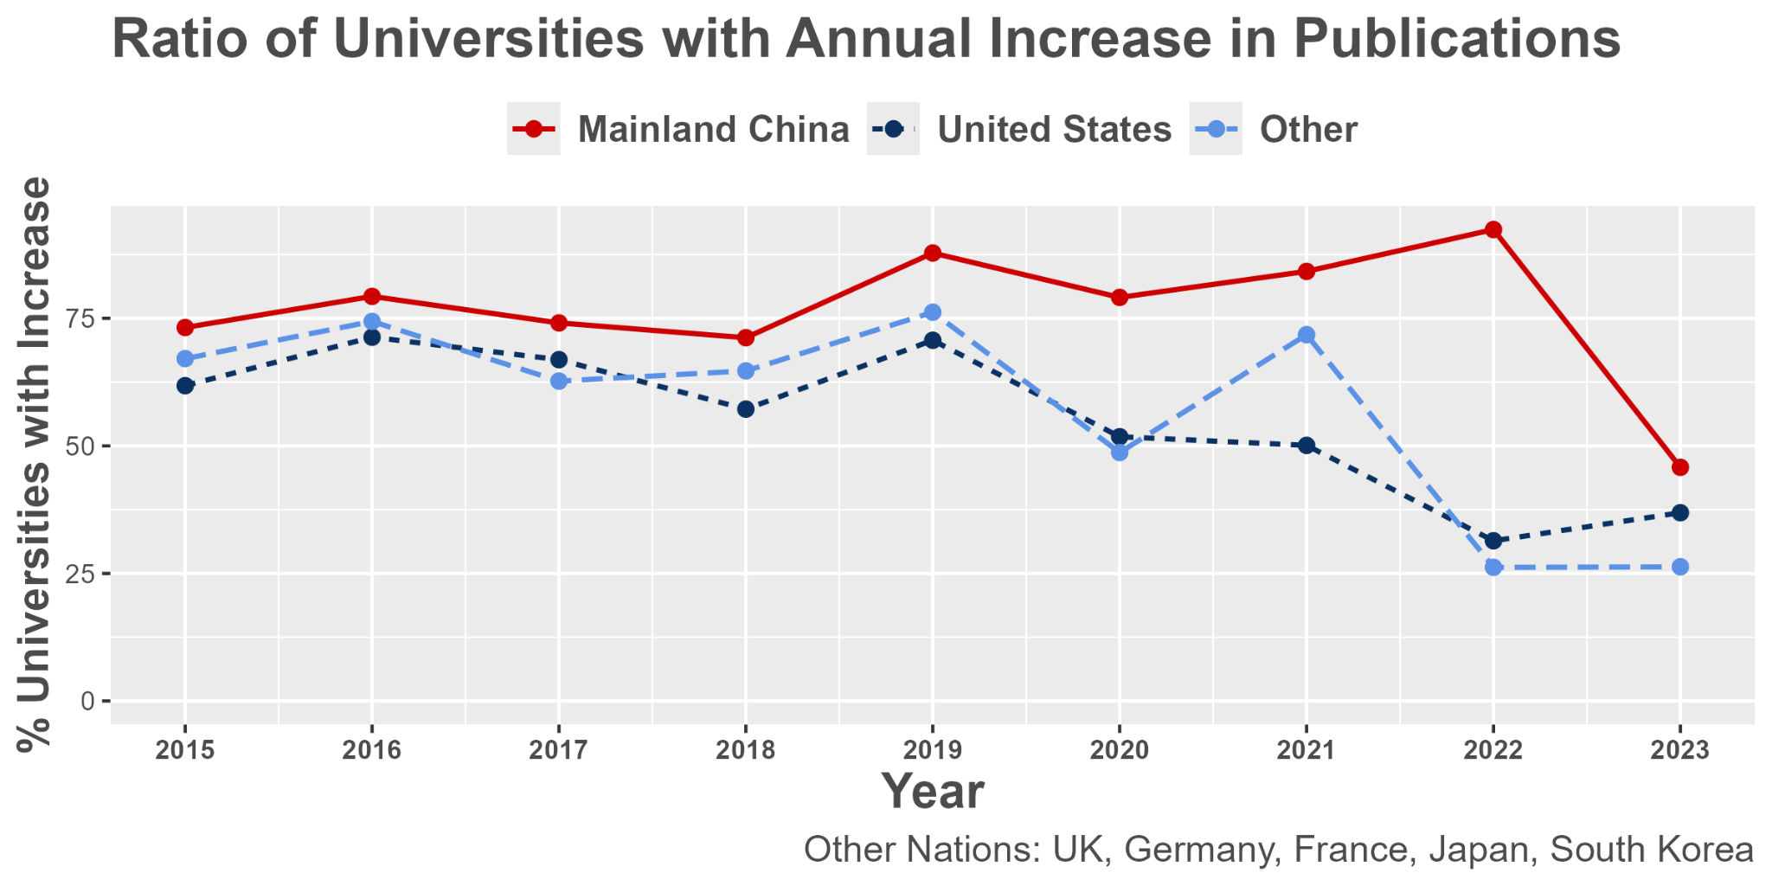
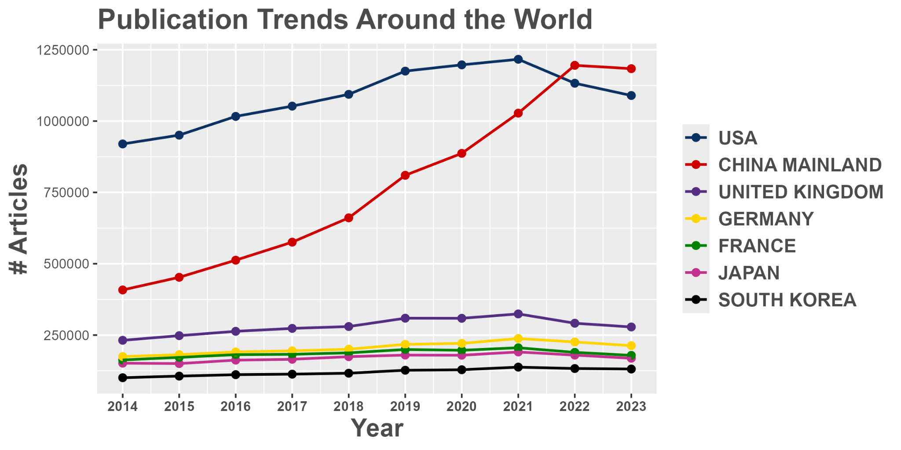
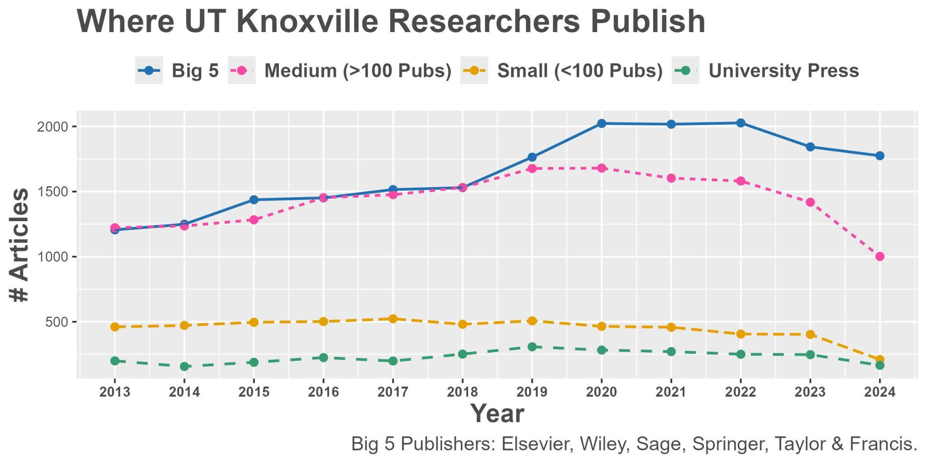
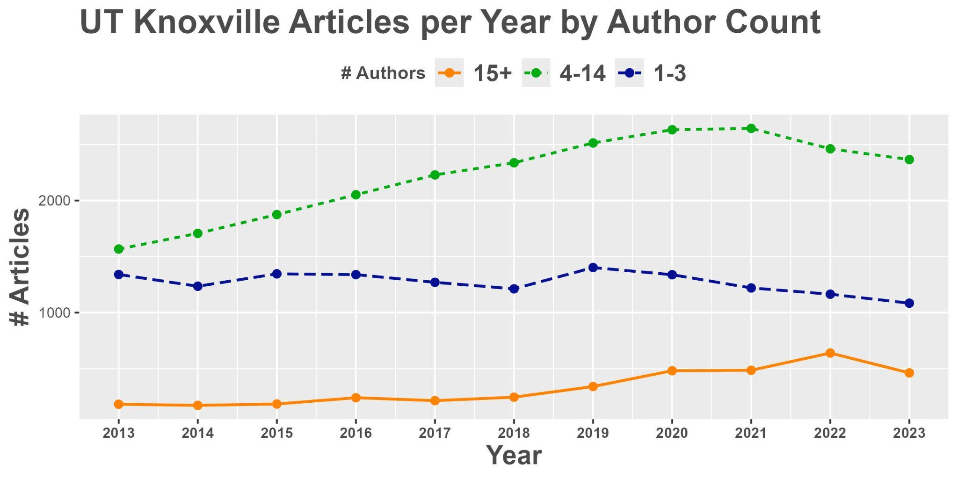

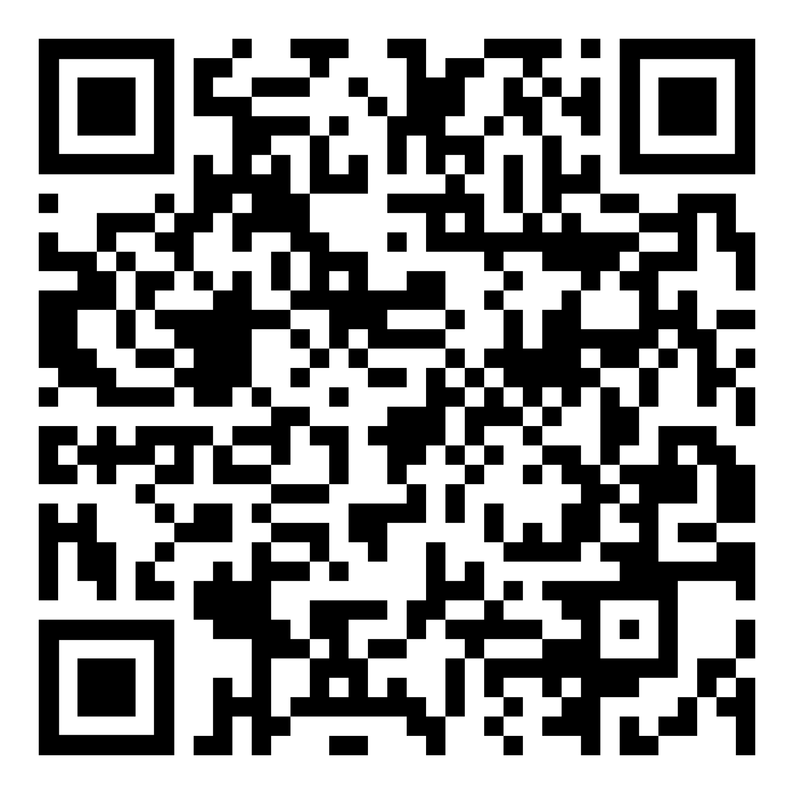
An Analytical Investigation into Scholarly Publication Trends
Background
Scholarly publishing serves as a significant factor for a researcher’s career advancement, affecting their reputation and recognition in their field.
However, scholarly publications have declined in recent years at the University of Tennessee, Knoxville (UT Knoxville) as part of a wider trend in scholarly publishing.
This research provides an overview of the decline while exploring potential contributing factors and their implications.
Descriptive Analytics
Factors Influencing the Decline
Research Spending: U.S. research relies more on private funding despite high overall spending.
Institutional Collaboration: U.S. single-institution and international collaborations are down.
Open Access Publishing: Pay-to-publish models boost access but raise equity and cost concerns.
Market Consolidation: A small number of major publishers dominate over 50% of published research, increasing paywalls and high Article Processing Charges (APCs).
Hyper-Authorship: More co-authors per paper has led to a decline in lower authorship output.
Author Leadership Shifts: Both senior and early career researchers take on first author roles less often.
Academic Discontent: Rising publication pressure is leaving researchers overwhelmed.
Rise of Preprints: Preprint platforms are growing rapidly, allowing researchers to share findings before peer review.
COVID-19 Pandemic: Global research was disrupted due to laboratory closures, funding cuts, and travel restrictions. Research on COVID-19 surged by mid-2021 but declined in 2022.
Gender Disparities During Pandemic: Women’s submission rates dropped sharply in early pandemic months. Senior roles experienced the largest decline.
Several major publishing regions saw funding rise in the last few years, thanks largely to enterprise funding sources.
Change in R&D Spending as % of GDP, 2003-2021
% of annual research spending from Enterprise sources, 2003-2021
Despite increased funding, many publishing universities and nations saw publishing declines entering the 2020s.
Publications at UT according to Web of Science, Scopus, and Dimensions, 2014-2023.
Methodology
This study takes a mixed-methods approach with an explanatory sequential design:
Quantitative - Publications were selected from the Web of Science (n = 22,385 publications at UTK), Scopus (n = 20,568) and Dimensions (n = 20,547) databases to analyze citation counts from 2019-2023. Additional data from InCites was used to identify publication trends.
Qualitative - A literature review using Web of Science and Scopus, supplemented by Google Scholar and the Nature Index, was used to contextualize the quantitative findings. The Keyword Searching method was applied using “academic publishing metrics”, “publication decline”, “publication trends”, “scientific productivity”, “research quality”, “authorship”, and “open access”.
# of universities whose InCites publication count increased from previous year, 2015-2023.
# of Total Publications in InCites by nation, 2014-2023.
From 2019-2023, medium-sized publishers and low author count work saw the largest drop-off in publications at UT Knoxville.
Conclusion
COVID-19 disruptions, shifts in authorship, and the financial pressures of open access and other publishing models have reshaped research priorities.
As recent research funding uncertainty threatens further declines in scholarly output, researchers will need to embrace uncertainty and cultivate a more resilient mindset when facing these challenges moving forward.
# of UT Knoxville articles published by publisher size, 2013-2024.
# of UT Knoxville articles published by author count, 2013-2024.
Alexander Harriman Brooke A. Noffsinger P. Judy Li, PhD
Collections Data Analyst Graduate Research Assistant Research Impact Librarian
aharrima@utk.edu btalley5@vols.utk.edu judyli@utk.edu
References, Code, and Data Used:
Notes:
Location breakdown:
https://my.ibisworld.com/us/en/industry/51113/geographic-breakdown

