Slide 1


Exploring Au-Ni Alloys for Magnetic-Plasmonic Applications
Department of Materials Science and Engineering, The University of Tennessee
J. Carothers, M. Roulier, B. Rowell, C. Walker
Advised by: J. Fowlkes, D. Garfinkel, P. Rack
Notes:
John

Slide 2
Motivation
Plasmons are an integral part of many energy harvesting devices and optical sensing instruments
  Solar panels
  Protein characterization tools
Lower the cost of these devices and improve performance
Notes:
John

Slide 3
Project Overview
Explored the Au-Ni composition space as a thin film
Characterized its magneto-plasmonic properties
Determined optimal concentrations and structures for plasmonic applications
Determined if ferromagnetic Ni can improve the Au plasmon resonance
Notes:
Michael
Preface of project, moving into technical details later
What’s of the project
* Explore the Au-Ni composition space in thin film form…

Slide 4
Theory and Concepts
Notes:
John

Slide 5
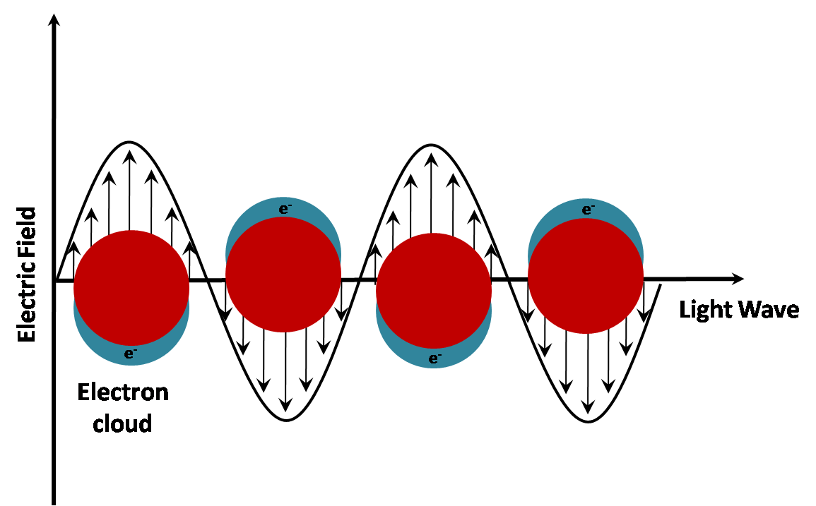
Plasmons
Quantum of free electron oscillation
Responsible for optical properties of metals and semiconductors
[3]
Notes:
John
Mention photons and phonons, refresher on “quantum”
Light is a wave with electric and magnetic components - oscillates
Oscillation leads change in spatial distribution of free electrons: plasma oscillation - plasmon
Mention plasma frequency: light below is reflected, light above is transmitted
Polariton-as n goes to infinity, when restricted occurs as surface plasmon
*Nanoparticle with the spectra
http://www.nanovexbiotech.com/gold-nanoparticle-sensing/ (image)

Slide 6
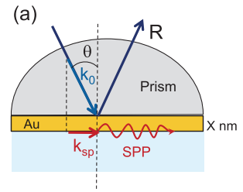
Plasmons
Plasmons alternate between the two interfaces
Leverages the change in dielectric constant at interface to propagate
Amplitude degrades with distance traveled
[4]
Notes:
Brandon

Slide 7
Optics
The physical characterization of plasmonics is performed via measuring optical properties
Refractive index “n”
  Determines how light bends as it travels through a medium
  Lower n values improve performance
Dielectric Constant “k”
  Ratio of the permittivity of material to the permittivity of vacuum
  Higher k values improve performance
Notes:
Brandon
How you use this…? - David

Slide 8
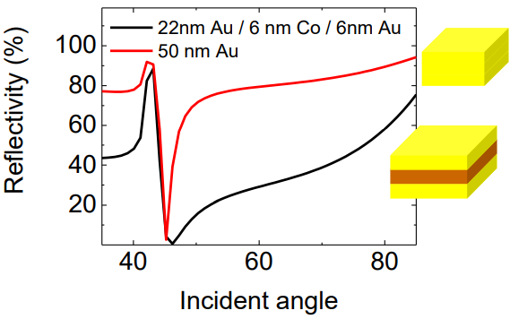
Ferromagnetic Contributions
Noble Metal
  Good resonance
  Narrow optical range
Ferromagnetic coupling
  Wide optical range
  Lower resonance
[7]
Notes:
Mike and Brandon

Slide 9
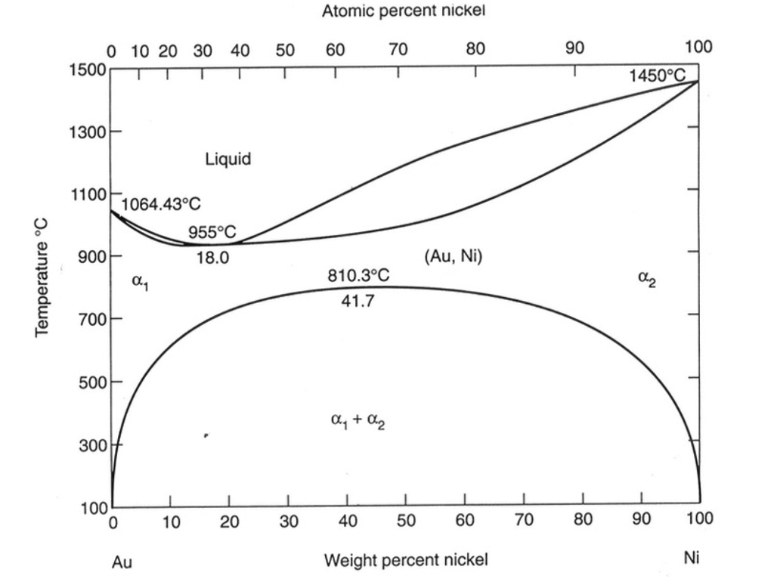
Materials Selection
Due to low plasma frequency of Au, plasmons easily generated
Ni is an inexpensive, well characterized ferromagnet
Au-Ni system was chosen for study
  Well behaved phase diagram
  Limited plasmonic characterization
Notes:
Chris

Slide 10
Synthesis of thin film
Notes:
Michael

Slide 11

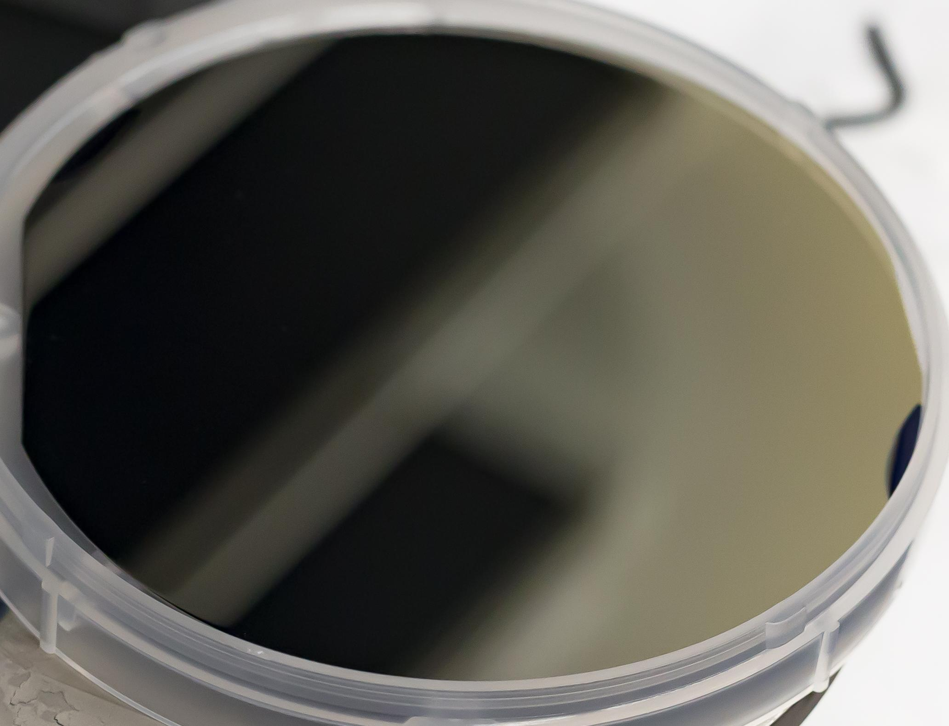
Synthesis
Co-Sputtering employed for synthesis
Approximately 300 nm thickness
Orientation of substrate yielded a composition gradient
Notes:
Michael
Sputtering
“Replication” of Au-Ni phase diagram
Allowed characterization of plasmonic response as a function of Ni composition
Able to determine the optimal Ni composition for improved optical performance

Slide 12
Sputtering
Sputtering traps film in
metastable state
Characterize 𝛂₁ and 𝛂₂ region
Notes:
Michael

Slide 13
Annealing
Structural effects
on optical
properties
Remove metastable state
  𝛂₁ and 𝛂₂ separation
Notes:
Chris

Slide 14
Quick Intermission for Questions?
Notes:
Chris

Slide 15
Review of Characterization Techniques
EDS
G-XRD
Ellipsometry
Notes:
John

Slide 16
SEM & EDS
Backscatter Scanning Electron Microscopy (SEM) used to view surface
Energy Dispersive X-ray Spectroscopy (EDS) used for compositional gradient confirmation
  Characteristic x-rays of elements
Notes:
John

Slide 17
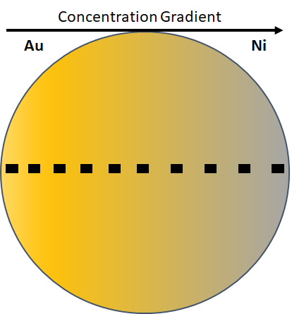
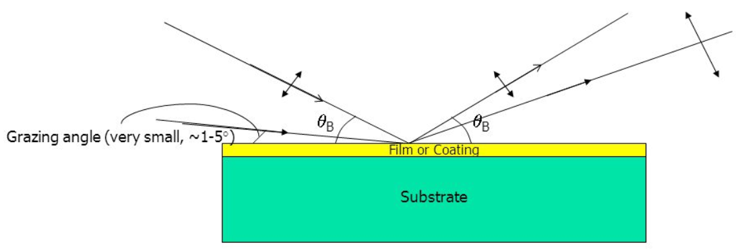
GXRD
Grazing angle XRD across compositional gradient
  Required for thin film XRD
Allows observation of phase change across film
[6]
Notes:
Chris

Slide 18
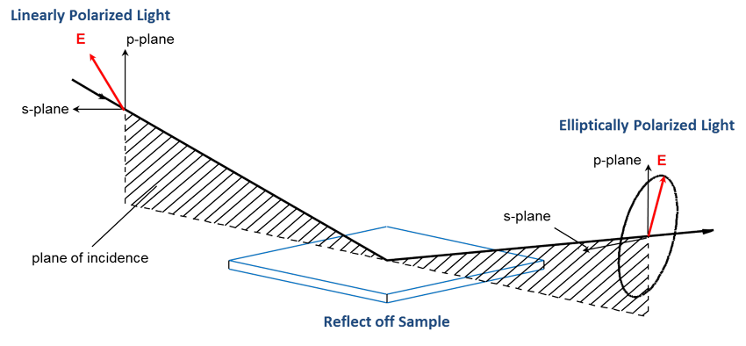
Ellipsometry
Measurements taken across gradient
  Determines “n” and “k” as function of composition
[6]
Notes:
Brandon

Slide 19
Parameters
Parameter | Value
SEM Image Voltage | 20 keV
EDS Scan Voltage | 10 keV
EDS Scan Current | 1000 mA
Grazing Angle | 4.0°
X-ray Source | Cu Kɑ 1.54 Å
X-ray Voltage / Current | 45 keV / 40 mA
Line scan dimensions | 12 x 0.4 mm
Divergence slit | 1/32° Fixed
Step Size | .03°
Ellipsometry Energy | 0.8 - 5 keV

Slide 20
Results

Slide 21
EDS
Characteristic peaks
  Au: 2.1 keV
  Ni: 0.85 keV
Confirms gradient exists
Notes:
chris

Slide 22
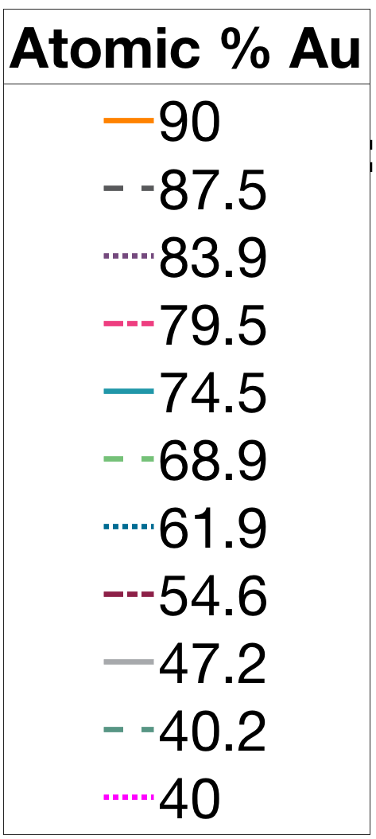
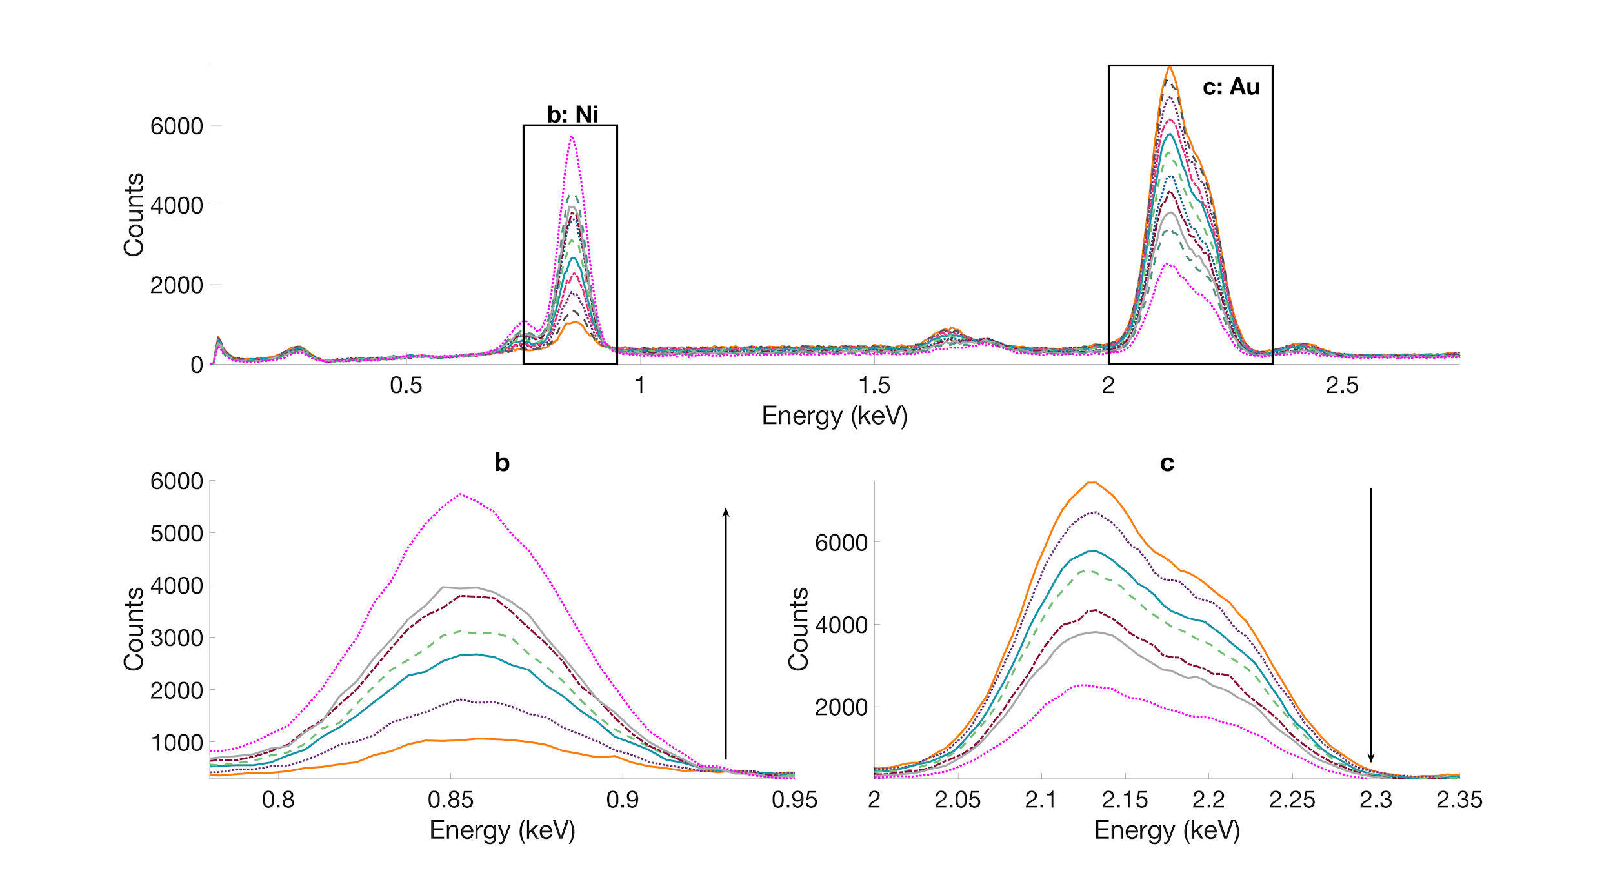
EDS
At % Ni
Notes:
chris

Slide 23
Pre-anneal XRD
Two peaks present for FCC
  (111) and (200)
  No individual 𝛂₁ or 𝛂₂ peaks
Proves metastable state
  Solved by annealing
Notes:
mikey

Slide 24
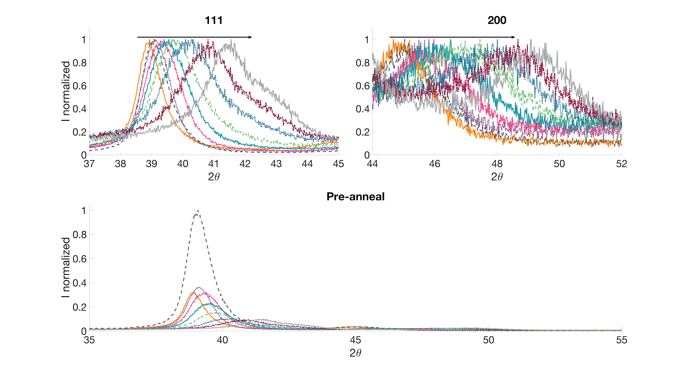
At % Ni
Notes:
michael

Slide 25
Post-anneal XRD
𝛂₁ and 𝛂₂ phase present
  Au rich (111) and (200) depicts 𝛂₁
  Ni rich (111) and (200) depicts 𝛂₂
Verifies removal of the metastable state
Notes:
John

Slide 26
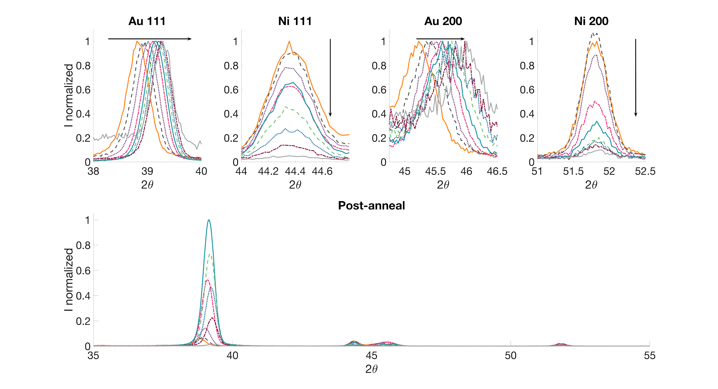
At % Ni
Pure Au 111 | 38.9
Pure Au 200 | 44.9
Pure Ni 111 | 44.42
Pure Ni 200 | 52.28
Notes:
John

Slide 27
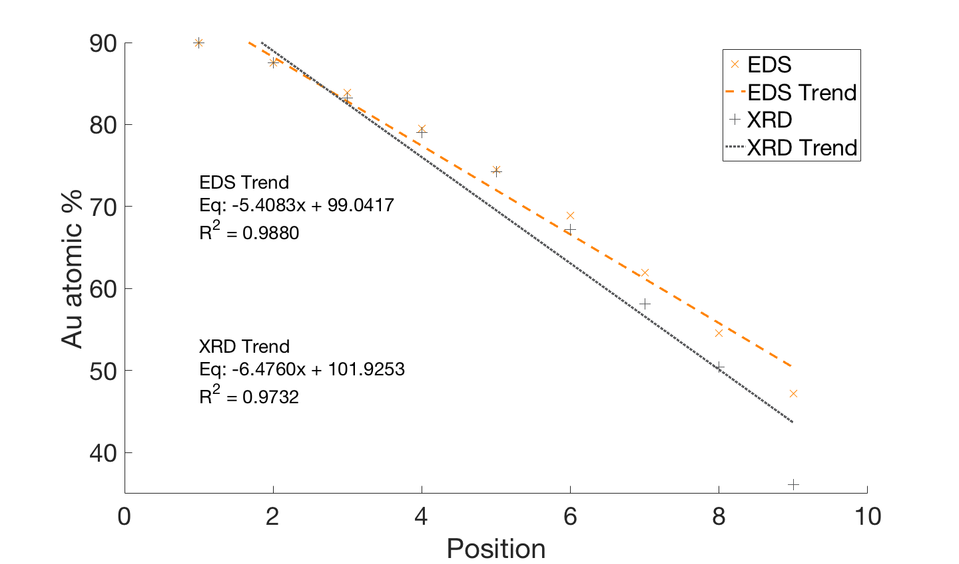
EDS vs. XRD Composition
Validates both methods
Notes:
chris

Slide 28
Ellipsometry
Au-Ni film vs. pure Au
  Analysis of data indicates comparable or better refractive index performance of film in high eV range ( > 2.6eV)
  Analysis of data indicates improved dielectric constant performance ( < 3.8eV)

Slide 29
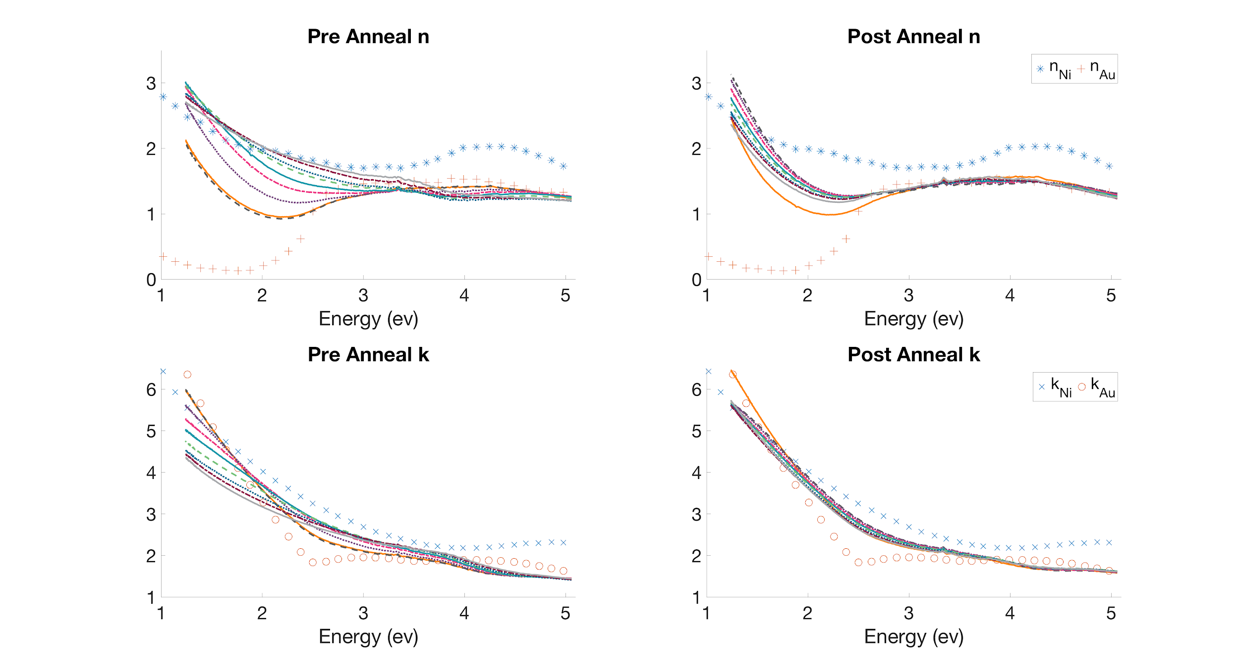
Ellipsometry Graphs

Slide 30
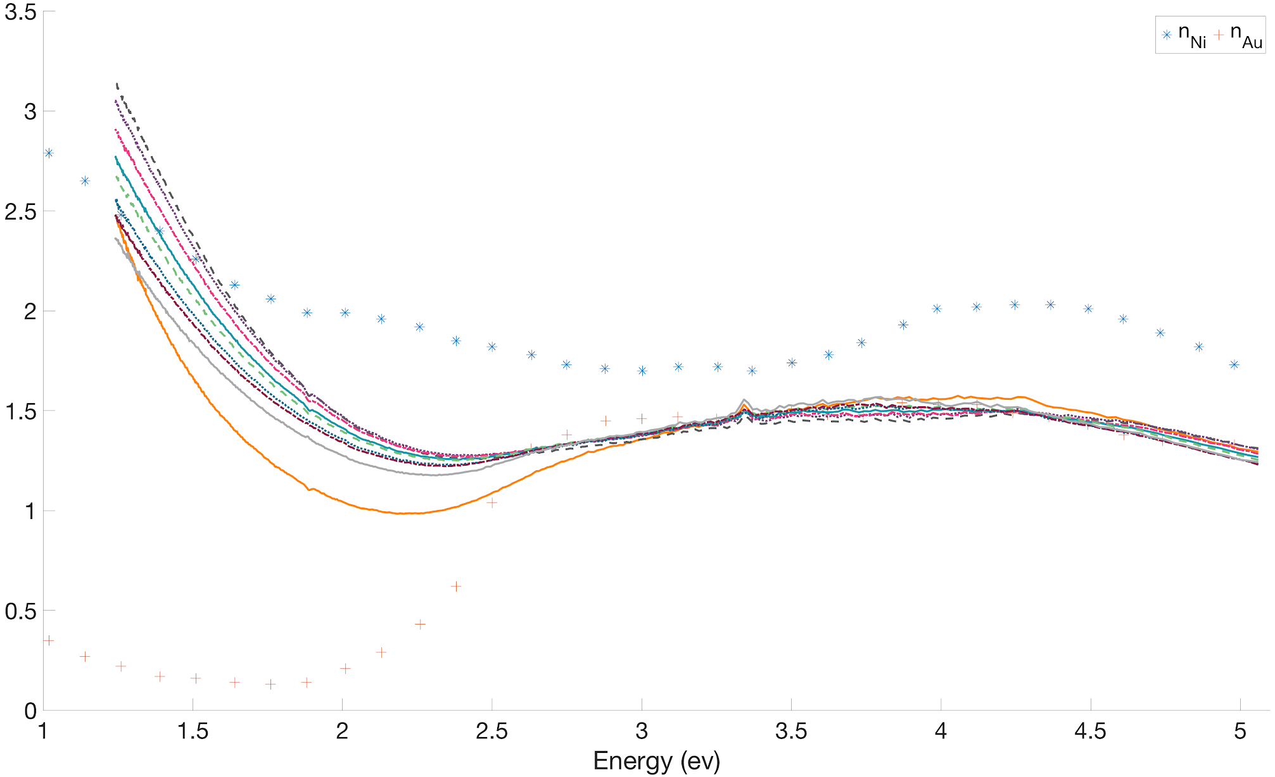
Post-anneal n

Slide 31
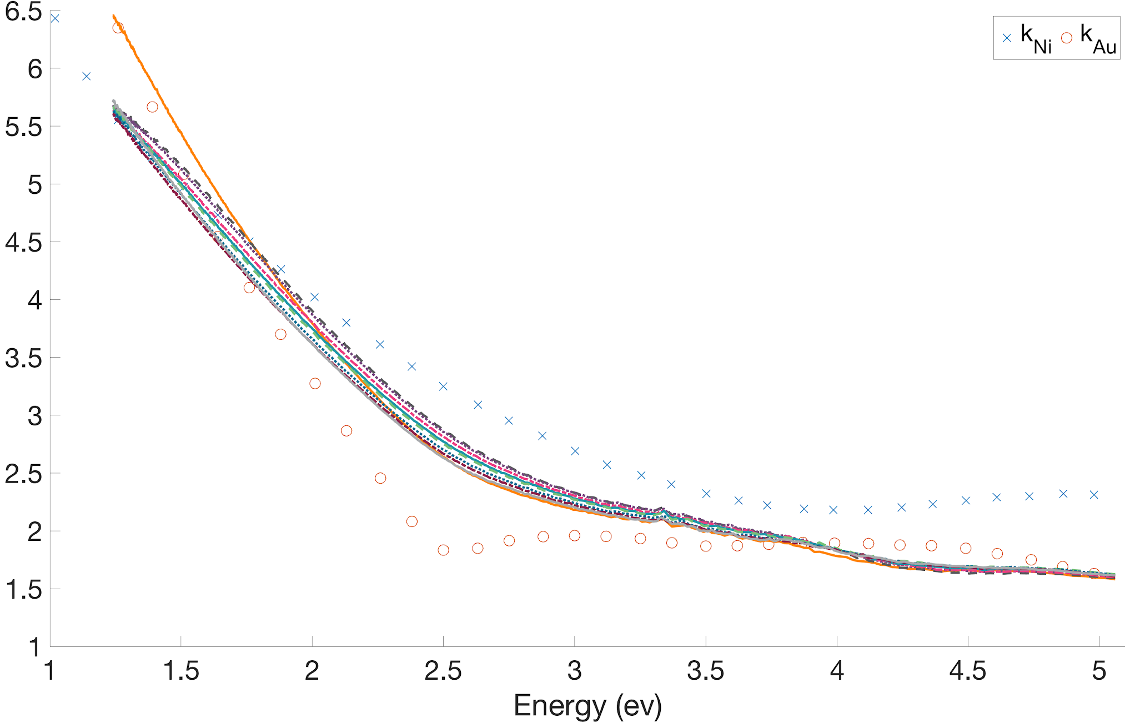
Post-anneal k

Slide 32
Optimal Composition
Superior performance of the annealed film in the 2.6 eV - 3.8 eV range is correlated to a Ni composition of up to 12.5%

Slide 33
Implications
In mid eV ranges optical applications (solar energy harvesting, sensing, etc.) addition of 12.5% Ni will improve plasmonic response of Au
Addition of Ni will lower cost maintaining or improving performance
Notes:
chris

Slide 34
Further Exploration
Magnetic characterization of Ni via magnetometry
Comparison of Au-Ni system to Au-Co
Quantitative cost analysis
Notes:
john

Slide 35
Questions?
Thank you!

Slide 36
References
[1] K. L. Chopra and I. Kaur, Thin Film Device Applications. New York: Plenum Press, 1983.
[2] H. Föll. Semiconductor Technology - Adhesion. Available: https://www.tf.uni-kiel.de/matwis/amat/semitech_en/kap_3/backbone/r3_2_2.html
[3] D. Martin-Becerra, G. Armelles, M. U. Gonzalez, and A. Garcia-Martin, "Plasmonic and magnetoplasmonic interferometry for sensing," New Journal of Physics, 2013.
[4] T. Yang, C. Manuel, R. d. Almeida, D. Ramasamy, F. José, and A. Loureiro, "A detailed study of Au–Ni bimetal synthesized by the phase separation mechanism for the cathode of low-temperature solid oxide fuel cells," Journal of Power Sources, vol. 269, 2014.
[5] D. K. Maurya, A. Sardarinejad, and K. Alameh, "Recent Developments in R.F. Magnetron Sputtered Thin Films for pH Sensing Applications—An Overview," Coatings, vol. 4, pp. 756-771, 2014.
[6] J. A. Woollam. (2017). Ellipsometry Data Analysis. Available: https://www.jawoollam.com/resources/ellipsometry-tutorial/ellipsometry-data-analysis
[7] A. Garcia-Martin, "Magnetoplasmonics: Fundamentals and Applications," 2008.

Slide 37
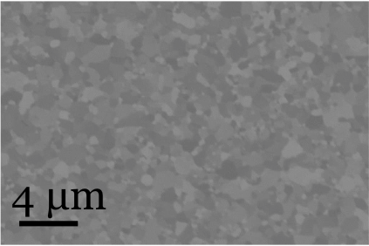
Appendix
4 μm

